Slide 1
Sales Talent Productivity Risks and Remedies for 2023
Explore pitfalls gathered in the SBI Fall 2022 CEO Survey and best practices for talent-related risks heading into 2023.
January 27, 2023

Slide 2
Key Takeaways
Planned hiring will be insufficient to adequately cover open territories
Onboarding is insufficient to rapidly ramp new hires to productivity
Identifying sources of employee burnout is necessary for sustained growth

Slide 3
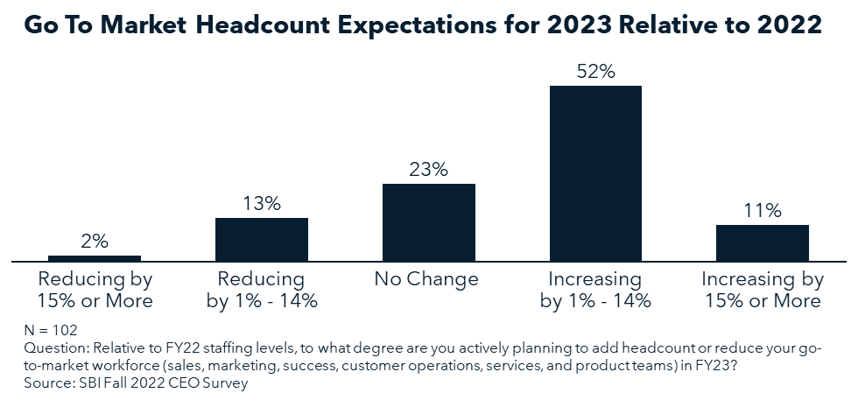
Plans to expand Sales headcount will be insufficient to adequately cover open territories (1/2)

Slide 4
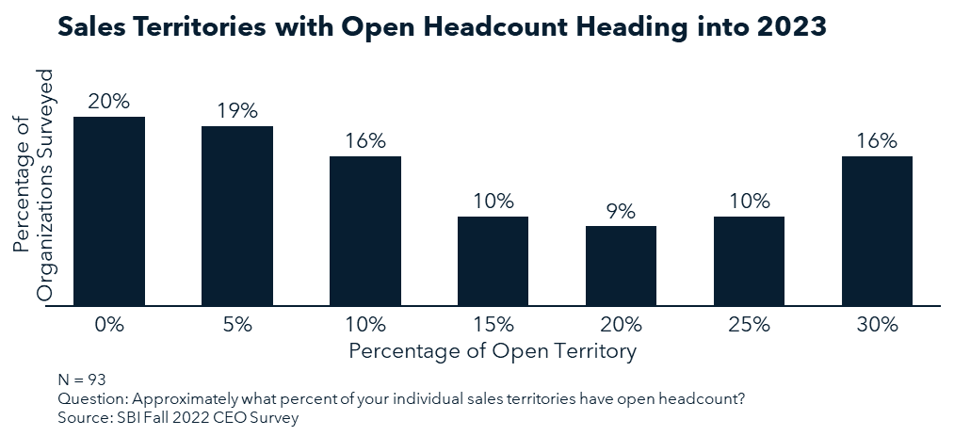
Plans to expand Sales headcount will be insufficient to adequately cover open territories (2/2)

Slide 5
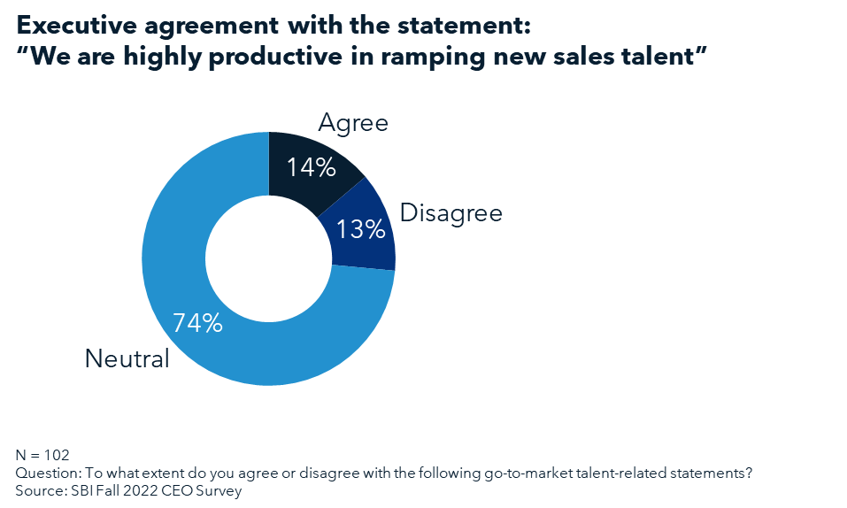
Shortcomings with onboarding new Sales hires is a significant risk (1/2)

Slide 6
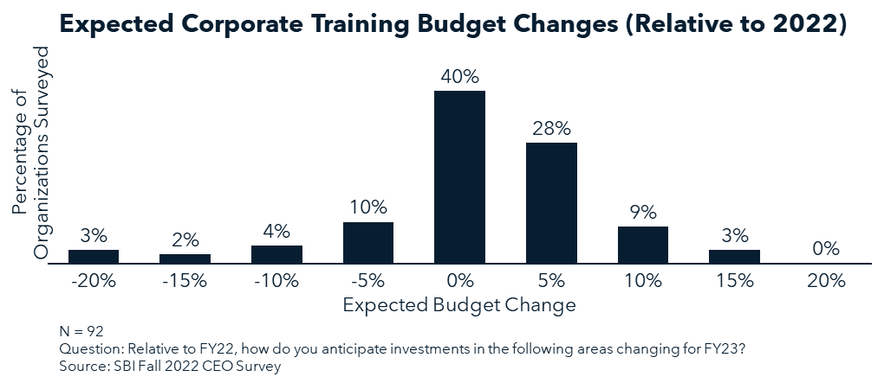
Shortcomings with onboarding new Sales hires is a significant risk (2/2)

Slide 7
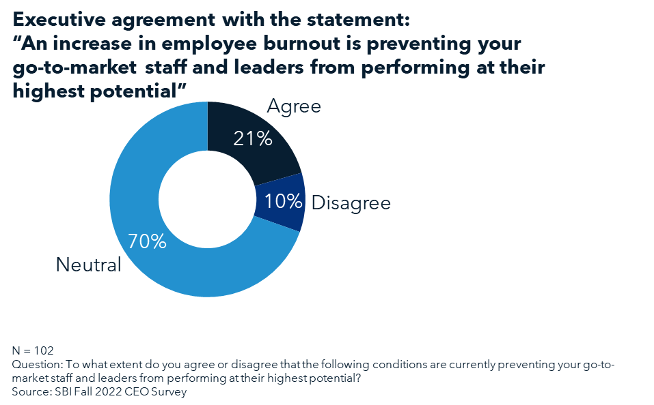
Burnout among employees is a threat to productivity, but leaders aren’t clear on the drivers (1/2)

Slide 8
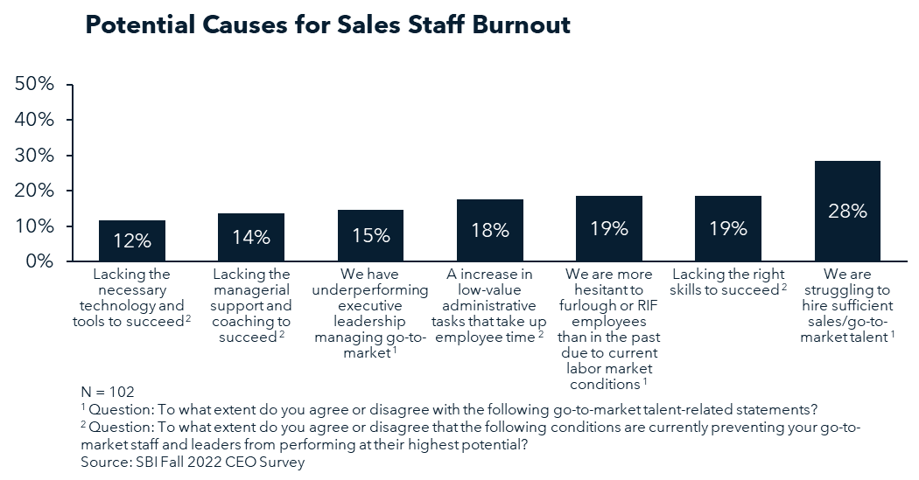
Burnout among employees is a threat to productivity, but leaders aren’t clear on the drivers (1/2)

