Slide 1
CEO Value Creation Pulse, Summer 2024
Declining Confidence in the Target, the Plan, and the Go-to-Market Model

Slide 2
CEO Value Creation Pulse, Summer 2024
SBI’s quarterly survey of CEOs and other C-level executives focuses on how they are planning for value creation, and the go-to-market strategies and tactics that will get them there. This report details four findings that should drive executive planning for H2 2024:
1. Slowing Demand Elevating Concerns Over Growth Plans (pages 3 - 7)
2. Declining Confidence in the Go-to-Market Model, but Limited Investment to Improve (pages 8 – 14)
3. Lacking the Fact Base to Build Better Strategies (pages 15 – 17)
4. Investing in Market Penetration, but Seeing Limited Returns (pages 18 - 22)
Together these findings serve as alerts to CEOs and their leadership teams of a need to look critically at their go-to-market strategies, and to evaluate both short-term and longer-term initiatives that can better position them to manage unsteady demand.
Respondent Title
Ownership Structure
Annual Revenue
Company Industry
<$500M USD
Software
10%
$501M - 2B USD
Business Products & Services
Public
$2.1 - 5B USD
Financial Services
Other C-Level
>$10B USD
Other
CEO
Private equity
sponsored
N = 102; Survey fielded in May – June 2024

Slide 3
What CEOs and Their GTM Leadership Teams Should Do
Tighten up on execution. CEOs tell us they are more squarely focused on execution than ever. Executive leaders need to get deeper into the details with their teams – setting the right objectives and metrics, regularly reviewing them and updating plans to ensure they are set up to deliver.
Focus on driving sales velocity. Revisit your funnel progression tactics to combat conservative decision-making and buyer distraction. Our clients are seeing executive decision-makers forcing more internal trade-offs to authorize purchases. Prioritize understanding the customer’s internal buying process and making it easy for them to buy from you.
Continue to invest in growing pipeline. Explore collaborative approaches to drive more high-quality lead volume. Use third-party data and channel partners to better understand client health, and leverage customer success teams to systematically generate cross-sell leads.
1. Slowing Demand Elevating Concerns Over Growth Plans
After rebounding in Q1, demand sentiment whipped back to somewhat negative, as more CEOs report consistent or declining demand. Perhaps as a result, fewer CEOs (barely half) express confidence in their growth plans. This is creating a shift back among investors and CEOs to a heavier weight on EBITDA relative to growth. Conversations emphasize that demand has largely been uneven, with some segments (particularly enterprise) remaining strong. Many CEOs and commercial leaders are pushing back their expectations for a demand rebound into later in the second half of 2024.
2. Declining Confidence in the Go-to-Market Model, but Limited Investment to Improve
3. Lacking the Fact Base to Build Better Strategies
4. Investing in Market Penetration, but Seeing Limited Returns

Slide 4
Tepid demand sentiment has quickly returned after Q1’s perceived acceleration
CEO Characterization of Demand
Slowing
Consistent
Accelerating
Q1 2023
Q1 2024
Q2 2024
N = 91 (Q1 2023); N = 87 (Q1 2024); N = 102 (Q2 2024)
Source: SBI Q1 2023 CEO Survey; SBI Q1 2024 CEO Survey; SBI Q2 2024 CEO Survey

Slide 5
Losing confidence in the plan
CEO Confidence in Growth Plan, and Ability to Execute It
Confidence in the Growth Plan
Confidence in Ability to Execute the Growth Plan
Not Confident
Neutral
Confident
Q1 2024
Q2 2024
Q1 2024
Q2 2024
N = 87 (Q1 2024); N = 102 (Q2 2024)
Source: SBI Q1 2024 CEO Survey; SBI Q2 2024 CEO Survey

Slide 6
A swing back toward earnings emphasis
CEO Perceived Relative Importance of Growth and Earnings to Investors
Growth
Earnings/ EBITDA
Q4 2022
Q3 2023
Q1 2024
Q2 2024
N = 102 (Q4 2022); 113 (Q3 2023); 87 (Q1 2024); 102 (Q2 2024)
Question: Allocate 100 points to indicate the relative importance your investors place on the following outcomes: Growth or Earnings / EBITDA.
Source: SBI Q4 2022 CEO Survey; SBI Q1 2024 CEO Survey; SBI Q2 2024 CEO Survey

Slide 7
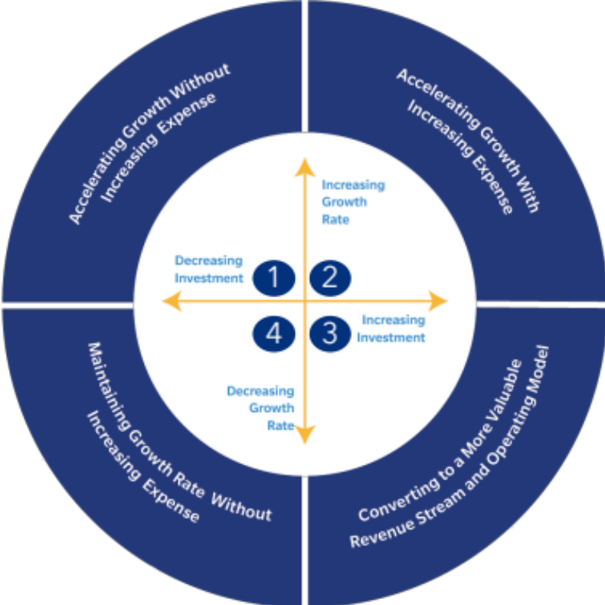
Growth emphasis declining from Q1 highs, with a doubling of CEOs pursuing value creation by managing expenses
SBI’s Value Creation Compass
Planned Value Creation Strategy
Q3 2023
Q1 2024
Q2 2024
Accelerating Growth without Increasing Expense
Accelerating Growth with Increased Expense
Maintaining Growth Rate with Increased Expense
Maintaining Growth Rate without Increasing Expense
1
2
3
4
N = 113 (Q3 2023); N = 87 (Q1 2024); N = 102 (Q2 2024 )
Source: SBI Q3 2023 CEO Survey; SBI Q1 2024 CEO Survey; SBI Q2 2024 CEO Survey

Slide 8
What CEOs and Their GTM Leadership Teams Should Do
Narrow focus to the strongest fit and highest propensity-to-buy accounts. Leadership teams tend to oversize territories to ensure all accounts are covered. This results in commercial teams focusing on lower-quality opportunities. Instead, establish more targeted coverage models with territories tightly aligned to high-value accounts.
Identify and prioritize strategic bets. Especially when growth is elusive, CEOs often push harder on tactics – e.g., leadership changes or compensation adjustments – and less on bigger bets that will drive the growth plan. Look hard at aspects of the go-to-market model like the commercial structure and routes-to-market, and drive alignment on the highest-potential bets to pursue.
Drive commitment to the plan. Dedicate specialists and firm governance to build conviction for seeing through go-to-market model refinements that will drive both short-term efficiency gains and long-term growth.
1. Slowing Demand Elevating Concerns Over Growth Plans
2. Declining Confidence in the Go-to-Market Model, but Limited Investment to Improve
Companies have seen continued growth in sales and marketing expenses since 2020, yet the growth gained from those incremental cost increases has declined. As a result, most CEOs rate optimizing the go-to-market model as their most critical value creation lever. Despite this importance, confidence in their ability to deliver on that ambition has steadily declined. This skepticism could explain why few CEOs report investing in improving the go-to-market model (e.g., through improving their coverage plan, territory designs, or account targeting).
3. Lacking the Fact Base to Build Better Strategies
4. Investing in Market Penetration, but Seeing Limited Returns

Slide 9
Commercial efficiency is eroding
Growth of Sales and Marketing Expenses, Indexed to 2020
Change in median value of annual sales and marketing expense per dollar
Median Growth Yield on Sales and Marketing Expense
Year-over-year growth $ / sales and marketing spend $
68%
$1.59
$1.68
FY21
$0.66
$1.30
$1.00
FY22
$0.51
FY23
$0.37
FY20
FY21
FY22
FY23
N=237 public companies in SaaS, information technology, and commercial services with $100M - $5B in annual revenue and headquarters in the US and Canada

Slide 10
Go-to-market model optimization is cited as a critical growth lever for most, and carries the second largest confidence gap
Criticality vs Confidence for Growth Levers for CY2024
Percentage rating each as critical to success and confident in ability to execute
-15%
Criticality
71%
Confidence
67%
63%
56%
57%
52%
48%
50%
51%
49%
43%
46%
47%
43%
43%
46%
43%
40%
36%
35%
Optimize go-to-market model to improve sales & marketing productivity
Boost market penetration and/or expansion
Increase customer retention and decrease churn
Identify and exercise pricing and packaging leverage
Develop and launch new products
Shift revenue model to capture greater ACV and CLTV
Evolve service delivery model to increase gross profit
Drive revenue through most cost-efficient channels
Bolster profitability of low margin customers/ segments
Reduce customer acquisition cost to lower go-to-market expense
N = 102
Source: SBI Q2 2024 CEO Survey

Slide 11
Confidence in the go-to-market model is hitting new lows
Percentage of CEOs Expressing Confidence in Their Organization’s Ability to Optimize the Go-to-Market Model to Improve Sales and Marketing Productivity
67%
68%
63%
56%
Q1 2023
Q3 2023
Q1 2024
Q2 2024
N = 91 (Q1 2023); 113 (Q3 2023); 87 (Q1 2024); 102 (Q2 2024)
Source: SBI Q1 2023 CEO Survey; SBI Q1 2024 CEO Survey; SBI Q2 2024 CEO Survey

Slide 12
Few are prioritizing go-to-market strategy investments 2024
Planned GTM Leadership Team Resource Investments in 2024 to Improve Commercial Team Productivity
Limited to None
Moderate
High
Frontline manager effectiveness (e.g., skill and deal coaching)
Sales training and development
Revenue technology
Improved account targeting (e.g., redefined ICP)
Coverage model redesign
Territory redesign
Go-to-market organization design
Sales compensation redesign
Sales enablement and tools
Sales process redesign
Customer data enhancement
N = 102
Source: SBI Q2 2024 CEO Survey

Slide 13
Coverage models are largely unchanged
Portion of CEOs Who Report Evolving Their Customer and Prospect Coverage Models Over the Past 12 Months
Substantial change
No change to
small change
N = 102
Source: SBI Q2 2024 CEO Survey

Slide 14
Those who are getting the go-to-market strategy right are more likely to report they are making or beating revenue expectations
Portion of CEOs Reporting Their Organizations Are Performing At or Above Revenue Expectations So Far in 2024
74%
75%
61%
55%
54%
38%
Don’t Have the Right GTM Strategy
Have the Right GTM Strategy
Not Confident in Their GTM Model
Confident in Their GTM Model
Don’t Have the Right Market Coverage in Place
Have the Right Market Coverage in Place
N = 102
Source: SBI Q2 2024 CEO Survey

Slide 15
What CEOs and Their GTM Leadership Teams Should Do
Rationalize revenue technologies to refine commercial datasets. Streamline revtech stacks by eliminating unused solutions that complicate data ingestion and reporting and don’t add value, potentially reclaiming up to 20% of the revtech budget.
Empower revenue operations as the source for all go-to-market data. Top-performing companies often have highly competent revenue operations leaders with broad authority to control how commercial data is generated, analyzed, and reported to senior business leaders. This allows functional leaders to focus on execution, rather than hunting down performance metrics or reconciling data with other teams.
1. Slowing Demand Elevating Concerns Over Growth Plans
2. Declining Confidence in the Go-to-Market Model, but Limited Investment to Improve
3. Lacking the Fact Base to Build Better Strategies
A well-designed go-to-market strategy and model rests on a foundation of analytical rigor. Most companies lack confidence in the quality of their underlying data and technologies to enable that rigor. At the same time, most CEOs report at best a moderate investment in improving this in 2024. They understandably are hesitant to invest more, yet as a result they may be actively causing damage by making decisions using a flawed fact base.
4. Investing in Market Penetration, but Seeing Limited Returns

Slide 16
Aside from talent challenges, GTM organizations’ largest capability gaps are in revenue technology and reporting
CEO Ratings of Criticality and Adequacy of Contributors to Value Creation Goals
Percentage Viewing As
Critical to Overall Success
Percentage Agreeing
They Currently Have it Right
86%
79%
77%
70%
74%
68%
67%
67%
60%
61%
61%
60%
61%
53%
56%
51%
49%
45%
42%
38%
Right GTM Strategy
Right Product Market Fit
Right Operating Model
Right Market Coverage
Right Organizational Model
Right Roles
Right People in Our GTM Org
Right Skills in our GTM Org
Right Digital Capabilities
Right Data and Insights
N = 102
Source: SBI Q2 2024 CEO Survey

Slide 17
Few leadership teams making big investments to improve go-to-market technology capabilities
Planned Go-to-Market Leadership Team Resource Investment (Time, Budget) in Revenue Technology in 2024
Planned Go-to-Market Leadership Team Resource Investment (Time, Budget) in Customer Data Enhancement in 2024
High to
very high investment
High to
very high investment
No investment to
moderate investment
No investment to
moderate investment
N = 102
Source: SBI Q2 2024 CEO Survey

Slide 18
What CEOs and Their GTM Leadership Teams Should Do
Avoid pushing too much incremental resourcing to new logo acquisition. Particularly in a moment where commercial efficiency remains a high priority, existing customers remain a low-cost, high-return opportunity set. Determine whitespace with your highest-potential base to improve account targeting for expansion, and ensure sales roles are designed to optimize expansion.
Improve new seller onboarding to ensure more in-year contribution. Our Q1 CEO survey saw a growing portion reporting longer productivity ramps for new hires. Align onboarding learning objectives with clear, specific metrics that are tied to business outcomes, rather than vague progress reports without context to the business. Assess new hire competencies and proficiencies to determine where focus is needed.
1. Slowing Demand Elevating Concerns Over Growth Plans
2. Declining Confidence in the Go-to-Market Model, but Limited Investment to Improve
3. Lacking the Fact Base to Build Better Strategies
4. Investing in Market Penetration, but Seeing Limited Returns
As the risk of missing growth targets increases, many CEOs are shifting attention and resourcing toward market penetration. This includes a high portion placing a larger emphasis on commercial roles focused on pursuing new business. Boosting market penetration is the second most-prioritized growth lever among CEOs, but also an area where they are least likely to express confidence. This is so far showing in their results, where the portion who are seeing improvements in pipelines, deal volume, and deal size declined in Q2.

Slide 19
Small but noticeable shift toward more revenue from new customers
Relative Share of Net New Bookings From New vs Existing Customers
New Customers
Existing Customers
Q1 2023
Q1 2024*
* Question not asked in SBI Q2 2024 CEO Survey.
N = 91 (Q1 2023) ), 87 (Q1 2024)
Source: SBI Q1 2023 CEO Survey; SBI Q1 2024 CEO Survey

Slide 20
Boosting market penetration is second most often cited as a critical growth lever, and carries the largest confidence gap
Criticality vs Confidence for Growth Levers for CY2024
Percentage rating each as critical to success and confident in ability to execute
-24%
Criticality
71%
67%
Confidence
63%
56%
57%
52%
48%
50%
51%
49%
43%
46%
47%
43%
43%
46%
43%
40%
36%
35%
Optimize go-to-market model to improve sales & marketing productivity
Boost market penetration and/or expansion
Increase customer retention and decrease churn
Identify and exercise pricing and packaging leverage
Develop and launch new products
Shift revenue model to capture greater ACV and CLTV
Evolve service delivery model to increase gross profit
Drive revenue through most cost-efficient channels
Bolster profitability of low margin customers/ segments
Reduce customer acquisition cost to lower go-to-market expense
N = 102
Source: SBI Q2 2024 CEO Survey

Slide 21
Most CEOs are increasing investment in new business “hunters”, despite skepticism about their effectiveness
Emphasis and Effectiveness of Various Routes-to-Market
Larger Emphasis
Effectiveness
New business development (e.g., account executive "hunters")
Renewals or customer success
Sales Development (SDR, BDR)
Channel account teams
Account management (e.g., account manager "farmers")
Hybrid account executives (e.g., individuals with both "hunter" and "farmer" responsibility)
Product-led growth without sales support
N = 102
Source: SBI Q2 2024 CEO Survey

Slide 22
Renewals showing consistent improvement; new revenue indicators are declining
Renewal rates (MRR or ARR)
Quality of Prospective Customer Pipeline
Speed Progressing Through Marketing Funnel
Sales Deal Volume
Net-New Sales Deal Velocity
Sales Deal Size
Better than last quarter
Same as last quarter
Worse than last quarter
20%
22%
21%
36%
31%
36%
33%
36%
32%
30%
42%
43%
49%
45%
52%
55%
67%
61%
29%
34%
43%
38%
43%
32%
43%
46%
44%
48%
36%
44%
27%
25%
38%
23%
43%
49%
20%
45%
37%
31%
32%
20%
21%
16%
24%
21%
20%
25%
24%
17%
14%
13%
15%
8%
Q3 2023
Q1 2024
Q2 2024
Q3 2023
Q1 2024
Q2 2024
Q3 2023
Q1 2024
Q2 2024
Q3 2023
Q1 2024
Q2 2024
Q3 2023
Q1 2024
Q2 2024
Q3 2023
Q1 2024
Q2 2024
N = 113 (Q3 2023); N = 87 (Q1 2024); N = 102 (Q2 2024)
Source: SBI Q3 2023 CEO Survey; SBI Q1 2024 CEO Survey; SBI Q2 2024 CEO Survey

Slide 23
About SBI
Driven by insights and delivered from experience, SBI continues to help clients grow their revenue, margin and enterprise value in ways never before possible.
Working with us, leaders can expect confidence and trust with experienced partners every step of the way. We engage and support our clients as an extension of their team, both guiding and working side-by-side to deliver relatable, practical strategies that work for today and tomorrow.
sbigrowth.com

