Slide 1

CEO Quickstart Guide
The Plan for Leaders to Accelerate Revenue Growth
Includes content supplied by Sales Benchmark Index; Copyright © Sales Benchmark Index, 2023

Slide 2


Congratulations on the new role leading your organization.
Your success will be measured by how well you define and execute your vision for the growth of your company.
SBI has worked with hundreds of executives over the years and has developed benchmarks, best practices, and diagnostic tools to help you navigate and accelerate your success. Our goal is to help you exceed your growth objectives as we have for countless others.
To aid you on this journey, we have assembled a quickstart guide that’s specific to commercial functions to help you make the most out of your first 100 days in the organization (and beyond!). This document is broken up into three sections which will track your organization's performance against current benchmarks, assess the current state of the organization, and help you execute a go-to-market motion that will exceed bookings and revenue goals.
I also want to welcome you as a friend of the firm, and let you know that we are always here with an open ear to help you along this exciting journey. Please don’t hesitate to reach out should you need any guidance or have questions along the way.
Once again, congratulations on the new role. We wish you the best of luck in, “making your number.”
Best Regards,
Mike
Mike Hoffman
CEO, SBI

Slide 3
Key strategic questions that will drive the GTM strategy
Revenue
Model
Go-to-Market
Model
Client
Experience
Optimizing the revenue model to maximize margin expansion and enterprise value
Optimizing GTM resource allocation to drive more efficient and effective revenue growth
Create a client experience that aligns commercial functions and allows for the continued monetization of the customer base
What is the current revenue model of the organization, and what do you need to change (e.g., more recurring) to drive enterprise value?
How can the revenue mix be optimized via different growth channels, markets, and segments?
What can be done to drive product margin expansion (e.g., pricing, discounting, cost of goods sold, etc.)?
What are the most profitable selling channels, and how can you optimize the mix?
What are the individual functional strategies, and how do they align with the optimal GTM strategy?
Are the functional strategies aligned to drive the growth thesis?
What is the optimal allocation of GTM resources (e.g., people, money, and time) to generate the greatest demand?
What opportunities exist to further improve the commercial engine to drive greater enterprise value?
What routes-to-market will generate the greatest improvement on sales rep productivity?
Has the client journey been documented?
Who are the functional owners of all stages and/or milestones across the client journey?
How well aligned are all the functional activities/touchpoints across the client journey?
What are the optimal marketing, sales, and customer success processes that drive increased new logo acquisition and penetration of the existing customer base?
Do you have a process to measure customer engagement and satisfaction across client journey milestones?

Slide 4
Executive summary — three-phased approach to accelerated revenue growth
Phase 1:
Learn and Assess
Phase 2:
Set the Strategy
Phase 3:
Accelerate for Results
Timeline: Day 1 - 45
Objective: Understand ability to exceed the revenue number
Focus Areas:
GTM assessment
Operational insights and benchmarks
Dependencies and risks
Assess the commercial leadership team (sales, marketing, customer success, etc.)
Desired Outcomes:
Inject excitement, set a positive tone about the opportunity, lay the foundation for a culture of execution and a one-team ethos
Understand current-state GTM culture and ignite the organization around execution
Identify key markets and opportunities for revenue acceleration
Establish a one-team approach with the functional leaders and P&L owners to establish alignment and support
Ensure functional interlock via the revenue growth office to manage and monitor all commercial initiatives
Timeline: Day 46 – 90
Objective: Define revenue growth strategy and GTM plan
Focus Areas:
Establish fact base and core metrics
Market, account, and buyer segmentation
Marketing and sales organization structure
Territory plans, quotas, and compensation planning reviews
Sales and marketing operations process
Create a coverage model, and align the sales and marketing motions to the market and customer type
Desired Outcomes:
Plan for remainder of the current year to minimize disruption and set up the upcoming year for success
Create coverage model, define buyer process, and decide on sales motions which are based on the market and customer type
Optimize sales and marketing organizations
Revamp quotas and comp plans
Timeline: Day 91+
Objective: Execute revenue growth strategy
Focus Areas:
Design and implement a revenue growth office
Day-to-day execution
Key sales and marketing talent acquisitions
Organizational acceleration
GTM setup for upcoming year
Desired Outcomes:
Define three-year revenue plan
Adjust sales model to be more cost-efficient
Reduce customer acquisition cost
Increase customer lifetime value
Optimize expense-to-bookings
Improve sales productivity per rep

Slide 5

Phase 1: Learn and assess the organization while setting a cultural foundation of execution
Four Pillars of GTM Execution
Phase 1:
Learn and Assess
01
Strategy
02
Process
Evaluate and understand your ability to exceed the revenue number
GTM assessment
Revenue plan and operational insights
Sales and marketing leadership talent review
Dependencies, risks, and requirements
Clearly defined GTM strategy with functional interlock
Sales and marketing processes that drive efficiencies
Inject excitement, set a positive tone, and lay the foundation for a culture of execution
03
Structure
04
Talent
Allocating resources in areas of greatest potential
Best-in-class talent with defined roles and responsibilities

Slide 6

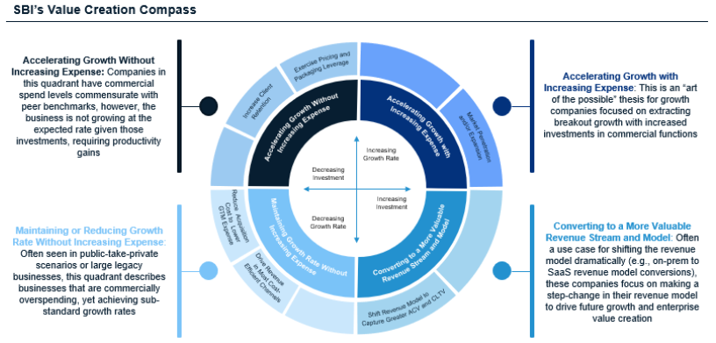
Phase 2: Set the GTM strategy that drives top-line revenue and increases enterprise value
Phase 2:
Set the Strategy
Define revenue growth strategy and GTM plan
Determine the appropriate growth strategy that’s relative to desired investment and commercial imperatives
Establish a fact base
Market, account, and buyer segmentation
Marketing and sales organization structure
Defined GTM strategy with functional interlock that lays out plan for next ~three years
Key questions to answer to support GTM strategy design

Slide 7

Phase 3: Execute the GTM strategy through best-in-class revenue growth program design
Phase 3:
Accelerate for Results
Outline for a Revenue Growth Office, used to manage strategic GTM programs
STEERING COMMITTEE
Revenue Growth Office
Growth Transformation Office Lead (TBD)
Project Management Leads (TBD)
Define revenue growth strategy and GTM plan
Design revenue growth office
Determine revenue growth programs
Day-to-day execution
Foundation building with short term, quick wins
STRATEGIC PROGRAMS
Program 1
Program 2
Program 3
Program 4
EXECUTIVE SPONSOR
TBD
TBD
TBD
TBD
BUSINESS OWNERS
TBD
TBD
TBD
TBD
GTM strategy accelerated with core challenges being addressed and foundation in place for the next 6-8 quarters
FUNCTIONAL TEAM SUPPORT
Functional Team Support
(HR, Finance, Legal, Process, Policy, Technology, Change Management)
ADVISORY SUPPORT
TBD

Slide 8
Timeline for first six months with monthly objectives and key actions
Timeline for First Six Months
Month 1 | Month 2 | Month 3 | Month 4 | Month 5 | Month 6
Listen and Learn | Identify Growth Opportunities | Develop Revenue Growth Program and Plan | Begin Revenue Growth Program - Horizon 1 | Implement New Processes and Structure | 2023 GTM and Revenue Planning
1:1s with key leaders, executives, and P&L owners Global introduction to all commercial functions (virtual, F2F) Start GTM assessment by reviewing current strategy, processes, structure, and talent Establish a culture of inclusion and execution | Understand ability to exceed revenue number in current year and next year Identify foundational gaps in GTM to address Define dependencies, risks, and requirements to achieve number Quantify upside for addressing gaps Agree to growth opportunities to pursue in the short, medium, and long term | Develop revenue growth program and plans based on opportunities Stand up revenue growth office to manage strategic, cross-functional efforts Assign owners and timelines and set expectations Stand up operating cadence to manage all activities | Begin executing revenue growth programs and plans Design new solutions to address foundational GTM challenges Begin to test and pilot new solutions for quick wins and field adoption Set up KPIs to measure and track, including dashboards and reporting | Complete Horizon 1 of revenue growth programs Begin process of implementing new solutions around process and structure Ensure GTM-wide communication and expectations are set Implement Horizon 1 of new processes and structure changes Begin process of driving programs regionally | Continue implementation and monitoring of Horizon 1 efforts Begin the process of current year revenue and GTM planning Conduct top-down and bottom-up analysis to determine revenue plan Define GTM strategy for the next ~three years Detail GTM plan for the following year
Continuous Activities: Communication, Cross-Functional Interlock, Internal and External Management, Fact Base Building

