Slide 1
Organizational Design and Coverage Model Playbook

Slide 2
Table of contents
01
Executive Summary
02
Best Practices and Model Examples
03
Methodology
04
Execution Plan

Slide 3
Executive summary — SBI’s perspective
SBI’s perspective on organizational design and coverage includes the following four components.
1
Market opportunity. Leveraging account segmentation output will cover the highest potential regions, verticals, and geographies.
2
Customer/partner potential. Use of the ROAD model will identify the optimal sales motion for each customer/partner.
3
Employee engagement. Selecting the right people to cover the right accounts is critical for success.
4
Improved sales metrics. When organizational design and coverage are done correctly, the following metrics will improve:
Sales budget attainment.
Rep capacity and selling time.
Rep productivity.
Customer acquisition cost/customer lifetime value (CAC/CLTV).

Slide 4


Executive summary — organizational design and coverage model definitions
Organizational Design
Coverage Model
Determine the right roles, headcount, and organizational chart required to make your numbers.
This is done by quantitatively determining the headcount that you’ll need to hit revenue targets, and subsequently designing roles that meet these targets via role clarity.
Organizational design can be achieved by:
Understanding headcount model needs vs top-down and bottom-up analysis.
Designing clear RACI models and job profiles.
Leveraging account segmentation to understand account potential, whitespace analysis, and cross/up sell opportunity.
Including an implementation and change management plan.
Coverage should be done prior to organizational design changes to help you cover market potential with the most cost-effective, direct and indirect sales channels.
This lets you serve the needs of your customers while optimizing CAC/CLTV.
Coverage model changes depend on:
Understanding buyer channel preferences.
Tracking CAC/CLTV financials.
Determining capacity model by role based on a bottom-up analysis of time.
Strategizing the right coverage plan by channel to determine what roles are needed.
Understanding how to increase selling time and/or selling capacity.

Slide 5

Impact of a sub-optimal organizational design and coverage model
01
02
03
04
05
06
Misalignment between functions, including sales, customer success, renewals, and marketing
Incorrectly covering accounts, verticals, regions, and channels
Reps focusing too much of their time on the wrong accounts, verticals, or channels
Inaccurate account coverage hampers rep productivity, impacting sales numbers and increasing quota misses
Lack of focus or confusion within sales teams can lead to low employee engagement, which leads to higher attrition rates
Reduced productivity and high attrition rates can cause customer satisfaction issues, lowering customer retention

Slide 6
How to launch a successful organizational design and coverage model
 |  | Pre-kickoff |  | Execution |  | Implementation
Best Practices |  | Analysis/resources needed: Account potential analysis prior to project kickoff Rep productivity and region performance (in dollars and percentage) for the last two years Current org design, coverage model, and job descriptions Review and understand seven org design options (see Slide 10) |  | During execution: Capture voice of the customer (how do they want to buy) Conduct rep interviews and time study Capture best practices from top-performing reps Identify at least two options with pros/cons for discussion with leadership Ensure cross-functional interlock with finance, customer success, marketing, etc. |  | During implementation: Ensure sales leadership and manager buy-in Create guidelines for account holdover/carry over process Regular monitoring and evaluation of metrics Frequently capture voice of the customer and reps Ensure cross-functional interlock is occurring
Risks to Mitigate |  | During pre-kickoff: Waiting too long for data – data paralysis instead of analysis Not defining and baselining project success metrics, which are tied to the revenue growth plan |  | During execution: Change management Overcomplicating design of solution Unclear ownership between sales and sales operations Believing you know what your customers want without asking them (start from a blank sheet of paper) |  | During implementation: Lack of feedback process to iterate and improve from one performance period to the next Unmodeled costs or add backs eliminating budgeted cost savings
Project Management Requirements
Recommended time: 8 – 10 weeks
Dependencies:
Account segmentation
Output Drives:
Territory design
Quota and compensation design
Stakeholders:
Accountable
Sales operations leader
Responsible
Sales leaders
Sales operations leader
Contributes
Finance leader and analysts
Product group leaders
Informed
Executive leadership team

Slide 7
Best Practices And Model Examples

Slide 8


Guiding principles and questions to ask
Guiding Principles
Questions to Ask
Start with a blank sheet of paper in mind. Do not let doubt and bias corrupt the ideal coverage model for your business.
Capture customer feedback on how customers prefer to buy, not how they do so currently.
Capture employee feedback on what they truly spend their time doing and what they can accomplish
It’s about getting the right people in the right positions to cover the right customers
Differentiate revenue by existing customers and prospects (e.g., retention and expansion)
Segment customers to reflect differences in size, geography, industry, product, and behaviors
Drive interlock across functions to reconcile differences between top-down and bottom-up approaches
What type of selling roles do we need in our organization?
What is the right number of people for each role?
Have we correctly deployed sales capacity against the market opportunity?
Through which sales channels do our customers want to engage our sales team?
What type of organization best supports our customers and how they want to buy?
What level of specialization are our buyers willing to pay for?
In what verticals and regions do we have the most potential?
What is the ideal cost and production for each selling role?
How can each selling role optimize their time?
How do we best manage our teams and ensure they get optimal training and coaching?

Slide 9

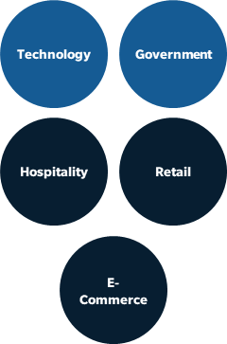
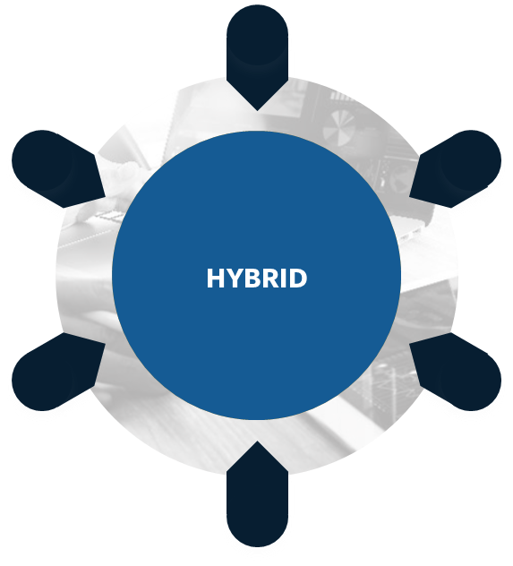
SBI’s seven sales organizational design models When you should deploy each model and the pros and cons to consider
Stratification
Stratify your accounts based on size, e.g., current spend, spend potential, employee count, etc. This type of design can be seen in organizations with a clear hierarchy, where different layers represent different levels of decision-making.
Global account managers
Field sales
Inside sales
Hunter/Farmer
The hunter-farmer model recognizes that different sales situations require different strategies. Hunters are crucial for expanding the customer base and bringing in new business, while farmers are vital for building customer loyalty, repeat business, and overall CLTV. Many organizations adopt a combination of both approaches to create a balanced and effective sales strategy.
New logos
Existing customers
Geography
The geography model involves structuring a sales organization based on rep proximity to geographic areas. This involves understanding how regional differences, distribution patterns, market opportunities, and resource allocation affect consumer preferences and behaviors.
NV
NE
IN
WV
KS
MO
KY
NC
AZ
NM
OK
AR
TN
SC
ORG DESIGN MODEL
TX
LA
MS
AL
GA
FL
Persona
The persona model involves structuring a sales organization based on the needs, preferences, and behaviors of different buyer personas. These are typically aligned to different members of the C-Suite, e.g., CEO, CTO, CMO, etc.
CIO
CMO
CFO
Product/Solution
The product/solution model involves structuring a sales organization based on how a specific product or solution addresses the specific needs, problems, and goals of customers.
MS
D&F
Software
Aftermarket
Service
Industry/Vertical
An industry/vertical sales model is a strategy used by companies to organize their sales efforts and tailor their products or services to specific industries or verticals. Instead of taking a one-size-fits-all approach, companies adopting this model focus on understanding the unique needs, challenges, and trends of particular industries and then developing specialized sales strategies to cater to those industries.
Hybrid
This sales model is any combination of the designs listed above. Combing more than two options for a hybrid approach adds too much complexity and will be difficult to implement and scale.

Slide 10

Stratification model
Deploy this model when the following applies:
Description
Stratify your accounts based on size, e.g., current spend, spend potential, employee count, etc. This type of design can be seen in organizations with a clear hierarchy, where different layers represent different levels of decision-making.
Significant amount of market potential sits at top of the market.
Buying process increases in complexity up the pyramid.
Long-tail buyers are willing to engage with inside sales or low/no touch model.
Global account managers
Field sales
Inside sales
Pros
Cons
Selling expenses are aligned with opportunities.
Maximize revenue per head in limited resource environments.
Prospects/customers not equally managed.
Territories may exhibit large geographic dispersion.

Slide 11
Hunter/farmer model
Deploy this model when the following applies:
Description
The hunter-farmer model recognizes that different sales situations require different strategies. Hunters are crucial for expanding the customer base and bringing in new business, while farmers are vital for building customer loyalty, repeat business, and overall CLTV. Many organizations adopt a combination of both approaches to create a balanced and effective sales strategy.
Customer base requires significant account management.
Efficient for high-dollar, complex, and long sales cycles.
Margin available to accommodate two types of sales roles and management.
New logos
Existing customers
Pros
Cons
Efficiency is achieved through assigning specific tasks to reps, i.e., efficiency is reached by instilling role clarity.
This model enables the focused acquisition of top prospects.
De-emphasizes initial campaign’s customer focus and relationship-building.
Requires increased coordination when handing off accounts.

Slide 12
Geography model
Deploy this model when the following applies:
Description
The geography model involves structuring a sales organization based on rep proximity to geographic areas. This involves understanding how regional differences, distribution patterns, market opportunities, and resource allocation affect consumer preferences and behaviors.
Customers are densely populated in clustered geographic locations.
Customers want someone present when they have a problem.
Sales reps are either generalist or specialists, i.e., the sale is less complex or there are fewer products in portfolio.
NV
NE
KS
MO
IN
KY
WV
AZ
NM
OK
AR
TN
SC
NC
TX
LA
MS
AL
GA
FL
Pros
Cons
Provides customers with local and state knowledge.
This model enables cost containment, e.g., keeping travel and entertainment expenses low.
Doesn’t align the best sales resources with the best opportunities.
As product sets grow, it becomes more difficult for reps to have expertise in all areas.

Slide 13
Persona model
Deploy this model when the following applies:
Description
The persona model involves structuring a sales organization based on the needs, preferences, and behaviors of different buyer personas. These are typically aligned to different members of the C-Suite, e.g., CEO, CTO, CMO, etc.
Buyer types have different purchasing styles and decision criteria.
The audience of potential buyers is highly varied.
Specialized knowledge by persona is vast and job function expertise is required.
CIO
CMO
CFO
Pros
Cons
Reps can target messaging to the evaluation criteria and objectives of specific personas.
Reps become skilled at selling to and thus gaining credibility or experience with specific personas.
Customers may become confused with multiple sales representatives calling the same accounts.
Reps need to be product/industry generalists.

Slide 14
Product/solution model
Deploy this model when the following applies:
Description
The product/solution model involves structuring a sales organization based on how a specific product or solution addresses the specific needs, problems, and goals of customers.
Customers require deep product knowledge.
Product complexity is high.
The number of products grows beyond the ability for one rep to acquire necessary expertise.
MS
D&F
Software
Aftermarket
Service
Pros
Cons
This model ensures faster results and a reduced sales cycle for new products.
Cross- and up-sell opportunities are limited due to siloes.
Rising costs of sales operations due to a customer base that is widely spread across different geographical locations.

Slide 15
Industry/vertical model
Deploy this model when the following applies:
Description
An industry/vertical sales model is a strategy used by companies to organize their sales efforts and tailor their products or services to specific industries or verticals. Instead of taking a one-size-fits-all approach, companies adopting this model focus on understanding the unique needs, challenges, and trends of particular industries and then developing specialized sales strategies to cater to those industries.
Customer base requires significant subject matter expertise on their industry.
Sales cycles are high dollar, complex, and long.
When the company in question is focused on services, as opposed to products.
Technology
Government
Hospitality
Retail
E-Commerce
Pros
Cons
Sales force develops deep knowledge of how to sell into specific industries.
There’s a potential to leverage referral networks via industry-specific groups.
Selling expenses become quite high.
Reps require larger geographies to make their number, i.e., there’re higher travel and entertainment expenses.

Slide 16
Hybrid model
HYBRID
HYBRID
The hybrid model includes any combination of the previously listed designs.
Combining more than two options to form your sales strategy will add too much complexity and be difficult to implement and scale.

Slide 17
Organizational Design and Coverage Model Methodology

Slide 18
Five steps to designing an organizational design and coverage model
Step 1: Analysis and Performance Review
Step 2: Customer and Rep Surveys
Step 3: Capacity Model
Step 4: Headcount Cost Model
Step 5: Coverage and Final Decision
Description
Conduct an analysis and performance review of the current state of your organizational design and coverage model.
Include expense-to-bookings ratios, span-of-control ratios, rep productivity, review of current job descriptions, etc.
Conduct a customer survey to better understand how your customers prefer to buy and communicate.
Conduct a rep time study analysis to understand how your reps spend their time.
Classify the efforts of reps into selling and non-selling categories.
Building a rep productivity capacity model to help determine if you have the right number of reps and what the ideal rep capacity is for your organization.
This will be an input into building your headcount cost model.
Develop a headcount cost model to understand whether you need to hire more reps or increase rep productivity.
This phase of organizational design is where you begin to better understand potential cost savings.
Build two to three different organizational design and coverage models with pros and cons to evaluate and make final decision.
You should define decision criteria and evaluate each option against that criteria.

Slide 19

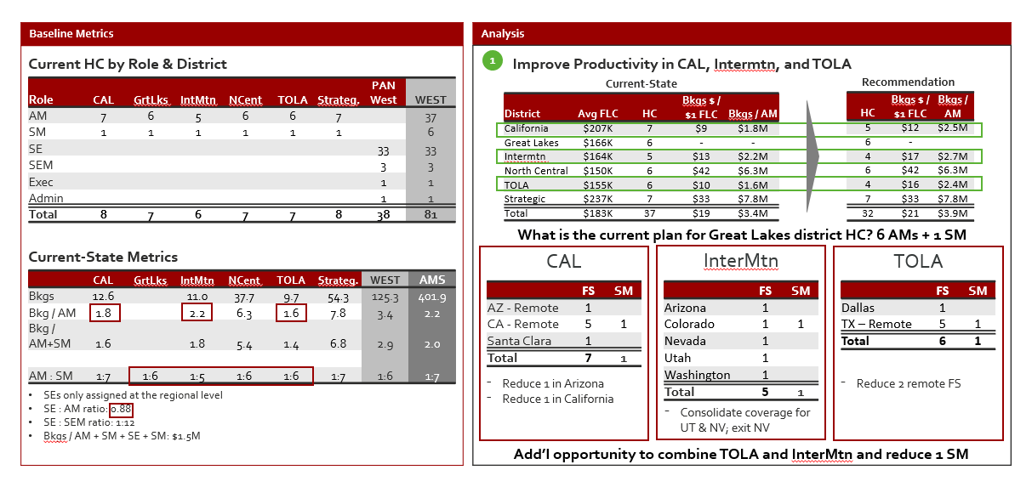
Begin with an analysis of current organizational design and coverage model
Best-in-class organizations use the following analyses to assess their current state model:
Current headcount by role and region
Cost by rep and region
Product performance (if needed)
Number of products can a rep sell (if needed)
Sales rep interviews (A, B and C player interviews)
Customer interviews
Performance of regions by rep, across two-year spans
Rep productivity
Quota attainment
Expense-to-bookings ratio
Sales-to-sales-engineers ratio
Analysis of A, B, and C player reps
Span of control
Potential for each geographic region and territory
Current customers
Prospects
Whitespace analysis
Analysis and Performance Review | Customer and Rep Surveys | Capacity Model | Headcount Cost Model | Coverage and Final Decision

Slide 20
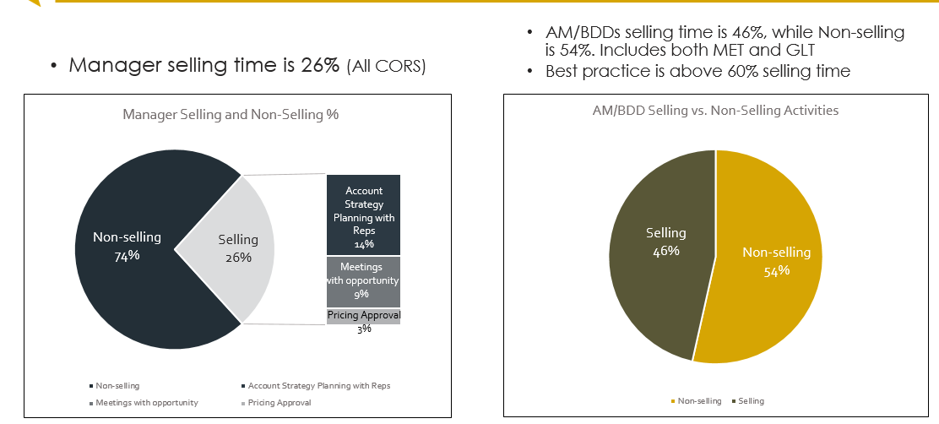
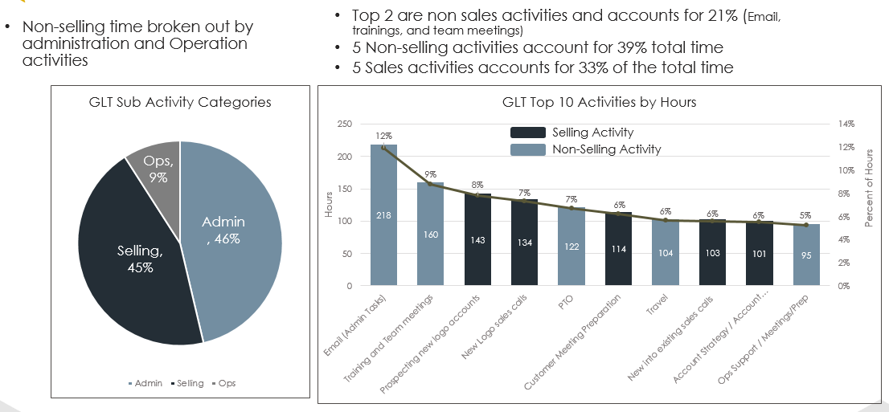
Conduct both a customer survey and a sales rep time study
A critical step in building organizational design and coverage models is capturing the voice of your customers and sales reps.
Customer Survey:
Rep Time Study:
Understand how your customers prefer to engage and through which channel.
Understand how your customers prefer to buy.
Determine how much specialization your customers are willing to pay for.
Must be anonymous.
Define selling activities vs non-selling activities.
Quantify in half-hour increments selling time vs. non-selling time.
Calculate time off normal workload (validate with managers and reps).
Split out selling, operations, and admin duties by role.
Analysis and Performance Review | Customer and Rep Surveys | Capacity Model | Headcount Cost Model | Coverage and Final Decision

Slide 21
Build a rep productivity capacity model based on results of time study
The rep productivity capacity model uses the following inputs to establish estimated sales productivity:
Temporal data to establish standardized selling year and week.
Expected selling time reps -- use rep time study.
Expected hours expended per opportunity.
Average win rate.
Average deal size.
On-target earnings.
Field Account Rep
VAR Channel Account Manager
Rep Production Capacity Model
Weeks in Year | 50
Hours in Week | 40
Hours in Year | 2,000
% Selling Time | 60%
Hours Selling in Year | 1,200
Number of Hours Per Opportunity | 12
Opportunities Per Year | 100
Win Rate | 20%
Number of Closed-Won | 20
Average Deal Size | $240,000
Average On-Target Earnings. | $200,000
Estimated Annual Quota | $4,800,000
Cost of Sales | 4.2%
Rep Production Capacity Model
Weeks in Year | 50
Hours in Week | 40
Hours in Year | 2,000
% Selling Time | 50%
Hours Selling in Year | 1,000
Number of Hours Per Touchpoint | 4.5
Number of Touchpoints | 222
Number of Touchpoints Per Partner Per Year | 24
Partner Capacity | 9
Average Partner Size | $900,000
Average On-Target Earnings | $200,000
Ex. Attained Yearly Quota | $8,333,333
Cost of Sales | 2.4%
Inside Sales Rep
Inside Channel Account Manager
Output provides estimate for optimal sales productivity numbers.
Note: Average data can be individualized/customized as better data about territory potential becomes available.
Rep Production Capacity Model
Weeks in Year | 50
Hours in Week | 40
Hours in Year | 2.000
% Selling Time | 75%
Hours Selling in Year | 1.500
Number of Hours Per Opportunity | 3.25
Opportunities Per Year | 461.5384615
Win Rate | 25%
Number of Closed-Won | 115.3846154
Average Deal Size | $26.300
Average On-Target Earnings. | $118,000
Estimated Annual Quota | %3,034,615
Cost of Sales | 3.9%
Rep Production Capacity Model
Weeks in Year | 50
Hours in Week | 40
Hours in Year | 2,000
% Selling Time | 50%
Hours Selling in Year | 1,000
Number of Hours Per Touchpoint | 0.5
Number of Touchpoints | 2,000
Number of Touchpoints Per Partner Per Year | 12
Partner Capacity | 167
Average Partner Size | $95,000
Average On-Target Earnings | $70,000
Ex. Attained Yearly Quota | $15,833,333
Cost of Sales | 0.4%
Data from sales rep capacity model forms basis for territory headcount model.
Analysis and Performance Review | Customer and Rep Surveys | Capacity Model | Headcount Cost Model | Coverage and Final Decision

Slide 22
Develop a headcount cost model to enhance decision-making on hiring and productivity
A final piece of building your organizational design and coverage model is understanding the ideal headcount for your new organization.
(Prior year revenue * forecasted revenue goal increase)
÷
Top-Down Model
Current headcount
Determine the following decisions:
How many people are needed for the future state?
How many people from the current team will make the transition?
How many new heads are going to be required?
Who will be transiting from the group leadership team to operations to manage the transitioning accounts?
Productivity required
(Prior year revenue * forecasted revenue goal increase)
Things to consider:
Build model for both current and new positions.
Build separate model or inputs for different geographies.
Distinguish cost model between routes to market (direct vs channel, field vs inside).
÷
Bottom-Up Model
Average rep selling time
Headcount required
Analysis and Performance Review | Customer and Rep Surveys | Capacity Model | Headcount Cost Model | Coverage and Final Decision

Slide 23
Build out two to three options with pros and cons to inform final decision-making
Use the following considerations and decision criteria to guide your conversation with the steering committee.
Partner Coverage
Partner split by ROAD thresholds to align to iCAMs or CAMs
Opportunity Coverage
Opportunities split by ROAD and/or industry thresholds to align to TAMs/inside/vertical
Customer Coverage
Customer split by strategic named accounts or verticals and resourced by potential
CAM
Named Account
Vertical
Field
Coverage considerations:
Opportunity coverage.
Customer coverage.
Partner coverage (If necessary).
Vertical/named account coverage.
iCAM
Customer Success*
Inside
SEs to cover across models
Decision criteria:
Cost of each coverage model.
Quantified opportunity/potential for each model.
Span of control.
Training/enablement required.
Hiring/backfill required.
Disruption (employee and customer).
VP
Channel
Strategic
Partnerships
Vertical Sales
Field Sales
Inside Sales COE
Named
Accounts East
Named
Accounts West
Technical Sales
Distribution
Master Agents/SP
CX Manager
SLED/HC West
East
ISR Mgr
CLoud
Cloud SE
Agent West
Agent Central
SLED/HC East
Central
ISR Mgr
OnPrem SE
Inside Cloud SE
Agent East
VAR
West
ISR
Inside OnPrem
Advanced Tech
Ops
VAR East
ICAM
VAR West
Analysis and Performance Review | Customer and Rep Surveys | Capacity Model | Headcount Cost Model | Coverage and Final Decision

Slide 24
Organizational Design and Coverage Model Execution Plan

Slide 25
High-level execution plan
 |  | Week 1 | Week 2 | Week 3 | Week 4 | Week 5 | Week 6 | Week 7 | Week 8
1 | Confirm data sources and availability
2 | Create RACI
3 | Conduct rep/MGR/customer interviews
4 | Conduct rep and customer survey
5 | Analyze survey and performance data
6 | Leverage account segmentation output
7 | Create and discuss design/coverage options
8 | Review job descriptions/head count impact
9 | Define HR/hiring strategy
10 | Finalize org design and coverage
11 | Hold town hall to explain/rollout changes
12 | Use output to influence territory design, quota, and compensation design
Pre-kickoff
Execution
Implementation

Slide 26
Identify roles in the new coverage model to avoid duplication of efforts and ownership
Buyer Phase |  | Final Approval |  | Implement
Role |  | Finalize Contract | Customize service-level agreements | Validate Decision | Maintain Communication
Senior vice president |  | C | C | I | I
Regional vice president |  | A | A | C | C
Strategic rep |  | R | R | R | R
Mid enterprise rep |  | R | R | R | R
Inside sales rep |  | R | R | R | R
Sales engineer |  | C | C | C | C
Operations – other |  | I | I | I | I
Sales ops |  | I | I | I | I
Finance |  | C | C | I | I
Legal |  | C | C | I | I
What is a RACI?
A RACI is a tool that maps out the team’s key activities the team across the buying process.
What does a RACI do?
A RACI delineates roles and responsibilities for all the members of the sales team.
What does it mean to implement a RACI?
Implementing a RACI means that everyone knows who does what and when, resulting in accountability and reduced waste from overlapping sales efforts.
R
Responsible
A
Accountable
Key
C
Consulted
I
Informed

