Slide 1
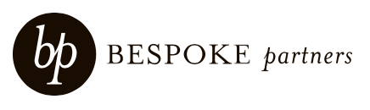
Aligning Go-To-Market Leadership Teams Co-hosted by Mike Hoffman (SBI), Eric Walczykowski (Bespoke Partners), and Bryan Kurey (SBI)
May 2023

Slide 2
1.
Early 2023 Market Trends

Slide 3

Demand continuing to soften
Assessment of Demand Over the Past Twelve Months
Q4 2022
Q1 2023
+7%
-11%
Demand is significantly slowing
Demand is somewhat slowing
Demand appears consistent
Demand is somewhat accelerating
Demand is significantly accelerating
Q4 2022 N = 102; Q1 2023 N = 91
Response to question: To what extent do you perceive softening demand indicators for your business?
Source: SBI Q4 2022 CEO Survey; SBI Q1 2023 CEO Survey

Slide 4
Expecting acceleration late 2023 or beyond
Expected Timing of Demand Acceleration Among respondents who report demand as flat or slowing
33%
24%
26%
7%
Within the Next Three Months
Within the Next Six Months
By the End of 2023
Sometime After 2023
N = 55
Question: When are you expecting/ forecasting demand to accelerate?
Source: SBI Q1 2023 CEO Survey

Slide 5
Pipelines and volume improving, velocity flat
Deal Indicators Compared With Previous Quarter
Pipeline Indicators
Speed Indicators
Better than last quarter
30%
30%
Same as last quarter
56%
54%
Worse than last quarter
37%
55%
29%
29%
33%
15%
18%
15%
How would you characterize the quality of your prospective customer pipeline?
How are you forecasting sales deal volume for the current quarter?
How would you characterize the speed with which prospects are progressing through your Marketing funnel?
How would you characterize the velocity of NET-NEW bookings across the current quarter?
N = 91
Source: SBI Q1 2023 CEO Survey

Slide 6
4
Go-To-Market Leadership Team Confidence and Alignment

Slide 7
Moderate confidence in executive teams
Confidence in Ability of Go-To-Market Leadership Team to Drive Commercial Success
Chief Revenue Officer or Equivalent
Chief Marketing Officer or Equivalent
Chief Customer Officer or Equivalent
Not Confident
Not Confident
Not Confident
5%
3%
Confident
Confident
Confident
Neutral
Neutral
Neutral
N = 91
Source: SBI Q1 2023 CEO Survey
N = 91
Source: SBI Q1 2023 CEO Survey
N = 91
Source: SBI Q1 2023 CEO Survey

Slide 8
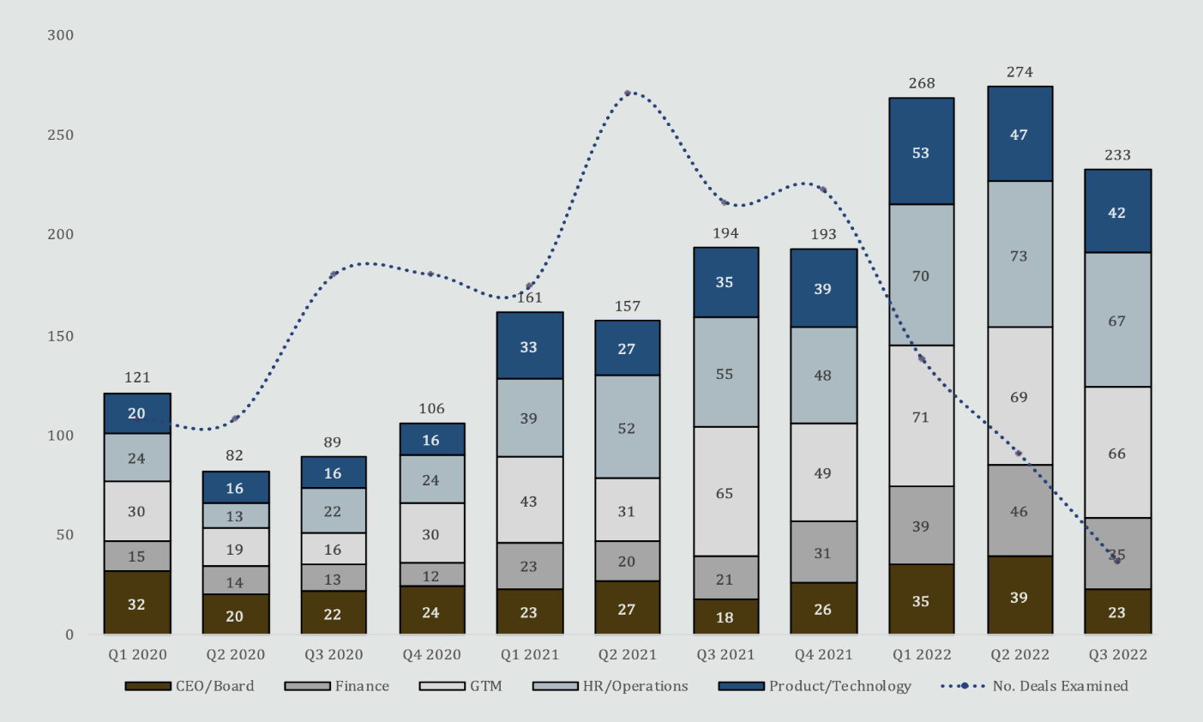

The tight market for leadership talent
Private equity sector illustrates state of the talent market overall
Private equity deal volume in 2021 created a tight “seller’s market” for leadership talent
Surge in C-suite turnover for certain roles followed as demand spiked

Slide 9
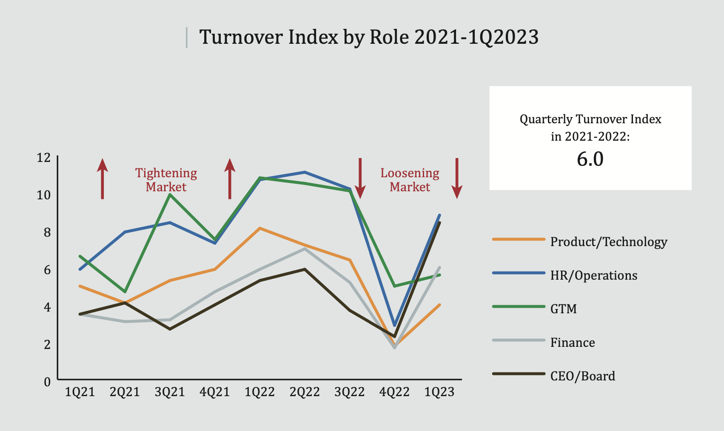
Market tightness: turnover
Executive position turnover is a chief indicator of market tightness
Positions with highest turnover rates have the most openings and the most recruiting activity
GTM roles historically among the most active with highest turnover

Slide 10
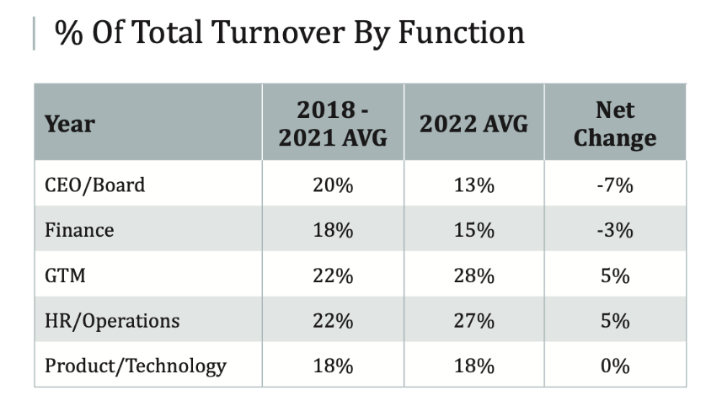
Go-to-market “sellers market”
Highest turnover in 2022 was among GTM leaders, consistent with perception that GTM leaders can be “hoppy”
Average OTE comp packages of GTM leaders topped CEO’s packages briefly in 2021 and reached on average about $500,000 between base and bonus
Search volume for GTM leaders doubled in 2021 and has remained very high

Slide 11
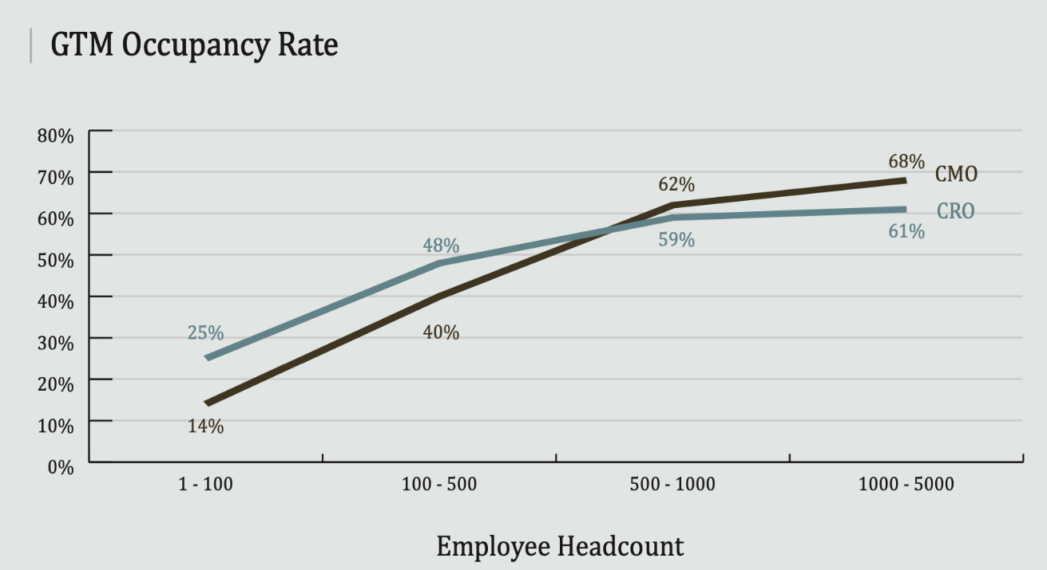
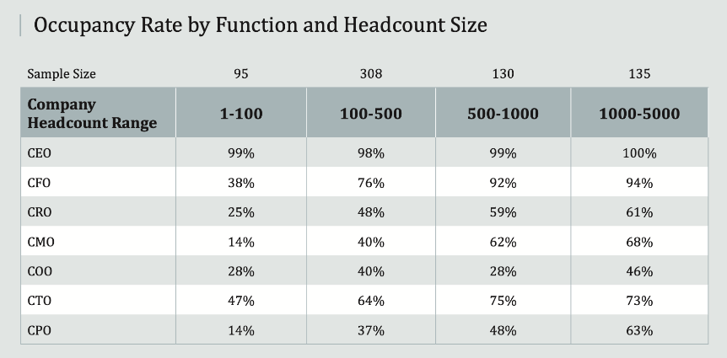
Go-to-market leadership team composition
C-suite GTM roles: Chief Sales Officer (CSO), Chief Marketing Officer (CMO), Chief Customer Success Officer (CCSO), Chief Revenue Officer (CRO) or Chief Growth Officer (CGO) and others
Often CRO covers all GTM functions, or in smaller companies they are managed by lower-level executives (VP)
When companies reach ~500 employees, sales and marketing functions often split into two C-level roles

Slide 12
High executive alignment; even higher where there is more momentum
Executive Team Alignment on Growth Initiatives
73%
High Momentum
Low Momentum
55%
30%
18%
9%
6%
6%
0%
3%
0%
Highly misaligned - we barely communicate about it and/ or strongly disagree on what we should do
Somewhat misaligned - we occasionally communicate about our initiatives and/ or continue to operate separately
Neither misaligned nor aligned
Somewhat aligned -- we communicate frequently about our initiatives and/ or coordinate them when we can
Highly aligned - we communicate regularly about our initiatives and/ or operate all of them jointly
N = 91
Question: Which of the following best describes the degree of alignment among your C-suite/ executive leadership team on your growth initiatives?
Source: SBI Q1 2023 CEO Survey

Slide 13
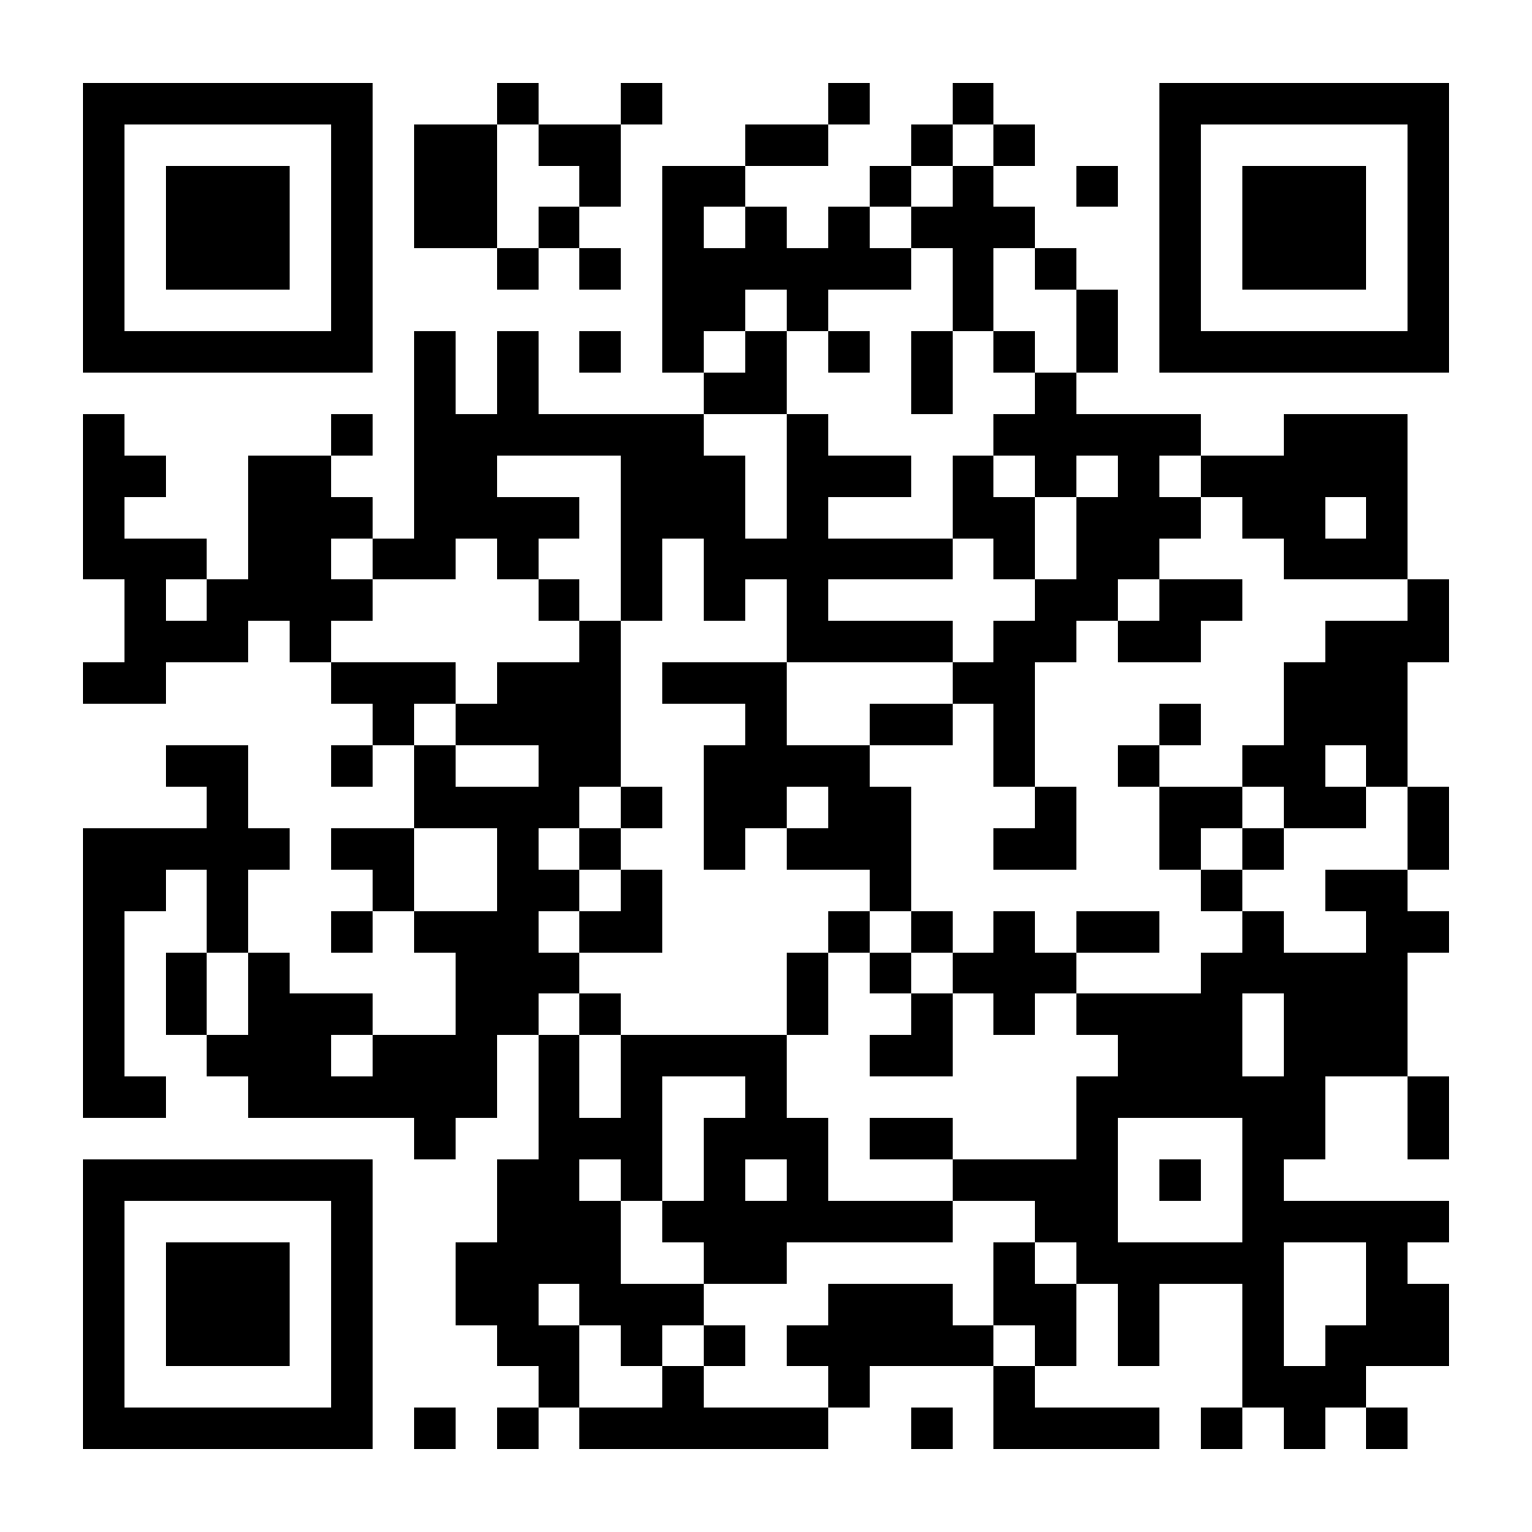
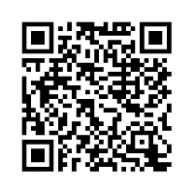
Learn More
Private Equity Talent Benchmark Report
Digital Talent Assessment
Scan for more information
Scan for more information

