Slide 1
Connecting Commercial Talent to Actionable Results
Webinar: 27 June 2023

Slide 2
Seller productivity is a significant challenge in the current business environment
Recent Trends in Deal Size
Recent Trends in Deal Velocity
CEO Characterization of Seller Productivity
Accelerating
Better than last quarter
Increasing
Flat or shrinking
Flat or slowing
No change or worse than last quarter
“The issue isn’t pipeline. It’s pipeline movement. Pockets of our business are productive, but net-net, we’re struggling with mid-stage conversion.”
Chief Revenue Officer
Mid-Size Software Company
N = 91 CEOs and go-to-market leaders
Source: SBI Q1 2023 CEO Survey

Slide 3
SBI Research Question:
What are the best sellers doing differently to close deals faster?

Slide 4
SBI conducted an advanced analysis to understand winning behaviors
SBI’s Research Methodology
1.
2.
3.
Built inventory of 90+ seller skills and behaviors observed through decades of client talent assessments
Surveyed 300+ SEs, SDRs, and Sales Managers across industries and company sizes on those skills and behaviors
Conducted factor analysis to develop seller profiles, and tested them against outcomes with regression analysis

Slide 5
Four distinct approaches appear among sellers
Unique Seller Approaches Identified Using Factor Analysis
Selling Approach
Narrowing
Dictates process steps and pace
Associated Behaviors
Prevents the introduction of additional “noise”
Establishes a smooth close
Expected Outcome
Urgency
N = 325 sales reps
Source: SBI 2023 Seller Skills Survey

Slide 6
Four distinct approaches appear among sellers
Unique Seller Approaches Identified Using Factor Analysis
Selling Approach
Narrowing
Provoking
Dictates process steps and pace
Shares insights on social platforms
Associated Behaviors
Prevents the introduction of additional “noise”
Activates professional network
Shares insights directly with buyers
Establishes a smooth close
Tightly aligned with Marketing
Expected Outcome
Urgency
Reconsideration
N = 325 sales reps
Source: SBI 2023 Seller Skills Survey

Slide 7
Four distinct approaches appear among sellers
Unique Seller Approaches Identified Using Factor Analysis
Selling Approach
Narrowing
Provoking
Translating
Dictates process steps and pace
Shares insights on social platforms
Uses buyer data in business case
Associated Behaviors
Prevents the introduction of additional “noise”
Activates professional network
Knows the buyer deeply
Shares insights directly with buyers
Establishes a smooth close
Tailors proposals to the buyer context
Tightly aligned with Marketing
Expected Outcome
Urgency
Reconsideration
Acceptance
N = 325 sales reps
Source: SBI 2023 Seller Skills Survey

Slide 8
Four distinct approaches appear among sellers
Unique Seller Approaches Identified Using Factor Analysis
Selling Approach
Narrowing
Provoking
Translating
Anticipating
Dictates process steps and pace
Shares insights on social platforms
Uses buyer data in business case
Makes process easy for buyer
Associated Behaviors
Prevents the introduction of additional “noise”
Activates professional network
Knows the buyer deeply
Engages buyers individually
Shares insights directly with buyers
Tied into internal direction and changes
Establishes a smooth close
Tailors proposals to the buyer context
Tightly aligned with Marketing
Emphasizes internal planning and collaboration
Expected Outcome
Urgency
Reconsideration
Acceptance
Motion
N = 325 sales reps
Source: SBI 2023 Seller Skills Survey

Slide 9
Narrowing is most prevalent among today’s sellers
Unique Seller Approaches Identified Using Factor Analysis
Selling Approach
Narrowing
Provoking
Translating
Anticipating
Dictates process steps and pace
Shares insights on social platforms
Uses buyer data in business case
Makes process easy for buyer
Associated Behaviors
Prevents the introduction of additional “noise”
Activates professional network
Knows the buyer deeply
Engages buyers individually
Shares insights directly with buyers
Tied into internal direction and changes
Establishes a smooth close
Tailors proposals to the buyer context
Tightly aligned with Marketing
Emphasizes internal planning and collaboration
Expected Outcome
Urgency
Reconsideration
Acceptance
Motion
Portion of Sellers
34%
19%
25%
22%
N = 325 sales reps
Source: SBI 2023 Seller Skills Survey

Slide 10
Narrowing is extending sales cycles
Productivity Improvement From Mastering Each Sales Approach
Narrowing
Average Change in Sales Cycle Time When Performed Well
20% longer
N = 325 sales reps
Source: SBI 2023 Seller Skills Survey

Slide 11
Provoking is extending sales cycles too
Productivity Improvement From Mastering Each Sales Approach
Narrowing
Provoking
Average Change in Sales Cycle Time When Performed Well
20% longer
22% longer
N = 325 sales reps
Source: SBI 2023 Seller Skills Survey

Slide 12
Focusing on Translating and Anticipating accelerates deals
Productivity Improvement From Mastering Each Sales Approach
Narrowing
Provoking
Translating
Anticipating
Prevalence Among Sellers
34% of sellers
19% of sellers
25% of sellers
22% of sellers
Average Change in Sales Cycle Time When Performed Well
20% longer
22% longer
1% shorter
12% shorter
N = 325 sales reps
Source: SBI 2023 Seller Skills Survey

Slide 13

Focusing on Translating and Anticipating accelerates deals … and leads to larger sales price
Productivity Improvement From Mastering Each Sales Approach
Narrowing
Provoking
Translating
Anticipating
Average Change in Sales Cycle Time When Performed Well
20% longer
22% longer
1% shorter
12% shorter
Average Change in Deal Size When Performed Well
7% larger
9% larger
16% larger
11% larger
X
Deal size improvements undercut by extended sales cycles
Deal size improvements amplified by
shorter sales cycles
N = 325 sales reps
Source: SBI 2023 Seller Skills Survey

Slide 14
Sales managers are over-indexing on the wrong approaches, costing sales productivity
Sales Manager Emphasis Across Seller Approaches
Anticipating
Provoking
As deals slow, managers are over-correcting and favoring a Narrowing approach in an effort to drive urgency. This is having the reverse effect of costing sales productivity.
Translating
Narrowing
N = 325 sales reps
Source: SBI 2023 Seller Skills Survey

Slide 15
Talent Baselining Case Study

Slide 16
Talent Assessments baseline the Commercial Talent Strategy and provide a foundation to recruit, ramp, and retain sellers
Talent Top-Grading Components
EMPLOYEE EXPERIENCE (EX) DESIGN • PLANNING • PROGRAMS
BEST IN CLASS TOP-GRADING FOR COMMERCIAL TALENT
The core talent system
Onboarding
Training & Coaching
Role Profiles
Sourcing
Hiring
Talent Assessments
Enablement
Retention Programs
Succession
Planning
We Are Here
Offboarding
Quick Wins
Long-Term Wins
PERFORMANCE MANAGEMENT • ANALYTICS • INSIGHTS
TALENT TECH STACK • DIGITAL ENABLEMENT • REPORTING
12

Slide 17

Similar to ACME, it’s important to understand why to conduct a Talent Assessment prior to starting the journey
ACME Company Reasons for Conducting A Talent Assessment
Baseline the Organization
Individual Development / Coaching
Why Talent Assessments?
Names in Boxes
Invest in Leadership
Invest in Verticalization
14

Slide 18
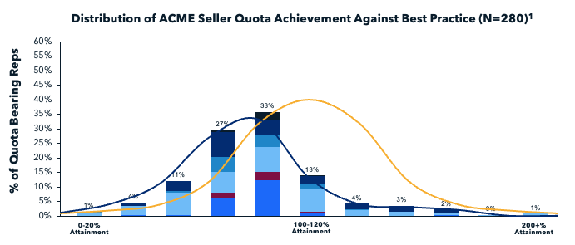
Step 1: Assess the performance of quota bearing reps compared to best practice
Sales Rep (N=105)
SE Manager (N=13)
SE/SA (N=54)
CAM (N=10)
ISR (N=66)
Sales Manager (N=32)
Quota Achievement % Distribution - Best Practice
Quota Achievement % Distribution – ACME FY22
Note¹: Quota Bearing Reps in seat for FY22; SDRs not included as ACME SDR quota attainment not based on customer spend
15

Slide 19
Step 2: Identify strengths and opportunities by role to develop career progression and learning
ACME Competency Strengths and Opportunities, By Role
SDRs | All Regions
Total Headcount: | 33
Avg. Tenure: | 1.7 Years
Avg. YTD Attainment: | 134%
ISRs | All Regions
Total Headcount: | 64
Avg. Tenure: | 2.0 Years
Avg. YTD Attainment: | 87%
Field Reps (AM/AE) | All Regions
Total Headcount: | 115
Avg. Tenure: | 2.3 Years
Avg. YTD Attainment: | 85%
Career Progression Identify skill development for cohorts and individuals required for success prior to elevating into new roles (SDR to ISR to Field)
Competency Averages | Value
Managing Processes | 5.50
Phone Qualifying Skills | 5.24
Lead Management | 5.08
Tenacity | 4.96
Email Communication | 4.90
Active Listening | 4.80
Resourcefulness | 4.74
Market Intelligence | 4.64
Utilizing Marketing Programs | 4.51
Buyer Focus | 4.49
Social Prospecting | 4.44
Strong Communication | 4.37
Competency Averages | Value
Ambition | 5.32
Tenacity | 5.24
Team Player | 5.21
Sales Approach | 5.06
Strong Communication | 5.06
Active Listening | 5.00
Objection Handling | 4.84
Interacting & Adapting | 4.83
Persuasion | 4.81
Social Prospecting | 4.78
Product Knowledge | 4.73
Phone Selling | 4.32
Competency Averages | Value
Cost Justification | 5.50
Objection Handling | 5.24
Support Resources Mgmt. | 5.08
Product Knowledge | 4.96
Establish Exec. Sponsorship | 4.90
Sales Approach | 4.80
Bus. Case Development | 4.74
Referral Generation | 4.64
Mktg. Program Utilization | 4.51
Social Prospecting | 4.49
Negotiation | 4.44
Learning & Development Identify learning opportunities to upskill cohorts and individuals to enable success in their current role
16

Slide 20
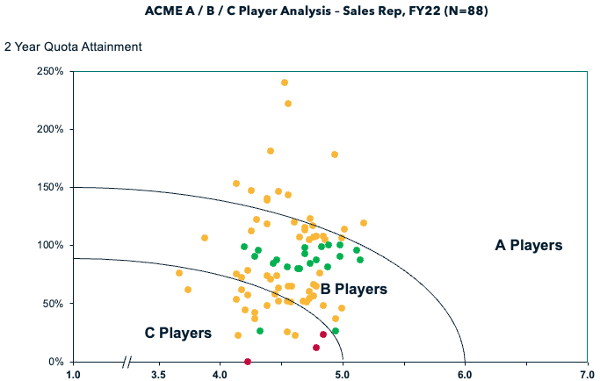
Step 3: Correlate attainment and competencies with tenure to trend top performers
Tenure
<1 year
1-3 years
>3 years
Average Competency Score
17

Slide 21

Step 4: Understand top performers (A Players) to help emulate winning competencies and behaviors within B & C Players
ACME A / B / C Player Analysis – Sales Rep, FY22 (N=88)
A Players
B Players
C Players
Seller Stats | Value
# of Reps: | 16 (18%)
Avg. Tenure: | 2.4 Years
Avg. YTD Attainment: | 111%
Avg. Deal Size: | $13.9K
Median Cycle Length: | 28 Days
% 2021 President’s Club | 42%
Top Competencies | Average Score (1-7 Likert Scale)
Objection Handling | 5.05 Highest
Product Knowledge Acquisition | 5.04
Support Resource Management | 4.98
Cost Justification | 4.89
Sales Approach | 4.75
Winning Behaviors – A Players
Objection Handling: Consistently overcomes customer objections to advance sales campaigns and win business through preparation, planning and proactiveness
Product Knowledge Acquisition: Learns new products quickly and integrates those products into their selling approach; takes advantage of any available industry and product learning opportunities
Support Resource Management: Uses both internal resources – including customer success and technical – to help them move customers through the funnel both more efficiently and effectively than doing so alone
Cost Justification: Presents compelling, multifaceted and relevant information to the buyer as to why the cost of the product/service is justified to solve their business needs; articulates the unique value-add of the solution to the buyer
Sales Approach: Follows a structured sales process and effectively handles a variety of sales scenarios independently by identifying high-potential opportunities, preparing before interactions with opportunities, leveraging internal organization support structures and consistently documenting opportunity planning

Slide 22
Step 5: Identify the most effective sales approaches and their distribution
ACME Performance Across Seller Profiles
Narrowing
Provoking
Translating
Anticipating
Prevalence Among Sellers
30% of sellers
30% of sellers
18% of sellers
22% of sellers
Sales Cycle Impact Compared with Average
27% longer
12% shorter
26% shorter
41% shorter
Deal Size Compared with Average
2% smaller
46% smaller
43% larger
24% smaller
Note: Profile compositions for ACME Company and Benchmark vary slightly due to enhancements to behavioral questions prior to general assessment release.
Numbers represent difference from ACME Company averages.

Slide 23
Where Do You Begin?

Slide 24

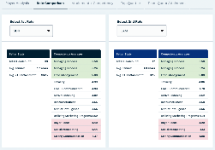
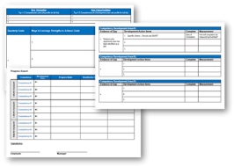
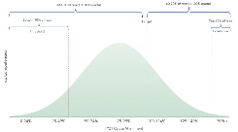
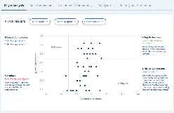
SBI’s Digital Talent Assessment
WHY
Baseline your organization, invest in future leadership, and identify coaching opportunities.
Receive personalized recommendations, targeted solutions and development plans to scale top competencies from your strongest sellers.
WHAT
Our data-driven 4-step approach provides a comprehensive view of individual and cohort data, with personalized recommendations.
Fully-automated tool allows you to determine the right scope for your organization based on your objectives.
HOW
The SBI Pro Talent Assessment tool maps your sales org, products, geography and performance.
Deploy the 15-to-30-minute survey through our secure tool.
An SBI expert will schedule a 30-minute follow-up to discuss your results and action items.
SAMPLE ASSESSMENT OUTPUTS:
Cohort Analysis:
Identify strengths and weaknesses across dozens of behaviors for each Sales role
Quota Attainment Distribution:
Understand how your team performs from a quantitative standpoint
A / B / C Player Analysis:
Map assessment results to actual performance to identify A, B, & C players
Individual Development Plans:
Define opportunity areas to prioritize coaching and development by team or individual
21

Slide 25





SBI’s Digital Talent Assessment
Thank You
Bryan Kurey
Head of Research
bryan.kurey@sbigrowth.com
(202) 285-8866
Tony Erickson
Senior Partner
anthony.erickson@sbigrowth.com
(972) 897-0246

