Slide 1


The 4 Planning Pitfalls Putting Your 2023 Strategy at Risk Hosted By: Nick Toman & Ryan Tognazzini
August 30th, 2022

Slide 2
Agenda
01
02
03
Welcome
CEO Research & Insights—Executive Summary
Q&A

Slide 3
2022 CEO Research & Insights

Slide 4
CEOs are readying for a recession, but primarily through expense management, not adapting their growth strategy
Q: To what extent do you perceive softening demand indicators for your business through the remainder of FY2022 and early FY2023?
Q. Is your organization financially or budgetarily taking explicit actions to prepare for an economic recession in late ’22 or early ‘23?
N =120.
Source: SBI CEO Growth Survey, 2022.
N =120.
Source: SBI CEO Growth Survey, 2022.
“Everyone has the playbook on how to quickly take out 5-10% of the operating expense quickly. We’ve all had to do that recently. What separates the winners and losers is knowing where to redirect investment to capture revenue when things go sideways.”
– PE Operating Partner

Slide 5
CEOs are spreading growth bets too thinly, and that will cost them growth in a recessionary environment
Comparison of Growth Approaches, 2021 vs. 2022
Key Attributes of Recent High-Growth versus Low-Growth Companies
Likelihood of Agreement with Commercial Operating Conditions
+42%
Low Growth
+168%
54%
High Growth
51%
Frequency of Growth Approach
38%
+81%
29%
16%
19%
Driving disproportionate investment toward a narrow set of higher-demand existing products and markets.
Driving relatively equitable investment across various product sets and markets to limit exposure.
Driving disproportionate investment into a narrow set of higher-demand new products and markets.
Scrutinizing shifting demand indicators, with planned contingencies and willingness to shift resources quickly to respond to market conditions.
N =120.
Source: SBI CEO Growth Survey, 2022.
N =120.
Source: SBI CEO Growth Survey, 2022.

Slide 6
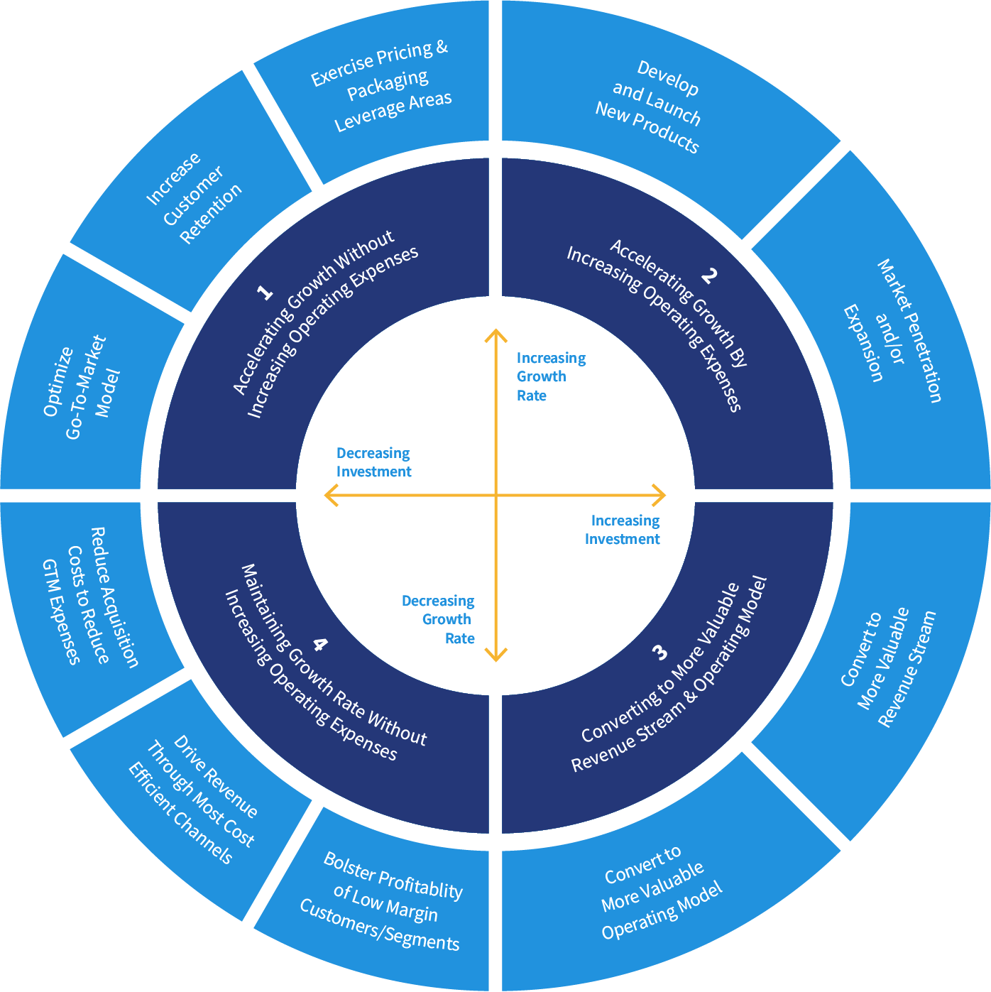
SBI Value Creation Compass
CEOs must get clearer in articulating their value creation strategy, and how that strategy evolves as expenses are reduced

Slide 7

There is an active shift underway across the businesses SBI serves, with productivity becoming focal to growth
Frequency of Value Creation Compass as Reported by CEOs
38%
36%
16%
10%
Q2: Accelerating Growth with Increased Operating Expense
Q1: Accelerating Growth without Increased Operating Expense
Q3: Converting to a More Valuable Revenue Stream/Operating Model
Q4: Maintaining Growth Rate without Increased Operating Expense
N =120.
Source: SBI CEO Growth Survey, 2022.

Slide 8
CEOs aren’t feeling terribly confident in their team’s ability to execute a productivity pivot – don’t overlook the basics to get started
SBI Value Creation Compass
CEOs Reporting Moderate-to-High Confidence in Their Organization's Ability to Execute
N =120.
Source: SBI CEO Growth Survey, 2022.
‹#›

Slide 9
Pivoting from a growth playbook largely based on adding headcount to generating greater productivity per head is a significant change
CEO Perception of Talent and Sales Talent Struggles
CEO Confidence in their organization’s ability to drive improved sales and marketing productivity
CEO % Agreement on go-to-market talent questions
High Confidence
Low Confidence
N =120.
Source: SBI CEO Growth Survey, 2022.
N =120.
Source: SBI CEO Growth Survey, 2022.

Slide 10
CEOs are not terribly confident in their key commercial leaders’ abilities to drive execution in this environment
CEO Perceptions of Growth Leadership
CEO Perceptions of CRO/Equivalent Leadership Capabilities
Q: Candidly speaking, how confident are you in the following executive’s ability to drive commercial success for your organization?
Percent Agreeing or Strongly Agreeing
N =120.
Source: SBI CEO Growth Survey, 2022.
N =120.
Source: SBI CEO Growth Survey, 2022.

Slide 11
Key Takeaways & Next Steps
1
2
3
4
5
Don’t Over-index on Cost Reduction; Evolve Your Growth Plan Now
Narrow the Number of Growth Bets & Secure Alignment on the Value Creation Strategy and Related Growth Bets
Leverage the SBI Value Creation Compass to Drive That Alignment
There are Productivity Gains had by “Getting Back to Basics”
Assess Whether Your Leaders Can Make the Pivot
(Leaders Need to Develop a Plan for Productivity Improvement)
Visit us at sbigrowth.com for support and resources on these actions

Slide 12


Q&A
Nick Toman
President
Email: nick.toman@sbigrowth.com
Ryan Tognazzini
Senior Partner
Email: ryan.tognazzini@sbigrowth.com

Slide 13
Thank You

