Slide 1
Unlocking the potential of customer marketing to drive growth.
Hosted by: Tracy Hansen and Aaron Bean
April 25, 2023

Slide 2
Agenda For Today
CMO growth priorities
SBI go-to-market leader survey results
Customer marketing discussion

Slide 3
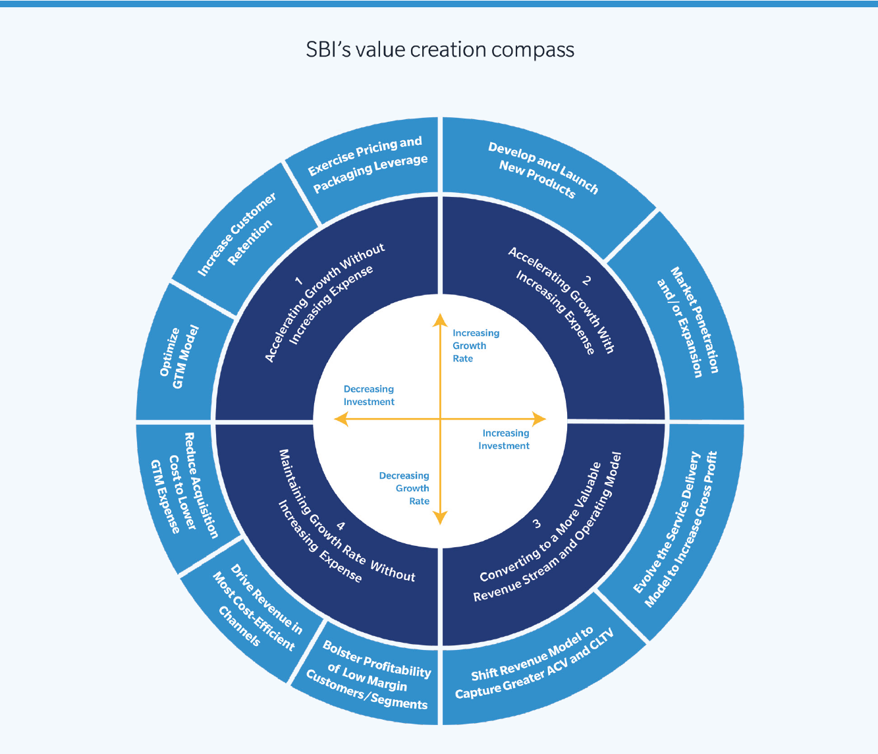
Which growth levers is your organization prioritizing today?
SBI has identified ten “growth levers” that go-to-market teams can pull as they execute their growth strategies (outer ring of the compass).
Optimize GTM Model
Increase Customer Retention
Exercise Pricing and Packaging Leverage
Develop and Launch New Products
Market Penetration and/or Expansion
Evolve the Service Delivery Model to Increase Gross Profit
Shift Revenue Model to Capture Greater ACV and CLTV
Bolster Profitability of Low Margin Customers/ Segments
Drive Revenue in Most Cost-Efficient Channels
Reduce Acquisition Cost to Lower GTM Expense

Slide 4

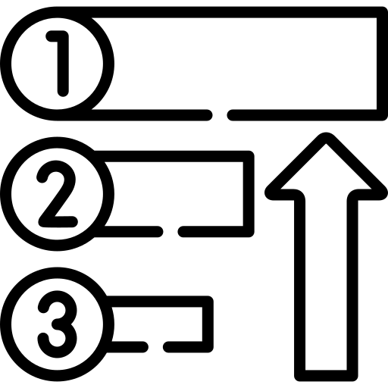

CMOs driving value though tight execution against focused growth bets
Essential growth levers for 2023 strategies
Increasing customer retention
Market penetration and/or expansion
Driving revenue via the most cost-efficient channels
Priority growth bets
Identifying and penetrating whitespace in existing accounts
Upsell and cross-sell opportunities
Net new acquisition for some
Addition focus areas
Refining demand-generation strategies
Improving journey mapping and customer data analysis
Ensuring content is aligned with the pre- and post-sale customer journeys
Vector art from Flaticon.com

Slide 5
01
CEO perspectives on demand, revenue & customer marketing

Slide 6
CEOs expecting demand acceleration late 2023 or beyond
Expected Timing of Demand Acceleration
Among respondents who report demand as flat or slowing
33%
24%
26%
7%
Within the Next Three Months
Within the Next Six Months
By the End of 2023
Sometime After 2023
N = 55
Question: When are you expecting/ forecasting demand to accelerate?
Source: SBI Q1 2023 Survey

Slide 7
Pipelines, volume forecasts, and renewal rates improving, other demand indicators flat from previous quarter
Pipeline and Demand Indicators Compared With Previous Quarter
Better than last quarter
30%
30%
33%
Same as last quarter
38%
46%
45%
Worse than last quarter
56%
54%
37%
55%
47%
44%
29%
37%
43%
29%
33%
15%
15%
18%
20%
18%
17%
12%
How would you characterize the quality of your prospective customer pipeline?
How would you characterize the speed with which prospects are progressing through your Marketing funnel?
How are you forecasting sales deal volume for the current quarter?
How would you characterize the velocity of NET-NEW bookings across the current quarter?
How would you characterize trends across the current quarter in the average deal size of NET-NEW bookings?
How are you forecasting deal size for the current quarter?
What trends are you seeing in renewal rates for monthly or annually recurring revenue (MRR or ARR)?
How are you forecasting customer renewals for the current quarter?
N = 91
Source: SBI Spring 2023 CEO Survey
Notes:
1. Quality of pipeline – 56% better than last quarter
2. Speed/ velocity of marketing funnel – 85% same or better than last quarter
3. Sales deal volume – 54% better than last quarter
4. Net new booking velocity -
5. Ave deal size of net new bookings -
6. Deal size forecast –
7. Renewal rate trends (MRR & ARR) 46% better than last quarter
8. Quarterly renewals for Q1 – 45% better than last quarter

Slide 8
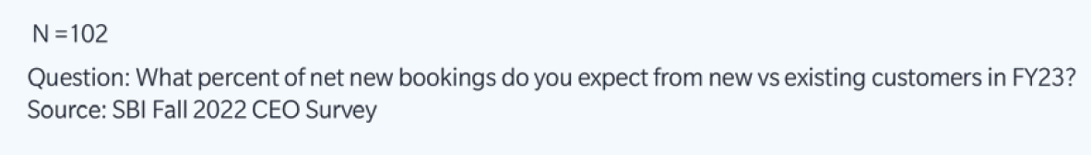
60% of net new revenue will come from existing customers in 2023.
Increasing from just over 40% at the end of 2022.
SBI Fall 2022 CEO Survey

Slide 9
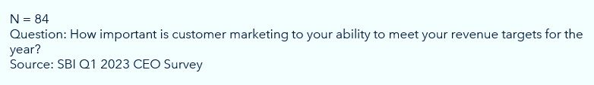
70% see customer marketing as important to meeting their 2023 revenue targets
Yet, many marketing teams remain more heavily focused on demand generation.
SBI Spring 2023 CEO Survey

Slide 10
02
CMOs seeing increased confidence but still constrained

Slide 11
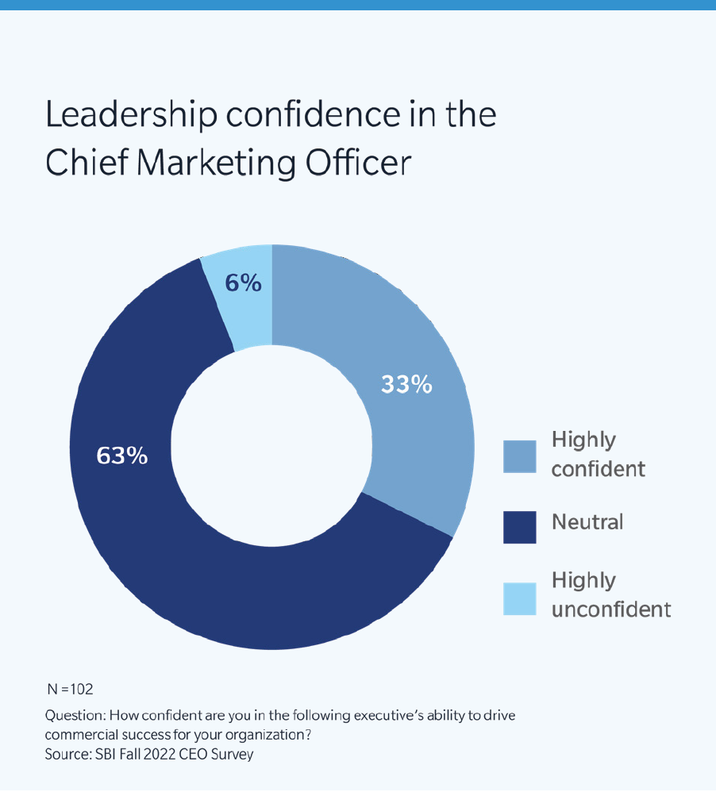
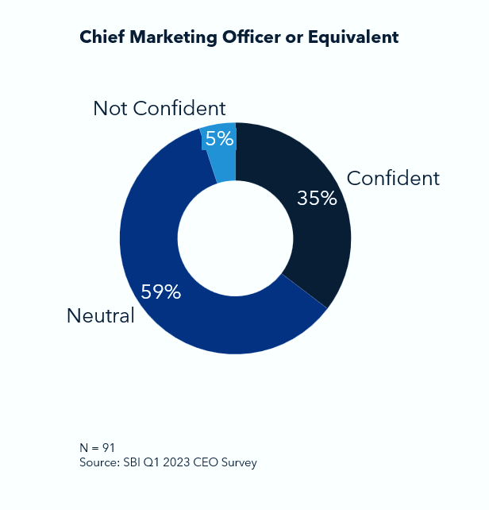
Leadership confidence in CMOs is improving slightly
Confidence in ability of CMOs to drive commercial success
Fall 2022
Winter 2023
Question: Candidly speaking, how confident are you in the following executive’s ability to drive commercial success for your organization?

Slide 12
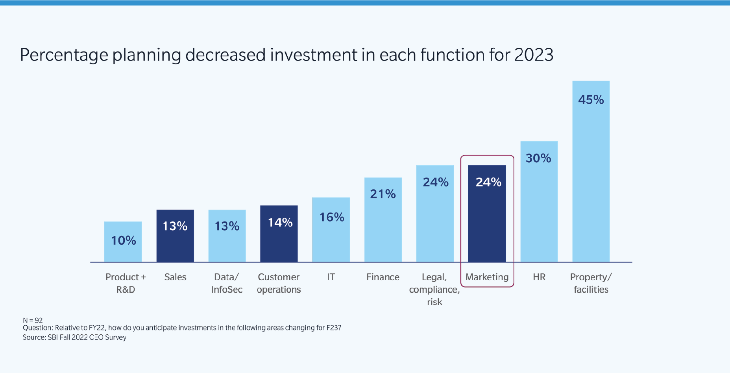
However, most marketers likely to see decreased investment

Slide 13
03
Let’s talk customer marketing

Slide 14
Customer Marketing
Activities designed to drive retention, loyalty, advocacy, growth and community participation for current customers. The strategy relies heavily on maximizing strong customer relationships.
Key customer marketing activities
Journey-aligned content and communications development to support customer value realization
Automation / scaling of customer success activities focused on deepening customer relationships and improving CSAT and NPS
Advocate identification and cultivation
Cross-sell and upsell campaigns and programs
How does SBI define customer marketing?

Slide 15
Identifying Customer Marketing Priorities
Key Indicators for Prioritization of Customer Marketing Activity
Have users completed installation?
Is the customer using the full service (e.g., all seats, features?)
Is the customer using key product features?
How is overall product usage trending?
Are support needs spiking? Lower?
Are customers satisfied with the solution?
Are users seeing value / desired outcomes?
How is customer health (where Health Score in place)?
Would greater access (more users / more features) impact critical business priorities?
How is NPS trending?
What are community activity levels?
What is review/rating performance?
Customer Journey Stages
Implementation
Onboarding
Adoption
Retention
Expansion
Advocacy

Slide 16
The three foundations of good customer marketing.
Customer data analysis
Segmentation & modeling
Well-defined roles & responsibilities

Slide 17
Visibility into the customer journey is a challenge for many
Fragmented and siloed customer engagement data leaves important questions unanswered…
How are customers engaging with the business and its products?
How are different departments engaging customers?
How are customer engagement programs performing?
Impact: limited insight to refine customer engagement plays
Impact: missed opportunities and out of context communications
Impact: guessing on where to focus optimization efforts

Slide 18
Segmentation and modeling focus and refine customer marketing efforts
Product Utilization
Features used/ not used
Cadence of product use
Integrations implemented
User adoption velocity
Customer Profile & Persona
Champion
User
Value Realization Stakeholder
Financial Decision Maker
Engagement Profile
Advocate
Reference provider
Community contributor
Customer event participant
Trainings & certifications completed
Customer Data
Value & Growth Potential
Contract value
Contract term
Time to renewal
Customer spend history
Propensity to buy score
NPS, CSAT score
Customer Age
1-30 days, 30-90 days, 3-6 months, 6-12 months, 1-2 years, 2-3 years, 3-5 years, 5+ years

Slide 19
No clear owner of customer marketing
Organizational responsibility for customer marketing
1%
A cross-functional team of account managers, customer success managers, marketing and/ or other functions
A dedicated and separate customer marketing team
A dedicated individual or team within our Marketing organization
Part of the responsibilities of individual(s) in our Marketing organization
We do not run any customer marketing programs
N = 84
Question: Who in your organization is responsible for customer marketing (post-sale marketing designed to deepen customer relationships and drive further adoption and usage of product features)?
Source: SBI Q1 2023 CEO Survey

Slide 20


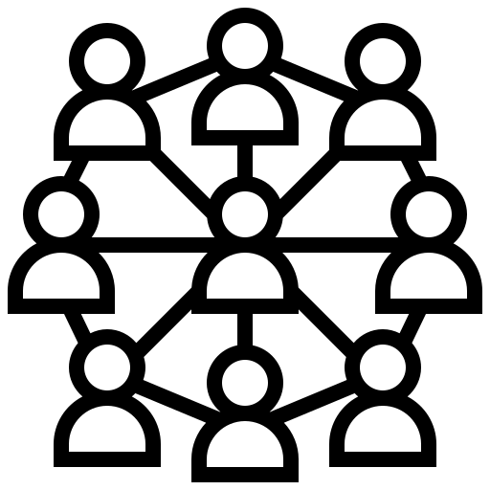

Four common “recipes” for customer marketing
Resourcing models observed in enterprises driving growth via customer marketing strategies.
Conductors
Who: ADs/AEs/CSMs
When: Account-based strategy
Determine which plays to run
Lead coordination of activities across teams
Coordinate regular team interlocks and own decisions
Work with marketing to develop campaigns, personalized messaging and content
Catalysts
Who: Customer Marketers
When: Customer expansion at scale
Scale 1:1 customer success motions with cohort and segment-based marketing campaigns
Drive product adoption and utilization as well as awareness and expansion into new buying centers
Develop messaging, content and offers for customer campaigns
Partner with events team to run high-value customer events
Storytellers
Who: Content Marketers
When: Large diverse customer base
Develop and maintain customer stories program
Develop and maintain customer advocacy program
Produce content across multiple formats to tell and share customer stories
Develop and maintain reference-able customer lists
Orchestrators
Who: Customer Lifecycle Mgrs
When: Retention/ churn a priority
Manage overall flow and cadence of customer communications
Coordinate customer information and insights between marketing and customer success teams
Ensure multi-channel communications are not overwhelming customers
Vector art from Flaticon.com

Slide 21
Customer Marketing / Customer Success Interlocks
Customer Marketing
Customer Success
Segmentation and Targeting
Provide customer context/health for improved results
Account Tiering / Alignment of Customers
Build messaging / plans for ICP
Buyer Personas and Messaging
Suggest updates based on user personas / cust journey
User Personas and Customer Journey
Share target buyers and value prop for new offers
Campaign Themes and Programs (including ABM)
Provide feedback on CS objectives and high priority accts
Account Prioritization and Customer Feedback
Create programs / tactics aligned to CS objectives
Scaled Communications
Update customer data to ensure value received
Account Tiering and Health Assessment
Build journey-aligned content/nurtures
Mobilize Advocates
Source advocates and referenceable customers
Identify Advocates
Create scalable content / stories leveraging advocates

Slide 22
Refine your customer marketing approach by starting with data, segmentation, clear roles, and responsibilities.
1
What are your current practices around the three foundations of good customer marketing?
How do you approach your installed base today?
When did you last conduct an account segmentation?
What attributes define your most opportune customer segments?
How should your customer engagement strategy change as you focus on different account segments and customer cohorts?
Which plays are best directed by whom? Sales, a combination of customer success and account management, marketing for scale to reach a higher number of accounts?
2
3
4
5
6

Slide 23
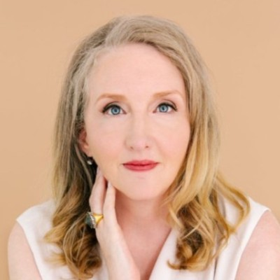
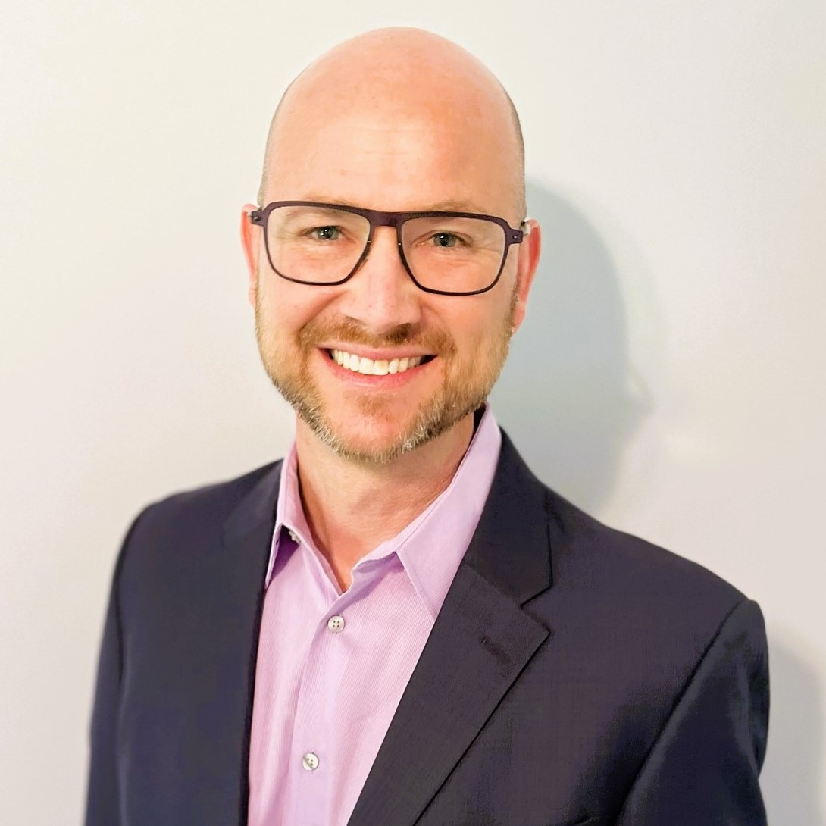
Thank You
Tracy Hansen
Partner & Marketing Practice Lead
Email: tracy.hansen@sbigrowth.com
Aaron Bean
Marketing Analyst
Email: aaron.bean@sbigrowth.com

