Slide 1
Account Segmentation Process Guide
A step-by-step guide to completing an account segmentation exercise

Slide 2
01
Introduction & Overview

Slide 3
Account Segmentation Terms & Definitions
Term | Definition
Ideal Company Profile (ICP) | Often referred to as an ICP, this is a representation of what an “ideal” customer or prospect looks like, made up of various propensity-to-buy factors, to support sales planning and resource allocation efforts.
Propensity-to-Buy Factors | A factor – either firmographic or nurture – that is an indicator of an ideal customer or prospect. These factors are weighted based on their relevance and importance in the ideal company profile.
Firmographic Factors | Factors that are data-based and/or objective in nature. This means that the information for the factor can be identified without ever having an interaction with the company and can be incorporated into the Ideal Company Profile effort. Examples of firmographic factors are: a company’s industry, their revenue size, the number of employees they have, their geographic location, etc.
Nurture Factors | Factors that are qualitative in nature. This means that the information for the factor must be obtained by having an interaction – or series of interactions – with the customer and prospect. Once those interactions are conducted, information can be “inputted” into the ICP and scored accordingly. Examples of nurture factors are: the strength of the relationship, the number of stakeholders involved in the decision-making process, their experience using similar solutions before, etc.
Account Score | An Account Score is the numeric representation of the ICP. Usually scored out of 100 points, it is the aggregate score that company receives based on their relation to the propensity-to-buy factors. See slides 16 and 17 for more detail.
Potential Spend | Potential Spend is the quantified amount of money that a customer or prospect can spend on your company’s solutions over a given period of time (usually 1 year). Calculated using different techniques, potential spend is an indication of what the total wallet share you can capture from an account is.
ROAD Model | ROAD Model is framework that is used to determine what the optimal account assignment and motion is for a given account. It is a 2x2 model – where one axis a company’s account score and the other is their potential spend – and it is segmented into 4 quadrants, each where a different motion is recommended based on those two figures.

Slide 4
Typical Consulting Timeline for Completing an Account Segmentation Project**
 |  | Week 1 | Week 2 | Week 3 | Week 4 | Week 5 | Week 6 | Week 7 | Week 8 | Week 9 | Week10
1 | Define Timeline & Milestones
2 | Request Data
3 | Receive all Data
4 | Complete Initial Analysis to Validate & Define Source Data
5 | Create Model & Enrich Data Set
6 | Add Prospects
7 | Calculate Potential Spend
8 | Define Propensity-to-Buy Factors
9 | Create Account Score
10 | Create ROAD Model
11 | Validate Stack Rankings & Output
12 | Produce Insights and/or Link to Next Workstream
13 | Final ownership of model
PRE-KICKOFF
EXECUTION
FINALIZE
**For many companies, simply compiling and cleaning data can consume weeks or even months. Adjust timeline based on this reality and for your company’s maturity, complexity and customer base; and for the experience and bandwidth of your people executing the project.

Slide 5
Pitfalls & Best Practices to Consider When Conducting an Account Segmentation Exercise
STAGE/PHASE OF EXERCISE | PITFALLS | BEST PRACTICES
Prior to Start | Waiting too long for the data Assuming the data is available – either internally in a different system or through a third-party vendor Moving ahead before confirming data accuracy / usability Initiating work before defining and baselining project success metrics which are tied to larger corporate goals Using select vendors for data enrichment that have a long lead time | Collect all data before beginning of project Confirm validity of data prior to kick off Align success metrics to future pilot Confirm data enrichment plan at the onset of project
During Exercise | Overcomplicating solution design Overinvesting in data cleansing Not involving everyone necessary in the design of the solutions and aligning on process and output throughout Allowing murky ownership of roles and contribution between Product, Marketing and Sales Allowing confusion to perpetuate where a team is unclear or “does not believe” the data | Design complexity of solution based upon your organization’s capabilities Ensure at least 80% of bookings data is cleansed before moving on Create workbook and show updates frequently Appoint a single owner for both pilot and future state Include notes in the workbook for sources, assumptions, and anything else that might cause hesitancy around data Remove any “working tabs” in the workbook prior to passing along to the executive team
Enablement & Operationalizing | Lacking a dedicated internal resource with appropriate capabilities to take ownership of materials going forward Maintaining unclear/non-existent metrics for tracking ongoing solution value Skipping a defined data refresh/update process Allowing unclear and inconsistent communications on the output and its use | Share model with GTM team, extracting key insights with immediate implications for commercial strategy and ensuring stakeholders understand how to use the information If possible, assign model ownership to Data Science or Analytics, with RevOps or Sales Ops providing direction and process Establish a cadence with functional leaders to review workbook and how it can be leveraged to support GTM objectives Select leading and lagging metric(s) to track value of work; tie metrics to appropriate function and objectives Have a clear, simple and frequent (every 3-6 months) data refresh process

Slide 6
Ideal Set of Resources & Team to Complete Account Segmentation Initiative
Role on Account Segmentation Effort | Executive Sponsor | Day-to-Day Leader | Data Analysts | Supporting Members
Primary Responsibilities | Set objectives and success metrics Manage business conversations with functional leaders Drive organizational change management | Oversee the completion of the exercise Ensure business context is included into work product Deliver quick wins to functional leaders to demonstrate value | Build the segmentation model and conduct key analyses Aggregate and manage data inputs and third-party vendors Surface findings and insights from the data | SFDC/CRM manager to support technical components IT to provide data pulls Finance to validate data Functional leaders for input and feedback
Level of Involvement in Effort | Weekly Updates & Key Decisions | Daily Guidance Giving | Heavy Involvement day-to-day | As needed
Common Role in a Commercial Team | Head of Sales; CFO | Head of Sales Operations | Sales Operations Managers Analytics Managers Data Scientists | SFDC Managers; Marketing Operations Managers; Finance Analysts

Slide 7
02
Step-by-Step Process

Slide 8
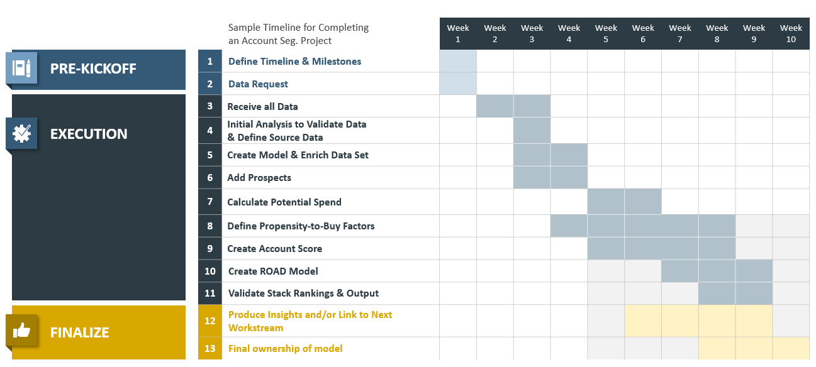
Define Timeline & Milestones
Agree to what is going to be produced and by when with key stakeholders
Key Activities
Main steps in defining timeline and milestones
Agree to objectives and success criteria
Set key dates and milestones
Discuss dependencies and implications with functional and business leaders
Conduct kickoff meeting with internal sponsors to drive awareness and engagement
Account Segmentation Timeline – Illustrative
Roles & Responsibilities
Action: Project manager to propose roles and responsibilities for each stage of the project w/ assigned participants
Exit Criteria: All stakeholders have agreed to outputs and timelines, with alignment around the end-state and project goals.
*Define timelines and milestones at very beginning of project. Be sure to discuss the dependencies on receiving and having clean data. Identify point people who will provide data.

Slide 9
Data Request
Create and submit a data and documentation request
Key Activities
Main steps in data request
Understand data currently available to use in exercise
Develop formal data request that can be shared internally
Request data and documentation from relevant team members / cross-functional partners
Manage and complete tracking sheet to monitor files as they are provided
Determine what third-party data sources are needed to support analysis; source as needed
Data Request Sheet – Illustrative
3 Year Customer File with Spend Info
Prospect Target List
Sales Territories with Rep Mapping
3 Year Historical Financial Data
TAM/SAM and Additional Market Data
Sales Pipeline Data
Supporting Functional Data – e.g., Marketing Funnel Metrics
Roles & Responsibilities
Action: Project manager to propose roles and responsibilities for each stage of the project w/ assigned participants
Exit Criteria: Executive sponsors align on key data requirements / available inputs to inform analysis; project manager receives access to all required data assets
*Best practice is to prioritize data request items

Slide 10
Data Receipt and Validation
Project team has collected all data and aligned on inputs with executive team
Key Activities
Main steps in receive all data
Data analysts view inputs on receipt and assess for validity / usability
Project manager updates tracking grid
Project manager contacts data providers with questions and concerns
Data analysts clean / manipulate data as needed
Data Tracking Sheet – Illustrative
Data File | Received? | Validated? | Questions?
Name of Data File Requested | Has the file been received? If so, from whom? | Has the file been reviewed and validated for accuracy? | What questions exist around the file that the team needs answered?
File No. 1 | Yes | Yes | N/A
File No. 2 | No | No | Have we asked the right stakeholder for this?
File No. 3 | Yes | No | Is this the latest and greatest file?
… | … | … | …
Roles & Responsibilities
Action: Project manager to propose roles and responsibilities for each stage of the project w/ assigned participants
Exit Criteria: Top-priority datasets collected, including customer data, prospect data (if available) and 3 year spend information (as granular as possible)
*This step is likely to continue for the first few weeks. It’s important to prioritize the most critical data requests to begin work.

Slide 11
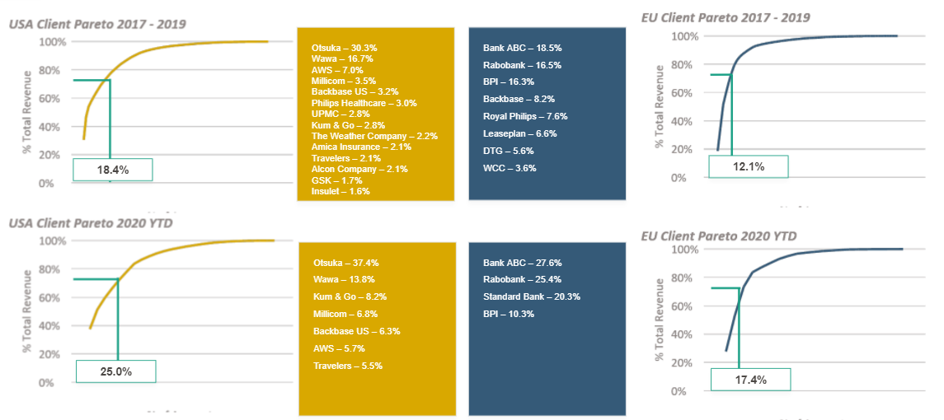
Initial Data Analysis to Validate Data and Define Source Data
Evaluate data quality and agree to “source of truth” data set(s)
Key Activities
Main steps to validate data and define source data
Use ratio analysis to identify big outliers (ex. Bookings/HC)
Confirm understanding of data by conducting descriptive analysis on customer set (i.e., # of customers, ASP, # of products per cust., etc.)
Formally agree to the key data set(s) to be used as the ‘source of truth’ (i.e., customer data, financial data, prospect data, etc.)
Begin building model using source data as starting point
Data Validation Analyses – Illustrative
Roles & Responsibilities
Action: Project manager to propose roles and responsibilities for each stage of the project w/ assigned participants
Exit Criteria: Team has agreed to ‘source of truth’ data sets as foundation for future work

Slide 12
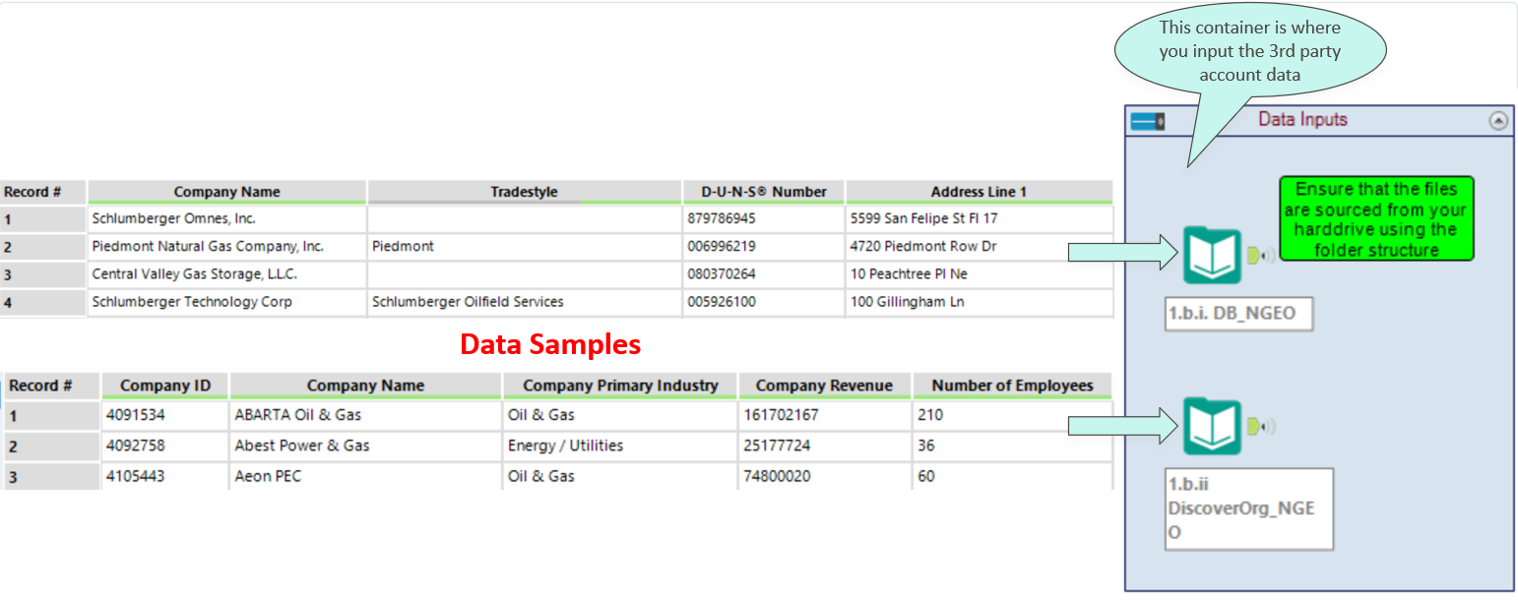
Create Model and Enrich Data Set
Begin building the model and enrich data with firmographic information
Key Activities
Main steps to create model and enrich data
Set up main data tabs (i.e., raw customer data, customer spend info) to be where all analyses are executed from
Append firmographic information to customer data (and prospect data if available) using third data source (i.e., Hoovers); Agree to what info will be appended
Main components of model: raw data, customer master, prospect list, assumptions, firmographic data, etc.
Model Creation & Enrichment – Illustrative
Roles & Responsibilities
Action: Project manager to propose roles and responsibilities for each stage of the project w/ assigned participants
Exit Criteria: Base model has been built and all necessary data has been enriched with firmographic information

Slide 13
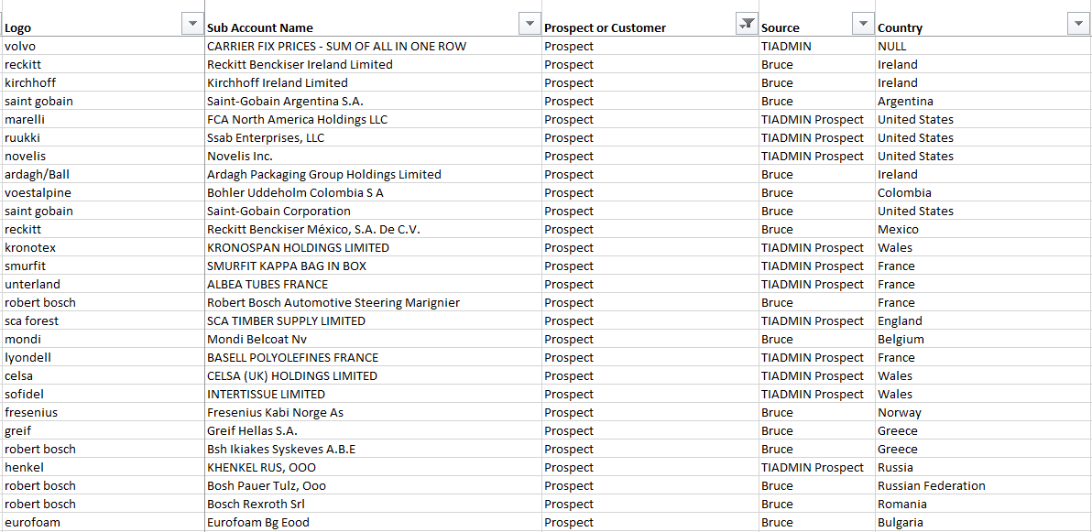
Add Prospects
Incorporate prospects into the model
Key Activities
Add prospects to model
Note – skip step if prospect information is included in other data sets
Agree to criteria that is used to build prospect data set (i.e., industries, geos, company sizes, etc.) with key stakeholders
Pull prospect data from third party data
Incorporate into model and validate with team
Ensure no duplicate records with customers or prospects
List of Prospects to Add to Model – Illustrative
Roles & Responsibilities
Action: Project manager to propose roles and responsibilities for each stage of the project w/ assigned participants
Exit Criteria: All prospects have been incorporated into the model and validated with the team
*Work with people in the field to understand “can’t miss” prospects that should be added into the model. Also use this as an opportunity to begin getting input on potential amounts and how to determine potential in prospect accounts.

Slide 14
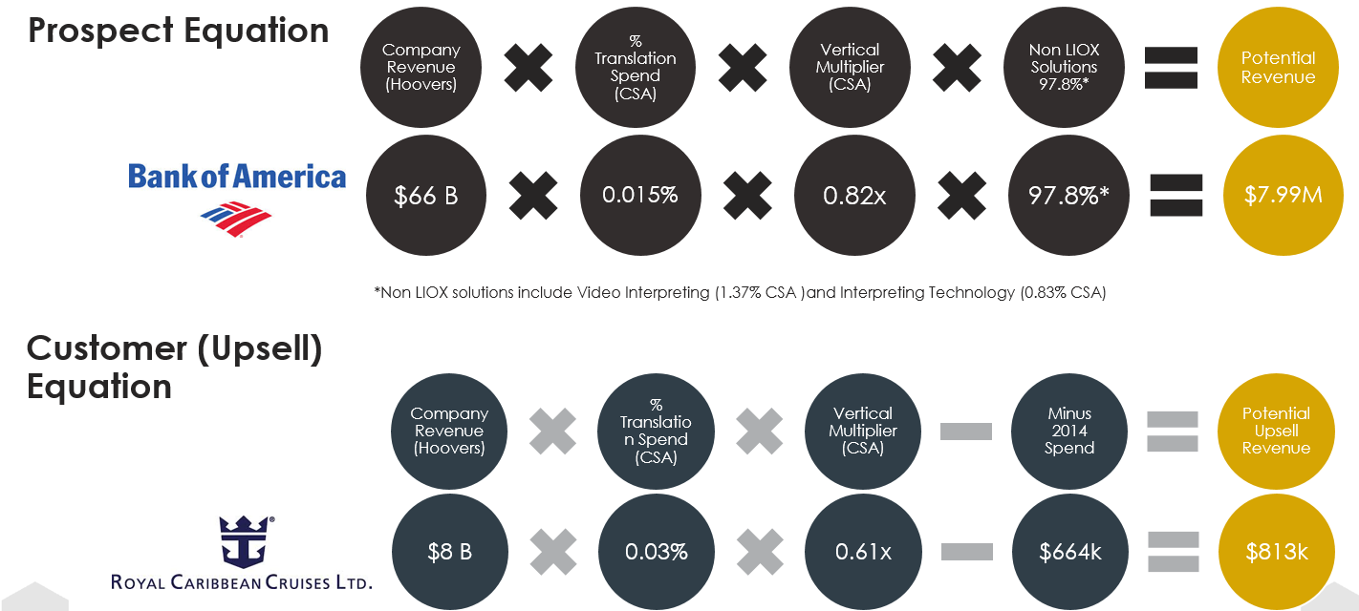
Calculate Potential Spend
Determine how much customers and prospects can spend in a given year
Key Activities
Calculate potential spend
Agree to methodology for calculating potential spend and determine any differences for customers vs prospects
Define ways to validate potential spend after calculating (i.e., sales leader validation)
Once calculated and agreed upon, “overlay” potential spend onto all accounts
Ensure methodology is dynamic
Potential Spend Calculation – Illustrative
Roles & Responsibilities
Action: Project manager to propose roles and responsibilities for each stage of the project w/ assigned participants
Exit Criteria: Output of potential spend is agreed on and all accounts have a potential spend figure associated
*It is critical to determine the time length that potential spend will represent. This is often done over one year, but there are times when it can represent a longer lifecycle (i.e., if the average product lifecycle is 3 years). Agree on how much time the potential spend figure represents.

Slide 15
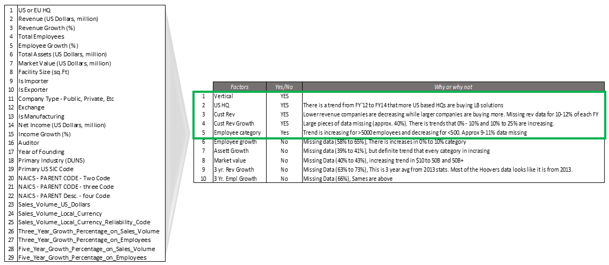
Define Propensity-to-Buy (PtB) Factors
Determine the firmographic inputs that are used in the Account Score
Key Activities
Define propensity-to-buy (PtB) factors
Understand how PtB factors are inputs to the Account Score
Conduct Expert Panel with the sales org to get their input on what factors are most important and potential weighting
Analyze various data factors for what is most predictive with an “ideal” account. Use standard descriptive analysis approaches.
Determine if different PtB factors are needed for customers vs. prospects. Document if so.
Select PtB factors that are firmographic, NOT nurture factors if possible
Identifying Top Propensity Factors – Illustrative
Roles & Responsibilities
Action: Project manager to propose roles and responsibilities for each stage of the project w/ assigned participants
Exit Criteria: Set of factors to be used in the Account Score and the weighting of each factor are agreed upon
*It is common to try and have many PtB factors. A best practice, particularly for a less mature sales org, is to have fewer factors. A good number is between 3-5. If more advanced, 4-6 factors is more appropriate. Focus the on how fewer factors makes the work more digestible and how this will evolve over time.

Slide 16
Create the Account Score
Take the PtB factors and translate those into an account score all customers and prospects in the data set
Key Activities
Create the Account Score
Take the PtB factors from the prior step and incorporate that as a “formula” in the model
Overlay a “score” onto each account based on the PtB factors
Build the model so it is dynamic and can be augmented if the factors and/or weights change over time
Validate the output of the Account Score to ensure it’s accurate. For example, review the top customers and see what their score is (should be near 100).
Account Scoring Model – Illustrative
Company Rev.
Employee Size
Company Growth %
HQ
Total
40 pts.
35 pts.
15 pts.
10 pts.
100 pts.
Total Company revenue
Total employee headcount in Company
Company revenue growth over 3 years
HQ location of the company
Roles & Responsibilities
Action: Project manager to propose roles and responsibilities for each stage of the project w/ assigned participants
Exit Criteria: All accounts have an ‘Account Score’ assigned to them and these are validated by the team
*It’s very important to validate the output of the account scoring exercise. Review the account scores for the top customers after the modeling is done and validate they have “higher” scores (i.e., closer to 100) than less attractive customers.

Slide 17
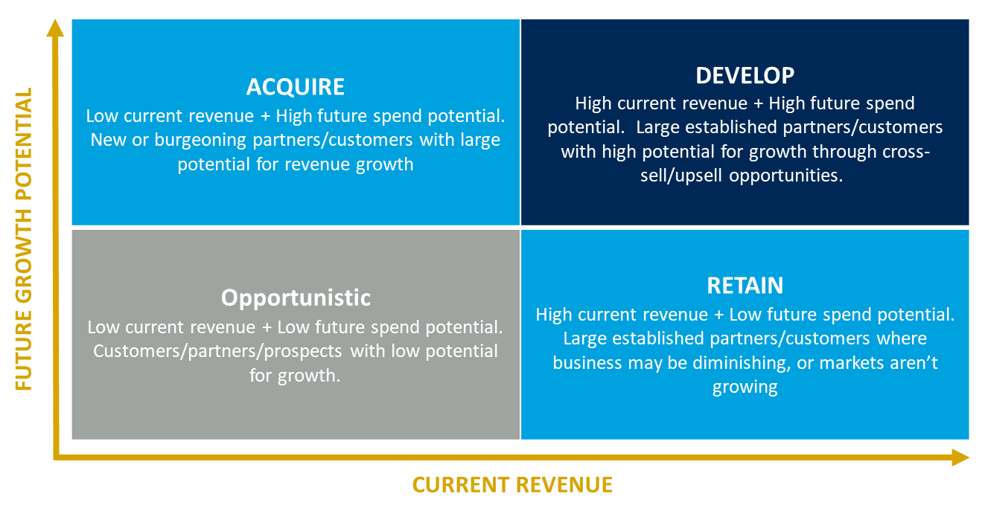
Validate Stack Rankings & Output
Validate the final stack ranking of accounts and all data outputs
Key Activities
Validate stack rankings & output
Stack rank the accounts based on Account Score and/or Potential Spend and review for final validation
Make any final tweaks to potential spend and/or account score factors or weights at this time
Create ROAD model (or similar 2x2 framework) that incorporates Account Score and Potential Spend
Formally complete step and ensure all buy-in is there as this output will now be used in future efforts
ROAD Model Framework – Illustrative
Roles & Responsibilities
Action: Project manager to propose roles and responsibilities for each stage of the project w/ assigned participants
Exit Criteria: Final output (Account Score and Account Potential) for all accounts has been validated

Slide 18
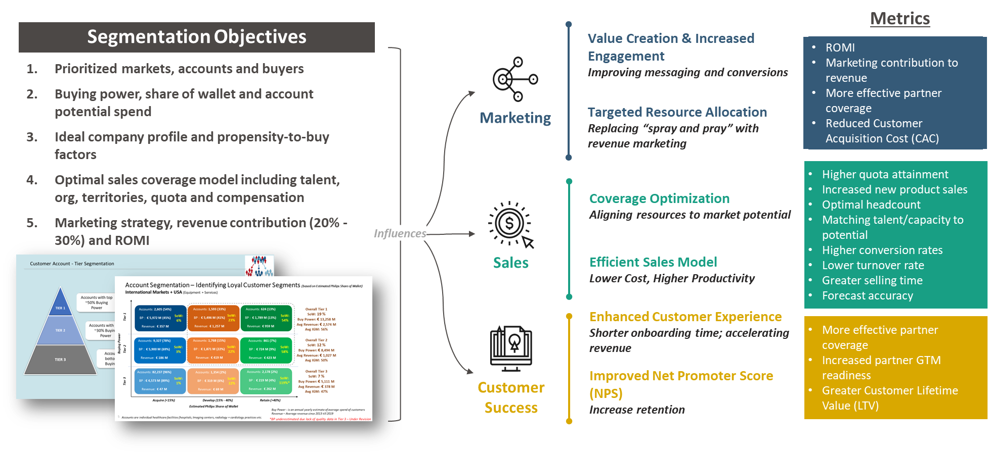
Produce insights and/or link to the next exercise
Generate meaningful insights from the work and/or link to the next part of the engagement (i.e., Sales Ops)
Key Activities
Produce insights and/or link to next workstream
Conduct a readout with functional leaders to share key insights from account segmentation, including key recommendations and implications
(If account seg is feeding into another workstream) determine what changes / updates need to be made to the model so the work can be an input into the next workstream(s)
Where Account Segmentation Feeds Other Areas – Illustrative
Roles & Responsibilities
Action: Project manager to propose roles and responsibilities for each stage of the project w/ assigned participants
Exit Criteria: Team has socialized key insights; sales org begins using insight to inform related priorities such as territory and org design

Slide 19
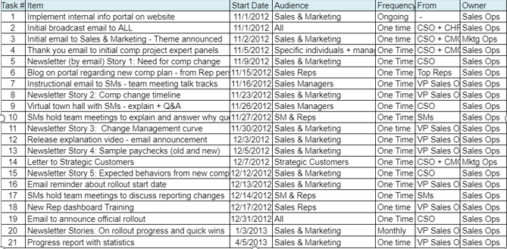
Organizational Enablement
Educate and socialize the team on the output of the account segmentation project
Key Activities
Enable the organization to use the output
Conduct a series of interactions with functional leaders reviewing the output of the work and how they can leverage
Identify areas for quick wins and longer term opportunities from the analysis
Provide broader communication, emphasizing the WIIFM (What’s in it for me) concept, on how each role will benefit from the output
Create a plan to review progress and how the work has been leveraged every 90 days
Communication Plan Template – Illustrative
Roles & Responsibilities
Action: Project manager to propose roles and responsibilities for each stage of the project w/ assigned participants
Exit Criteria: All key stakeholders have been briefed on the output and have clarity on how this will benefit them and their teams

