Slide 1
Building Multi-Horizon GTM Plans
Grounded in Growth Theses from SBI’s Value Creation Compass

Slide 2
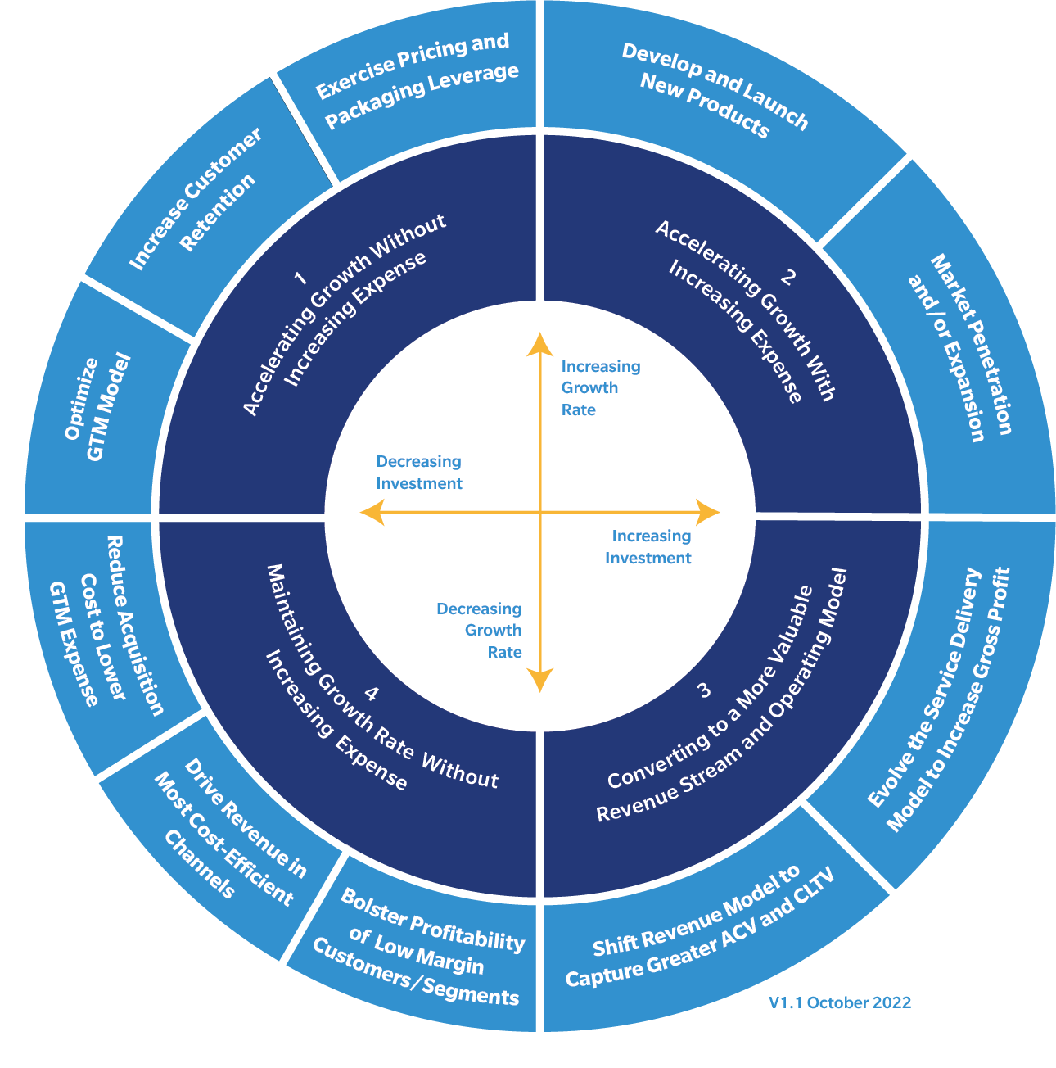
SBI’s Value Creation Compass aligns GTM strategy with the CEO’s corporate strategy
Organizations utilize our four quadrants to position themselves strategically, with each quadrant representing distinctive growth strategies. These strategies are informed by a growth thesis that typically extends beyond a single year but may adjust during the year due to market dynamics.
Each quadrant focuses clients on specific growth imperatives. A company’s position within the Value Creation Compass (VCC) is determined by two factors:
The magnitude of investment it intends to allocate for growth in the current cycle compared to the previous one, depicted on the X-axis.
The anticipated ROI in terms of growth, as a result of the expenditure, shown on the Y-axis.

Slide 3
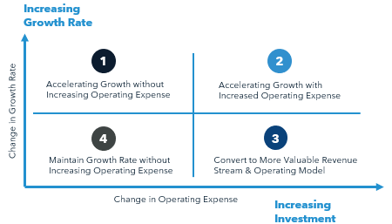
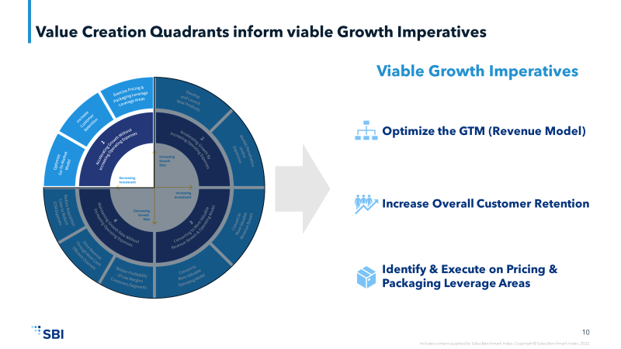
Growth theses cascade to growth imperatives and become the multi-horizon growth plan
Identify Growth Thesis
Choose Amongst Growth Imperatives
1
2
A company’s growth thesis is informed by two dimensions:
Spend and investment needed to drive growth.
Expected growth rate.
Select actions that support the growth thesis. For example, a Quadrant 1 thesis suggests the following growth imperatives:
Optimize the GTM model.
Increase customer retention.
Identify & execute on pricing & packaging, i.e., increase prices.

Slide 4
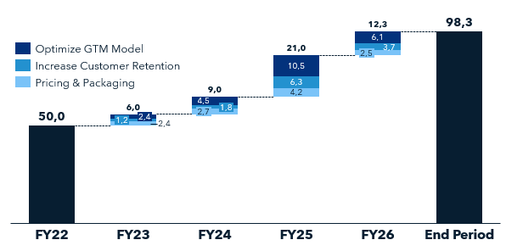
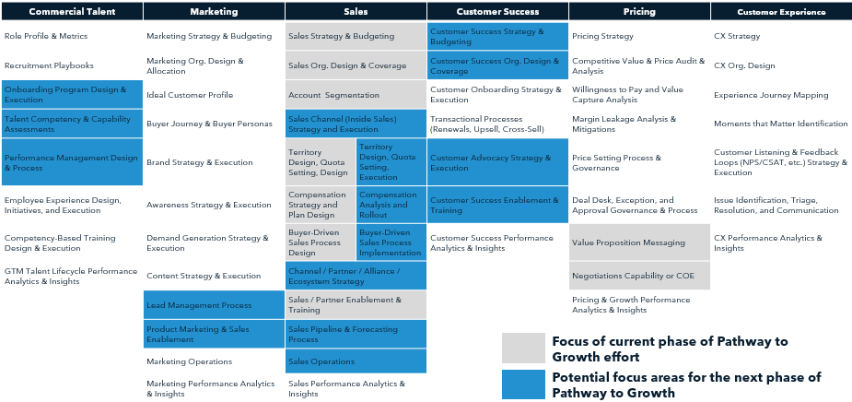
Growth theses cascade to growth imperatives and become the multi-horizon growth plan
Size Growth Imperatives
Design Your Multi-Horizon Growth Plan
3
4
Assess each imperative to forecast its contribution to growth within the current year, known as Horizon 1, and in subsequent horizons.
Develop and enhance GTM capabilities tailored to each imperative. Methodically prioritize and order the initiatives that will drive you toward your objectives. And then, allocate resources to these initiatives by carefully considering your organization's abilities, available bandwidth, and the risks involved.

Slide 5
Putting the Idea Into Practice

Slide 6
ACME’s Growth Thesis Discussion
Example Discussion Points
ACME is steering towards a SaaS-first, cloud-centric business model that’s indicating of a strategic pivot to Quadrant 3 to enhance revenue quality and operational efficacy. This transition is progressing as expected. However, the following factors suggest a potential realignment to a Quadrant 1 growth thesis: Below-industry-average revenue growth in the Americas. Sales and marketing expenditure is in line with industry standards at 25% of revenue. ACME’s commitment to dividend payouts maintains pressure on sales and marketing budgets.
SBI Value Creation Quadrants
Increasing Growth Rate
1
2
Accelerating Growth without Increasing Operating Expense
Accelerating Growth with Increased Operating Expense
Change in Growth Rate
4
3
Maintain Growth Rate without Increasing Operating Expense
Convert to More Valuable Revenue Stream & Operating Model
Change in Operating Expense
Increasing Investment
Notes:
In companies with multiple operating units, initiatives may span multiple quadrants. Typically, however, a primary quadrant will emerge as the main focus of the corporate strategy.
The greater the diffusion of initiatives across quadrants, the greater the risk of conflicting initiatives.

Slide 7
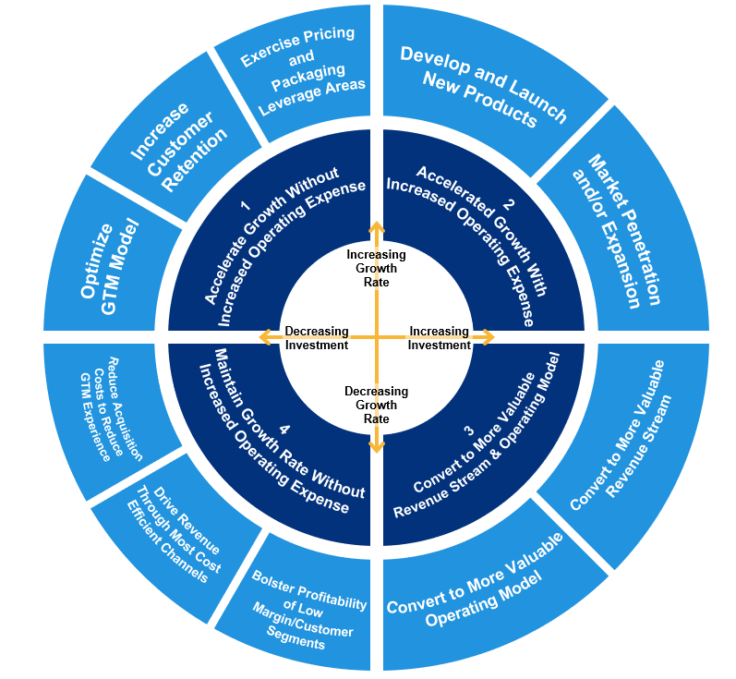

Growth imperatives focus and guide the selection of growth initiatives
Quadrant 1 Example: How to execute against growth imperatives
ACME Imperative Focus
Optimize GTM Model
Optimize the organization’s coverage model to improve seller productivity by aligning based on calculated in-year revenue potential.
Align territories and design quota/compensation to improve seller productivity and retention.
Optimize end-to-end demand generation processes and metrics to produce more opportunities and lower customer acquisition cost (CAC).
Modernize sales process and value-selling tactics, develop a coaching program, and hone sales enablement strategy to raise win rates.
Increase Customer Retention
Reprioritize coverage for existing accounts to increase Net Retention Rates.
Skew allocation to customer marketing over prospect marketing
Optimize customer onboarding to spur adoption, hasten expansion, and maximize retention.
Commercialize customer success function to monetize upsell and renewals.
Exercise Pricing & Packaging Leverage Areas
Develop pricing/bundling strategies to capture additional value in existing customer base (i.e., margin leakage analysis).
Optimize pricing/packaging offers (i.e., trials) for new logo acquisition and to spur migration of legacy to SaaS.
Identify value-based pricing strategies to increase customer lifetime value (CLTV).

Slide 8
ACME’s whitespace analysis in new logo accounts indicates a potential of 16% annual growth by 20XX, achievable with a refined GTM strategy
ACME’s growth strategy includes capturing more market share within its existing customer base for core offerings, acquiring new customers, and expanding indirect sales channels.
Additionally, there’s a focus on retaining customers and increasing revenue through cross-selling non-core products and upselling within the existing customer portfolio.
Optimize GTM Model
Incremental existing customer whitespace capture in core products plus incremental new logo potential capture plus incremental growth in indirect channel
Incremental net dollar retention plus cross-sell non-core products
Incremental upsell in existing customer portfolio
Increase Customer Retention
Customer Expansion
$31.9
$219.7
16% CAGR
$27.3
$4.2
Client Bookings Walk (M)
$19.7
$3.5
$140.8
$2.1
FY22
FY23
FY24
FY25
End Period
Source: Client US 2021 and 2022 Bookings Data projected for 2022 + SBI analysis of account segmentation potentials

Slide 9
Through discussion with an SBI Growth Advisor, five revenue commercial initiatives emerge (related to Quadrant 1 growth imperatives)
Optimize GTM Model
Commercial Initiatives
Talent Effectiveness and Enablement
Demand Generation Optimization
Channel/Partner Strategy
Customer Success & Renewals Excellence
Strategy & Packaging for Cross-Sell
1
Increase Customer Retention
2
3
Exercise Pricing & Packaging Leverage Areas
4
5
Initiatives represent major objectives that will need to be broken down into discrete workstreams; the GTM capabilities map on the next page helps to identify them in greater detail.

Slide 10
These commercial initiatives resulted in 17 discrete workstreams to be prioritized over various projected timelines
1
2
4
Talent Effectiveness and Enablement |  | Demand Generation Optimization |  | Customer Success & Renewals Excellence
Organizational Structure: Align sales, marketing, and customer success based on coverage and segmentation to improve efficiency/effectiveness. |  | Marketing Demand Generation: Optimize programs, especially digital marketing spend to generate additional incremental seller pipeline to support new logo acquisition. |  | Customer Success Evolution: Optimize coverage, service tiers, compensation, and incentives in line with SaaS best practices.
Territory Optimization: Assign based on current spend and future spend potential with whitespace equal to 10-12x seller quota assignment. |  | Lead Scoring and Process Optimization: Drive conversion of marketing-generated leads to opportunities through qualification, routing, and handoff optimization. |  | Customer Onboarding: Define rules of engagement, RACI, and transition/handoff events for new customers in first year.
Quota/Compensation Optimization: Move away from equal allocation towards potential-based, and improve incentives aligned to bookings goals. |  | Sales Process Optimization: Align sales activities to the buyer journey and portfolio selling, including specific upsell and cross-sell plays through a formal sales playbook. Review sales overlays engagement and RACIs to ensure clear handoffs and defined responsibilities. |  | Renewals Excellence: Review renewals process and RACIs between customer success, finance, and sales to optimize in light of expansion potential.
Competency & Capability Assessments: Review current seller competency and capability against SaaS and cloud-based selling and develop training and hiring plans to close gaps. |  |  |  | Customer Advocacy: Ensure formal customer advocacy program is in place to capture and leverage loyal customers for new logo acquisition.
Frontline Manager Optimization: Assess and optimize middle management to bring spans of control in-line with benchmarks and improve the employee experience.
Seller Onboarding Program: Improve time-to-productivity to two quarters through a 30/60/90-day onboarding program.
Coaching Playbook and Program: Formal coaching program with cadences tailored to a development plan is key to driving productivity and retention; invest in coaching. For example, 52% of regional account managers (RAMs) and 59% of inside RAMs disagree that they receive weekly coaching.
●
●
●
●
●
3
5
Channel/Partner Strategy
Partner Segmentation and Strategy: Review channel strategy including types/number of partners, channel product fit, and competitive channel analysis in light of account segmentation.
Marketplace Partner Design: Design channel programs for each type of partner, inclusive of tiering, rewards & incentives, model, etc., including hyperscalers.
Strategy & Packaging for Cross-Sell
Pricing & Packaging Assessment: Review current state pricing, packages, and offers relative to cross and upsell strategy; benchmark with market. Cross-Sell Bundle/Offer Development & Campaign: Determine optimal product combinations, develop offers, and design/execute campaigns to increase penetration.
●
ACME-led workstreams guided by SBI Growth Advisory

Slide 11
Prioritizing initiatives by value and degree of difficulty informs sequencing and exposes resource constraints
ACME Strategic Prioritization Matrix
Group workstreams into categories based on their potential impact and difficulty/risk
Coaching Playbook and Program
Front-Line Manager Optimization
High
Competency & Capability Assessments
Quick Wins - No-regret moves that can be implemented with high speed:
Organizational Structure
Territory Optimization
Quota/Comp Optimization
Customer Onboarding
Pricing/Packaging Assessment
Prioritize & Allocate Resources - Prioritize effort as next phase workstreams:
Frontline Manager Optimization
Coaching Playbook and Program
Lead Scoring and Process Optimization
Marketing Demand Gen Optimization
Partner Seg & Strategy
Sales Process Optimization
Customer Success Evolution
Marketplace Partner Design
Renewals Excellence
Future/Dependent – Future-state opportunity areas or dependent on other workstream:
Competency & Capability Assessments
Seller Onboarding Program
Customer Advocacy
Customer Success Evolution
Marketing Demand Generation
Partner Strategy & Seg
Marketplace Partner Design
Lead Scoring and Process Optimization
Level of Effort
Sales Process Optimization
Renewals Excellence
Pricing/Packaging Assessment
Organizational Structure
Seller Onboarding Program
Territory Optimization
Low
Quota/Comp Optimization
Customer Advocacy
Customer Onboarding
Low
Value to ACME
High
= Quick Wins
= Prioritize & Allocate Resources
= Future/ Dependent
In Progress
Future Activity Required

Slide 12
SBI’s Revenue Growth Plan outlines a structured approach for ACME to achieve its revenue objectives across multiple planning horizons
Revenue Growth Plan (RGP)
Horizon 1: Lay the Foundation
Horizon 2: Implement and Iterate
Territory and quota are aligned to growth objectives and potential.
Demand generation and new logo engine are mobilized.
Sales, marketing, customer success, and product are interlocked and aligned to specific areas of the buyer journey.
Horizon 3: Realize the Vision
Seller enablement and coaching are aligned to new motions/coverage.
Account potential is quantified and prioritized.
Sales coverage is aligned to the largest market opportunity.
Sales compensation is aligned to potential and growth objectives.
A plan for the customer success org is formulated.
Maintain account engineer productivity at $1M per rep.
Achieve net revenue retention rate of 120%+.
In the future state, accountability, empowerment, and a growth mindset drives the GTM organization.
Achieve 16% YoY bookings growth by 20XX.
By starting with the end goal first, Horizon 3 sets a clear benchmark for success.
Client strategists continually build upon the foundation with new initiatives and workstreams by identifying future opportunities to push the envelope on growth targets.
In Horizon 2, the workstreams of Horizon 1 evolve from their build-and-deploy phase to a state of value realization, marking a pivotal shift in focus towards making our project outputs live within GTM teams and adjusting if leading indicators lag targets.
This stage is characterized by a robust cycle of diagnose, build, and deploy activities.
Horizon 1 commences with laying down the groundwork, knowing that each step is a building block towards realizing the future we’ve envisioned in Horizon 3. This comprises client-driven or consulting-delivered workstreams.
The creation of a centralized program, or growth office, will create cross-functional alignment from ideation to value realization.

Slide 13
For more resources like this, contact your advisor or visit SBI Pro.
Schedule a session with your advisor
SBI Advisors help clients with practical advice, whether strategic or surgically tactical, to drive revenue and growth.
Contact your advisor to schedule a work session and tune this guidance to your situation.
Login to SBI Pro:
https://pro.sbigrowth.com/

