Slide 1
Customer Success Onboarding Playbook
Executive Summary

Slide 2
Help customers be successful and drive sustained growth.
Empower customers to solve problems
Enable teams to be more successful
Grow faster and more profitably

Slide 3









Best-in-class customer success framework
Cultivate a best-in-class Customer Success organization that drives value for customers by focusing on the following six core functions
Customer Onboarding:
During the initial onboarding period, properly introduce new customers and users to products, functionality and best practices
Customer Life Cycle Management:
Understand the life cycle of your customers, and the key leverage points that you must orchestrate
Value Creation & Community:
Throughout the customer life cycle, identify, generate, and communicate the value that the product portfolio creates
Advocacy Process:
Leverage your successful relationships to generate references and referrals both inside the account and to other accounts
Opportunity Management Process:
Build an opportunity management process to uncover additional sales opportunities
Sales Handoffs:
Cross-functional process integration of Customer Success and Sales for retention and expansion of accounts
1. Customer
Onboarding
6. Sales Handoffs
2. Customer
Life Cycle Management
Customer
Success
5.
Opportunity Management Process
3. Value Creation & Community
4. Advocacy Process

Slide 4
01
Executive Summary

Slide 5
Onboarding & Enablement Approach Executive Summary
Purpose
Reduce Customer Success Managers (CSM) ramp time
Provide a comprehensive onboarding program for new hires & talent
Executive
Summary
Onboarding programs are successful when anchored on competencies and proficiency levels
Using best-in-class characteristics, expert interviews, and input, develop a list of core and role- specific competencies with corresponding target proficiency levels
Using the competencies, create a list of target capabilities for the first 30, 60, and 90 days for new CSMs
Use the 30-, 60-, and 90-day capabilities to inform a weekly onboarding curriculum through the lens of a
“Learn, Watch, Do, Reinforce” framework
Build certifications into the weekly onboarding curriculum to ensure CSMs are progressing through the
onboarding process
Incorporate 3 ancillary programs into the weekly onboarding curriculum to enhance comprehension and the overall experience for new hires: Ride Along Program, In Person Training, and the Fast Ramp Onboarding Peer
The Ride Along Program allows CSMs to shadow tenured CSMs for distinct internal and external meetings to reinforce learnings
The In Person Training will allow to reinforce learnings through in-person curriculum and allow new hires to meet their peers
The Fast Ramp Onboarding Peer will provide new hires with a peer-level resource for questions about curriculum or day-to-day operations
Utilizing the onboarding as a reference, create a Ramped Training program that identifies areas of development for tenured CSMs

Slide 6
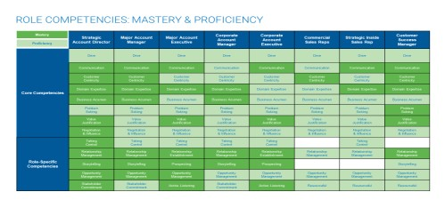
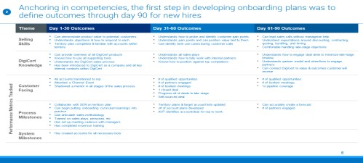
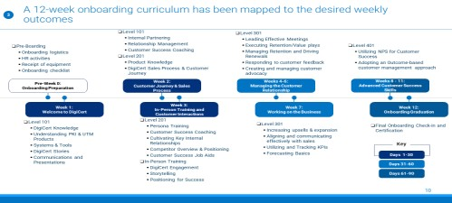
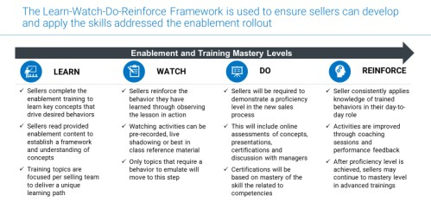
The four components of the onboarding program work together to achieve desired onboarding outcomes
01
Competencies
and Proficiencies
Core competencies are the foundation of what is developing in their new CSMs, with proficiencies denoting the baseline requirement
02
30-60-90 Day
Onboarding Plan
The outcomes of the 30-60-90 Day Onboarding Plan are anchored to the core competencies
03
Onboarding Certification Program
Onboarding activities drive towards the desired outcomes outlined in the 30-60-90 Day Onboarding Plan, forming the foundation of the certification process
Learn-Watch-Do- Reinforce Framework
The Learn-Watch-Do-Reinforce Framework is applied to each activity in the weekly onboarding plan to help drive successful outcomes of the onboarding plan
04

Slide 7
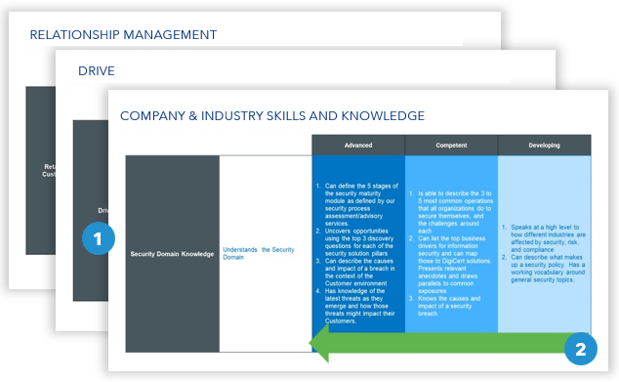
Create definitions and proficiency levels for each proficiency to provide guidance in the ongoing development of CSMs
1
01
Definitions are provided for each of the core and role- specific competencies. They describe what is meant by each of the competencies.
02
Role proficiencies describe the types of behavior that occur within each level competency They are set up progressively, so that as one moves towards expert, one is building upon their skillset already possessed in the beginner and intermediate levels.

Slide 8
Anchoring in competencies, the first step in developing onboarding plans is to define outcomes through day 90 for new hires
2
 | Theme | Day 1-30 Outcomes | Day 31-60 Outcomes | Day 61-90 Outcomes
 | Customer Success Skills | Can demonstrate product value to customers Understands and can demonstrate product value to customers Understands how the product is different from the competition | Can plan a customer success strategy Can define the customer lifecycle journey Understands pain points and can position value tied to them Can identify opportunities for cross-sell/upsell Can help bridge customers to necessary data | Can manage customer relationship without managerial help Tools to scale Can identify appropriate KPIs and track them Understands what triggers churn and how to prevent churn with customers
 | Knowledge | Understands the company and the environment Can provide overview of all products Knows how to use all supporting tools & systems Has been introduced to company and all key internal contacts within | Understands the Customer Lifecycle (CLM) & the customer journey Understands all customer value plays Understands how to fully work with internal partners Understands how to leverage customer success job aids | Understands how to leverage customer data and utilize data to bridge & address customer needs Understands partner model and when/how to engage partners Can connect to value & outcomes customer will receive
Performance Metrics Tracked | Customer Facing | All accounts transitioned to rep Attended a customer webinar/ training session Shadowed a mentor in all stages of the onboarding process | Increased usage of customer’s existing product group # of check-ins conducted Renewals Win rate | % customer onboarded/products implemented # of trainings and webinars conducted NPS Contract retention
 | Process Milestones | Can begin putting onboarding curriculum learnings into practice Trained on customer value plays, personas, etc. Has set up meeting cadence with managers Has completed in-person training | Can articulate customer lifecycle Can articulate customer value plays, personas, andupsell/cross-sell strategy Manager identifies customer accounts for CSM coverage | Can map project plan & manage for complete customer lifecycle # of customer engaged
 | System Milestones | Has created accounts for all necessary tools

Slide 9
A 12-week onboarding curriculum has been mapped to the desired weekly outcomes
3
Pre-Boarding
  Onboarding logistics
  HR activities
  Receipt of equipment
  Onboarding checklist
Level 101
  Internal Partnering
  Relationship Management
  Customer Success Coaching
  Level 201
  Product Knowledge
  Onboarding Process & Customer Journey
Level 301
  Leading Effective Meetings
  Executing Retention / value plays
  Managing Retention and Driving Renewals
  Responding to customer feedback
  Creating and managing customer advocacy
Level 401
  Utilizing NPS for Customer Success
  Adopting an Outcome-based customer management approach
Pre-Week 0:
Onboarding Preparation
Week 2:
Customer Journey & Onboarding Process
Weeks 4-6:
Managing the Customer Relationship
Weeks 8-11:
Advanced Customer Success Skills
Week 1:
Welcome
Week 3:
In-Person Training and Customer Interactions
Week 7:
Working the Business
Week 12:
Onboarding Graduation
Level 101
  Knowledge
  Understanding all Products
  Systems & Tools
  Stories
  Communications and Presentations
Level 201
  Persona Training
  Customer Success Coaching
  Cultivating Key Internal Relationship
  Competitor Overview & Positioning
  Customer Success Job Aids
  In-Person Training
  Engagement
  Storytelling
  Positioning for Success
Level 301
  Increasing upsells & expansion
  Aligning and communicating effectively with sales
  Utilizing and Tracking KPIs
  Forecasting Basics
Final Onboarding Check-in and Certification
KEY
Days 1-30
Days 31-60
Days 61-90

Slide 10
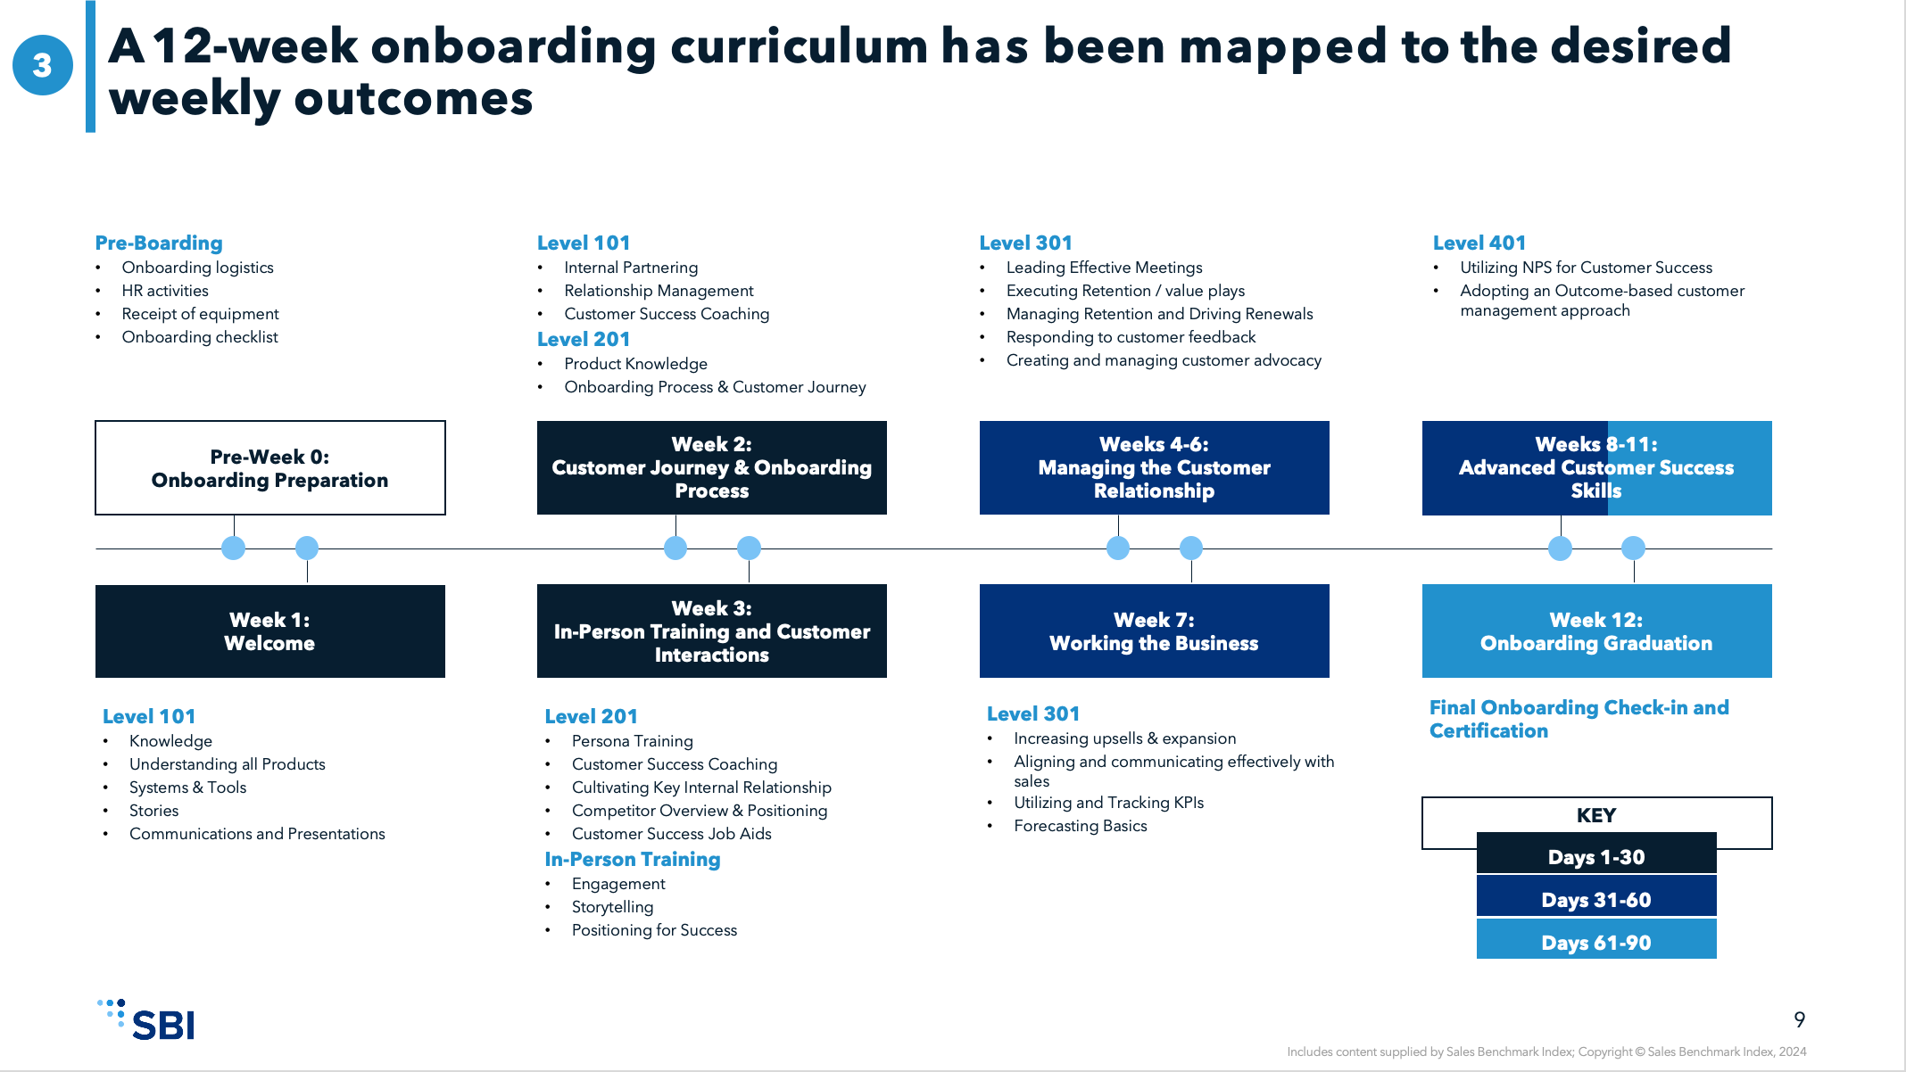
4 Levels of certification have been layered onto the 12-week onboarding curriculum to track progression and aptitude
3
Purpose: The onboarding certification program will help guide new hires through onboarding
and allow managers to monitor progress.
Certifications will occur at the end of each level of curriculum (i.e., Level 101, 201, etc.) – Tying certifications to the end of each level of onboarding curriculum provides distinct checkpoints for new-hires and allows managers to easily check progress.
Certification 1
Certification 2
Certification 4 represents the end of onboarding – After Certification 4, the new hire has completed onboarding and is ready equipped with the knowledge needed to be effective.
Certification 3
Completion of certification will be tracked on onboarding curriculum checklists & LMS system – CSMs track their progress both through LMS system & ticking items from the onboarding curriculum checklist. Completion of each certification will be signed off on by a manager

Slide 11




Integrate the "Learn-Watch-Do-Reinforce Framework" into curriculum to ensure CSMs can develop and apply the skills they are taught
4
Enablement and Training Mastery Levels
LEARN
WATCH
DO
REINFORCE
CSMs complete the enablement training to learn key concepts that drive desired behaviors
CSMs read provided enablement content to establish a framework and understanding of concepts
Training topics are focused per selling team to deliver a unique learning path
CSMs reinforce the behavior they have learned through observing the lesson in action
Watching activities can be pre-recorded, live shadowing or best in class reference material
Only topics that require a behavior to emulate will move to this step
CSMs will be required to demonstrate a proficiency level in the new process
This will include online assessments of concepts, presentations, certifications and discussion with managers
Certifications will be based on mastery of the skill the related to competencies
CSM consistently applies knowledge of trained behaviors in their day-to- day role
Activities are improved through coaching sessions and performance feedback
After proficiency level is achieved, CSMs may continue to mastery level in advanced trainings

Slide 12
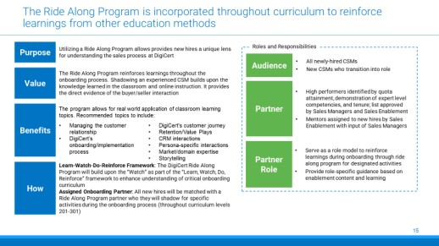
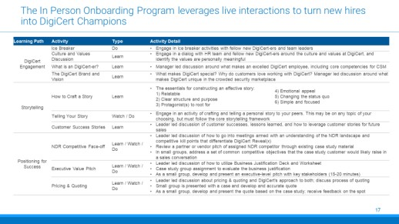
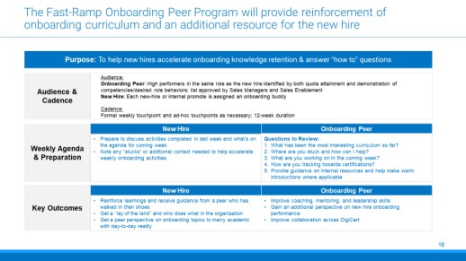
Enhance comprehension of onboarding curriculum with Ride Along Program, In Person Training, and Fast-Ramp Onboarding Peer Program
Week 1-12 Onboarding Curriculum
Ride Along Program
In Person Training (Optional)
Fast-Ramp Onboarding Peer
Ancillary
Programs
New hires are paired with tenured CSMs to shadow distinct meetings
Builds upon the “Watch” of the Learn- Watch-Do-Reinforce framework
The in-person onboarding program leverages live interactions to turn new hires into Champions
In-Person Training will utilize parts of the current Jumpstart program
New hires will be paired with a tenured rep at the same level
Onboarding peer will act as a secondary
resource to the new hire’s manager
Program
Overview
Timing
4 distinct meetings between new hire and tenured CSM
To be determined
First 120 days

Slide 13
The Ride Along Program is incorporated throughout curriculum to reinforce learnings from other education methods
Purpose
Utilizing a Ride Along Program allows provides new hires a unique lens for understanding the onboarding process at
Roles and Responsibilities
Value
The Ride Along Program reinforces learnings throughout the onboarding process. Shadowing an experienced CSM builds upon the knowledge learned in the classroom and online instruction. It provides the direct evidence of the buyer/seller interaction
Audience
All newly-hired CSMs
New CSMs who transition into role
Benefits
The program allows for real world application of classroom learning
topics. Recommended topics to include:
Managing the customer relationship’s
onboarding/implementation process's customer journey
Retention/Value Plays
CRM interactions
Persona-specific interactions
Market/domain expertise
Storytelling
Partner
High performers identified by quota attainment, demonstration of expert level competencies, and tenure; list approved by Managers and Enablement
Mentors assigned to new hires by Enablement with input of Managers
How
Partner Role
Serve as a role model to reinforce learnings during onboarding through ride along program for designated activities
Provide role-specific guidance based on enablement content and learning
Learn-Watch-Do-Reinforce Framework: The Ride Along Program will build upon the “Watch” as part of the “Learn, Watch, Do, Reinforce” framework to enhance understanding of critical onboarding curriculum
Assigned Onboarding Partner: All new hires will be matched with a Ride Along Program partner who they will shadow for specific activities during the onboarding process (throughout curriculum
levels 201-301)

Slide 14
For more resources like this, contact your advisor or visit SBI Pro.
Schedule a session with your advisor
SBI Advisors help clients with practical advice, whether strategic or surgically tactical, to drive revenue and growth.
Contact your advisor to schedule a work session and tune this guidance to your situation.
Login to SBI Pro:
https://pro.sbigrowth.com/

