Slide 1
Compensation Design Best Practices

Slide 2



SBI assesses and designs compensation plans across 10 design principles to ensure an organization’s ability to attract and retain top sales talent
Sales Compensation Strategy
1
Competitive
Alignment to Market
Plan Effectiveness
2. Eligibility
5. Measures & Weights
8. Quotas & Crediting
3. Target Pay Levels
4. Pay Mix
6. Upside Opportunity
7. Plan Mechanics
9. Timing
10. Administration
2 | Eligibility | Who should be eligible for sales compensation (versus other forms of variable pay)
3 | Target Pay Levels | How do base salary and target variable incentive (e.g. on-target earnings) earned at target performance compare to market
4 | Pay Mix | Is the allocation of on-target earnings between fixed salary (e.g. base salary) and variable pay aligned with the selling role?
5 | Measures & Weights | Have the right performance measures been selected to align with the overall corporate strategy? Are they controllable by reps?
6 | Upside Opportunity | Are top performers adequately rewarded compared to average and bottom performers?
7 | Plan Mechanics | Do the payout tables (e.g. thresholds & excellence), links, and incentive caps create a plan that drives a pay for performance culture?
8 | Quotas & Crediting | Are the rules determining which sales individuals receive quota credit for certain sales and allocation of those goals aligned?
9 | Payout Timing & Performance Period | Does the payout timing provide adequate cash flow? Does it align with the pay levels, pay mix, and performance measures?
10 | Administration | Are the plans simple and easy to understand? Is plan execution (e.g. processes, systems, measurement, etc.) effective and efficient?
Notes:
SBI assesses and designs compensation plans across 10 design principles to ensure an organization’s ability to attract and retain top sales talent
This is your story board
Following this framework will inform the data you need and the analysis to conduct to determine alignment to market
A common mistake that organizations & consultants make is not following this framework; we jump into selecting performance measures without understanding the strategic imperatives
You can have the best compensation plan in the world, but if it is not aligned to the sales strategy and corporate objectives it will not work
Call on Alex & Julie

Slide 3
SBI follows a four-step process in assessing, designing and rolling out compensation plans
01
Current-State Plan Assessment
02
Direction Setting & Plan Design
03
Quota-Setting & Allocation
04
Communication & Implementation Planning
Project Planning
Executive Interviews (7-10)
Current Plan Assessment
Pay Level Benchmarking
Pay & Performance Analysis
Pay Differentiation
Quota Achievement
Tenure & Turnover Analysis
Sales Rep Survey
Rep Focus Groups (3-5)
Design Team Meetings
Compensation Philosophy
Incentive Plan “Straw Models”
Financial Modeling
Plan Finalization
Global Governance Framework
Legal Review
Executive Approval
Account & Territory Potential
Rep Production Capacity Models
Quota Setting Principles & Process
Quota Assignment Methodology
Quota Stress Testing
Sensitivity Models (as needed)
Implementation planning
Roll-out strategy and transition roadmap
Communication Material Development
Train-the-Trainer Materials
Plan Documents
Compensation Calculators
FAQ Sheets
Terms & Conditions
Activities
Weeks 1 – 3
Weeks 4 – 6
Weeks 7– 9
Weeks 10 – 11
Assessment of design principles against business objectives and sales strategy
Evaluation of current-state sales incentive plans
Current state plan comparison to market and industry best practice
Leverage assessment findings to set future-state plan direction
Develop plan designs that align to business and sales strategy and incorporate best practices to drive desired behavior and performance
Understand cost and rep-level impact of new plan design
Review of current-state quota-setting methodology and processes
Develop and assign quotas that reflect market potential, not just historical spend patterns
Alignment of rep and management quotas to financial targets
Clearly articulated implementation plan outlining priority, effort, timing and dependencies for plan roll-out
Develop tools and resources that will enable sales reps to “win” early
Outcomes
Overall objective is to develop sales compensation plans that align to the business objectives and sales strategy, are competitive with industry
and best-practice, are simple and easy to understand and administer, and deliver financial results

Slide 4
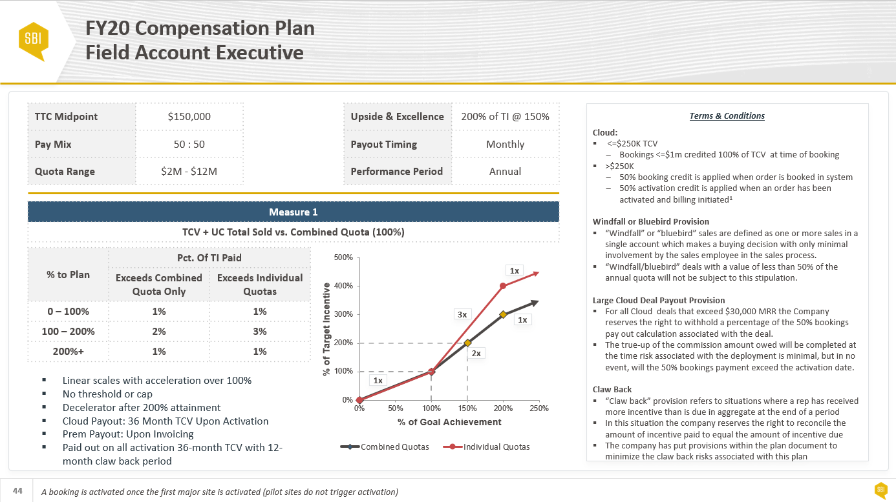

What is Compensation Design & Quota Setting?
For Sales Incentive Eligible Roles:
Incentive Eligibility
On-Target Earnings (e.g. Base + Target Variable)
Pay Mix (Base : Variable)
Performance Measures & Weights
Upside Opportunity
Target Quota
Payout Timing
Performance Period
Terms & Conditions
Administrative Guidelines
Best-in-class incentive plans drive greater strategic alignment between corporate and sales objectives, enable organizations to attract and retain top sales talent and reward the field for delivering results
Notes:
The objective of compensation design is to develop compensation plans that drive greater strategic alignment between corporate and sales objectives, enable organizations to attract and retain top sales talent and reward the field for delivering results
So what does an end deliverable look like?
For each role in scope, we are delivering a one-page overview called a “Plan Abstract”
Plan Abstracts define the 10 design principles, such as On-Target Earnings, Pay Mix, Target Performance, etc.

Slide 5
An effective compensation plan ensures alignment between sales and corporate objectives, while balancing the following…
Helps achieve desired behaviors
Ensures consistency with the messages about corporate strategy
Ensures compatibility with the culture and SFE drivers
Simple to understand, implement, and communicate
Simple
Aligns with
Corporate Obj.
Continuously motivates to perform better
Encourages to direct the effort appropriately
Pays within the set budget
Protects against risks of forecasting and market uncertainties
Keeps administration costs within the budget
Strong Pay for Performance Culture
Fiscally
Responsible
Provides equal earning opportunities to each individual
Sales force perceives the plan to be fair
Pays only for achieving desired results
Accounts for results not attributable to sales force effort
Fair
Pays for Performance
Standard approach
Limited changes
Same for all
Easily adapted
Frequent adjustment/change
Customized
Structured
Flexible
Notes:
The first design principle is Strategic Alignment
The objective here is to align the Corporate & Sales Objectives and drive the desired behavior
Effective compensation design balances the following:
#1: You want plans that are simple (fewer measures) but support the financial targets, product mix targets and other strategic imperatives
#2: You want to drive a strong pay and performance culture and reward top performers but need to adhere to cost targets
#3: You want to create equitable earnings opportunity, but reward for performance
#4: You want to create standardized plans, but provide local flexibility

Slide 6
As a best practice, firms should limit the number of performance measures to three with a minimum of 20% weighting per measure to drive greater focus
By the Numbers
3
Measures
20%
Weighting
SBI recommends no more than 3 performance measures; For roles with lower on-target earnings and conservative pay mix roles, consider fewer measures to driver greater focus
Each performance measure should represent at least 20% of the incentive opportunity so that there is meaningful incentive dollars to drive desired behaviors
Performance Measure Guidelines
Performance Measure Principles
Criteria | Description
Specific | Clear and unambiguous telling exactly what is expected of the reps
Measurable | Concrete criteria for measuring progress towards goal attainment; should be quantified by the company and understood by all individuals
Attainable | Measures should be challenging but realistic. The measures should be influenced by the individual salesperson with more than 50% achieving
Relevant | Measures should be aligned to the overall corporate objectives, directly linked to the sales strategy and be financial in nature where possible
Timely | Reps should be able to influence the measures in the defined performance period (e.g. Annual, Discrete, YTD)
Principle | Description
Effort vs. Results | Measure results when practical Exceptions: Extremely long sales cycles
Level of Measurement | Measures are more motivational the closer they are to rep Exception: Team-focused needs
Absolute vs. Quota | Quota direct performance more reflectively Exceptions: Start-ups and/or territories are not equal
Notes:
The fifth design principle is measures & weightings
As a rule of thumb, organizations should limit the number of measures to 3 with each measure representing 20% of target incentive opportunity.
Too many measures dilutes focus, while too low of a weighting results in not enough incentive dollars to drive the desired behaviors
Performance measures should meet the S.M.A.R.T criteria
S: Specific – clearly defined
M: Measurable – ability to measure performance
A: Attainable – strive for 50 – 60% of your reps being able to achieve
R: Relevant – do they align with the corporate objectives & sales strategy
T: Timely – can the reps influence the results in the period

Slide 7
There are two common approaches to designing compensation plans: cost of sales (commission plans) and cost of labor (quota plans)
Commission Rate
Individual Com. Rate (ICR) / Base Com. (BCR)
Bonus Formula
Overview & Calculation
Pay a % of each unit of measurement The rate is consistent for every person on the plan | Pay a % of each unit of measurement The rate is different for each employee based on their target incentive and quota |  |  | Pay a % of the target incentive for each % of quota attainment The incentive formula is consistent for every person on the plan
$30K Target Incentive / $3M Goal = 1% Com. Rate | A | $30K Target Incentive | = 1% Com. Rate | 1% Target Incentive = 1% Quota Attainment 1% x (100% of Quota) x $30K = $30,000
 |  | $3M Quota
 | B | $30K Target Incentive | = 2% Com. Rate
 |  | $1.5M Quota
1% x $3M = $30,000 | A: 1% x $3.0M = $30,000 B: 2% x $1.5M = $30,000
Pros & Cons
Simplest mechanic to communicate & administer Easy for reps to calculate their payouts (overall and at deal-level) Reduces emphasis on importance of goal-setting Links earnings directly to performance & encourages self-driven behavior Ramped rates can provide emphasis on goals/quota | Most prevalent in software sales Emphasizes target incentive since rates are based on target incentive Accommodates varied target incentives Accommodates varied territories/quotas Simple to communicate Relatively easy for reps to calculate their payouts (overall and at deal-level) | Emphasizes target incentive since payouts are communicated as a % of target incentive Accommodates varied target incentives Accommodates varied territories/quotas Easily move accounts as needed (quota moves with account) Reps linked to company goals
Does not accommodates varied target incentives Does not accommodates varied territories/quotas Difficult to move accounts May not link performance to company overall goals | Incumbents in the same job will have different ICRs ICRs decrease from one year to the next as the quota increases Require more administration to calculate and they must be re-calculated every time a target incentive or a quota is changed Relies heavily on quota setting practices | Requires additional calculation and ongoing communication to demonstrate incentive calculations More difficult for reps to calculate their payouts (overall or deal-level) Relies heavily on good quota setting practices
Cost of Sales
Cost of Labor

Slide 8

Best-in-class organizations anticipate that 50% to 60% of their sales reps will meet and/or exceed target achievement
Non-Performers
Average Performers
Top Performers
Threshold
90% Attain
Target
50% to 60% Attain
Excellence
10% Attain
Best-in-class organizations anticipate that 50% to 60% of their sales reps will meet and/or exceed target achievement
Too few reps achieving quota results in actual pay levels that are not competitive with market and can result in increased rep attrition
90% of the organization's sales reps should participate in the plan (i.e. earn > $1 in incentive payment)
No more than 10% of the organizations’ sales reps should exceed excellence (e.g. the performance level in which 200% to 300% of incentive is delivered)
Too many sales reps below threshold and/or above excellence is an indication that the quota setting process is sub-optimal and/or an inappropriate alignment of sales resources to accounts
LOW TO NON PERFORMERS
BELOW AVERAGE PERFORMERS
AVERAGE PERFORMERS
ABOVE AVERAGE PERFORMERS
HIGH PERFORMERS
10%
80%
10%
Notes:
Best-in-class organizations anticipate that 50% to 60% of their sales reps will meet and/or exceed target achievement
No more than 10% of your sales reps should be at or below threshold – this can be demotivating to the sales force and result in rep attrition
No more than 10% of your sales reps should be at or above excellence – this would be a cost prohibitive model and suggest quota setting challenges

Slide 9
Determine the appropriate payout timing based on pay mix, sales cycle time, and relative importance of full year results
Infrequent
Payout Timing
Frequent
Annual
Quarterly
Monthly
Target incentive represents less than 25% of base salary (pay mix: 80:20 to 90:10)
Length of selling cycle is several months up to and exceeding one year
High importance of full-year sales results
Difficult to assess daily progress towards the annual financial target
Target incentive represents 25% to 50% of base salary (pay mix: 65:35 to 80:20)
Length of selling cycle is several months and seldomly exceeds one year
Medium importance of full-year sales results
Actual sales or progress toward sale can be measured easily
Target incentive represents at least 50% of base salary (pay mix: 50/50 to 65:35)
Length of selling cycle can be measured in days and/or weeks
Low importance of full-year sales results
Easy to count results and evaluate performance
Most Prevalent Timing

Slide 10
Recurring Revenue Sales Measures
Contract Value
Recurring Revenue
Billed Revenue
Total Contract Value (TCV)
Annual Contract Value (ACV)
Net New Bookings (NNB)
Annual Recurring Revenue (ARR)
Monthly Recurring Revenue (MRR)
Net Recurring Revenue (NRR)
Total Billed Revenue (TBR)
Total Billings
Total Portfolio Net Revenue
Total Revenue
Net Revenue
Existing Business / Renewals
# of Deals
Renewals
Churn
Renewal Rate
Sales to Existing Customers
New Logo
New Deal Bonus
Number of Logos
Contract Signing Bonus

Slide 11
Product Focus Compensation Options
Option
Example
Description | Pro’s | Con’s
Primary metric is total or core product sales (e.g. bookings, orders, revenue) Use second separate weighted metric to measure and reward performance on one or more product lines (product focus) Typically need links or thresholds to ensure employees do not “shop the plan” and sell what is easiest | Strong message on specific product focus goals – impacts both target incentive and upside payouts Difficult for sales representative to achieve total target incentive without achievement of product focus goal | Requires separate product focus quota Treats all products in the product focus quota equally (i.e., values $1 equal to $1) unless value-adjusted Salesperson can “shop the plan”¹ unless a hurdle, threshold, or other mechanic is applied
Primary metric is total or core product sales (e.g. bookings, orders, revenue) Separate weighted performance measure in compensation plan that incrementally rewards based on number of product categories above quota | Measure weight communicates importance of balanced selling across product categories Flexibility to change product categories each performance period to drive appropriate focus from BUs Direct linkage to BU goals | Requires multiple separate product category quotas Binary measurement for each product category – does not provide upside pay for individual product categories Treats all product categories equally
Use achievement of product category quota(s) to drive tiered accelerator rates on total or core product sales (e.g. bookings, orders, revenue) | Reduces sales representative’s ability to “shop the plan”¹ by linking product sales performance to primary sales metric Can be used as both a carrot and a stick | Requires product category quota(s) Only impacts total sales upside pay and therefore may not drive desired product focus for sales below 100% Binary “on/off” nature of hurdles does not reward incremental achievement levels
01 Separate Product Focus Metric
02 Balanced Product Performance
03 Gate/Hurdle
I. Total Sales – 60%
II. Product Focus – 40%
I. Total Sales – 60%
II. Balanced Perf. – 40%
# of Product Category Quotas >= Target | % of Target Incentive
5 of 5 | 200%
4 of 5 | 150%
3 of 5 | 100%
2 of 5 | 50%
I. Total Sales – 100%

Slide 12
Product Focus Compensation Options (cont.)
Option
Example
Description | Pro’s | Con’s
Modify total or core sales payouts by a factor to increase or reduce payout based on product performance | Reduces sales representative’s ability to “shop the plan”¹ by linking product sales performance to primary sales metric Can be used as both a carrot and a stick | Provides > 100% target incentive on total sales when achieve 100% of total sales quota Slightly more complex to administer than separate measures
Increase or decrease product category quota credit based on desired emphasis (e.g. Prod A credit = 80% of $ sold, Prod C credit = 120% of $ sold, etc.) To maintain costs, generally used for a small % of business, unless coupled with quota uplifts and/or value reductions | Provide separate emphasis on specific product line categories Does not require separate quotas Enables the sales representative to sell product mix that matches customer requirement Simple, directive, easy to understand Allows assignment of specific relative value for each product or product line | Plan design complexity of having various credit “values” by product; can also be inaccurate Tracking complexity - creates two “sets of books” – actual sales and sales for incentive purposes Sales rep can “shop the plan”¹
Increase or decrease product category payments (or commission rates used to calculate payouts) based on desired emphasis (e.g. Prod A payment = 80% of $1 payment, Prod C credit = 120% of $1k payment, etc.) To maintain costs, generally used for a small % of business | Provide separate emphasis on specific product line categories Does not require separate quotas Enables the sales representative to sell product mix that matches customer requirement Simple, directive, easy to understand Allows assignment of specific relative value for each product or product line | Plan design complexity of having various payment/rate “values” by product; can also be inaccurate Sales rep can “shop the plan”¹ Difficult to communicate with quota-based incentive mechanics that do not calculate payments for each deal
04 Modifier
05 Quota Credit Value Adjustment
06 Payment (Rate) Value Adjustment
I. Total Sales – 100%
I. Total Sales – 100%
I. Total Sales – 100%

