Slide 1
How to Build a Revenue Operations Capability and Charter
Current as of March 30, 2024

Slide 2
Table of Contents
Revenue Operations Overview | 4
Revenue Operations Structure and Scope | 6
Creating a Revenue Operations Charter | 11
Revenue Operations Impact on Cross-Functional Partners | 13
Revenue Operations Client Examples | 14

Slide 3
The purpose of Revenue Operations is to increase commercial efficiency through process, technology, metrics and best practices.

Slide 4
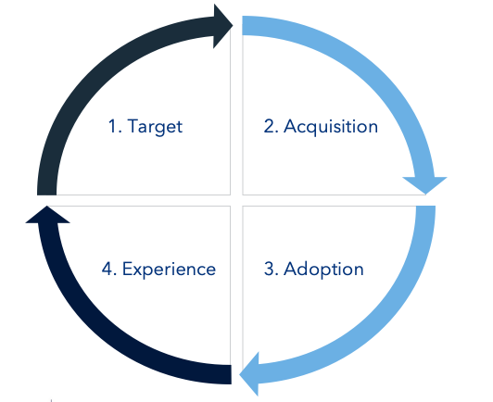
Revenue Operations Overview
Revenue Operations has emerged as an organizational best practice that unifies topline functions of Marketing, Sales, and Customer Success
Revenue Operations vs Sales Operations
As companies work to understand the complete Customer Experience; Revenue Operations covers the entire lifecycle (cradle to grave) while Sales Operations covers only active demand management
Buyers don’t differentiate between Sales, Marketing, or Success interactions; Revenue Operations ensures continuity from purchase through to CX
Systems, data, and reporting all should be optimized across the lifetime of a prospect-customer. Revenue Operations achieves this coordinated and holistic view

Slide 5

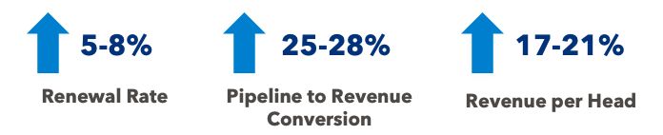
Revenue Operations’ View Across Go-to-Market Results in Improvements to Commercial Productivity
Key Outcomes Experienced with Integrated RevOps:
Productivity – maximizing effectiveness for the company across all departments
Efficiency – optimizing the cost for each output of productivity
Transparency – giving management the visibility and analysis needed to make decisions
Comprehensiveness – supporting all revenue generating and customer facing functions of the business
* Benchmark ranges from a recent SBI analysis of B2B selling organizations

Slide 6
Revenue Operations Structure
From Decentralized (e.g. Siloed)
Functional Operations
To Centralized
Revenue Operations
VP
Marketing
VP
Sales
VP
Customer Success
VP
Marketing
VP
Sales
VP
Customer Success
VP
RevOps
Marketing Ops
Sr. Customer Success Managers
Sr. CSM
Demand
Gen
Sales Management
Customer Success Managers
Strategy
Demand
Gen
Sales Operations
Sales Management
Sales
Support
CSM
Product Marketing
AEs / BDRs
Operations
Product Marketing
AEs / BDRs
Sales Enablement
CS Ops
Marcom
Field Marketing
Solution Engineers
Insight
Field Marketing
Solution Engineers
Sales Admin
Lead Management
Tools
Admin

Slide 7






Revenue Operations’ Scope Spans Capabilities Critical to all Go-to-Market Functions
1. Scope of Revenue Operations Charter
2. Data Strategy Establish the data required to drive initiatives and market, company, and departmental decisions | 3. Analytic Strategy Set and define metrics measured consistently and accurately, with signoffs on all parties involved | 4. Reporting Standardize a single source of truth and share those reports universally throughout the entire organization | 5. Systems Manage and monitor the underlying systems and their connectivity across all departments to get a single source of the truth | 6. Support Act as a conduit between functions to allow the company to increase Revenue and successfully hit key strategic initiatives | 7. Revenue Ops Org Design The optimized structure, roles, development plans, KPIs to execute the Rev Ops Charter.
Data governance | Sales analytics | Reporting and dashboards | Sales process management | Sales, Marketing, and CS stakeholder mgmt | Role design
Metrics selection and definition | Marketing analytics | Pipeline management and forecasting | Sales technology oversight | Strategic project & transformation support | Capacity planning and sizing
 | Customer intelligence |  | CRM/SFA program effectiveness | Performance management | Customer segmentation
 |  |  |  | Revenue operations talent management | Territory design and coverage

Slide 8
Revenue Operations Strategy Typically Supports 4 Key Business Outcomes
All Of Them Should Show Improvement In Year 1 of a Revenue Operations Deployment
Outcome | How will Revenue Ops Support this Initiative? | How will Revenue Ops be measured?
Purchase Ease / Selling Ease | Data Strategy: Define data required to make decisions across departments (Marketing, Customer Success, Sales, Etc.) IT Systems: Automate core business processes to increase the productivity across business functions Cross-functional Support: Represent Rev Ops within the other corporate functional groups and reduce the administrative burden from Rev Ops | % UAR Selling Time (improvement) Time to quote (Improvement) Data Cleanliness (% of records that are duplicates) SFDC Usage Dashboards and tools/systems used On time reporting and analytics output
Increased Productivity per Head | Purchase Segmentation: Create and maintain the account segmentation process Rev Ops Structure and Coverage: Properly structuring the Rev Ops organization to determining what accounts to cover by segment and determining the right channels to cover said segments. Rev Ops Processes: Implement a Rev Ops process that focuses on account management (current accounts) and opportunity management (new business/new logos) | Customer 360 Usage Pipeline Coverage CQ, CQ+1, CQ+3 Pipeline by Type – New Logo, Up/Cross Sell Pipeline Average Deal Size - ACV, TCV Sales process adoption Bookings/head (new logo, Upsell/Cross-Sell, Renewals
Forecast Accuracy | Forecast and Pipeline Process: Implement a consistent and accurate forecast process that is used throughout the organization based on best practices. Reporting and Analytics: Create role-based reports/dashboards that drive visibility and decision making for the user (Marketing, Customer Success, Sales, Etc.) | New Business Pipeline Coverage CQ, CQ+1, CQ+3 Pipeline by Type – New Logo New Business Pipeline Average Deal Size - ACV, TCV New Business Bookings/head New Logo acquisition compared to PY and Plan
Increased New Logo Acquisition | Compensation/Quota Design: Develop an incentive compensation program that stays within the corporate budget, attracts/retains top talent and motivates desired behavior; work with sales managers and finance to ensure that plans are best in class | Sales Process Adoption Pipeline Coverage CQ, CQ+1, CQ+3 Pipeline growth inline with plan

Slide 9



Revenue Operations Reporting Should Span Behavior, Leading, and Lagging Indicators
Lagging
Indicators
Of the reports being produced, many are looking in the rear-view mirror. Lagging indicators tell you ‘what’ happened.
Best in class companies measure behavioral, leading, and lagging indicators
Leading Indicators
By measuring leading indicators, the Revenue Ops team can provide more insight on what will happen, why it will happen and what we can do about it today.
Behavioral Indicators
Reporting and inspecting on behavioral and leading KPIs will ensure each department is completing the activities needed to produce leading and lagging results.

Slide 10
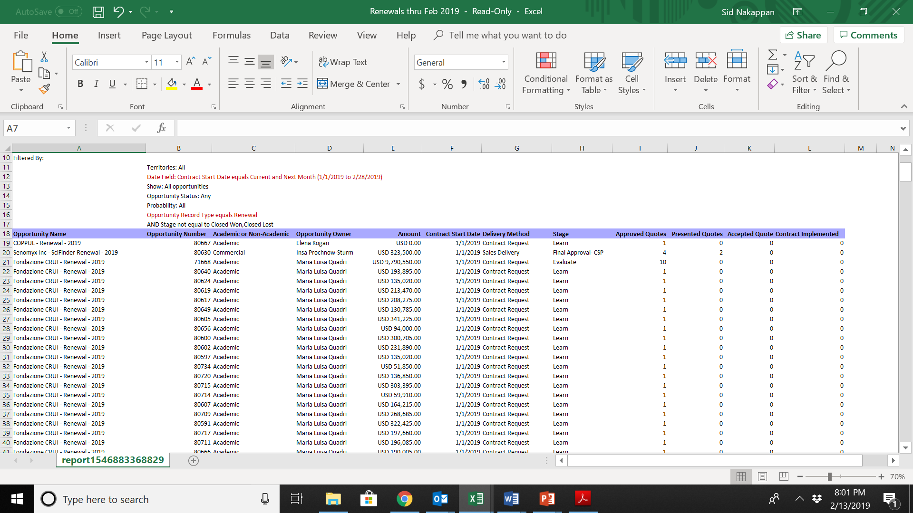
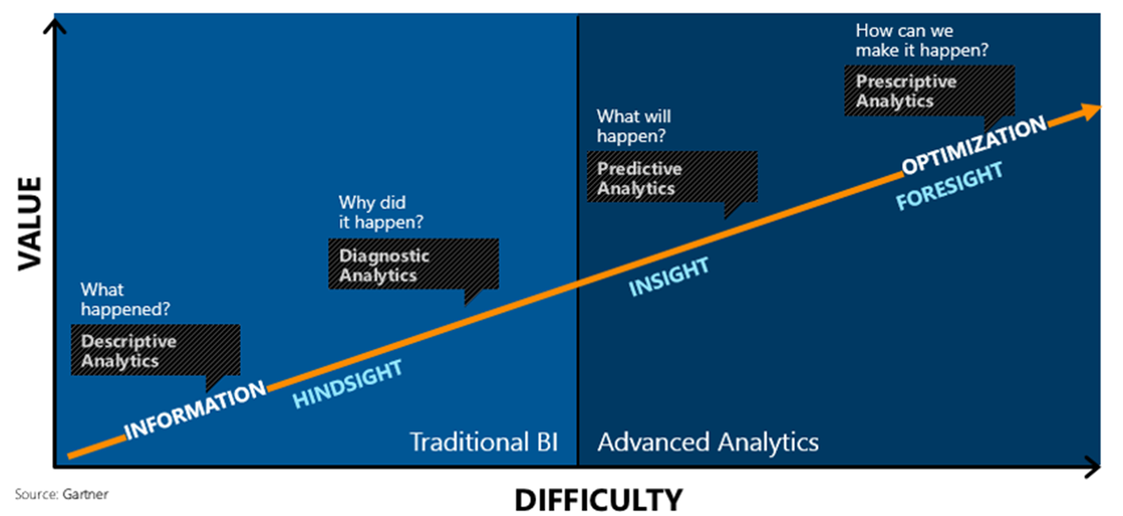
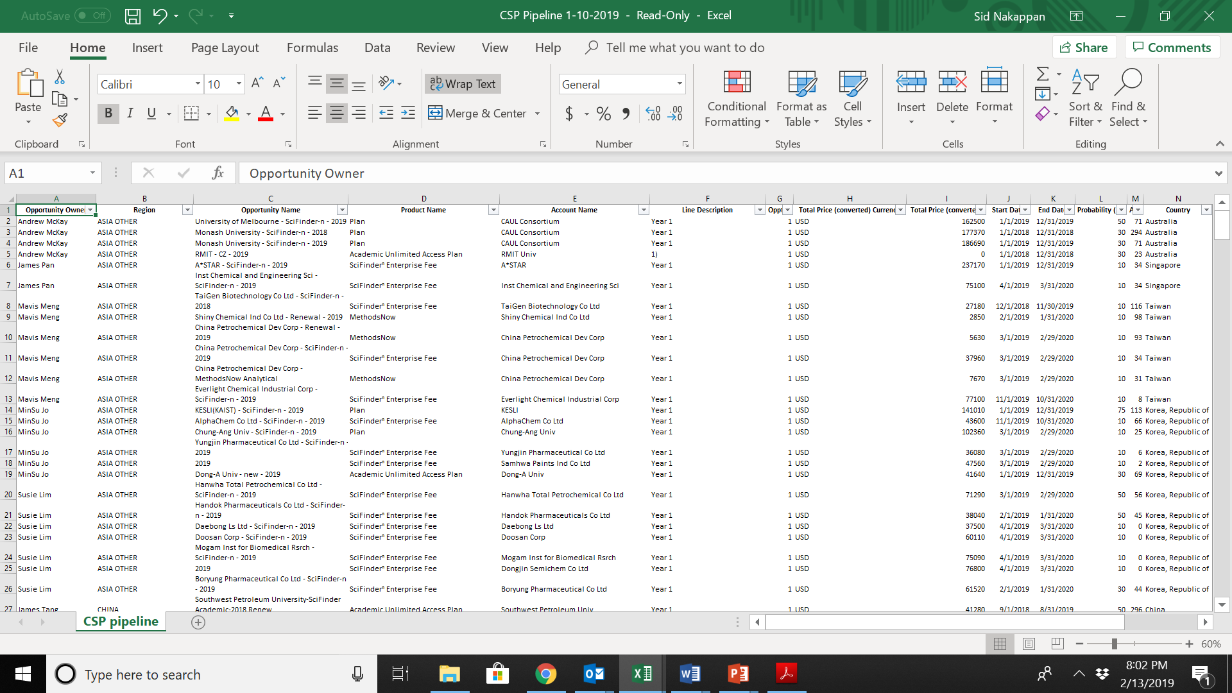
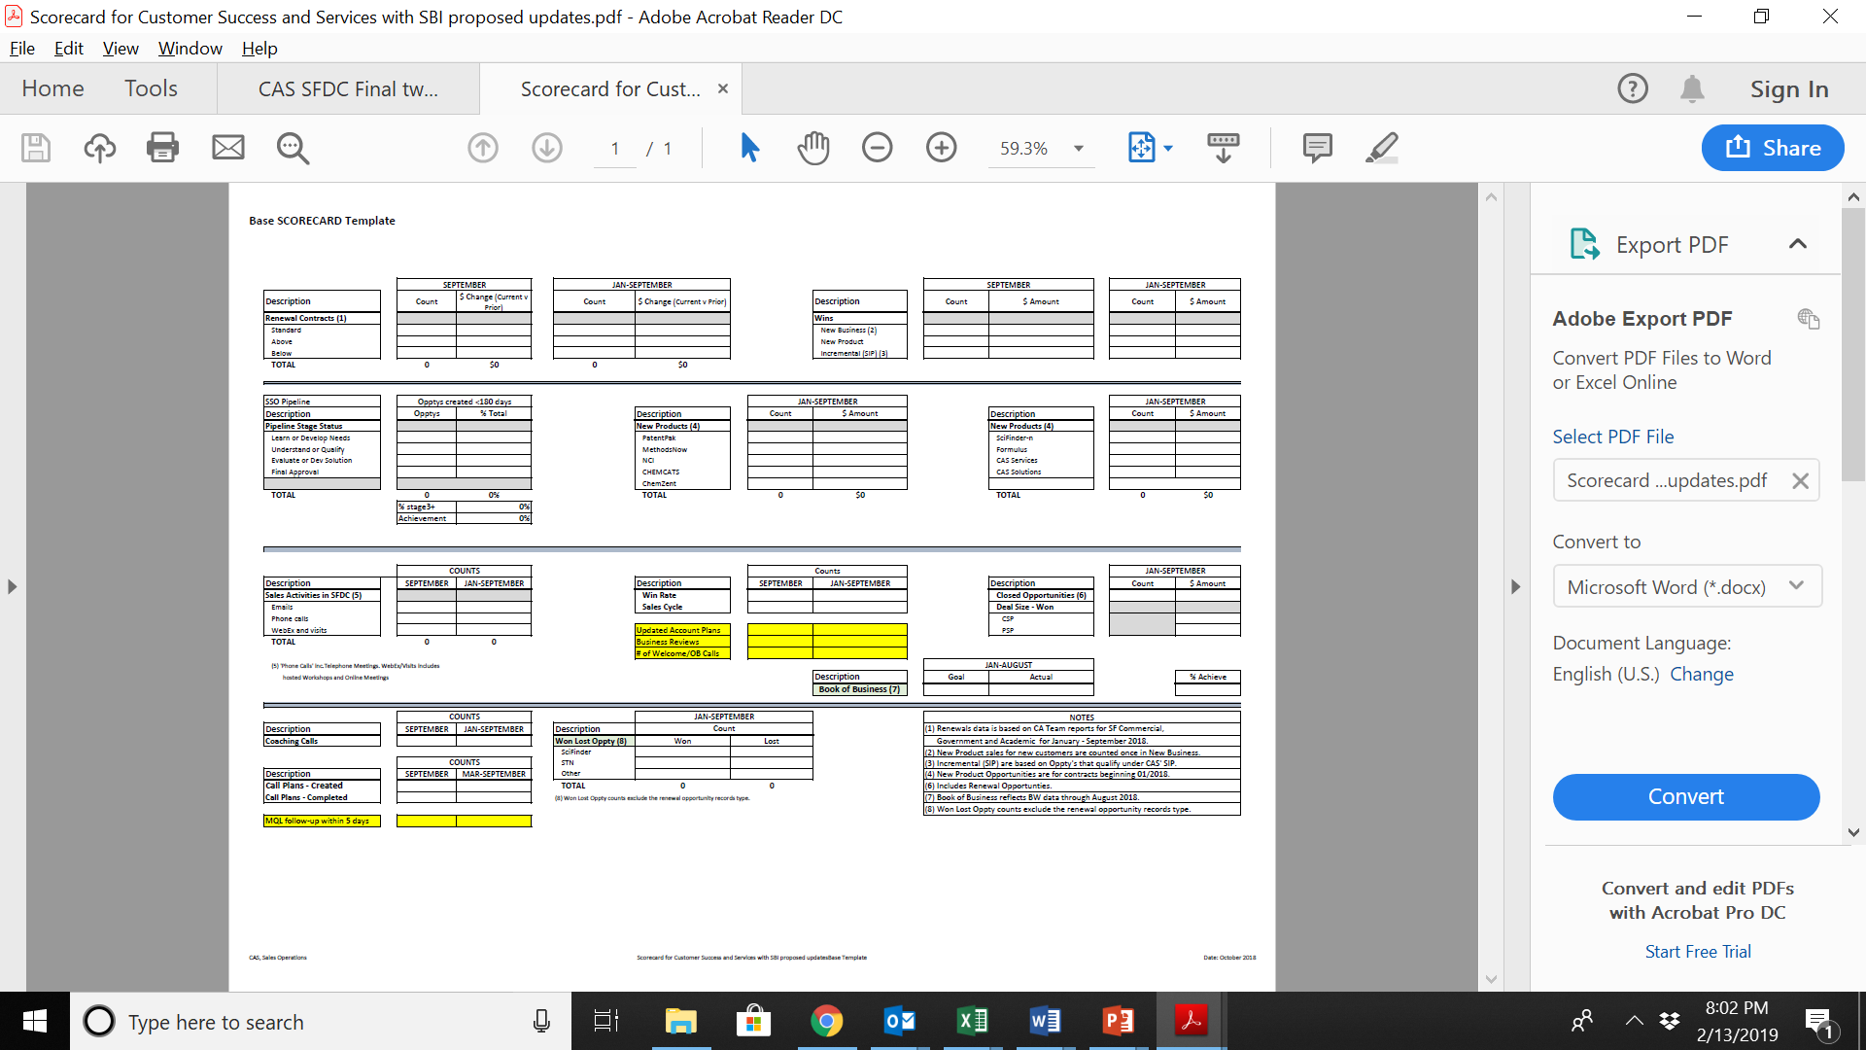
Revenue Operations
Revenue Operations should work toward proactive, cross-functional, and predictive insights
that inform decision making for the entire commercial function.
Reporting Examples
Renewals
Reports
Pipeline
Reports
Churn Reports

Slide 11
Building a Revenue Operations Charter
Process for Defining a Charter
1. Hold a meeting with CEO and GTM C-suite
2. Understand leadership expectations
3. Define the data required for decision-making
4. Understand areas owned by other functions
Common Revenue Operations Responsibilities
Sales Planning
Territory Design
Sales Process
Sales Compensation
Quota Setting
Sales Org Design
Customer Churn
Renewal Rates
Upsell/Cross-Sell Potential

Slide 12
Key Questions to Consider
1. Scope of Revenue Operations Charter
What is the role of the Revenue Ops team to drive efficiency in the sales organization and how can this improve in the future?
What is the Revenue Ops team not doing today that it SHOULD be doing in the future?
What is the Revenue Ops team doing today, that it should NOT be doing in the future?
2. Data Strategy | 3. Analytic Strategy | 4. Reporting | 5. Systems | 6. Support | 7. Revenue Ops Org Design
How are decisions made around what data points should be captured to drive sales decisions?
Who decides what needs to be measured?
How are data points identified and what systems need to capture said data points?
What are the core metrics to be analyzed and drive decisions?
Who is deriving insights from the data using what methods?
How are the insights leveraged by the Revenue Ops team and sales management teams to drive change?
How are the reports disseminated to the executive team (modality/system, frequency, etc.)?
Who is creating the reports?
How are dashboards leveraged for Pipeline, Forecast, and QBR processes?
What systems are being leveraged to drive efficiency in the sales organization?
How much time is being spent on systems in the field?
What is the technology roadmap for the future and what efficiencies will those systems drive?
Who makes systems roadmap decisions?
Who is managing the sales systems today?
Who represents the field to other functional groups within the organization?
What processes are in place to guide sales (Big Deal Review, Deal Desk/CPQ, QBRs, etc?)
How is selling time is being impacted by administrative burden (selling drag)?
What is the Revenue Ops team doing today and what needs to be done in the future to eliminate/reduce selling drag?
What is the right structure for the Revenue Ops team and why?
What roles do we need that we don’t have today and why?
Where do we have inefficiencies, as far as roles and responsibilities today and why?

Slide 13
How Revenue Operations Supports Cross-Functional Teams
Function | Objective | Revenue Ops Priority
Product | Meet New Product Revenue and Margin Goals Gain visibility to current and future performance by product | Create and deploy buyer-centric direct training content Create and deploy Sales Dashboards , Pipeline Reports & Forecasts with Product-level detail
Customer Support | Align Sales processes and procedures to make it easy to do business with Improve overall Customer Satisfaction | Win / Loss / Renewal Reporting Sales Training content for operating efficiently with Support functions throughout
IT | Deploy systems that directly support business objectives Minimize IT and overall company costs associated with system deployments, data capture, access or use. | Automate Sales Pipeline reporting Support the creation of sales performance dashboards and compensation reconciliation reporting
HR | Attract and retain “A” players Develop Talent to increase effectiveness and efficiency Evaluate personnel to ensure the company makes the most of its human resources | Support HR in identifying and codifying “A” player competencies Build and deploy training and other enablement content / tools for on-boarding and existing reps Deliver sales performance dashboards and associated analysis that provides common definitions and approach
Finance | Meeting revenue and margin goals Improved Forecasting Accuracy Aligning sales compensation and all other sales costs to sales and overall company strategy | Alignment of Sales and Finance Pipeline reporting and Forecasting methodology Instituting a Pipeline Management process to improve reliability of Pipeline data Expediting compensation reconciliation and reporting. Supplying reports that deliver insight into sales resource effectiveness and efficiency
Marketing | Improved efficiency and effectiveness in Lead & Demand Generation Increased contribution to overall revenue goals Maximizing impact of Marketing created content | Account Segmentation output to be leveraged for fine-tuned campaign targeting Instituting a Pipeline Management process with specific SLA’s for sales actions against leads generated. Shared KPI’s with Marketing Joint effort with Marketing to create more effective persona-based sales training content
Sales | Measure and respond to sales organizations’ overall performance, efficiency and effectiveness Recommend strategic sales initiatives; deploy and monitor their roll-out Represent sales to other key functional groups within the organization Deliver common measurements, processes, tools & training to the sales organization to drive consistency and predictability | Align Sales & Finance reporting to eradicate inconsistent data use and remove ambiguity Ensure resource allocation and structure aligns with sales opportunities Improve Pipeline Management process and forecasting to improve reliability of the forecast Deliver consistent sales performance dashboards and associated analysis that ensure common view of good vs. bad performance
CEO | Measure and respond to overall Sales Performance Gaining Pipeline Visibility Ensuring Pipeline Accuracy Identifying Growth Opportunities by Segment Competitive Intelligence | Sales Dashboard reporting to all levels Pipeline Reporting by Product and Time Horizon Pipeline Management Process Account Segmentation to address Direct, Legacy and Services Revenue Opportunity Revenue Enablement Win/Loss reporting and Competitive Intelligence training development

Slide 14
Revenue Operations: Client Examples

Slide 15
Revenue Operations is the effectiveness and performance arm of the ACME go-to-market organization.
The goal is to drive improvements that increase commercial effectiveness and efficiency.

Slide 16
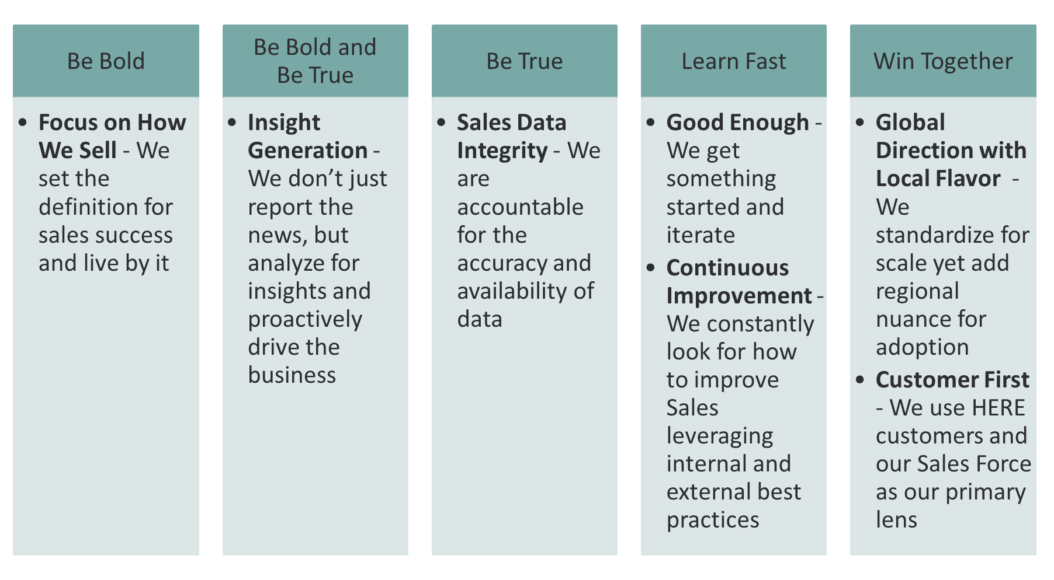
Client Example: Charter Mission Statement, Business Outcomes and Values
Revenue Operations Mission Statement: Optimize the efficiency and success of the commercial team with focus on business outcomes via shared values
Business Outcomes
Values
1. Get Back to Growth
Increase new logo growth through account segmentation and planning
Win big at existing large customers through buying center expansion using Big Deal Reviews, QBRs, and Data Analytics
2. Maximize Selling Time
Revenue Ops can implement processes to improve efficiencies for the sales org (selling time)
By optimizing the coverage of the sales team via account segmentation and territory design, Sales heads work on the right things increasing productivity
3. Increase Sales Visibility, Planning and Decision Making
By improving data strategies and implementing the right forecasting, pipeline and QBR processes and driving the sales process, forecast accuracy, departmental interlock and understanding of the business improves
4. Optimize ROI of the Selling System
Through the use of data and analytics, determine the optimal allocation of budget and resources to maximize sales results
5. Build Scalability
Leveraging a charter, standard process definitions, and Data/Systems automation, Revenue Ops reduces admin while building global scalability and maintaining a local flavor

Slide 17
Client Example: Core Values of Revenue Operations
1. Set the Standard
Define a customer based selling process and live by it
2. Be Fact Based
Analyze data for insights and proactively drive the business
3. Focus on Integrity
Accountable for the accuracy and availability of data and insights
4. Continuously Improve
Always looking for ways to improve sales leveraging internal and external best practices

Slide 18




Client Example: Core Accountabilities of Revenue Operations
Detail
Systems Strategy
Data Strategy- Identify, access and manage data required to drive sound sales decisions with maximum efficiency
Systems Strategy- Automate core business processes to increase efficiency and effectiveness of the sales organization by removing administrative burdens
Analytics- Analyze data (qualitative & quantitative) to produce key insights to sales & executive leadership
Reporting- Report upon data which provides insights leading to actions that improve revenue and booking performance
Sales Process – Create structure and methodology to selling activities in a way that optimizes sales productivity
Territory Design & Quota- Assign accounts, opportunities and quotas based on a balanced and optimal load.
Sales Support- Assist the sales department in a means which drives the greater additional business efficiencies
Sales Support
Analytics
Data Strategy
Territory Design & Quota
Reporting
Sales Process

Slide 19
Client Example: Pipeline & Revenue Metrics Actively Monitored by Revenue Operations
Metrics | Calculation
Total Pipeline by X X = LOB, Region, Industry, Rep, Etc. | Y = (Total Pipeline by X) / (Total Pipeline)
Total Pipeline by Time Time dimension to vary | Y = (Total Pipeline in Time Range) / (Total Pipeline)
Average Deal by Pipeline Stage | Y = (Sum of Pipeline by Stage) / (Number of Opportunities by Stage)
Average Close Rate by Stage | Y = (# of Deals Closed Which Entered Certain Stage) / (# of Total Opportunities)
Conversion Rate by Stage | Y = (# of Deals Which Advance to Next Stage) / (# of Total Deals by Stage)
Average Age of Opportunity by Stage | Y = (Sum of Opportunity Days by Stage) / (# of Total Opportunities by Stage)
Annual Contract Value by X X = Time Dimension, Region, Rep, etc. | Y = (Sum of Contacts by X) / (# of Total Contracts by X)
Total Revenue by X X = Time Dimension, Region, Rep, etc. | Y = (Sum of Revenue by X)
Quota Attainment | Y = (Total Revenue Attained) / (Quota)
Renewal Success Rate | Y = (# of Customers Which Renewed) / (# of Total Customers Eligible for Renewal)
Percent of Total Customers With Logged Activity | Y = (# of Customers With Activity Logged) / (# of Total Customers)
Percent of Opportunities With Logged Activity | Y = (# of Opportunities With Activity Logged) / (# of Total Opportunities)

Slide 20
Appendix

Slide 21




4 Pillars of Performance: Planning, Strategy, Execution, and Optimization
Revenue Operations delivers value across 4 pillars of performance: Planning, Strategy, Execution, and Optimization. The challenge is in coordinating these across the leaders of each function
Strategy | Planning | Execution | Optimization
KPIs by Function Shared Definitions Prioritized Metrics Benchmarks & Targets Revenue & Financial Plan Budget Methodology | Audience/Account Segmentation Brand Strategy Market Intelligence Positioning & Messaging Channel Marketing Campaign Strategy Content Strategy Cross-Functional Communication | Revenue Marketing Lead/Opportunity Scoring Lead/Opportunity Tracking Lead/Opportunity Routing Lead/Opportunity Lifecycle Mapping Engagement Tracking Predictive Analytics Automation | Data Maintenance Reporting Tools Data Cleanliness Data Validation/ Enrichment Data Storage & Upkeep Attribution Methodology

Slide 22
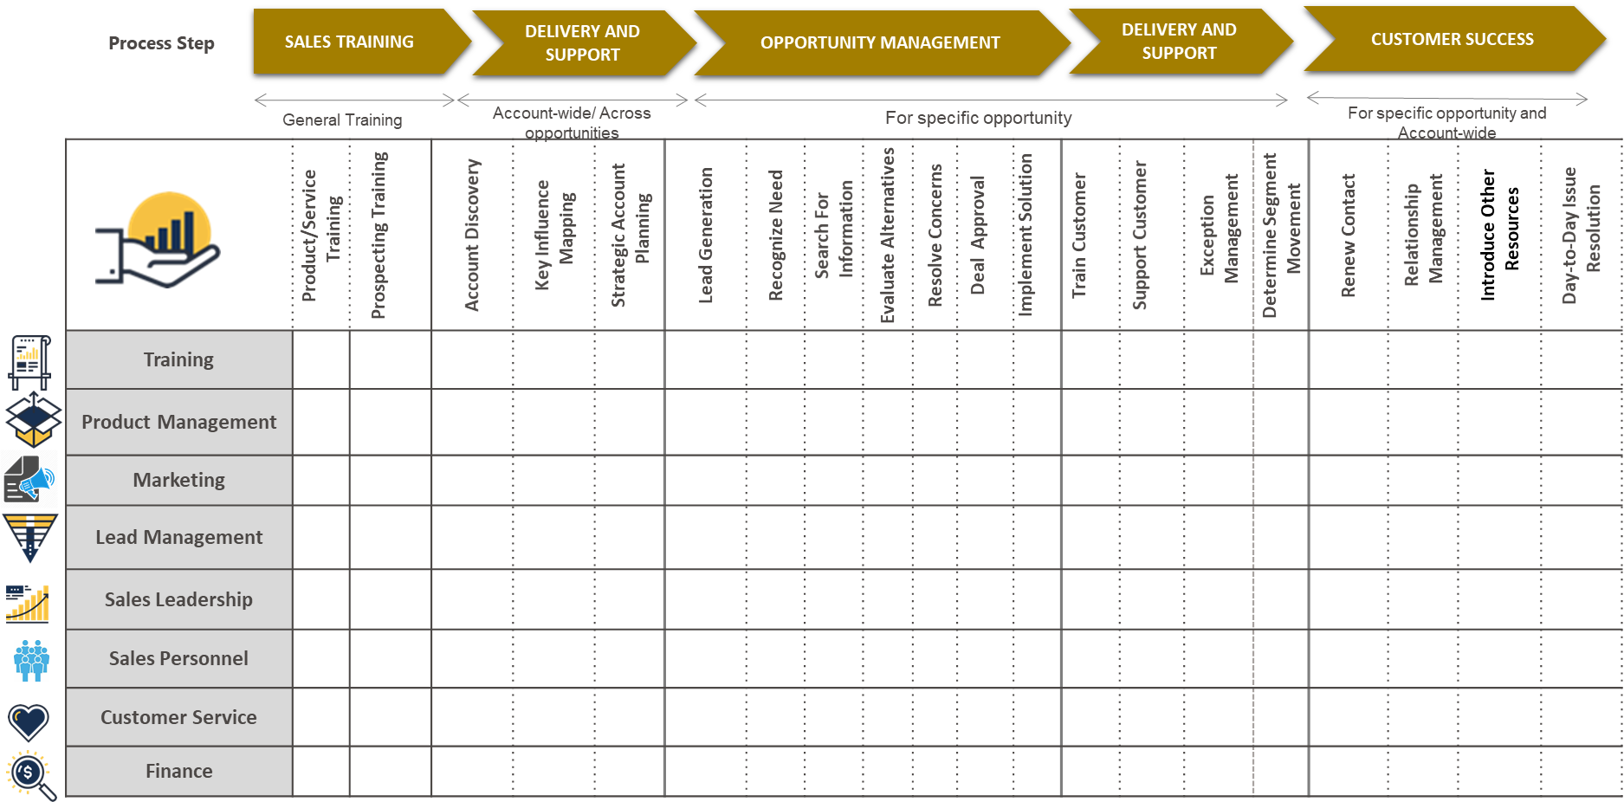
RACI Exercise
A RACI exercise is the best way to capture and bring together the duties and tasks of many others into the one Revenue Operations organization

