Slide 1
Marketing Campaign and
Content Planning Playbook

Slide 2


“From the beginning, Virgin used clear, ordinary language. If I could quickly understand a campaign concept, it was good to go. If something can’t be explained off the back of an envelope, it’s rubbish.”
Sir Richard Branson
Founder and Chairman, Virgin Group

Slide 3
Developing a marketing campaign is a complex task. Doing an effective job requires defining all aspects of the campaign across several dimensions. The goal is to spark a unique point of view that can be quickly and easily expressed to a target audience with a compelling and engaging voice.
This playbook follows the SBI Campaign and Content Planning Framework process and provides insights, instruction, and understanding so that any member of the marketing organization can begin the process of developing a campaign.
How to
use this playbook
When used effectively the playbook and planning framework will trigger new thinking. You’ll discover what matters most to your target audience and will be able to align your messaging to their key concerns. By following this rigorous process, you will arrive at a point of simplicity with a well-refined message targeted to a precise audience and a compelling offer.

Slide 4
Step One: Design the Campaign

Slide 5

“Simple can be harder than complex. You have to work hard to get your thinking clean to make it simple. But it’s worth it in the end because once you get there, you can move mountains.”
Steve Jobs
CEO, Apple

Slide 6
Campaign Planning Process, Step 1
Campaign Design
Objective
Design marketing campaigns that attract buyers to your products/solutions
Campaign Overview
Campaign Goals
Market/Audience Profile
Campaign Calendar
Competitive Assessment
Competitive Positioning
Market Message
Measurement Plan
Step 1
Campaign Design Deliverables

Slide 7
Campaign Design: Overview
CAMPAIGN NAME (WORKING TITLE) |  | <ENTER>
CAMPAIGN OWNER / SPONSOR |  | <ENTER>
PRODUCT/SOLUTION |  | <LIST THE PRODUCT(S) / SERVICE(S) THAT WILL BE INCLUDED IN THIS CAMPAIGN>
EXTENSION/NEW? | <ENTER> | CREATIVE NEEDED (Y/N) | <YES OR NO> | LEVEL OF EFFORT | <LOW, MEDIUM, HIGH>
TO/FROM RUN DATES |  | <DATE START> - <DATE END>
BUDGET |  | <$>
OPPORTUNITY STATEMENT |  | <WHAT IS THE OPPORTUNITY / PURPOSE OF THIS CAMPAIGN? WHAT PROBLEM IS IT ADDRESSING OR TRYING TO SOLVE IN THE MARKET?>
PRIMARY OBJECTIVE |  | <BRIEFLY DESCRIBE THE DESIRED OUTCOME OF THIS CAMPAIGN AND IF IT ALIGNS WITH STRATEGIC GOALS OF THE COMPANY. FOR EXAMPLE, “PRODUCE 10 NEW-LOGO ACCOUNTS OVER THE NEXT 2 QUARTERS TO MEET CAGR GROWTH GOALS.”>
SECONDARY OBJECTIVE |  | <BRIEFLY DESCRIBE THE SECONDARY OBJECTIVE(S) OF THIS CAMPAIGN. FOR EXAMPLE, “GENERATE DEMAND THROUGH THOUGHT LEADERSHIP ASSOCIATION.”>
EXPECTED RESULTS |  | <WHAT ARE THE ANTICIPATED/EXPECTED RESULTS? QUANTIFY WITH OBJECTIVE TARGETS>

Slide 8
Campaign Design: Overview
SAMPLE
CAMPAIGN NAME (WORKING TITLE) |  | Let ACME Help Increase Sales
CAMPAIGN OWNER / SPONSOR |  | Melissa Lopez
PRODUCT/SOLUTION |  | Solution: Gain new customers Product(s): Field Sales, Inside Sales, Lead Generation
EXTENSION/NEW? | <ENTER> | CREATIVE NEEDED (Y/N) | YES | LEVEL OF EFFORT | HIGH
TO/FROM RUN DATES |  | 3/21 – 4/4
BUDGET |  | <$>
OPPORTUNITY STATEMENT |  | Opportunity / Purpose: Increase Marketing Qualified Leads (MQL) to setup for Sales Qualified Leads (SQL) Problem Addressed: Lack of production from companies' sales orgs. Talent gap in sales orgs.
PRIMARY OBJECTIVE |  | PRODUCE XX NEW MQL’S OVER THE NEXT 2 QUARTERS
SECONDARY OBJECTIVE |  | IMPLEMENT A REPEATABLE PROCESS OF DESIGNING, PLANNING AND EXECUTING MARKETING CAMPAIGNS
EXPECTED RESULTS

Slide 9
Campaign Design: Market / Audience Profile
TARGET MARKET SPECIFICATIONS | <LIST THE VERTICAL MARKET, IF APPLICABLE> <LIST THE MARKET SEGMENT (LE, ME, SE)> <LIST THE GEO AND/OR REGION FOR THIS CAMPAIGN> <WILL THIS CAMPAIGN TARGET EXISTING CUSTOMERS, PROSPECTS, OR BOTH?> <WILL THIS CAMPAIGN BE ROUTED THRU CHANNEL PARTNERS OR BE DIRECTLY COMMUNICATED TO THE TARGET?>
TARGET AUDIENCE/PERSONA PROFILE | <LIST THE PRIMARY BUYER / DECISION MAKER PERSONA> <LIST ANY SECONDARY BUYER / DECISION MAKER PERSONA, IF APPLICABLE> <WHO ARE THE INFLUENCERS> <WHO ARE THE USERS>
TARGET AUDIENCE/PERSONA CHARACTERISTICS | <WHAT DO WE KNOW ABOUT THE TARGET PROSPECT?> <WHAT IS THE MOST URGENT PROBLEM THAT WE CAN FOCUS ON FOR THIS CAMPAIGN?> <WHAT IS IT ABOUT THEIR ATTITUDES AND WORKING ENVIRONMENT THAT WOULD HAVE AN EFFECT ON THIS CAMPAIGN?> <WHAT DO WE KNOW ABOUT THEIR EMOTIONAL DRIVERS/TRIGGERS?>
TARGET MARKET/AUDIENCE DATA | <EXISTING CUSTOMER QTY> <TARGET PROSPECT QTY> <MARKET SEGMENTATION / INDUSTRY CODES>

Slide 10
Campaign Design: Market / Audience Profile
SAMPLE
TARGET MARKET SPECIFICATIONS | Vertical: Insurance, Computer Manufacturing, Rental & Leasing, Electrical Equipment Appliance and Component Manufacturing Market Segment: Mid-Market to Enterprise Geo: United States Customer Focus: Prospects only (excluding current customers) Direct or Channel Directed Communication: Directly communicated to the Target Persona
TARGET AUDIENCE/PERSONA PROFILE | Primary Persona: Steve (VP Sales / Sales Leader) Influencers: Cole (CEO), Frank (CFO)
TARGET AUDIENCE/PERSONA CHARACTERISTICS | MOST URGENT PROBLEM: Increasing sales to avoid missing quarterly number again. Making up lost ground to ensure hitting the annual number. ATTITUDES: Nervous about making quota, they are the hardest working person in the company, need additional help to make the number WORKING ENVIRONMENT: Tons of meetings, managing overbooked schedule, heavy travel, reactive EMOTIONAL DRIVERS & TRIGGERS: Job security, unforeseen changes / surprises, capacity (time)
TARGET MARKET/AUDIENCE DATA | Target Personas in Database: Target Personas in Social 123:

Slide 11
Campaign Design: Calendar and Funnel Estimates
(Utilize SBI Campaign Calendar Template)
SAMPLE
2023 Campaign & Content Calendar Summary | Q1 2023 |  |  |  |  |  |  |  |  |  |  |  |  | Q2 2023 |  |  |  |  |  |  |  |  |  |  |  |  | Q3 2023 |  |  |  |  |  |  |  |  |  |  |  |  | Q4 2023
Month of | January 2023 |  |  |  |  | February 2023 |  |  |  | March 2023 |  |  |  | April 2023 |  |  |  | May 2023 |  |  |  |  | June 2023 |  |  |  | July 2023 |  |  |  | August 2023 |  |  |  |  | September 2023 |  |  |  | October 2023 |  |  |  |  | November 2023 |  |  |  | December 2023
Week of | 3 | 10 | 17 | 24 | 31 | 7 | 14 | 21 | 28 | 7 | 14 | 21 | 28 | 4 | 11 | 18 | 25 | 2 | 9 | 16 | 23 | 30 | 6 | 13 | 20 | 27 | 4 | 11 | 18 | 25 | 1 | 8 | 15 | 22 | 29 | 5 | 12 | 19 | 26 | 3 | 10 | 17 | 24 | 31 | 7 | 14 | 21 | 28 | 5 | 12 | 19 | 26
Campaign 1: <ENTER DESCRIPTION / TITLE HERE> | Theme: <ENTER DESCRIPTION / TITLE HERE> |  |  |  |  |  |  |  |  |  |  |  |  | Theme: <ENTER DESCRIPTION / TITLE HERE> |  |  |  |  |  |  |  |  |  |  |  |  | Theme: <ENTER DESCRIPTION / TITLE HERE> |  |  |  |  |  |  |  |  |  |  |  |  | Theme: <ENTER DESCRIPTION / TITLE HERE>
Outbound Emails (series of 6 or 7 with progressing CTAs)
XYZ Contributed Article Published
Anchor/Gated Content Offer Publiished
Blog Article or Contributed Article (XYZ, ABC, or similar - targeting 4 per quarter)
Webinar
Campaign 2: <ENTER DESCRIPTION / TITLE HERE> | Theme: <ENTER DESCRIPTION / TITLE HERE> |  |  |  |  |  |  |  |  |  |  |  |  | Theme: <ENTER DESCRIPTION / TITLE HERE> |  |  |  |  |  |  |  |  |  |  |  |  | Theme: <ENTER DESCRIPTION / TITLE HERE> |  |  |  |  |  |  |  |  |  |  |  |  | Theme: <ENTER DESCRIPTION / TITLE HERE>
Outbound Emails (CTA: download/read our most recent: blog article, press release, white paper, webinar, publication)
Campaign 3: <ENTER DESCRIPTION / TITLE HERE> | Theme: <ENTER DESCRIPTION / TITLE HERE> |  |  |  |  |  |  |  |  |  |  |  |  | Theme: <ENTER DESCRIPTION / TITLE HERE> |  |  |  |  |  |  |  |  |  |  |  |  | Theme: <ENTER DESCRIPTION / TITLE HERE> |  |  |  |  |  |  |  |  |  |  |  |  | Theme: <ENTER DESCRIPTION / TITLE HERE>
Outbound Emails (series of 6 with progressing CTAs) | last Q4 email
Blog Article or gated content offer (targeting 1 per month)
Supporting Content - Sales Enablement, Media & Public Relations (non-campaign specific)
Press Release (timing tbd and based on newsworthy topics - targeting 1 per month)
Supporting Social Media Posts - Unpaid (campaign- and non-campaign-specific)
Media Opportunity - Contributed Article , Podcast, or other (tbd - targeting 2 per quarter)
Published Article (tbd - targeting 1 per quarter)
Industry Conference - Speaking Presentation
Client Case Studies
Sales Enablement (Infographic, Flyer/Sell Sheet, and/or Updated Web Content - targeting 1 per month)
2023 Revenue Marketing Program Funnel Goals By Month | January 2023 |  |  |  |  | February 2023 |  |  |  | March 2023 |  |  |  | April 2023 |  |  |  | May 2023 |  |  |  |  | June 2023 |  |  |  | July 2023 |  |  |  | August 2023 |  |  |  |  | September 2023 |  |  |  | October 2023 |  |  |  |  | November 2023 |  |  |  | December 2023 |  |  |  |  | 2023 AVER/MO | 2022 AVER/MO
MQLs | 33 |  |  |  |  | 33 |  |  |  | 33 |  |  |  | 33 |  |  |  | 33 |  |  |  |  | 33 |  |  |  | 33 |  |  |  | 33 |  |  |  |  | 33 |  |  |  | 33 |  |  |  |  | 33 |  |  |  | 33 |  |  |  |  | 33 | 24
SALs (BANT-Qualified + First Meeting Set) | 3 |  |  |  |  | 3 |  |  |  | 3 |  |  |  | 3 |  |  |  | 3 |  |  |  |  | 3 |  |  |  | 3 |  |  |  | 3 |  |  |  |  | 3 |  |  |  | 3 |  |  |  |  | 3 |  |  |  | 3 |  |  |  |  | 3 | 2.3
SQLs (Stage 1 Opportunities) | 2.5 |  |  |  |  | 2.5 |  |  |  | 2.5 |  |  |  | 2.5 |  |  |  | 2.5 |  |  |  |  | 2.5 |  |  |  | 2.5 |  |  |  | 2.5 |  |  |  |  | 2.5 |  |  |  | 2.5 |  |  |  |  | 2.5 |  |  |  | 2.5 |  |  |  |  | 2.5 | 1
Total Wins | 0.25 |  |  |  |  | 0.25 |  |  |  | 0.25 |  |  |  | 0.25 |  |  |  | 0.25 |  |  |  |  | 0.25 |  |  |  | 0.25 |  |  |  | 0.25 |  |  |  |  | 0.25 |  |  |  | 0.25 |  |  |  |  | 0.25 |  |  |  | 0.25 |  |  |  |  | 0.25 | 0
Marketing Contributed (MC) Pipeline ($s) | $1,470,000 |  |  |  |  | $1,470,000 |  |  |  | $1,470,000 |  |  |  | $1,470,000 |  |  |  | $1,470,000 |  |  |  |  | $1,470,000 |  |  |  | $1,470,000 |  |  |  | $1,470,000 |  |  |  |  | $1,470,000 |  |  |  | $1,470,000 |  |  |  |  | $1,470,000 |  |  |  | $1,470,000 |  |  |  |  | $ 1,470,000 | $523,150
MC New Logo Revenue ($s) | $210,000 |  |  |  |  | $210,000 |  |  |  | $210,000 |  |  |  | $210,000 |  |  |  | $210,000 |  |  |  |  | $210,000 |  |  |  | $210,000 |  |  |  | $210,000 |  |  |  |  | $210,000 |  |  |  | $210,000 |  |  |  |  | $210,000 |  |  |  | $210,000 |  |  |  |  | $ 210,000 | $0
RMT Monthly Mkt Spend (Lead Gen + Sales Enablement) | $93,476 |  |  |  |  | $74,576 |  |  |  | $112,426 |  |  |  | $79,976 |  |  |  | $76,826 |  |  |  |  | $101,426 |  |  |  | $118,176 |  |  |  | $113,876 |  |  |  |  | $112,656 |  |  |  | $134,976 |  |  |  |  | $113,326 |  |  |  | $165,356 |  |  |  |  | $ 108,089 | $82,904
Cost Per Marketing Qualified Lead | $2,833 |  |  |  |  | $2,260 |  |  |  | $3,407 |  |  |  | $2,424 |  |  |  | $2,328 |  |  |  |  | $3,074 |  |  |  | $3,581 |  |  |  | $3,451 |  |  |  |  | $3,414 |  |  |  | $4,090 |  |  |  |  | $3,434 |  |  |  | $5,011 |  |  |  |  | $ 3,275 | $3,285
Marketing Influenced Pipeline | $300,000 |  |  |  |  | $300,000 |  |  |  | $300,000 |  |  |  | $300,000 |  |  |  | $300,000 |  |  |  |  | $300,000 |  |  |  | $300,000 |  |  |  | $300,000 |  |  |  |  | $300,000 |  |  |  | $300,000 |  |  |  |  | $300,000 |  |  |  | $300,000 |  |  |  |  | $ 300,000 | tbd
Marketing Influenced Revenue | $100,000 |  |  |  |  | $100,000 |  |  |  | $100,000 |  |  |  | $100,000 |  |  |  | $100,000 |  |  |  |  | $100,000 |  |  |  | $100,000 |  |  |  | $100,000 |  |  |  |  | $100,000 |  |  |  | $100,000 |  |  |  |  | $100,000 |  |  |  | $100,000 |  |  |  |  | $ 100,000 | tbd
Total Revenue Contributed + Influenced by RMT | $310,000 |  |  |  |  | $310,000 |  |  |  | $310,000 |  |  |  | $310,000 |  |  |  | $310,000 |  |  |  |  | $310,000 |  |  |  | $310,000 |  |  |  | $310,000 |  |  |  |  | $310,000 |  |  |  | $310,000 |  |  |  |  | $310,000 |  |  |  | $310,000 |  |  |  |  | $ 310,000 | tbd
ROMI (target marketing contributed revenue + marketing influenced revenue) | 232% |  |  |  |  | 316% |  |  |  | 176% |  |  |  | 288% |  |  |  | 304% |  |  |  |  | 206% |  |  |  | 162% |  |  |  | 172% |  |  |  |  | 175% |  |  |  | 130% |  |  |  |  | 174% |  |  |  | 87% |  |  |  |  | 202% | tbd

Slide 12
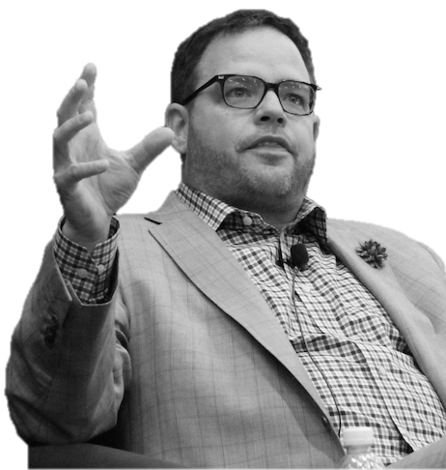
“If your stories are all about your products and services, that’s not storytelling.
It’s a brochure.
Give yourself permission to make
the story bigger.”
Jay Baer
Author

Slide 13

Differentiate Your Message
If you approach the competitive playing field in the same manner and with the same position as your competition, you will sound alike. Customers will be unable to differentiate between the products. All that’s left is price or intangibles that you can’t control.
What’s better is to have a uniquely differentiated position. When you do this, you set the rules of the gameplay according to your strengths. In other words, you “chalk the field” to play the game you intend to play, not the game your competitors are playing. This puts you at an advantage with the customers that want what you have to offer. And it puts your competitors at a disadvantage from the start.
Having an in-depth knowledge of your target buyer, your competitive landscape, and your product’s strengths and weaknesses will help you define a strong position.

Slide 14
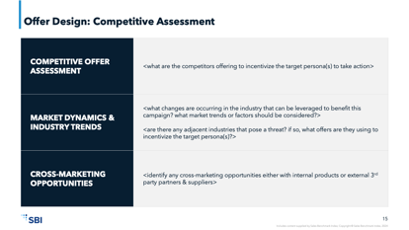
Using the Competitive Assessment Worksheet
This worksheet allows you to grasp an understanding of what is going on in the market by looking at the following:
Market dynamics
Industry trends
Cross-marketing opportunities
Once this worksheet is complete you will be able to specify the exact offers you will target to each persona in the buying process.

Slide 15
Offer Design: Competitive Assessment
COMPETITIVE OFFER ASSESSMENT | <what are the competitors offering to incentivize the target persona(s) to take action>
MARKET DYNAMICS & INDUSTRY TRENDS | <what changes are occurring in the industry that can be leveraged to benefit this campaign? what market trends or factors should be considered?> <are there any adjacent industries that pose a threat? if so, what offers are they using to incentivize the target persona(s)?>
CROSS-MARKETING OPPORTUNITIES | <identify any cross-marketing opportunities either with internal products or external 3rd party partners & suppliers>

Slide 16
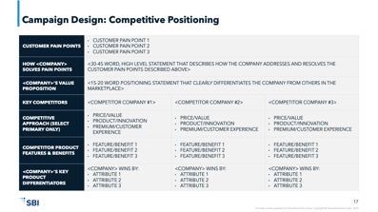
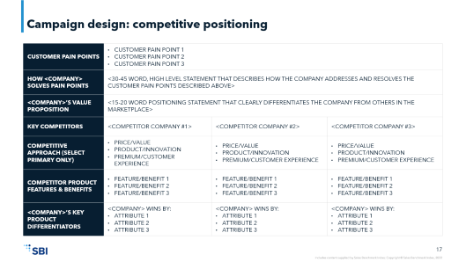
Using the Competitive Positioning Worksheet
Using market intelligence and customer feedback, complete the Competitive Positioning worksheet to hone a unique market message.
The first step is to identify the customer pain points. What do they care about? Many companies make the mistake of telling the customer what they should care about instead of listening to the customer and giving them something that they care about. Identify how your product or service addresses the pain points that the customer has. The Persona profiles and buying process maps are good reference material for this worksheet.
Next, evaluate your competition.
Who are they?
What position have they carved out in the marketplace.
Are they a value play leading with price?
A product play leaning on innovation/performance?
Or a premium play that promises the best customer experience?
Objectively identify how each competitor wins in the market; list their features and benefits. Then, one by one, articulate the differentiated attributes of your product or service by mapping them back to a customer pain point.

Slide 17
Campaign Design: Competitive Positioning
CUSTOMER PAIN POINTS | CUSTOMER PAIN POINT 1 CUSTOMER PAIN POINT 2 CUSTOMER PAIN POINT 3
HOW <COMPANY> SOLVES PAIN POINTS | <30-45 WORD, HIGH LEVEL STATEMENT THAT DESCRIBES HOW THE COMPANY ADDRESSES AND RESOLVES THE CUSTOMER PAIN POINTS DESCRIBED ABOVE>
<COMPANY>’S VALUE PROPOSITION | <15-20 WORD POSITIONING STATEMENT THAT CLEARLY DIFFERENTIATES THE COMPANY FROM OTHERS IN THE MARKETPLACE>
KEY COMPETITORS | <COMPETITOR COMPANY #1> | <COMPETITOR COMPANY #2> | <COMPETITOR COMPANY #3>
COMPETITIVE APPROACH (SELECT PRIMARY ONLY) | PRICE/VALUE PRODUCT/INNOVATION PREMIUM/CUSTOMER EXPERIENCE | PRICE/VALUE PRODUCT/INNOVATION PREMIUM/CUSTOMER EXPERIENCE | PRICE/VALUE PRODUCT/INNOVATION PREMIUM/CUSTOMER EXPERIENCE
COMPETITOR PRODUCT FEATURES & BENEFITS | FEATURE/BENEFIT 1 FEATURE/BENEFIT 2 FEATURE/BENEFIT 3 | FEATURE/BENEFIT 1 FEATURE/BENEFIT 2 FEATURE/BENEFIT 3 | FEATURE/BENEFIT 1 FEATURE/BENEFIT 2 FEATURE/BENEFIT 3
<COMPANY>’S KEY PRODUCT DIFFERENTIATORS | <COMPANY> WINS BY: ATTRIBUTE 1 ATTRIBUTE 2 ATTRIBUTE 3 | <COMPANY> WINS BY: ATTRIBUTE 1 ATTRIBUTE 2 ATTRIBUTE 3 | <COMPANY> WINS BY: ATTRIBUTE 1 ATTRIBUTE 2 ATTRIBUTE 3

Slide 18
Campaign Design: Competitive Positioning
SAMPLE
CUSTOMER PAIN POINTS | B / C PLAYERS – HAS A HANDFUL OF TOP TALENT BUT A LARGE POPULATION THAT CAN’T OR CAN BARELY CUT IT MAKING NUMBER – YEARLY / QUARTERLY NUMBER SEEMS INSURMOUNTABLE WITH THE CURRENT RESOURCES AVAILABLE
HOW <COMPANY> SOLVES PAIN POINTS | SPECIFIC PERFORMANCE MANAGEMENT CADENCE, SUCCESSFUL PLACEMENT PROCESS, ACCOUNT AND OPPORTUNITY SCORING AND TIERING, INNOVATION AND CONTINUOUS IMPROVEMENT PROCESS, CLEAR CONCISE REPORTING AND ANALYTICS
<COMPANY>’S VALUE PROPOSITION | ACME has developed a complete portfolio of services that have been optimized over the course of three decades. With extensive capabilities and configurable capacities, we are able to meet your sales challenge and drive better business outcomes.
KEY COMPETITORS | DO IT YOURSELF (DIY) | DO NOTHING | NICHE OUTSOURCED SALES VENDOR | LARGE OUTSOURCED SOLUTION PROVIDER | INCUMBENT VENDOR
COMPETITIVE APPROACH (SELECT PRIMARY ONLY) | We have the resources we need to accomplish the intended outcome; our people know us better, therefore the results will be better and less costly | TWO DECADES OF EXPERIENCE DELIVERS MULTI CHANNEL SOLUTIONS POSITIONED WELL IN TECH VERTICAL AND CHANNEL PROGRAMS | We have specialized experience addressing the specific challenge that customers face | We have an extensive portfolio of products and services that enable us to solve a variety of problems for our clients | We understand the client’s business better than anyone and have a history of providing results
COMPETITOR PRODUCT FEATURES & BENEFITS | Cost is already factored into the FY plan; existing familiarity with the business means an internal team can ramp up quickly | No disruption to the current business; cost savings | Dedicated resources; specific market/vertical experience | Product and services portfolio; relationship at the top of the organization | Knowledge of the client’s business developed over the course of their relationship; embedded technology; they promote “fear of change” to client
<COMPANY>’S KEY PRODUCT DIFFERENTIATORS | ACME has a proprietary process to identify and design the best solution components that make use of emerging best practices and technology to resolve the challenges that mid-market and enterprise customers face | ACME offers a flexible, scalable, custom-tailored, speed-to-revenue approach that allows customers to fit the solution into their timeframe and budget while realizing the desired improvements | ACME offers a comprehensive, proven set of products that address a broad range of sales-related challenges that mid-market and enterprise customers face | ACME has a similar breadth of products that are deployed through proprietary development and delivery process; ACME’s innovation team implements continuous process improvements to maximize results | ACME brings a fresh, alternative approach with a proven ability to quickly recruit and train talent; with over 35 years of experience across multiple vertical markets, our clients benefit from our exposure to best practices throughout the industry

Slide 19
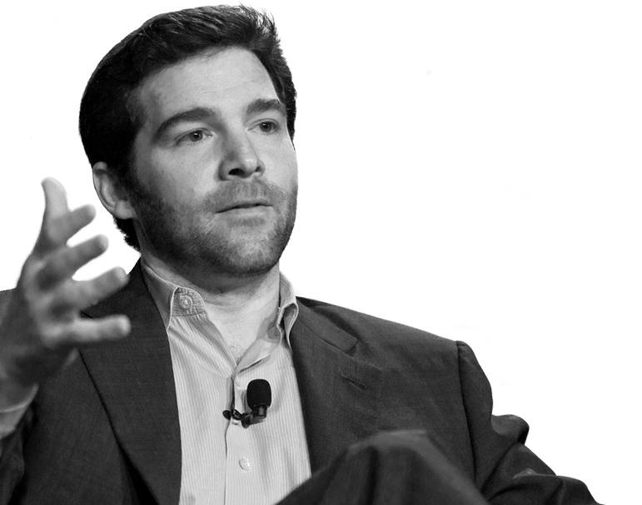
“Inspiration comes from three things: clarity of one’s vision, courage of their conviction and the ability to effectively communicate both those things.”
Jeff Weiner
CEO, LinkedIn

Slide 20
Clarify Your Unique Message
Filter your message development through these five lenses to ensure it is well constructed.
Credible
  Will people believe it?
Is your message credible? Will the target market believe what you have to say based on their preconceived opinions of your brand or your product?
Relevant
  Will people care?
Does your message address your audience’s key concerns? Does it solve their core problem? If it doesn’t, you’ll have a hard time capturing their attention.
What is your differentiated advantage? What can you claim that nobody else can?
Unique
  Can anyone else say it?
How sustainable is your message? You need a durable message based on something other than price, unless you are a value brand like 99 cent store or Walmart. For the rest of us, using price as a differentiator is a “go out of business” strategy.
Durable
  Will it last?
Do you give the market something to believe? Something to engage with? Is your message inspirational? Does it engage people emotionally or just rationally. Emotional triggers are far more effective than rational triggers. Emotions are very important for choosing at the point of decision. Without an emotional engagement, the buyer is left to logically decide between two options. And the list of pros and cons may paralyze them from taking any action.
Inspirational
  Will it engage emotionally?

Slide 21
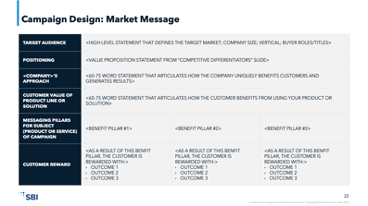
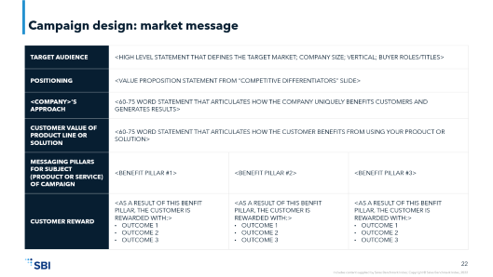
Using the Market Message Worksheet
Now that you’ve clarified your unique message it’s time to put it into a messaging framework.
The Market Message worksheet explores the various aspects that set your product or solution apart from others in the marketplace.
This worksheet is comprised of short phrases not long explanations. The goal is to be concise and brief.
Who is your target audience?
What value proposition are you delivering?
How does your company uniquely benefit customers?
How does the customer specifically benefit from your product or solution?
What are the messaging pillars that you go to market with and how do those benefits reward the customer?

Slide 22
Campaign Design: Market Message
TARGET AUDIENCE | <HIGH LEVEL STATEMENT THAT DEFINES THE TARGET MARKET; COMPANY SIZE; VERTICAL; BUYER ROLES/TITLES>
POSITIONING | <VALUE PROPOSITION STATEMENT FROM “COMPETITIVE DIFFERENTIATORS” SLIDE>
<COMPANY>’S APPROACH | <60-75 WORD STATEMENT THAT ARTICULATES HOW THE COMPANY UNIQUELY BENEFITS CUSTOMERS AND GENERATES RESULTS>
CUSTOMER VALUE OF PRODUCT LINE OR SOLUTION | <60-75 WORD STATEMENT THAT ARTICULATES HOW THE CUSTOMER BENEFITS FROM USING YOUR PRODUCT OR SOLUTION>
MESSAGING PILLARS FOR SUBJECT (PRODUCT OR SERVICE) OF CAMPAIGN | <BENEFIT PILLAR #1> | <BENEFIT PILLAR #2> | <BENEFIT PILLAR #3>
CUSTOMER REWARD | <AS A RESULT OF THIS BENFIT PILLAR, THE CUSTOMER IS REWARDED WITH:> OUTCOME 1 OUTCOME 2 OUTCOME 3 | <AS A RESULT OF THIS BENFIT PILLAR, THE CUSTOMER IS REWARDED WITH:> OUTCOME 1 OUTCOME 2 OUTCOME 3 | <AS A RESULT OF THIS BENFIT PILLAR, THE CUSTOMER IS REWARDED WITH:> OUTCOME 1 OUTCOME 2 OUTCOME 3

Slide 23
Campaign Design: Market Message
SAMPLE
TARGET AUDIENCE | TARGET MARKET: We are targeting the Steve Persona (VP Sales / Sales Leader). This Pilot campaign is agnostic of Vertical / Industry but will be driving efforts towards ACME’s core industries STEVE’S GOALS: ACQUIRE QUALITY TALENT THAT CAN HELP MAKE MY NUMBER. DESIRES TO WORK WITH AN OUTSOURCE VENDOR THAT UNDERSTANDS HIS STRATEGY AND VISION. WILLING TO WORK TOGETHER TO CREATE A LONG-TERM STRATEGIC PLAN.
POSITIONING | ACME has developed a complete portfolio of services that have been optimized over the course of three decades. With extensive capabilities and configurable capacities, we are able to meet your sales challenge and drive better business outcomes..
<COMPANY>’S APPROACH | ACME has a proven track record of meeting and exceeding sales goals by taking a consultative selling approach. We leverage specialized recruiting dedicated to commercial consisting of 80+ recruiters. We focus on innovation with our resources, implementation and business process training. ACME uses a performance based financial model aligned with the customers success.
CUSTOMER VALUE OF PRODUCT LINE OR SOLUTION | STEVE: “MARKETSOURCE HAS AN EXCELLENT TALENT POOL THAT WILL HELP MAKE HITTING MY NUMBER MORE ATTAINABLE, I WANT TO DIG INTO WHAT MARKETSOURCE HAS TO OFFER.”
MESSAGING PILLARS FOR SUBJECT (PRODUCT OR SERVICE) OF CAMPAIGN | DRIVE SALES THROUGH DIRECT SALES (UNDERSERVED ACCOUNTS) | IMPROVE EXECUTION WITH CHANNEL PARTNERS
CUSTOMER REWARD | MARKETSOURCE CAN GO THROUGH LOWER TIERED ACCOUNTS, INCREASE SIZE OF WALLET IN SMALL ACCOUNTS AND IDENTIFY LARGE OPPORTUNITIES IN UNSERVED ACCOUNTS | UNDERSTAND WHO THE RIGHT PARTNERS ARE TO WORK WITH LEARN HOW TO PROPERLY RECRUIT AND ACTIVATE THE CHANNEL PARTNERS

Slide 24
Step Two: Develop the Content

Slide 25
Use Content to Nurture Contacts Effectively
Suspects
Audience goal: Education
Marketing goal: Awareness
Consumption score: Low
Prospects
Audience goal: Research
Marketing goal: Engagement
Consumption score: Medium
Opportunities
Audience goal: Selection
Marketing Goal: Conversion
Consumption score: High
H
SOLUTION DEMO
ROI
CALCULATOR
WHITEBOARD VIDEO
REFERENCES
PRICING
WEBINARS
3RD PARTY
RESEARCH
TCO
CALCULATOR
E-BOOKS
TESTIMONIALS
RICH MEDIA
ANALYST
REPORTS
CASE STUDIES
Purchase Intent
SEO/SEM
WHITE PAPERS
PRESS RELEASES
SOCIAL MEDIA
LUNCH & LEARNS
E-BOOKS
COLLATERAL
INFOGRAPHICS
L
ARTICLES
TRADESHOWS
ADVERTISING
NEWSLETTERS
Customer Buying Stage
Not in Market
Stimulated
Problem Definition
Evaluate Options
Recommendation
Final Approval
Implementation

Slide 26

Campaign Content Cadence
Setting up and adhering to a rhythmic release of content is critical. If there is not a plan in place, it is easy for weeks to be missed. Not only does this reduce the library of content you are assembling in the process, but you are also not building expectations for your readers.
EXAMPLE:
Content Release:
Every other week
Target:
Rotation between all 4 Personas. Example: Content targeted towards Cole (CEO) persona will be released every 8 weeks
Goal:
As the content creation process builds muscle memory and becomes more efficient, the goal should be to release content on a weekly basis

Slide 27
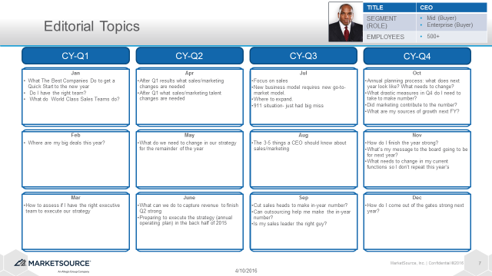
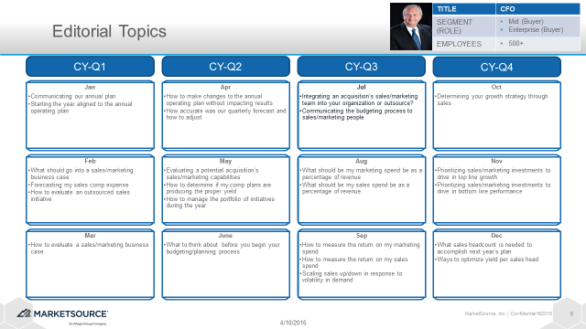
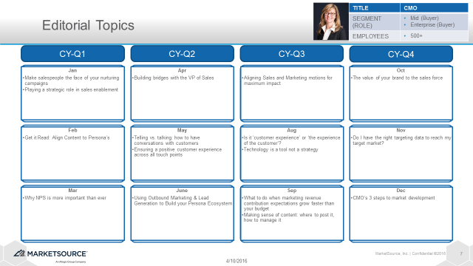
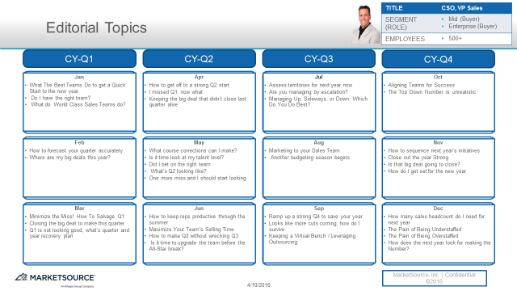
Step 1: Build the Content Calendar
Leverage calendar driven topics that relate to targeted Persona’s needs, wants and fears
Create Editorial Calendar:
Sales Driven Content Calendar
Sales & Marketing collaborate on production and distribution

Slide 28
Step 2: Identify and Assign Content to an SME (Subject Matter Expert)
Assign SMEs to Content:
Align the content topic to a resource that is knowledgeable in this area
Produce the Content:
Create drafts of content in a timely fashion to allow for group feedback and iteration
Collaboration between the SME, Sales and Marketing is essential

Slide 29
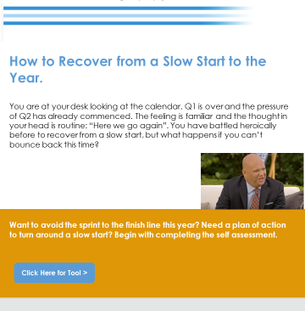
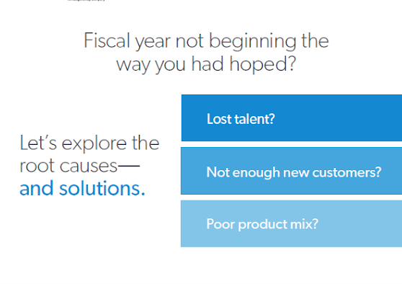
Step 3: Edit and Finalize Content for Distribution to the Market
Edit and Prepare the Content
Blog Post
Small changes (word choice) can be done electronically
Landing Page
Larger revisions are best conducted in a in-person group session
Approve Final Version of the Content
Once revisions have been completed, the final approval process and final testing will commence

Slide 30
Content RACI Schedule
SAMPLE
Marketing Content Creation
 | Creating the Annual Calendar | Assigning SME's to Content Development | Crafting / Writing the Content | Editing the Content | Approving the Content | Uploading Content to Marketo | Identifying Distribution List | Managing Distribution List | Testing Content Release | Creating & Providing Sales Enablement Tools | Building Reports and Dashboards | Assessing Performance against Metrics | Managing Personas
<ENTER NAME> | I - Informed | I - Informed | I - Informed |  | R- Responsible | I - Informed | I - Informed | I - Informed | I - Informed | I - Informed |  | I - Informed
<ENTER NAME> | R- Responsible | R- Responsible | A - Accountable | A - Accountable | R- Responsible | I - Informed | I - Informed | I - Informed | I - Informed | A - Accountable | I - Informed | R- Responsible | I - Informed
<ENTER NAME> | R- Responsible | R- Responsible | A - Accountable | A - Accountable | R- Responsible | A - Accountable | A - Accountable | A - Accountable | A - Accountable | A - Accountable | I - Informed | R- Responsible | A - Accountable
<ENTER NAME> |  |  |  |  | I - Informed | R- Responsible |  |  | R- Responsible |  | C - Consulted | A - Accountable
<ENTER NAME> |  |  |  | R- Responsible | I - Informed |  | R- Responsible | R- Responsible |  | R- Responsible | C - Consulted | A - Accountable
<ENTER NAME> |  |  |  | R- Responsible |  |  |  |  |  | R- Responsible |  | A - Accountable
<ENTER NAME> |  |  |  |  |  |  |  |  |  |  |  |  | R- Responsible
<ENTER NAME> |  |  | R- Responsible |  |  |  |  |  |  |  |  | A - Accountable | C - Consulted
<ENTER NAME> |  |  | R- Responsible |  |  |  |  |  |  |  |  | C - Consulted | C - Consulted
<ENTER NAME> |  |  | R- Responsible |  |  |  |  |  |  |  |  | A - Accountable | C - Consulted
<ENTER NAME> |  |  | C - Consulted | R- Responsible
<ENTER NAME> |  |  |  |  |  |  |  |  |  |  | A - Accountable
<ENTER NAME> |  |  |  |  |  |  |  |  |  |  | R- Responsible
<ENTER NAME> | C - Consulted | C - Consulted |  |  |  |  |  |  |  |  |  | I - Informed | C - Consulted
<ENTER NAME> |  |  |  | R- Responsible |  |  |  |  |  | C - Consulted
<ENTER NAME> | C - Consulted |  |  |  | R- Responsible |  |  |  |  | I - Informed |  | I - Informed | I - Informed
Key
R- Responsible | Those responsible for the performance of the task. There should be exactly one person with this assignment for each task.
A - Accountable | The one ultimately answerable for the correct and thorough completion of the deliverable or task, and the one who delegates the work to those responsible.
C - Consulted | Those whose opinions are sought; and with whom there is two-way communication.
I - Informed | Those who are kept up-to-date on progress; and with whom there is one-way communication.

Slide 31
Activate the Content Through Appropriate Campaign Activities
Activity Design
Objective: Design tactical marketing activities that capture the attention of the target audience by effectively utilizing the appropriate communication channels
Deliverables
Blog Content
Referral Sites & Back-linking
Webinars
Newsletters
Email
Teleprospecting
Face to Face Selling
PPC Advertising
Social Media
Tradeshows/Conferences
Sponsorships
Activity Plan

Slide 32
Additional Resources

Slide 33

Using A/B Testing to Improve Results
In order to refine the campaign and increase its effectiveness, always be testing elements of the outbound messaging. Using an A/B method focuses the experiment into two variants.
Edit and Prepare the Content:
Subject line
CTA button styles
Image size
Primary color
Use of video
Response form length
Headline
Voice/tone
A/B testing is only effective when a single variable is tested each time. This will allow you to isolate the impact and understand how changing one element of the message affects conversion rates.

Slide 34
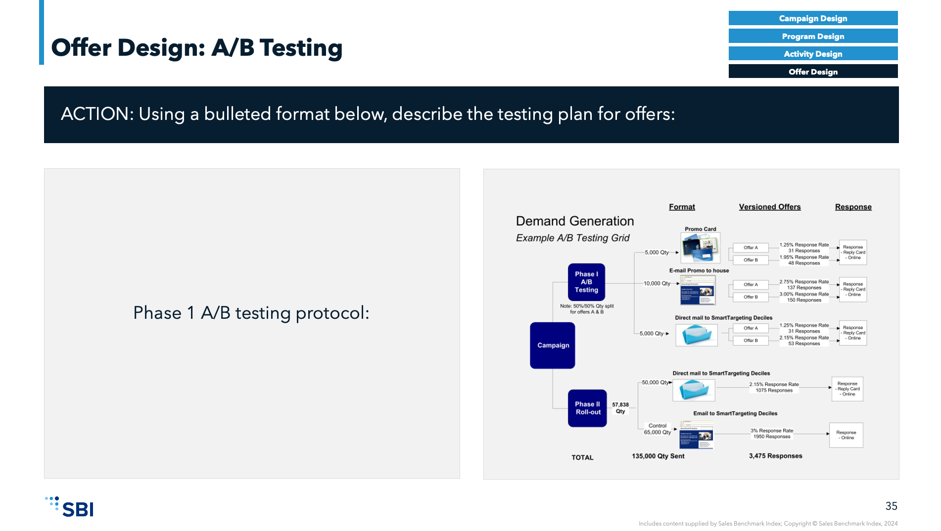
Using the A/B Testing Worksheet
The purpose of the A/B Testing Worksheet is to identify the areas of the campaign that can be tested in order to maximize audience response and engagement.
What will you test?
Start with large items, like the use of images. In a recent A/B test, Dell determined that the size of images in the outbound communication greatly impacted the response rate. The larger the image, the more engaged the audience was in the message. When the image was smaller, so was the response rate.
These kind of “structural” elements can be tested very easily. Once your audience provides you with their preference by virtue of the response rate or click-thru, you can begin testing other elements like voice/tone, color, and specific offer types.
The bottom line: have a plan. Conduct tests to determine preferences and carry the findings forward to make the campaign as successful as possible.

Slide 35
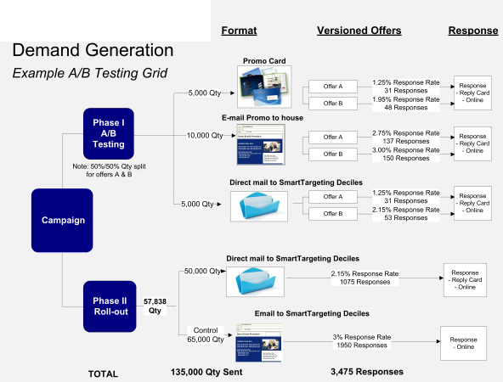
Offer Design: A/B Testing
Campaign Design
Program Design
Activity Design
Offer Design
ACTION: Using a bulleted format below, describe the testing plan for offers:
Phase 1 A/B testing protocol:

Slide 36
For more resources like this, contact your advisor or visit SBI Pro.
Schedule a session with your advisor
SBI Advisors help clients with practical advice, whether strategic or surgically tactical, to drive revenue and growth.
Contact your advisor to schedule a work session and tune this guidance to your situation.
Login to SBI Pro:
https://pro.sbigrowth.com/

