Slide 1
Quota Setting Playbook
Current as of March 30, 2024

Slide 2
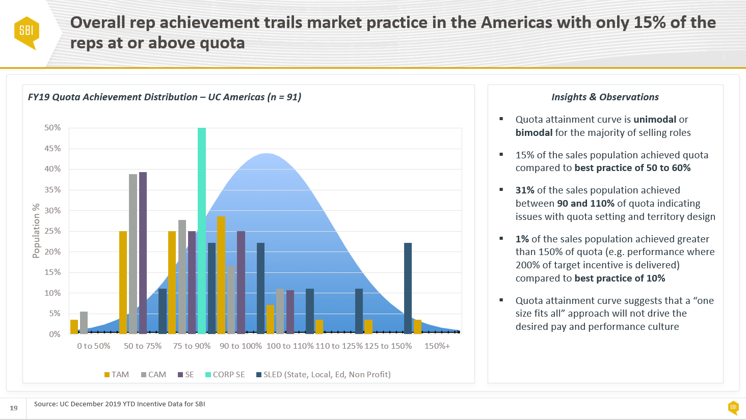
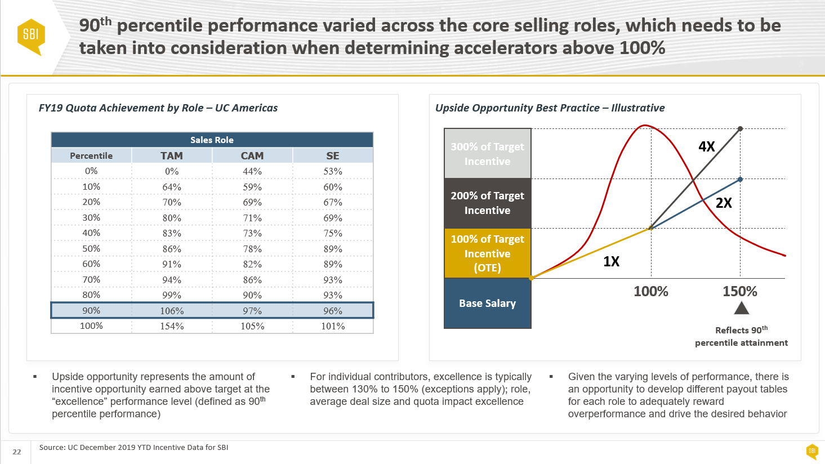
What Does Best-in-Class Quota Setting Look Like?
Overview
Link company objectives to sales rep targets.
IMPACT
Aligning quota setting processes to best practice will improve the attainment distribution curve, where approximately 50-60% of sales reps should be at or above quota. This will improve sales model cost efficiency and enable organization to retain top talent
A company’s revenue goal needs to be intelligently allocated to business units, territories, and sales reps. Unfortunately, it rarely is. Quota attainment, a metric tracked by most sales teams, often lies to executives. Reps who make quota do so because their quota expectation was based on the potential of a sales territory. Reps who miss quota do so because their quota expectation was not based on the potential of the assigned sales territory.
Example(s)
Approach
Assess Current State determine process strengths and weakness; analyze current state to understand contributing factors to quota attainment
Determine Appropriate Methodology based on available data and organization’s appetite for change
Apply Quota Allocation Methodology to develop individual rep quotas
Quota Stress Testing to understand the sales performance, incentive payout, and cost structure under various performance scenarios

Slide 3
Territory Design

Slide 4
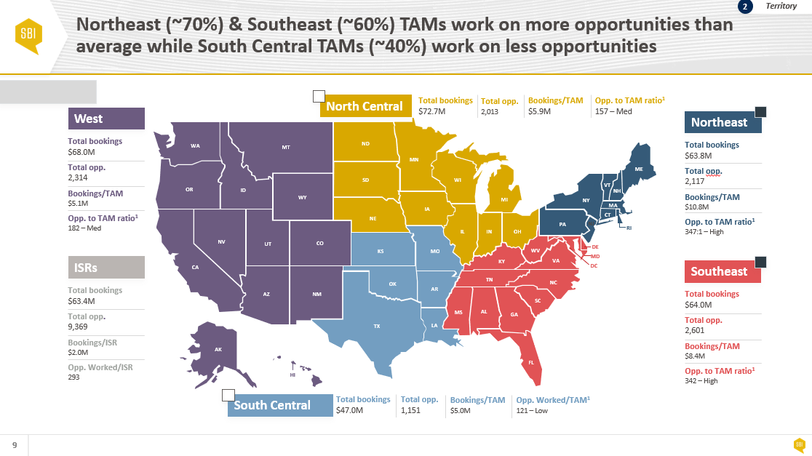
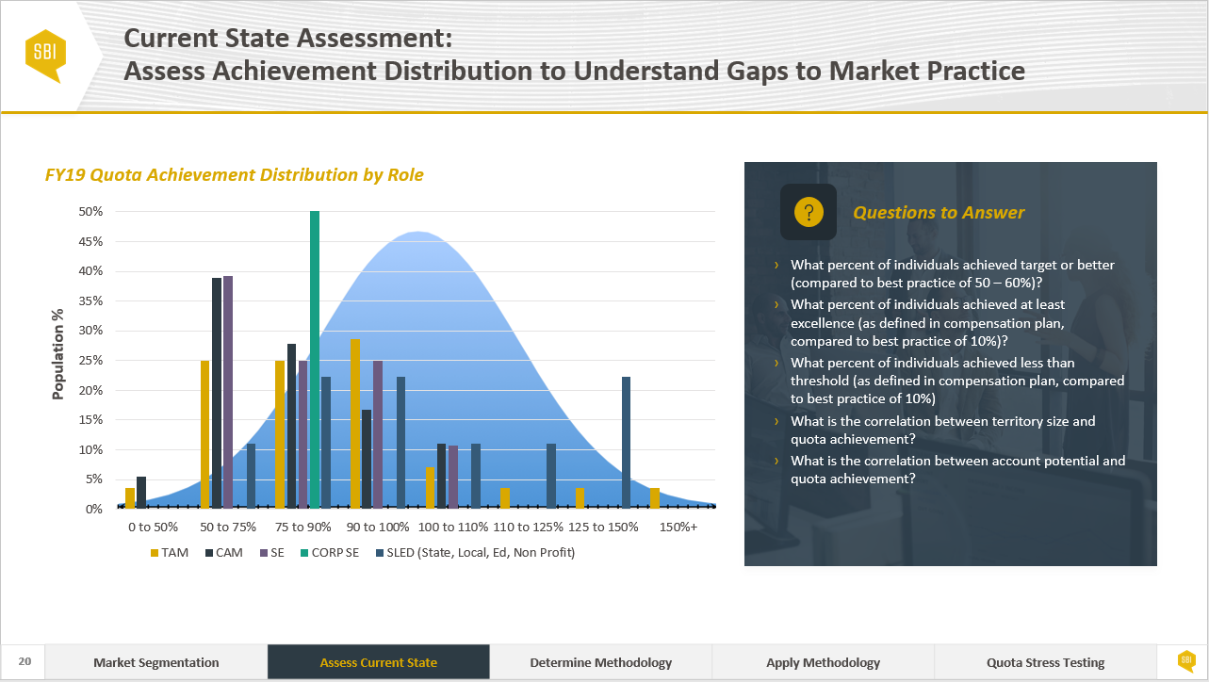
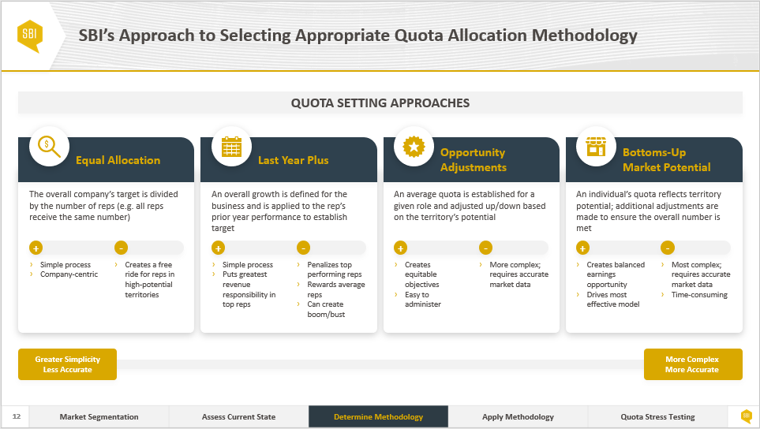
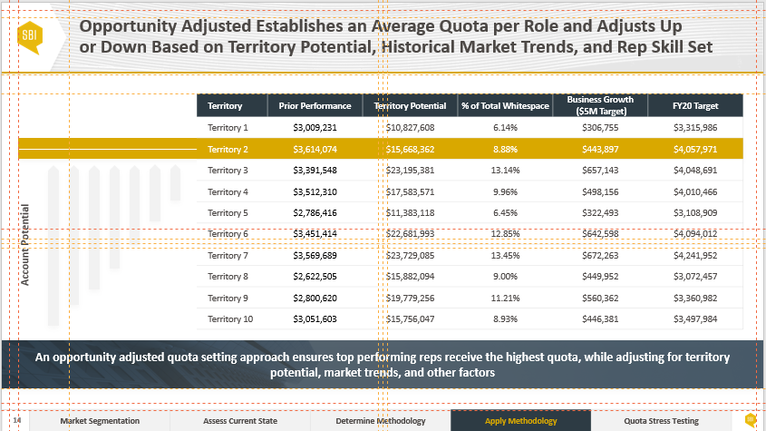
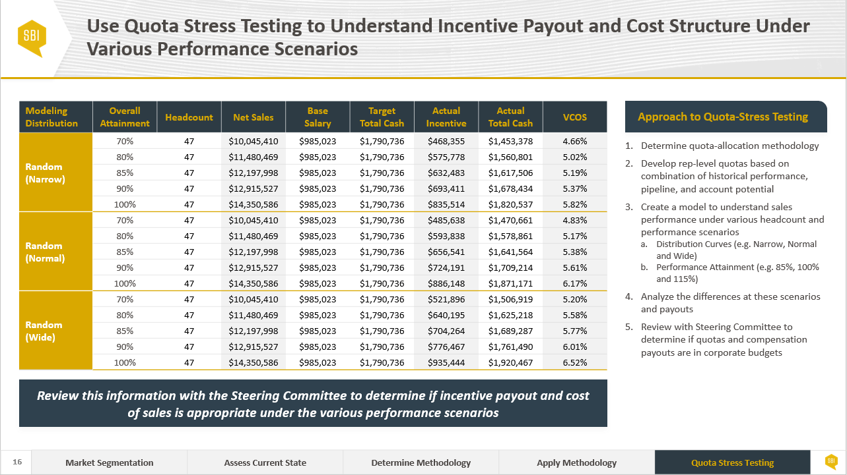
SBI Quota Setting Approach Follows a Five Step Process, Starting with Territory Design
Territory Design
Quota Setting
STEP 1: Territory Design
STEP 2: Assess Current State
STEP 3: Determine Methodology
STEP 4: Apply Methodology
STEP 5: Quota Stress Testing
Description:
Description:
Description:
Description:
Description:
Leverage account segmentation outputs to create territories (e.g. geographic or other) that are grounded in propensity to buy and service addressable market
Define rep level territories that are balanced on spend, potential and number of accounts/opportunities
Review bottoms-up and tops-down quota setting approaches
Assess quota attainment distribution by region, role, tenure, and quota band
Determine correlation between quota achievement and territory potential
Identify gaps to market practice
Select appropriate allocation methodology based on available data and level of effort
Methodologies include equal allocation, last year plus, opportunity adjustment, and bottoms up market potential
Apply quota allocation methodology to establish quotas at the rep/role level
Determine feasibility of rep quotas with a leading indicator driven approach
Understand incentive payout and cost structure under different performance scenarios
Compare required opportunities & leads to historical values based on deal size and win rate

Slide 5
Assess Current State

Slide 6

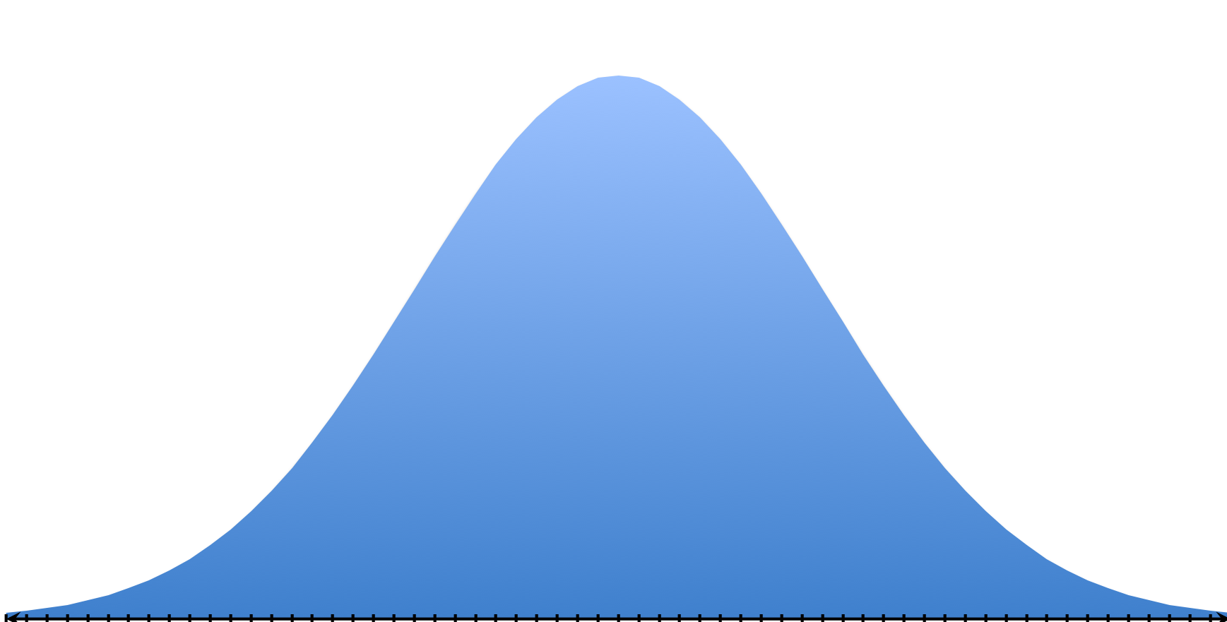
Current State Assessment: Assess Achievement Distribution to Understand Gaps to Market Practice
FY19 Quota Achievement Distribution by Role
Questions to Answer
What percent of individuals achieved target or better (compared to best practice of 50 – 60%)?
What percent of individuals achieved at least excellence (as defined in compensation plan, compared to best practice of 10%)?
What percent of individuals achieved less than threshold (as defined in compensation plan, compared to best practice of 10%)
What is the correlation between territory size and quota achievement?
What is the correlation between account potential and quota achievement?

Slide 7
Determine Methodology

Slide 8
There Are Four Common Quota Allocation Methodologies
QUOTA SETTING APPROACHES
Equal Allocation
Last Year Plus
Opportunity Adjustments
Bottoms-Up Market Potential
The overall company’s target is divided by the number of reps (e.g. all reps receive the same number)
An overall growth is defined for the business and is applied to the rep’s prior year performance to establish target
An average quota is established for a given role and adjusted up/down based on the territory’s potential
An individual’s quota reflects territory potential; additional adjustments are made to ensure the overall number is met
+
-
+
-
+
-
+
-
Simple process
Company-centric
Creates a free ride for reps in high-potential territories
Simple process
Puts greatest revenue responsibility in top reps
Penalizes top performing reps
Rewards average reps
Can create boom/bust
Creates equitable objectives
Easy to administer
More complex; requires accurate market data
Creates balanced earnings opportunity
Drives most effective model
Most complex; requires accurate market data
Time-consuming
Greater Simplicity
Less Accurate
More Complex
More Accurate

Slide 9


SBI’s Approach to Selecting Appropriate Quota Allocation Methodology Depends on Multiple Factors
 | Equal Allocation | Last-Year Plus | Opportunity Adjusted | Bottoms-Up Market Potential
Business Lifecycle | Start-Up | High-Growth | Mature | Mature
Data Quality | Lowest | Low | Moderate | High
Forecast Accuracy | Lowest | Low | Moderate | High
Simplicity | Simplest | Simple | Moderate | Complex
Speed of Execution | Fastest | Fast | Moderate | Slow
Ability to Differentiate | Not Required | Low | Moderate | High
Sales Rep Buy-In | Low | Moderate | High | Highest
Business Lifecycle: Where a business sits on the maturity curve as a measure of time, sales, and profits | Data Quality: The condition of data based on accuracy, completeness, consistency, reliability, and recency | Forecast Accuracy: How likely a rep will achieve allocated quota (e.g. the difference between actual and target) | Simplicity: The level of sophistication required to apply and implement
Speed of Execution: How quickly the quota setting process can be and needs to be achieved | Ability to Differentiate: The ability to differentiate quotas based on role, region, industry, and other factors | Sales Rep Buy-In: How much reps will believe in the equity and achievability of the quota

Slide 10
Apply Methodology

Slide 11


An Equal Allocation Methodology Distributes the Same Quota to Each Rep in the Organization
$100M
20
$5M
Field Plan
# of Reps
Rep Quota
An equal-allocation quota setting methodology is the simplest and is typically reserved for start-up organizations and/or acquisition-focused roles

Slide 12
Last-Year Plus Takes Prior Year’s Performance and Applies the Organization’s Growth Target on Top
Territory | Prior Performance | Growth Target | FY20 Target
Territory 1 | $3,009,231 | 10% | $3,310,154
Territory 2 | $3,614,074 |  | $3,975,481
Territory 3 | $3,391,548 |  | $3,730,703
Territory 4 | $3,512,310 |  | $3,863,541
Territory 5 | $2,786,416 |  | $3,065,058
Territory 6 | $3,451,414 |  | $3,796,555
Territory 7 | $3,569,689 |  | $3,926,658
Territory 8 | $2,622,505 |  | $2,884,756
Territory 9 | $2,800,620 |  | $3,080,682
Territory 10 | $3,051,603 |  | $3,356,763
Comments
Last-year plus is a simple process that puts the greatest responsibility in the organization’s top performing reps
Given the simplicity of this approach, it is often used when organizations face data integrity issues or Territory Design is not complete
This approach has a tendency of penalizing top performers and can create a boom/bust culture

Slide 13
Opportunity Adjusted Establishes an Average Quota per Role and Adjusts Up or Down Based on Territory Potential, Historical Market Trends, and Rep Skill Set
Territory | Prior Performance | Territory Potential | % of Total Whitespace | Business Growth ($5M Target) | FY20 Target
Territory 1 | $3,009,231 | $10,827,608 | 6.14% | $306,755 | $3,315,986
Territory 2 | $3,614,074 | $15,668,362 | 8.88% | $443,897 | $4,057,971
Territory 3 | $3,391,548 | $23,195,381 | 13.14% | $657,143 | $4,048,691
Territory 4 | $3,512,310 | $17,583,571 | 9.96% | $498,156 | $4,010,466
Territory 5 | $2,786,416 | $11,383,118 | 6.45% | $322,493 | $3,108,909
Territory 6 | $3,451,414 | $22,681,993 | 12.85% | $642,598 | $4,094,012
Territory 7 | $3,569,689 | $23,729,085 | 13.45% | $672,263 | $4,241,952
Territory 8 | $2,622,505 | $15,882,094 | 9.00% | $449,952 | $3,072,457
Territory 9 | $2,800,620 | $19,779,256 | 11.21% | $560,362 | $3,360,982
Territory 10 | $3,051,603 | $15,756,047 | 8.93% | $446,381 | $3,497,984
Account Potential
An opportunity adjusted quota setting approach ensures top performing reps receive the highest quota, while adjusting for territory potential, market trends, and other factors

Slide 14
Bottoms Up Market Potential Allocates Quota Proportionally to the Market Opportunity in Each Territory
The Data
Approach
$50M
$100K
Step
1
Step
2
Territory Potential
Average Deal Size
$50M
÷
$100K
=
500
500
÷
10
=
50
Territory Potential
Average Deal Size
Opportunities in Territory
Opportunities in Territory
Leads Per Proposal
Viable Opportunities
10
25%
Step
3
Step
4
Leads Per Proposal
Average Win Rate
50
÷
25%
=
12.5
12.5
÷
$100K
=
$1.25M
Viable Opportunities
Average Win Rate
Wins
Wins
Average Deal Size
Calculated Sales Quota
A bottoms-up quota setting approach is the most sophisticated model which creates equitable earnings opportunity and drives greater efficiency in the overall sales model

Slide 15
Quota Stress Testing

Slide 16

A Tops-Down and Bottoms-Up Approach to Quota Setting Is Recommended to Ensure Right Balance Between Expectation and Reality
Territory Potential
Description
Pros
Cons
The most common approach for setting quotas is tops-down; here the organization starts with a corporate target, which gets cascaded down to the various sales hierarchy
Ensures the board’s performance expectation is distributed to the field
Simple and easy to understand
Helps organizations identify the root cause of problems
Minimal weight to sales team’s abilities and historic performance
Contributes to higher sales rep turnover given unrealistic targets
The ideal approach for setting quotas is bottoms-up; sales managers start by looking at historic data and growth trends, which reflect what the reps can generate
Conservative based approach (“keep doing what you’re doing”)
Enables organization to create the most efficient coverage model and maximize expansion opportunities
Helps organizations identify the root cause of problems
More complex and timely; requires greater data accuracy
Does not sufficiently account for changing expectations with win rate, deal size, and sales cycle time
Bottoms-Up Approach
Organizations that leverage both tops-down and bottoms-up approaches are better able to identify risks and opportunities in the corporate plan

Slide 17
The Tops-Down Approach Ensures the Board Plan Is Met, While the Bottoms-Up Approach Identifies the Resource Requirements to Achieve the Plan
Board Target (Tops-Down)
Board Revenue Target | $100,000,000
5% Over-Assignment | $5,000,000
Field Quota | $105,000,000
Recommendation
Actual (Bottoms-Up)
Best Practice
The resulting calculation of Field Quota divided by the Expected Attained Yearly Quota produces the output of the Headcount Required to deliver on the Revenue Target as a result of over-assignment
Bottoms-up workload capacity approach starts with historical inputs, including percent selling time, average deal size, number of opportunities, and stage conversion rates
Allows organizations to quickly identify which levers (e.g. win rate, deal size, selling time) are misaligned to market and the corresponding uplift
Weeks in Year | 50
Hours in Week | 40
Hours in Year | 2000
% Selling Time | 60%
Hours Selling in Year | 1200
Hours per Opportunity | 10
Opportunities Per Year | 120
Close Rate | 30%
Number Closed-Won | 36
Average Deal Size | $75,000
Ex. Attained Yearly Quota | $2,700,000
Headcount Required | 39
Weeks in Year | 50
Hours in Week | 40
Hours in Year | 2000
% Selling Time | 40%
Hours Selling in Year | 800
Hours per Opportunity | 10
Opportunities Per Year | 80
Close Rate | 30%
Number Closed-Won | 24
Average Deal Size | $75,000
Ex. Attained Yearly Quota | $1,890,000
Headcount Required | 56
For every 2000 hours of administrative time, one additional sales support head is required; exact number of hours determined by multiplying number of sales reps by the number of hours in a year and the amount of administrative time we are shifting to a lower cost resource
For each business unit, this approach will calculate a different quota and headcount; this is important because stage to stage conversion rate can vary up to 4x based on segment
The incremental rep productivity often yields a more cost-effective model (e.g. productivity outpaces incremental cost of support resource)

Slide 18
Quota Stress Testing Helps the Steering Committee Understand the Incentive Payout Under Various Performance Scenarios
Modeling Distribution | Overall Attainment | Headcount | Net Sales | Base Salary | Target Total Cash | Actual Incentive | Actual Total Cash | VCOS
Random (Narrow) | 70% | 47 | $10,045,410 | $985,023 | $1,790,736 | $468,355 | $1,453,378 | 4.66%
 | 80% | 47 | $11,480,469 | $985,023 | $1,790,736 | $575,778 | $1,560,801 | 5.02%
 | 85% | 47 | $12,197,998 | $985,023 | $1,790,736 | $632,483 | $1,617,506 | 5.19%
 | 90% | 47 | $12,915,527 | $985,023 | $1,790,736 | $693,411 | $1,678,434 | 5.37%
 | 100% | 47 | $14,350,586 | $985,023 | $1,790,736 | $835,514 | $1,820,537 | 5.82%
Random (Normal) | 70% | 47 | $10,045,410 | $985,023 | $1,790,736 | $485,638 | $1,470,661 | 4.83%
 | 80% | 47 | $11,480,469 | $985,023 | $1,790,736 | $593,838 | $1,578,861 | 5.17%
 | 85% | 47 | $12,197,998 | $985,023 | $1,790,736 | $656,541 | $1,641,564 | 5.38%
 | 90% | 47 | $12,915,527 | $985,023 | $1,790,736 | $724,191 | $1,709,214 | 5.61%
 | 100% | 47 | $14,350,586 | $985,023 | $1,790,736 | $886,148 | $1,871,171 | 6.17%
Random (Wide) | 70% | 47 | $10,045,410 | $985,023 | $1,790,736 | $521,896 | $1,506,919 | 5.20%
 | 80% | 47 | $11,480,469 | $985,023 | $1,790,736 | $640,195 | $1,625,218 | 5.58%
 | 85% | 47 | $12,197,998 | $985,023 | $1,790,736 | $704,264 | $1,689,287 | 5.77%
 | 90% | 47 | $12,915,527 | $985,023 | $1,790,736 | $776,467 | $1,761,490 | 6.01%
 | 100% | 47 | $14,350,586 | $985,023 | $1,790,736 | $935,444 | $1,920,467 | 6.52%
Approach to Quota-Stress Testing
Determine quota-allocation methodology
Develop rep-level quotas based on combination of historical performance, pipeline, and account potential
Create a model to understand sales performance under various headcount and performance scenarios
Distribution Curves (e.g. Narrow, Normal and Wide)
Performance Attainment (e.g. 85%, 100% and 115%)
Analyze the differences at these scenarios and payouts
Review with Steering Committee to determine if quotas and compensation payouts are in corporate budgets
Review this information with the Steering Committee to determine if incentive payout and cost of sales is appropriate under the various performance scenarios

Slide 19

Leverage Outputs from Quota Stress Testing to Understand the Number of Leads, Opportunities, and Closed-Won Deals Needed to Hit Annual Revenue Targets
 | Historical Performance
 | Actual | % to Prior Year
FY20 Revenue Target | $14.4M | TBD
FY19 Average Deal Size | $100K | TBD
Number of Closed-Won Deals | 144 | TBD
FY19 Win Rate | 25% | TBD
Number of Opportunities | 576 | TBD
FY19 MQL to SQL Conversion Rate | 30% | TBD
Number of Leads | 1,920 | TBD
 | Ideal Future State
 | Actual | % to Prior Year
FY20 Revenue Target | $14.4M | TBD
FY19 Average Deal Size | $100K | TBD
Number of Closed-Won Deals | 144 | TBD
FY19 Win Rate | 40% | TBD
Number of Opportunities | 360 | TBD
FY19 MQL to SQL Conversion Rate | 40% | TBD
Number of Leads | 900 | TBD
Leverage historical performance inputs (e.g. average deal size, win rate and MQL to SQL conversion rate) to determine required productivity outputs (e.g. closed-won deals, opportunities, leads) required to achieve revenue targets
Identify initiatives to improve average deal size, win rate, and MQL to SQL conversion rate; recalculate required performance based on productivity improvements

