Slide 1
Revenue Growth Program Example

Slide 2
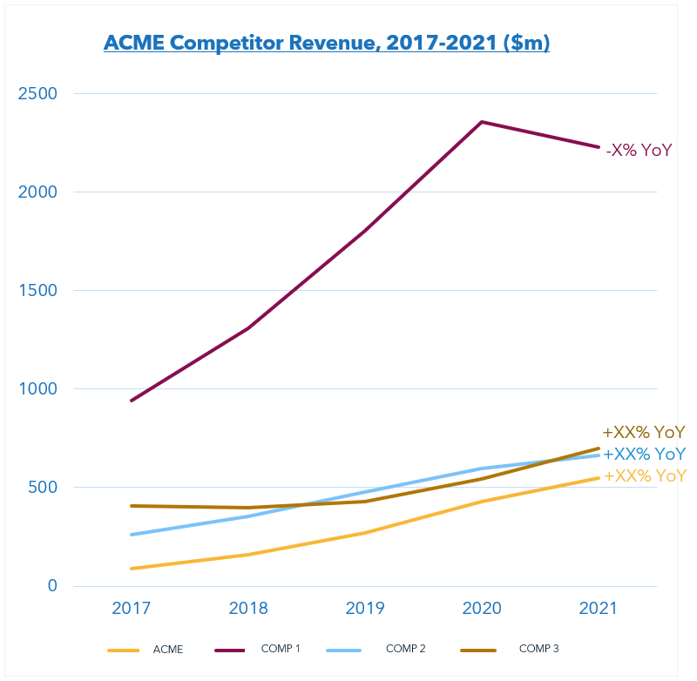
Situation and Context
Example
ACME has phenomenal growth potential…but headwinds exist
ACME has achieved $150m+ in revenue and $3b+ market cap on the strength of its technology
Massive growth potential remains
TAM is $40b and growing at 20% CAGR
$40b TAM across ACME’s 3 core use cases: A ($10b), B ($15b), C ($15b)
Top competitors are outpacing ACME in terms of revenue and/or EV
Competitor 1: $1b revenue, $14b market cap
Competitor 2: $250m revenue, $5b market cap
Competitor 3: $380m revenue, $8b market cap
ACME must re-imagine its revenue engine in order to accelerate revenue growth and overtake competitors
Product-centric to customer-centric orientation
Focus on delivering business outcomes vs. features
Pivot toward higher value customers and deals
Moving from one-size-fits to fit-for-purpose GTM
Aggressively scaling the High Velocity business

Slide 3
3-Year Vision and Journey
Example
Dramatically accelerating growth will require re-imagining ACME’s revenue engine
FY21
FY24
>$1b in revenue
$11b market cap
>$140k average ACV
Regularly close $3-5m deals
>80% gross renewal rate
Market- centric strategy
Segmented, multi-modal GTM
Lead with business value
Channel = force multiplier
Scaled High Velocity business
Affinity with technical and economic buyers
$150m in revenue
$3b market cap
~$35k average ACV
Rarely close $1m+ deals
~50% gross renewal rate
Product-centric strategy
One-size-fits-all GTM strategy
Lead with feature functionality
Disjointed channel strategy
Largely untapped Velocity segment
Affinity with technical buyers
Fundamental shift in where and how
ACME goes to market

Slide 4
Current Growth Initiatives
Example
Ongoing efforts have put ACME on the path to its 3-year goals
Establish account planning process
Develop ABM framework
Build enablement materials
Revenue
Growth Office
Key Accounts Strategy
Goal: Create a platform for driving large deals
Segment Enterprise accounts
Develop coverage model
Design key roles
Channel Sales
Goal: Drive expansion in the High Velocity segment
Systematize engagement model
Develop awareness strategy
Eliminate friction points
Improve onboarding
Customer Success
Goal: Improve CS impact and effectiveness
Define value props
Design engagement processes
Determine renewal ownership
Redesign coverage
Design key roles
Develop KPIs and scorecards
RevOps
Goal: Increase operational performance visibility
Build organization
Develop dashboards
Establish Interlock process, cadence
Fortify Sales tools
Renewals
Goal: Increase gross and net retention rates
Design org. model
Define roles, responsibilities, rules of engagement
Develop coverage model
Develop comp plan
Develop talent strategy

Slide 5
Additional Growth Levers
Example
Commercial bets aligning to 5 themes can accelerate ACME’s growth in FY22-24
Value Based Solution selling workstream execution
Renewals Model Shift workstream execution
High Velocity Inside Sales buildout
Revenue Marketing strategy and program
FY22-24 Growth
Account Retention & Expansion
Routes to
Market
Talent Acquisition & Enablement
Go-to-Market
Operational
Support
Customer Experience & Engagement
Buying center-level segmentation and GTM strategy
Pricing model optimization
ABM strategy and execution
Account Retention & Expansion
CS workstream execution
Segmented Customer Experience (CX) strategy and processes
Customer use case definition
CX analytics program
Distribution strategies
Partner segmentation / prioritization
Channel engagement model
Partner incentive model
Partner enablement resources
Customer Experience & Engagement
Routes to
Market
FY22-24 Growth
Operating model and governance design
Dataflow design and development
Tech stack integration / consolidation
Monitoring and decision support tools
Cross-functional interlock design
Cross-functional talent strategy
Employee experience design
Onboarding programs
High potential programs
Comp and quota optimization
Go-to-Market
Operational
Support
Talent Acquisition & Enablement

Slide 6
Prioritizing Commercial Bets
Example
ACME current state + SBI benchmarks informed estimated level of effort, time to realization
Account Retention & Expansion
CX & Engagement
Routes to Market
+$5-15m in revenue
+60% seller productivity
Level of Effort
Talent Acquisition & Enablement
+$60m in revenue
+NPS
GTM Ops Support
+5-20% in channel sourced revenue: ~$30-80m
+$75-100m in revenue
+Customer LTV
+Cost Efficiency
Time to Realization

Slide 7
Risks
Example
Type | Risk | Mitigation
Execution | Maintaining focus and persistence: simultaneously “building the plane while flying it” | Leverage RGO on an ongoing basis to avoid internal conflict between RGO initiatives and BAU activities
 | Lack of internal capacity | Factor internal capacity constraints in “time to execute”; prioritize initiatives accordingly Identify gaps to address with supplemental external resources
Operational | Disruption to customer relationships stemming from revised coverage | Transition plan for high-touch segments and marketing campaigns for low-touch to positively position the account changes and proactively communicate to customers
 | Required enhancements to CRM and other systems supporting GTM execution | Establish communication mechanisms / cadence from RGO to IT for prioritizing IT enhancements to support RGO business decisions
Talent | Lack of skillsets to execute initiatives | Continue to identify gaps, develop new job descriptions as necessary, and scale recruiting
 | Unwanted attrition due to org. disruption | Communicate and positively position changes at SKO HR to lead change management efforts on an ongoing basis Succession planning in key roles
 | Loss of morale / motivation due to changes in territory / comp | Engage HR for support in developing a comprehensive communication and change management strategy, including how revised segmentation and coverage will drive company-wide revenue uplift and improve “total benefits/ comp”
Financial | Initiative investments fail to generate anticipated returns | Communicate proactively, monitor and triage early warning signals
 | Transformation fails to resonate with investors; EV remains the same or declines | Communicate transparently the factors and market conditions that impacted outcomes

Slide 8
For more resources like this, contact your advisor or visit SBI Pro.
Schedule a session with your advisor
SBI Advisors help clients with practical advice, whether strategic or surgically tactical, to drive revenue and growth.
Contact your advisor to schedule a work session and tune this guidance to your situation.
Login to SBI Pro:
https://pro.sbigrowth.com/

