Slide 1
Revenue Marketing Methodology

Slide 2
Executive Summary: Revenue Marketing
What is a Revenue Marketing strategy?
Why a Revenue Marketing Strategy Works
Key Goals of the Revenue Marketing Strategy
A revenue marketing strategy aligns people, process, and technology within marketing to the revenue goals of the business. Marketing ensures it is supporting the revenue needs of all relevant stakeholder in Sales, Customer Success, Channel, and Product Management.
Is tied to the GTM strategy set by the CEO/Board
Reflects the goals of the Sales Strategy & Revenue Plan
Provides actionable guidance to marketing on campaigns, people, budget, priorities, and content
Aligns marketing to the broader business objectives
Creates accountability
Has a three-year view
Understanding marketing’s role in the business
Benchmarking past performance
Building a business case for increased/reduced marketing investment
Identifying how marketing supports the other functions within the RGM
Driving alignment with a unified revenue growth plan
Mapping the gaps/opportunities across People, Process & Technology

Slide 3
SBI Organization Design and Coverage Model Approach Follows a Six Step Process, Starting with a Current State Analysis & Performance Review
Defining how marketing will support revenue generation
Building the plan to execute on the strategy
STEP 1: Business Objectives
STEP 2: Marketing Priorities
STEP 3: Marketing Goals
STEP 4: Marketing Strategy
STEP 5: Key Actions
STEP 6: Operationalizing
Description:
Description
Description:
Description
Description:
Description
Description
Description:
Description:
Description
Description
Understand what the company wants to achieve in the next 3-5 years
This will help understand how marketing should prioritize its resources
Define the top areas of focus for marketing leadership such as org structure and hiring, routes to market, branding, messaging, etc.
Determine what marketing will contribute to the business objectives, i.e. through brand awareness, contribution to pipeline, contribution to revenue, sales leads, etc.
Define the approach marketing will take to achieve its goals
Define where revenue targets come from: cross-sell, upsell, new logo, or a combination
Determine if increase brand awareness is needed across channels and buyers
How the marketing strategy will be executed
Identify clear actions to execute on the marketing strategy, such as brand generation, ABM campaigns, enhanced buyer journey on the company website
Determine how marketing will work cross-functionally to execute the strategy and support the revenue plan
Component as to consider include Marketing Tech Stack, Website Development, Messaging and Content Development, CRM and Automation, ISR Automation and Calling
Business Objectives | Marketing Priorities | Marketing Goals | Marketing Strategy | Execution | Operationalizing

Slide 4
Best practice for business planning is to prioritize initiatives that have large impact, are achievable, and align GTM functions towards a common goal
Executive team collaborates to select 3-5 initiatives that are large impact, achievable, and aligned towards a common commercial goal
Quantifying the time, effort, and ROI of bets allows executives to make objective, informed tradeoff decisions versus making subjective or reactive decisions on where to make strategic investments.
It also helps understand when to expect results so teams don’t lose patience and change direction prematurely.
Time to Realization
How long before you see return on your investment?
6-9 Months, 9-18 Months, 18-24 Months
Level of Effort
How many resources and change will this bet take to implement?
Low, Medium, High
Impact on Enterprise Value
How much return on your investment can you expect?
Bet Placed
Bet Not Placed
New Product Launch
Customer Success
Talent Investment
Go-To-Market Transformation
LEVEL OF EFFORT
Pricing
Inside Sales
Revenue Marketing
Territory & Quota
TIME TO REALIZATION
Size of Bubble = Impact on Enterprise Value over selected horizon
Business Objectives | Marketing Priorities | Marketing Goals | Marketing Strategy | Execution | Operationalizing

Slide 5

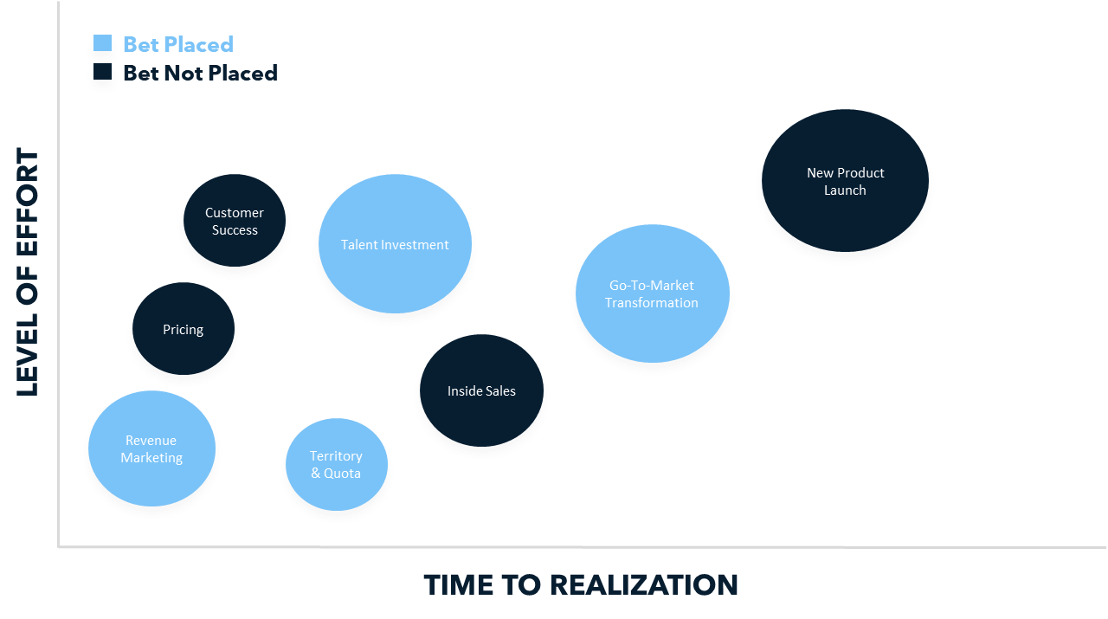

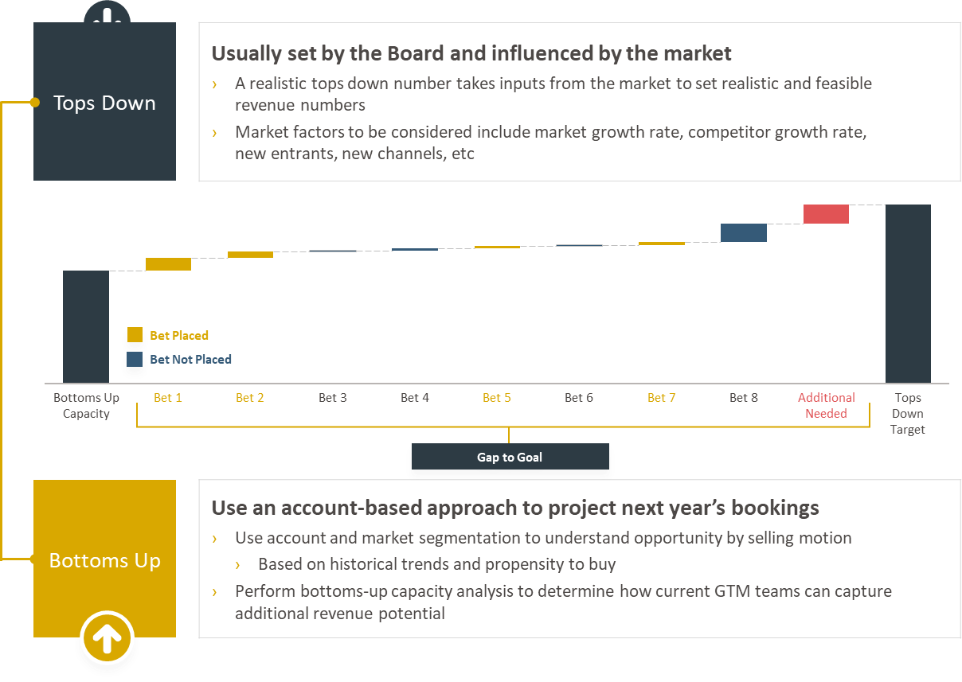
Revenue marketing goals must reflect the actions, guidance, and numbers articulated in the annual revenue plan built by Sales
Key Interlock Points:
Account segmentation
Buyer/customer journey
Sales enablement
Persona messaging
ABM and account plans
Lead follow-up SLAs
Business Objectives | Marketing Priorities | Marketing Goals | Marketing Strategy | Execution | Operationalizing

Slide 6
Assess the current state marketing organizational design for gaps and opportunities
Example Assessment:
Strengths
At the middle management and staff level Veritas has a strong bench of committed performers
The key functional areas needed to develop an Enterprise-caliber marketing operation exist
Opportunities
The current structure encourages role corruption and discourages accountability. For example, Solutions marketing updating website pages and Corporate marketing developing campaigns collateral
There is not a clear hierarchy with Solutions falling under CPO budget authority and Marketing contained within “Sales Enablement”
There is duplication of efforts because managers do not organize efficiently
Key Next Steps
Bring all Marketing functions & budget under the CMO
Ensure a single senior team member directs the global branding, strategic messaging and Solutions marketing
Promote or hire visionary agents of change to support the CMO as senior managers
Without an experienced, centralized leader to define top priorities and goals and execute a clear strategy, teams have confusion around roles and responsibilities, massive role corruption issues, and often have duplicative, missed work assignments or projects that are abandoned midstream. Most past successes can be attributed to staff who have gone above and beyond to patch these issues with overexertion and temporary fixes—staff burnout and attrition in Corporate and Campaigns is a risk at present.
1 | There is a core leader (CMO) who develops and operationalizes a focused strategy with the rest of the marketing organization | _{GULF}
2 | There are clearly defined marketing functions that operate in an integrated fashion | _{GAP}
3 | There is clarity about roles and responsibilities for cross-functional activities like campaign planning | _{GULF}
4 | There are strong agents for change directly managing the marketing staff | _{ALIGNED}
5 | The right people are in the right roles and overseen by the right managers | _{GULF}
6 | There is a sense of unity, team, and singleness of purpose within the marketing department | _{GAP}
7 | There are A-player role descriptions for each position on the Marketing organizational chart | _{GAP}
8 | The % distribution of A/B/C players on the Marketing team is known | _{GAP}
9 | You assess the talent on your Marketing team more than one time per year | _{GAP}
10 | The assessment process extends into the hiring process, so you only bring in A-player talent into the organization | _{GULF}
Business Objectives | Marketing Priorities | Marketing Goals | Marketing Strategy | Execution | Operationalizing

Slide 7
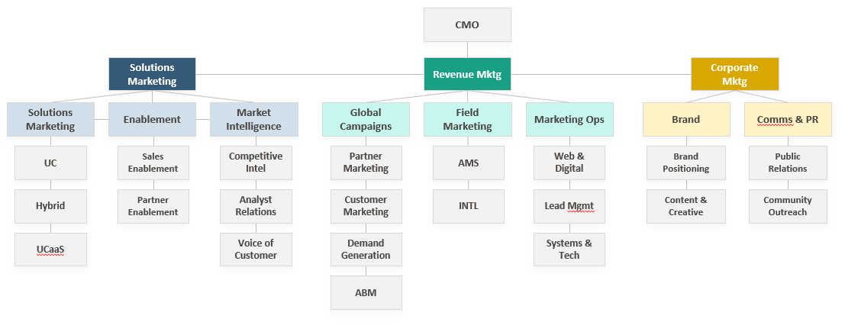
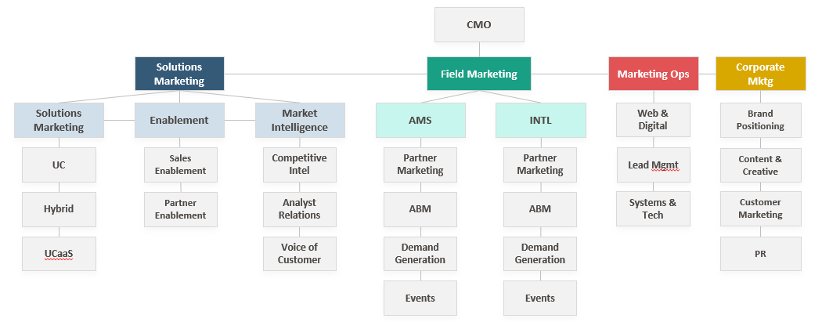
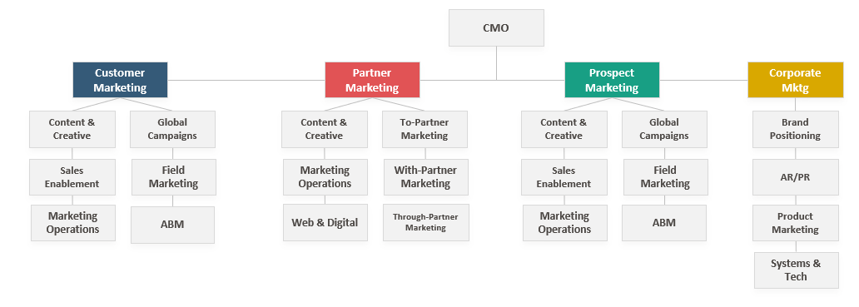
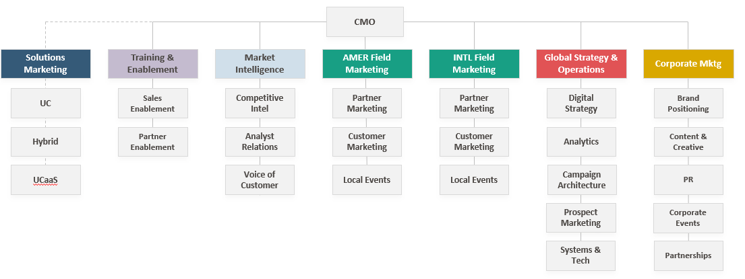
Choose a marketing organization that aligns with your primary marketing priorities and business objectives
OPTION A: Centralized
All messaging and programs driven by corporate marketing
OPTION B : Field-driven
Messaging and programs under field control
Benefits: Ensures strong message consistency across all platforms
Drawbacks: Communications can lack regional, channel and tactical nuances
Benefits: Allows for more autonomy at field level which will influence relevant messaging and campaigns
Drawbacks: Can cause inefficiencies and duplicate efforts, limited span of control
OPTION C: Audience-driven
Messaging and programs driven by audiences (partner, prospect ,and customer)
OPTION D: Hybrid/Field-Centralized
Corporate marketing driving messages and programs for field delivery
Benefits: Flat org, allows for autonomy at field level which will influence relevant messaging and campaigns
Drawbacks: Can cause inefficiencies and duplicate efforts
Benefits: Allows for hyper-targeted, audience-based messaging and content
Drawbacks: Can cause inefficiencies and duplicate efforts, limited span of control
Business Objectives | Marketing Priorities | Marketing Goals | Marketing Strategy | Execution | Operationalizing

Slide 8
Assess the current state marketing budget to determine if it is creating the desired returns on investment across people, process, and technology
Example Assessment:
Strengths
Marketing budget is within an acceptable range for percent of annual revenue
Budget is managed effectively without significant under/overspending
Opportunities
Current budget is over-allocated in headcount spend (45% vs 35% Benchmark)
Current budget is under-allocated in program spend (55% vs 65% Benchmark)
Events are underfunded despite accounting for ~68% of marketing generated revenue
Channel Marketing is underfunded despite a high percentage of Partner sourced revenue
Budget does not map back to specific campaigns, limiting reporting/visibility
Key Next Steps
Reduce allocation of headcount spend
Invest funding in Program Spend; Events, Channel Marketing
Integrate data across systems to tie in budget/spending figures to campaigns
The majority of current marketing performance is managed via excel reporting to pull data together from different systems. As a result it is difficult to tie spend back to specific campaigns and marketing-generated revenue. Necessary investments to address lead flow problems, staffing a senior Solutions role to own strategic messaging, and closed-loop reporting across finance, OSC, Eloqua and Adobe Analytics databases should be funded through a general reallocation away from headcount and towards programs, and reductions in under-performing and unreportable current activities.
1 | Accounts with the most potential are the focus of most of the marketing budget. | _{GULF}
2 | The marketing budget is sufficient to enable your company to reach your addressable market. | _{ALIGNED}
3 | The marketing budget is allocated against the “sweet spot” of your target market. | _{GAP}
4 | The marketing budget is sufficient to enable the company to achieve its revenue growth objective. | _{GAP}
5 | The marketing team utilizes an objectives-based budging method to assure you are focused on the most effective tactics. | _{GULF}
6 | Team actively measures the return generated from your marketing budget investments and adjust accordingly. | _{GAP}
7 | The budget is allocated strategically across markets, regions, and industries (not peanut butter spread) | _{GAP}
8 | Marketing spend is managed to the appropriate level required to outperform your competitors. | _{ALIGNED}
9 | Marketing has control over their marketing budget and the company prioritizes marketing needs appropriately. | _{GAP}
10 | Your budget is aligned with the strategic objectives of your go-to-market engine (i.e. Marketing, Sales, and Customer Success). | _{GAP}
Business Objectives | Marketing Priorities | Marketing Goals | Marketing Strategy | Execution | Operationalizing

Slide 9
Execution requires clear roles and responsibilities across the entire organization
Category | Description | Examples | Training & Enablement | Marketing Strategy & Ops | Field Marketing AMER/INTL | Demand Strategy & Digital | Corporate Marketing | PMO
Audience Definition | Define the specific segments, accounts, personas, and contacts we’ll target, and which products/solutions we want to position | Target Segment(s) Accounts Lists Buyer Personas | C | R | C | RA | S | CROSS FUNCTIONAL SUPPORT & CONSULTATION
Messaging Strategy | Define the core message(s) that will be delivered to each account/persona at each stage of the buyer’s journey. | Positioning Statement Primary Messaging Message Pillars | I | S | C | AS | RA
Content Development | Define the content and collateral to be deployed as an incentive for action - in alignment with each stage of the buyer’s journey. | Research Reports eBook/Whitepaper Case Studies | I | CI | CS | A | RA
Campaign Strategy | Define the demand creation vehicle(s) to be leveraged, and the sequencing / delivery cadence. | Themes & Pillars Campaign Calendars Tactic/Channel | I | CS | CS | RA | S
Campaign Execution | Execute the campaign strategy, schedule campaigns, create nurture flows, place media buys, manage direct mail pieces, etc. | Paid Media Nurture Track Design Manage Webinars | I | S | RC | RA | S
Sales Enablement | Develop the internal sales enablement content to equip the field with the knowledge, tools, and resources to be successful | Competitive Intel Battle Cards Sales Presentations | RA | I | S | I | SI
Regional/Local Events | Identify opportunities to engage with communities at a regional and/or local level. Plan and execute events & tradeshows | Events Trade Shows Local Associations | I | S | RA | AS | RS
Technology Infrastructure | Develop the technology infrastructure to support marketing initiatives. | Marketing Automation Chat ABM Tools | S | SC | C | RA | S
Reporting & Tracking | Process for testing messages, measuring results, and tracking performance. | Lead Management Attribution KPIs & Dashboards | C | AS | C | RA | I
Business Objectives | Marketing Priorities | Marketing Goals | Marketing Strategy | Execution | Operationalizing

Slide 10
Driving Success Through Centralized Planning and Focused Campaigns
CAMPAIGN SCOPE
CAMPAIGN PLAN
Marketing and Product leaders define campaign scope, outcomes, KPIs, and provide resource and budget.
Fully integrated campaign strategy, content, programs, and tactics developed.
1
2
3
4
5
MARKET OPPORTUNITIES
CAMPAIGN DEVELOPMENT
GLOBAL CAMPAIGN EXECUTION
Sales, Marketing, and Product leaders define key market opportunities and desired outcomes for the fiscal year.
Campaigns and product marketing jointly own creating the deliverables, field execution, reporting and success.
Execute campaigns through website, digital, partner programs, internal comms and field programs.
Business Objectives | Marketing Priorities | Marketing Goals | Marketing Strategy | Execution | Operationalizing

Slide 11
Suggested Meeting Cadence
CADENCE | WEEK # | MEETING DURATION | MEETING | DESCRIPTION | REQUIRED ATTENDEES
BI-WEEKLY | Ongoing | 60 minutes | Program Review | Goal: Planning session for prioritized Revenue Marketing & installed-base / prospect campaigns; Alignment meeting to discuss sequencing, resourcing, and ensure execution resources are aware of priorities Lead by: Corporate Marketing Lead and Demand Strategy & Digital Lead | Corporate Marketing Demand Strategy & Digital Field Marketing Marketing Strategy & Ops Training & Enablement
 | Ongoing | 60 minutes | Weekly Update | Goal: Review campaigns and Share go-forward plan and address concerns from team with stakeholder Lead by: Demand Strategy & Digital Lead | Demand Strategy & Digital Field Marketing Marketing Strategy & Ops
MONTHLY | Ongoing | 60 minutes | Program Update | Goal: Report out of marketing sub-teams account status, touch point execution and campaign success Lead by: Corporate Marketing Lead and Demand Strategy & Digital Lead | Demand Strategy & Digital Field Marketing Marketing Strategy & Ops Solutions Marketing Sales Leader Partner Leader
SEMI-ANNUAL | Every 12 weeks | 2-4 hours | Revenue Marketing Planning Session | Goal: Review last quarters performance and begin planning and budgeting for the upcoming year Lead by: CMO | Corporate Marketing Demand Strategy & Digital Field Marketing Marketing Strategy & Ops Solutions Marketing Sales Leader Partner Leader
ANNUAL | Every year | 1 day | Marketing Summit | Goal: Align on Revenue & Field Marketing priorities for the upcoming year Lead by: CMO | Corporate Marketing Demand Strategy & Digital Field Marketing Marketing Strategy & Ops Solutions Marketing Sales Leader Partner Leader
LOW
REVENUE MARKETING PROGRAM MATURITY
HIGH
NOTE: Bi-Weekly meetings recommended for early stage revenue marketing programs, but can be paired down to monthly once cadence and operating rhythm is established; Semi-Annual Revenue Marketing can become more frequent (Quarterly) as program scales
Business Objectives | Marketing Priorities | Marketing Goals | Marketing Strategy | Execution | Operationalizing

Slide 12
Operationalizing the marketing strategy requires cross-functional collaboration between product, sales, customer success, and marketing
 | FUNCTION | WHAT FUNCTION OWES MARKETING? | WHAT MARKETING OWES FUNCTION
INTERLOCKS | Product | Communicate the priority of Products and/or Solution groups Written documentation of product level research of the market, user and buyer needs, solution benefits and business case, points of differentiation and win strategy Collaborate with Product Marketing on product revenue objectives and launch plans – specifically through annual planning, quarterly plan updates | Marketing Plan written against the Product Strategy with plans that demonstrate how resources are allocated to reach the goals Detailed product launch plans with allocation of resources to hit deadlines, regular updates on progress Dashboards by product and/or priority solution area with real-time updates on marketing ToFu, Opp Management and Sales Wins against product goals Personas and Buyer Process Maps for members of Buying Decision Team and key influencers Quality positioning and sales enablement materials that convey the differentiation of the products and solutions
 | Sales | Communicate precise revenue goals by product and region Agree on common definitions for funnel stages Adhere to SLA for SQL/SAL follow-up Maintain active account and contact records in CRM Collaborate with marketing in Account-based Marketing and Sales Enablement initiatives to identify where custom SE materials, demos, RFP, etc. at the deal level can push a deal forward | Provide quality contact-level information updates and insights in a timely basis Battlecards that show true differentiation Higher quality leads from MDR team Active participation of Marketing in Pipeline review calls and QBRs to identify Sales Enablement opportunities ABM initiative partnership with high focus on 8-10 new logo and 7-8 base opportunities Higher quality CRM data through quality list purchase and data enrichment of key personas
 | Customer Success | ‘Enlist’ cross-sell/up-sell opportunities to marketing campaigns Add CRM contacts for users, buyers and influencers by account, map the BDT and assign persona tags Provide suggestions on marketing content and insights on the performance of existing content Coordinate permission/interviews with account level personas for referrals/case studies | Provide quality contact-level information updates and insights in a timely basis Communicate a campaign calendar of events and campaigns to suggest to customers Provide guidance for enlisting customers into automated nurture paths Notify CSM’s of relevant activity in marketing funnel for base contacts to work in coordination Provide X-Sell/Up-Sell content Provide buyer and influencer personas and Buyer Process Maps to guide CSM activities Onboarding content
Business Objectives | Marketing Priorities | Marketing Goals | Marketing Strategy | Execution | Operationalizing

Slide 13
For more resources like this, contact your advisor or visit SBI Pro.
Schedule a session with your advisor
SBI Advisors help clients with practical advice, whether strategic or surgically tactical, to drive revenue and growth.
Contact your advisor to schedule a work session and tune this guidance to your situation.
Login to SBI Pro:
https://pro.sbigrowth.com/

