Slide 1
Sales Coaching Playbook
A practical handbook for those who manage sales teams

Slide 2
Agenda
0. Introduction
12
I. Sales Coaching Excellence
17
  The Coaching Mindset
  5 Habits of Effective Coaches
  Coaching Methodology
    Skills Assessment
    Coaching Guidance
    Skills Development Plan
    Skills Coaching Guidance
    Skill Rubrics
  Establishing a Sales Management Cadence
  18
  23
  29
  33
  40
  47
  55
  85
  60
II. 1:1 Sales Coaching Cadence Meetings
65
  1:1 Coaching Session
  Deal Deep Dive
  Side-by-side Coaching Session
  66
  68
  70
III. Sales Team Cadence Meetings
72
  Daily Stand-Up Meeting
  Team Pipeline Review
  Team Forecast Review
  Team Skill Building Session
  73
  74
  76
  78
IV. Sales Director Cadence Meetings
80
  1:1 Sales Manager Coaching Session
  Team Pipeline Review
  Team Forecast Review
  Team Meeting
  81
  82
  83
  84

Slide 3
Playbook Introduction
Benefit
Data
1
A coaching playbook helps managers deliver consistent, effective coaching in a systemic manner that elevates the training all AEs receive
1
80% of Senior Executives say that meetings fail to achieve expectations and create value
Benefits of a Coaching Playbook
2
Dedicated coaching helps reps improve their win rates, shorten deal cycles, and increase deal size; a coaching culture can help sales managers achieve their number
2
66% of surveyed AEs say that managers’ coaching positively affected their deal outcomes; learning new skills and improving existing skills are the largest factors (53%, 49%)
3
The biggest constraint to coaching is manager time; defined coaching cadences and motions provide reps with the time needed to learn new skills
3
Only 63% of AEs say their managers provide enough coaching while sales managers tend to overestimate the time they spend coaching
4
Coaching scales well as initial investments pay dividends; continually growing seller competencies allows reps to rely upon and utilize each other as resources
4
At a leading technology firm, 56% of AEs utilize peers to improve as a salesperson; if the entire sales team is aligned on process and skills, then top performers can effectively disseminate skills

Slide 4




The Learn-Watch-Do-Reinforce Framework ensure managers knowledge and ability to leverage the Sales Leader Playbook effectively
Sales Leader Playbook Training and Adoption
01
02
03
04
LEARN
WATCH
DO
REINFORCE
Conduct a series of Sales Leader Playbook overview sessions with managers and directors
Review key components of the playbook, with separate sessions for each section (The Coach, The Manager, etc.)
Discuss ways to leverage the various tools available
Reinforce the content and behaviors learned through observing the lesson in action
Watching activities can be pre-recorded, live shadowing or best in class reference material
Only topics that require a behavior or action to emulate will move to this step
Managers will demonstrate proficiency in topics and behaviors discussed
This will include conducting skills assessments creating skill development plans with AEs, scheduling the proper cadence with their teams, and conducting live sessions (1:1 coaching, team building, etc.)
Managers consistently apply knowledge of coaching activities in their day-to-day role
Activities are improved through coaching by directors and sr. directors
Ongoing sales leader sessions will be leveraged to continue instilling coaching structure within the organization

Slide 5
Metrics to track to understand the adoption and success of the Sales Leadership Playbook
 |  | Metric or KPI | Detail
Execution Metrics | 1 | Usage | Usage and engagement with Playbook (i.e., opens over time, time spent on a page)
 | 2 | Coaching Calls | # of coaching calls held
 | 3 | Skills Assessment | Completion of the Skills Assessment (Manager and AE)
 | 4 | Skill Development Plan | Completion of the Skill Development Plan (Manager and AE)
Leading Indicators | 4 | Skills Assessment | Increase in ratings on the Skills Assessment
 | 5 | Pipeline Movement | Increased rate at which opportunities move through the sales process
 | 6 | Conversion Rates | Increased Conversion Rates
Lagging Metrics | 9 | Quota Attainment | Increased Quota Attainment %
 | 10 | Win Rate | Increased Win Rate %
 | 11 | Productivity Per AE | Increased Productivity Per AE
 | 12 | Side-by-Side Coaching | Decreased number of side-by-side and ad hoc coaching calls
 | 13 | Pipeline Creation | Increased pipeline creation per month vs. Goals
 | 14 | Pipeline Qualification | Increased pipeline qualified vs. goals
 | 15 | Activity Metrics | ASP vs. Peers on team
 | 16 | Attrition | Decreased regretted attrition

Slide 6
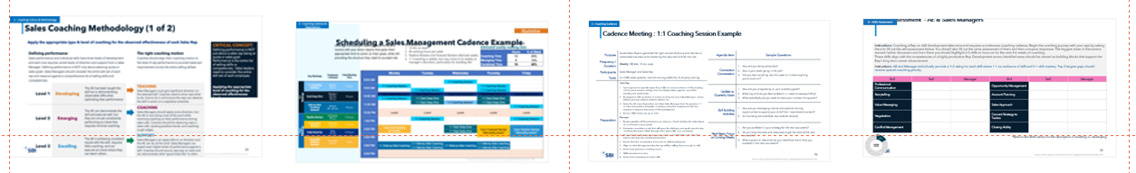
Coaching Program End State
Elements
Coaching Methodology
Coaching Sessions/ Cadence
Coaching Session Detail
Skill Development
Detail
Illustrates the different phases of the coaching journey
Outlines the common pitfalls and the principles to be an effective coach
Bi-Weekly
Team Pipeline Review​
Team Forecasting Review
Team Skill Building
Weekly ​
1:1 Coaching Session
Deal Deep Dives
Daily / As Needed
Daily Team Scrum​
Side by Side Coaching
Understand frequency, participants, and how to prepare
Meeting agenda and sample coaching questions
Guidance on behaviors to assess rep competency and develop necessary skills
Provides context for each skill and how to initiate the conversation

Slide 7
What’s in this section?
This section will provide the sales coach with the recommended preparation necessary for each coaching session. In addition, we use a standard coaching template and regular metrics to track sales process during every session. This document provides the overall framework to be followed for effective coaching.
I
How do I use this section?
Sales Coaching Excellence
Sales managers should use this section to better understand the differences between managers and coaches, learn the coaching methodology, the most common habits of effective sales coaches, and what to consider when establishing a cadence for sales management. Reference this sales coaching advice and be actively involved in regular coaching discussions that will improve sales performance.
Key Content
The Coaching Mindset
5 Habits of Effective Coaches
Coaching Methodology
  Skills Assessment
  Coaching Guidance
  Skills Development Plan
  Skills Coaching Guidance
  Skill Rubrics
Establishing a Sales Management Cadence

Slide 8
The Coaching Mindset

Slide 9
The Coaching Mindset (1 of 2)
Coaching Culture & Methodology
What is Coaching?
What are the advantages of the coaching mindset?
The coaching model is based on the belief that the question is the answer. The coach is responsible for helping people discover the answers they need through developing their own problem-solving skills. Therefore, good coaches consistently use insightful questions to help their people think through how to solve their own challenges. Ultimately, we want to help develop self-sufficient team members that consistently grow and achieve their goals.
Coaching uses a process of inquiry so that people can access their skills to reach their own level of awareness; it taps into
unused or underused strengths to advance their personal growth and learning
Coaching builds accountability by providing a safe environment for people to work on achieving the commitments they have made
Coaching is collaborative and interactive; it is about making personal discoveries and growing as an individual, rather than a premeditated process
Coaching is about responding to the needs of other people, rather than forcing them to follow a program
Coaching motivates people to reach their highest levels of productivity by creating new possibilities that didn’t exist before in their minds
2
Managing vs Coaching
The terms manager and coach are often utilized to mean the same thing, but they really focus on vastly different skillsets. Here is a quick overview of the differences between the two roles:
What do managers do? | What do coaches do?
Oversee resources and their production Define and manage processes Lead projects , review data, and solve problems | Bring out the best in people by focusing on strengths; encourage change & growth Have the right questions, but maybe not all the answers Empower people to be accountable for all their successes and failures

Slide 10
The Coaching Mindset (2 of 2)
Coaching Culture & Methodology
Guidelines for Coaching Success
For any coaching initiative to be effective and long lasting, there are important guidelines that the coach must follow consistently. These guidelines are as follows:
2
1
The Coach Must Have a Coach. First, it is important for coaches to receive training in coaching methods and competencies. This is because it is often hard
for managers to think like coaches should. In addition, every coach should themselves have a coach to guide and challenge them.
2
Coaching is a Choice, Not an Obligation. The relationship between the coach and employee is one of collaboration and partnership, not obligation.
Forced coaching will often be met with resistance. Participants must feel their best interests are primary to achieve real breakthroughs.
3
Surrender Your Agenda. Moving from a manager mindset to one of a coach is challenging. Separating your agenda from those you supervise is difficult.
Recognize the differences and be sure to adjust your thinking to one of total commitment to the growth of your employee.
4
You are Coaching People, Not Changing Them. Coaching, at its core, is a process of personal discovery. Improvement in humans is a process, not an imposed action. The approach of mandating change or new behaviors typically will backfire. Your employee might comply temporarily, but there will be no personal growth, buy-in or loyalty developed.
5
Trust is the Basis of Coaching Success. Safe and open communication is vital for personal breakthroughs to occur. Your employee must feel their best interests
are paramount to you, or they will not confide in you. Breach of this trust is deadly to the coaching process.
5
Recognize That Coaching Skills Differ from Management Skills. Good managers focus on process, results, sales, resources, customer satisfaction and the like.
A good coach focuses on one thing: the progression of their employee as they improve the attitudes, skills and behaviors that the employee wants to improve.

Slide 11
Principles to become a more effective coach
Coaching Culture & Methodology
There are key coaching principles that set a foundation for a productive environment. These building blocks are critical to maximizing production from each team member, regardless of their tenure.
2
1 | Maximize coaching impact by focusing on Emerging-Players | Coaches should split their time accordingly: Excelling-players: 20%, Emerging-players: 70%, Developing-players: 10%.
2 | Prioritize coaching time | Spend 60-70% of your time on coaching activities outlined in this playbook. It’s the highest leverage activity to scale your time and make your number.
3 | Keep your commitment | Do everything you can to keep your scheduled call time. When rescheduling is necessary, whoever cancels the meeting immediately sets an alternate time.
4 | Don’t default to deal review unless that is the set agenda | While it’s important to be aware of the reps’ pipeline health, their coaching sessions are meant to have a focus on competencies that can be improved to help support and growth their business.
5 | Coach from the source of truth (e.g., SFDC) | Coaching from a single source of truth encourages cleanliness of data and proper reporting practices that reps across the organization can align to. No coaching from ad-hoc spreadsheets.
6 | Control the quality of the interaction | Be present: video on for remote attendees, no distractions, and meet face-to-face in office setting Come prepared: clear agenda and set expectations prior to call Be energetic: the team takes on the personality of the Manager
7 | Hold reps accountable to results, but provide execution support | The Sales Manager must monitor progress frequently, reset the pace, and push people often. The Sales Manager cannot wait until the end of a month to uncover that the team missed the mark on key metrics. A day missed is a day of future pipeline / opportunity that is lost.

Slide 12
Avoiding the “One-Size-Fits-All” approach
Scenario | What to check for…
A sales rep has significantly fewer Booked/Executed meetings than other sales reps… | Wrong Prospect – The Rep is spending too much time on unqualified opportunities. Focus on selection criteria. Time Management – The Rep is not appropriately delegating time between selling and non-selling activities. Focus on the buyer’s decision process and metrics that can be monitored. Reluctance – The Rep is reluctant to make calls or abandons prospects prematurely. They may even be relying on email communication as a primary source. Focus on the importance of nurturing a relationship with the buyer to make them a champion of our organization.
A sales rep has many held Discovery Calls, but low opportunity created rates… | Build Trust and Credibility – The Rep is having trouble building trust and credibility with their champion during the Discovery Call or Qualification Stage. Focus on side-by-side coaching and observing reps with high conversion rates. Shallow Conversations – The Rep Is not conducting discovery calls in sufficient depth. Focus on reinforcing the sales qualification framework so reps are asking the right questions. Selection Criteria – Relates to Wrong Prospect, the Rep is doing too many discovery calls with poorly qualified prospects which takes away from in-depth questioning with better qualified prospects. Focus on selection criteria.
A sales rep has a good quantity of deals in pipeline stages, but struggles with closing the sale… | Articulate Value – The Rep has problems identifying and implicating the pain points with the customer. Focus on articulating the total value proposition and how the product translates into ROI or business needs aligned with pain points Address Customer Needs – Relates to Shallow Conversions, the Rep did not get deep enough during discovery calls resulting in underwhelming key call summaries. Focus on appropriate follow-up with prospects and communicating metrics that demonstrate how the solution/our company solves their pain. Non-Economic “Buyer”- The Rep is doing all the right things but with the wrong person – someone who lacks the budget and/or buying authority. Focus on techniques to get the economic buyer to provide input and/or attend meetings.

Slide 13
5 Habits of Effective Coaches

Slide 14

Coaching Habit 1: Explain Expectations
Coaching Culture & Methodology
Unclear expectations lead to unclear destinations
Equipping your team is the most important job of a leader and coach. You are only successful when your team is successful. Some key aspects of that equipping process are:
Start at the beginning of the performance process and inspire positive performance with crystal clear expectations;
waiting too late in the process to set expectations will feel like consequences are being imposed
Continually (and patiently) explain and educate with tips, tools, training and insights
Remember that most performance issues come from not setting clear expectations up front
Be very specific in setting expectations so there are no misconceptions
2
Ask these questions to gain alignment
Every team member is asking these questions regardless of whether you hear them, or not:
Where are we going? (Goals)
What are we doing to get there? (Plans)
How can I contribute? (Roles)
What’s in it for me? (Rewards)
Gaining alignment with your team does not just happen. These questions will serve as a guide to bridge today’s tasks with the broader team purpose. Focus should be placed on the longer-term results. The personal impact for team members achieving their goals could include promotion, development, recognition, expanded responsibilities, oversight of others, ownership of projects and financial rewards.

Slide 15

Coaching Habit 2: Ask Questions
Coaching Culture & Methodology
Managers tell, coaches ask
“The important thing is not to stop questioning. Curiosity has its own reason for existing.”
– Albert Einstein
At times, a lost art of managers is the ability to continually ask insightful questions. Setting clear expectations is the first step in coaching excellence. Then, we must engage our team members in the process of having them take ownership of delivering on those expectations. The best way to engage them is by asking purposeful questions.
The objective of asking those questions should be:
To gain understanding
To assess progress
To innovate
To motivate
2
Purposeful questions to ask could start with:
In which areas would you like to grow?
What do you love to do?
What do you need to be at your very best?
To motivate your people to action, you might ask:
What needs to happen for this to succeed?
What do you think the next steps should be?
What is in it for you and the team if this is successful?
In most situations, these coaching questions are excellent:
Why do you think this is happening?
What should we start, stop and keep to improve?
Is this your very best work?
Remember when asking these questions, let the other person respond without consequence or interruption. Be a great listener and remember, if you are talking, you are not learning.
Ask purposeful questions
Many managers start with questions focused on projects and processes. Instead, good coaches first focus on the person and how to improve their behaviors. Showing genuine interest in your team members as people is the foundation of a fully engaged team.

Slide 16

Coaching Habit 3: Involve the Team
Coaching Culture & Methodology
People will support what they help create
Take the ideas your team members give you and involve them in developing solutions to issues you are facing. Be sure you are always asking for solutions when challenges are brought to you by your people. Then, task them to help implement the solution so they will take ownership.
Involving your team in developing solutions will help make their work more interesting and efficient. Underutilized skills are a huge treasure trove for most organizations to help develop solutions. Certainly, all team members have differing skill levels that can be utilized. If you take a team approach to solving issues, consider assigning the following roles, based on capabilities:
Owner – the person ultimately responsible for the completion of the task
Performer – those that directly perform the tasks; they collaborate with experts as needed
Experts – the person who provides subject-matter expertise as requested by the owner and performer; this will encourage constant communication about best practices, customer needs and alternative approaches
Stakeholders – those who are kept up to date on progress by owners
2
“Tell me and I’ll forget; show me and I may remember; involve me and I’ll understand.”

Slide 17

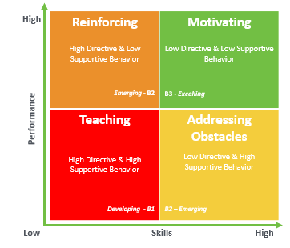
Coaching Habit 4: Measure Results
Coaching Culture & Methodology
Measure results and skill
If we chart the measurement of results and behaviors, we can define the results in four quadrants as follows:
“We made our quarterly numbers” is a very common victory cry of management teams everywhere. Why? Because we all like to win! And you must keep score to know if you are winning, or you can be active but not productive. There is no lack of metrics to measure, so be sure to focus on those measures that tell you the real story of progress.
Getting results is great, but they will not be sustainable without the right skill set. Underdeveloped skills include professional communication, negotiation, opportunity management, and additional skills required to progress an opportunity through the sales cycle.
You get the behaviors you are willing to tolerate. Ignoring issues puts your credibility as a leader at risk. Unaddressed performance matters do not go away, they just rear their heads in uglier ways eventually.
2
B2
B3
B1
B2
B1 | Developing | Coach for Teaching
B2 | Emerging | Coach for Reinforcing
B2 | Emerging | Coach for Addressing Obstacles
B3 | Excelling | Coach for Motivation
“What gets measured gets managed.”
– Peter Drucker
Will be addressed further in Coaching Methodology

Slide 18

Coaching Habit 5: Appreciate People
Coaching Culture & Methodology
Your team wants to feel fully appreciated
Looking for the good in everyone
The primary influencer of employee retention is their relationship with their direct supervisor. Regardless of company name and its stature, people normally stay or leave their jobs due to their relationship with their supervisor.
Usually, there is a gap in what appreciation employees expect and what their supervisor provides in the way of actual appreciation. Good intentions and thoughts do not count. As the coach, you must convert those intentions into regular actions that consistently show your true appreciation. In other words, it must be demonstrated regularly.
People who receive regular appreciation:
Experience increased productivity
Enjoy increased engagement with team members
Are more likely to stay with the organization
Receive higher loyalty and satisfaction scores from customers
As humans and especially as businesspeople, we are inclined to identify problems, issues and challenges quickly. But do we identify and recognize good behaviors and attitudes just as rapidly?
When we are hungry, our search for food becomes paramount. We look in the refrigerator, or the pantry for our next meal if we are at home. Or, if we are out of our home, the search for a restaurant is a high priority. The point is this: we block out all other inputs to satisfy our craving.
Do we do the same to find the good points in our team members? Do we block out the obvious challenges and issues to focus on the positives within everyone on our team? Are we identifying the good behaviors, results and attitudes just as quickly as we do any challenges?
The list of behaviors to appreciate is endless, but here are a few to get the process started:
A team member constantly encouraging others
A team member exhibiting strong focus
A team member consistently meeting quota or presenting high quality work
2
“Before you are a leader, success is all about growing yourself. When you become a leader, success is all about growing others.”
– Jack Welch

Slide 19
Sales Coaching Methodology

Slide 20
Sales Coaching Methodology (1 of 2)
Coaching Culture & Methodology
Apply the appropriate type & level of coaching for the observed effectiveness of each Sales Rep
2
Defining performance Sales performance and individual skills have three levels of development and each one requires varied levels of direction and support from a Sales Manager. Defining performance is NOT only about attaining quota or sales goals. Sales Managers should consider the entire skill set of each rep and measure against a comprehensive list of selling skills and competencies. |  |  |  | The right coaching motion Coaches should align their coaching motion to the level of rep performance to provide balanced improvement across the entire selling skillset.
Level 1 | Developing | The AE has been taught the skill but is demonstrating observable difficulties optimizing their performance. |  | TEACHING Sales Managers must give significant direction on the selected skill. Coaches need to show reps what to do, how to do it, and ensure the reps can observe the skill in action on a repetitive schedule.
Level 2 | Emerging | The AE can demonstrate the skill and execute well, but they are not yet consistently performing at a level that requires minimal coaching. |  | COACHING Sales Managers should apply some direction, but the AE is now doing most of the work while receiving coaching on their performance during sales calls. Coaches should be observing reps in sales calls, spotting positive trends, and coaching rough edges.
Level 3 | Excelling | The AE is achieving consistent results with the skill, requires little coaching, and can execute at a level where they can teach others. |  | SUPPORT Sales Managers can apply little to no direction and the AE can do all the work. Sales Managers can expect even higher levels of performance against a skill. Coaches should ensure reps stay on track and can demonstrate what “good looks like” to other team members.
CRITICAL CONCEPT
Defining performance is NOT just about a sales rep being at quota or sales goal. Performance is the entire list of selling skills or competencies. Sales leaders need to consider the entire skill set of each employee.
Applying the appropriate level of coaching for the observed effectiveness level

Slide 21
Sales Coaching Methodology (2 of 2)
Coaching Culture & Methodology
Moving the performance needle Once you have identified the skill(s) being coached and the level of performance, a Sales Manager must provide structured feedback and coaching using an action-oriented approach. This structured approach is a proven way to help AEs move the needle.
Topic / Skill - | Identify the topic or the skill that needs to be isolated and coached
Goal - | Identify the goals and what specifically needs to happen in relation to the coaching interaction
Reality - | Clearly explain the impacts (positive/negative) of the skill(s) being coached on selling interactions with prospects/customers
Options - | Brainstorm options for improvement (ask don’t tell unless they are struggling) and empower the AE
What’s Next - | Identify specific steps and obstacles and craft a timeline that includes actions, timelines and follow-up dates
Key mistakes to avoid
All talk and no direction or action - | This is the mistake of a Sales Manager who either doesn’t know the skills they are coaching or is afraid to give harder feedback
Not having good examples to use - | This is the mistake of the “hands off” Sales Manager who either has not listened to calls or spent enough time at the desk listening
All bark and no positive reinforcement - | This is the mistake of a Sales Manager who forgets that coaching is not just about identifying mistakes – it is about balanced feedback and building on strengths as well
Not discussing consequences when appropriate - | When performance gaps reach the point of no return, Sales Managers must be able to elevate the conversation to levels where reps realize their job is on the line
Lack of follow-up in a timely manner - | The investment in coaching requires an investment in follow-up at a near-term 1:1 (the next week) or reps know that they can hide
2

Slide 22

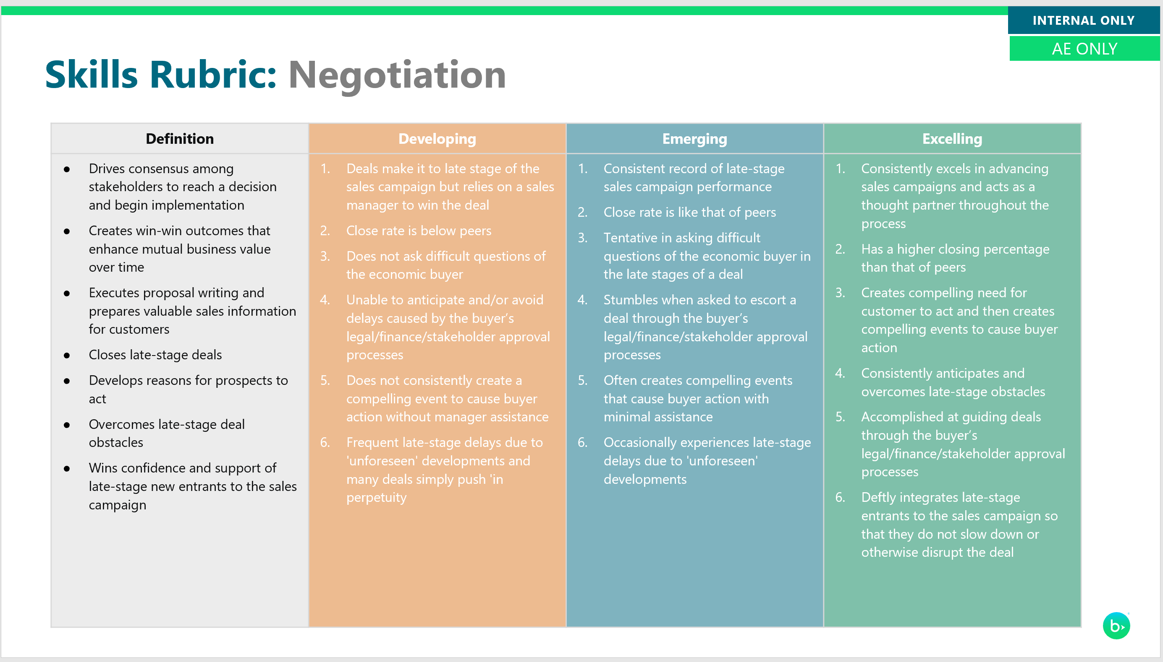
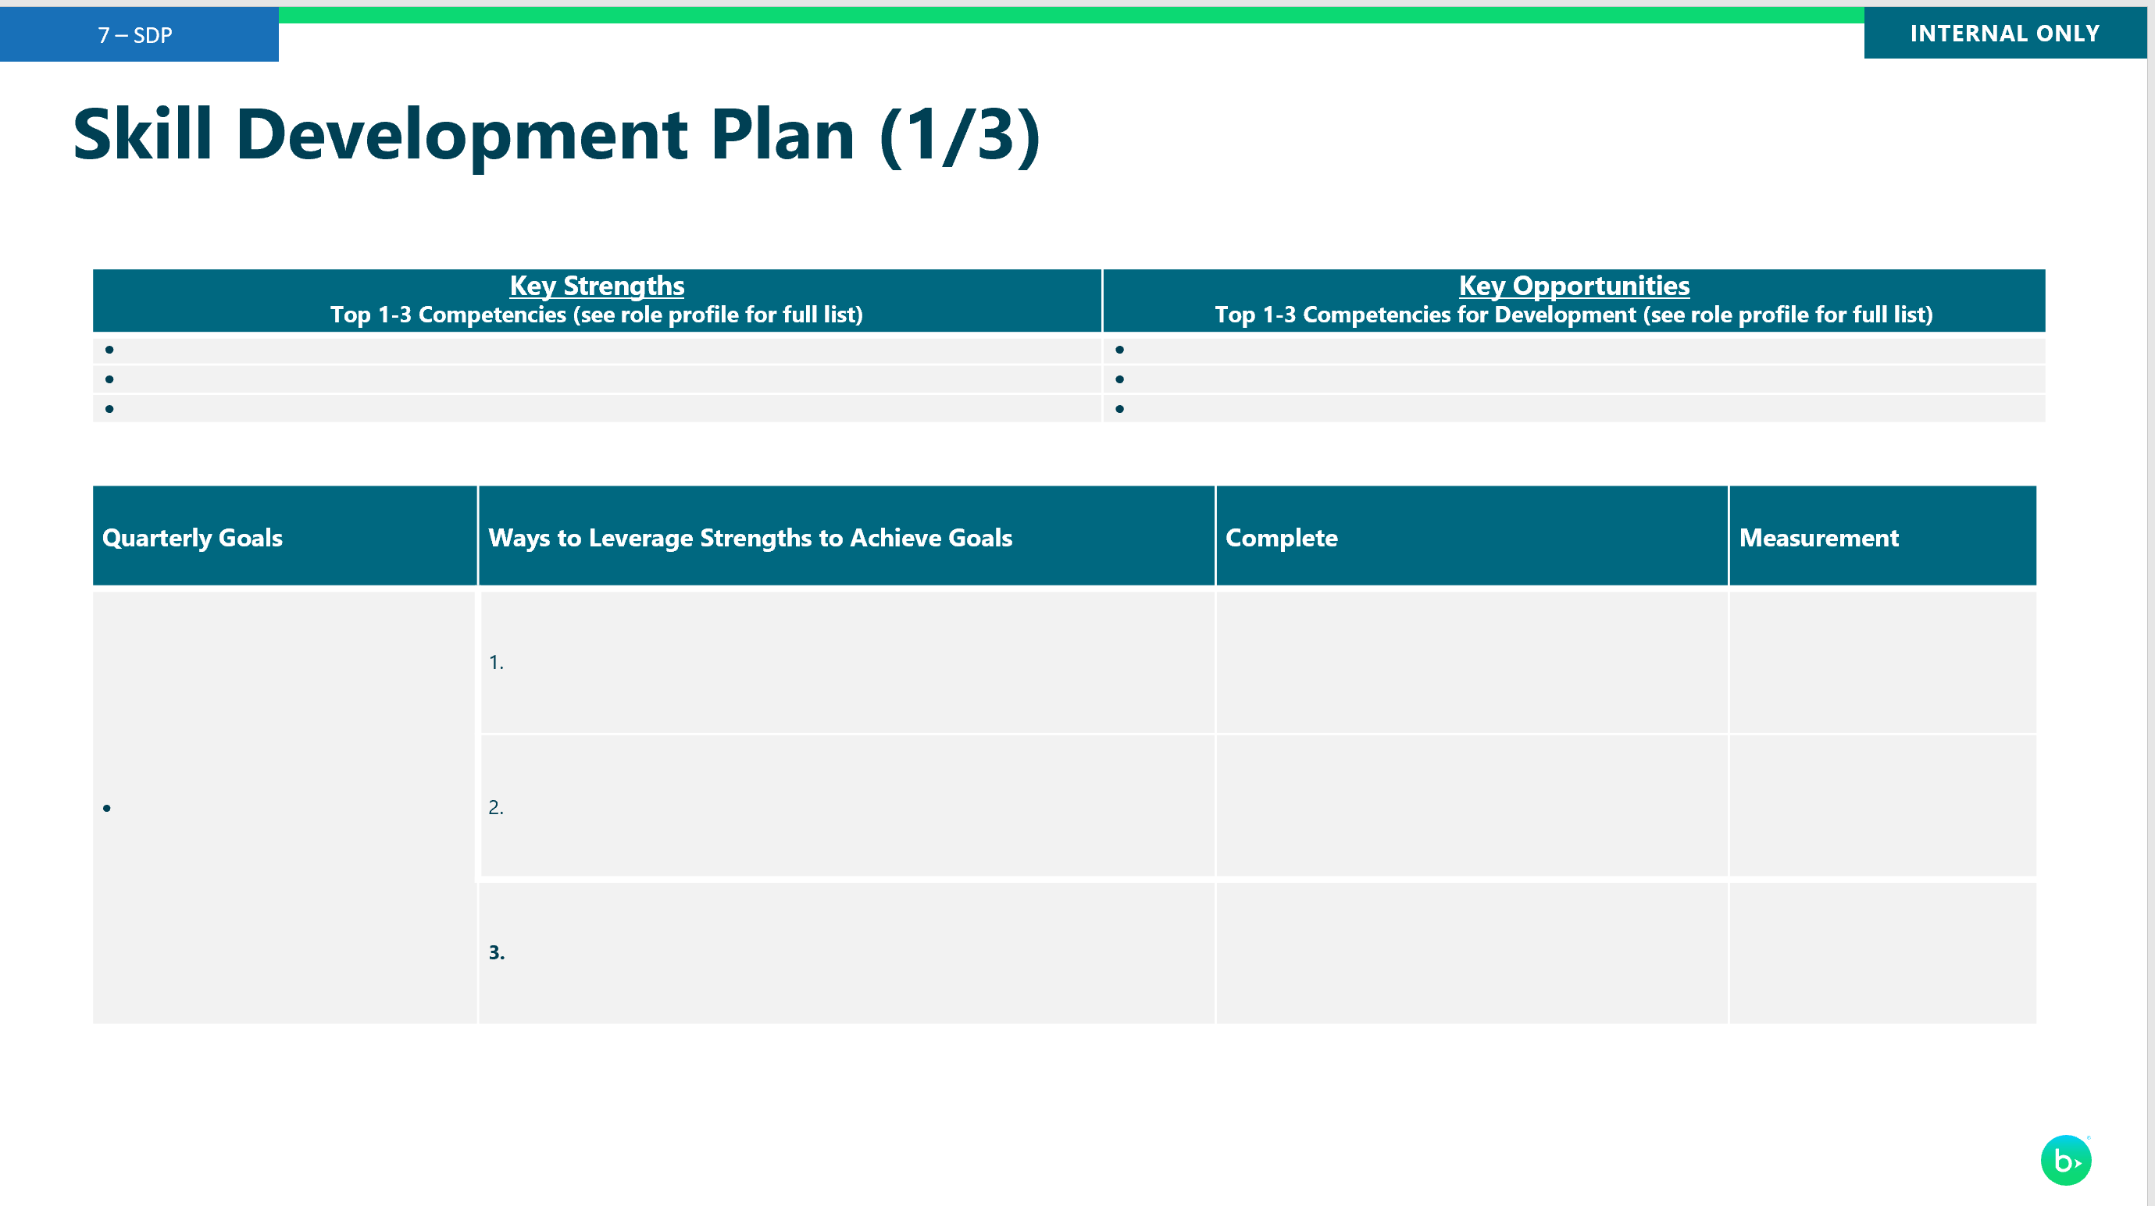
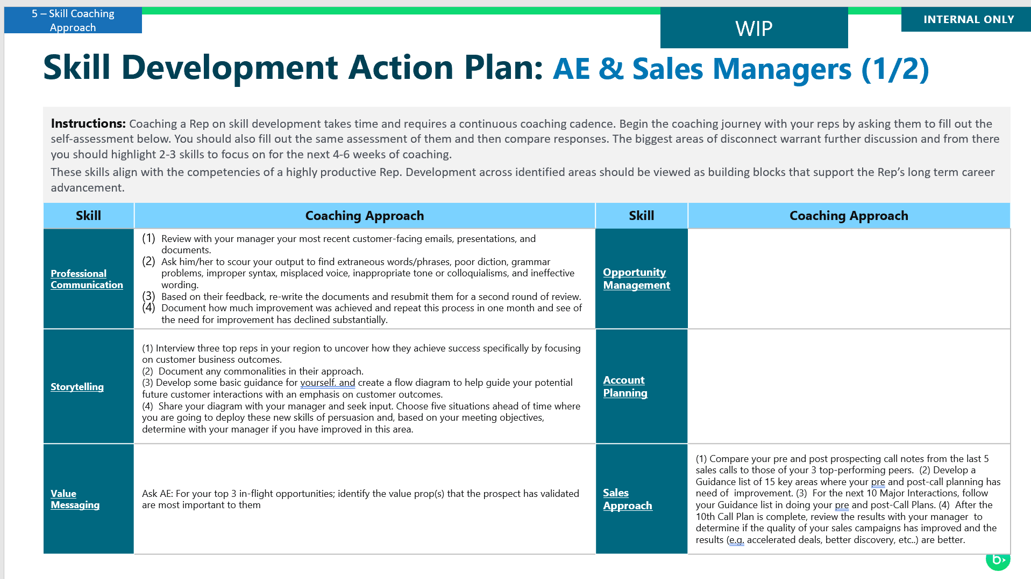
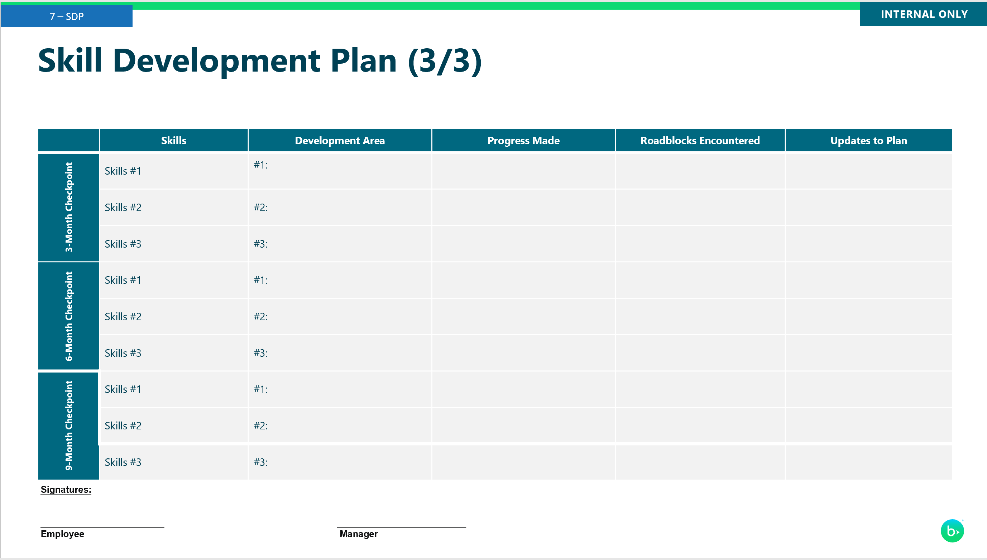
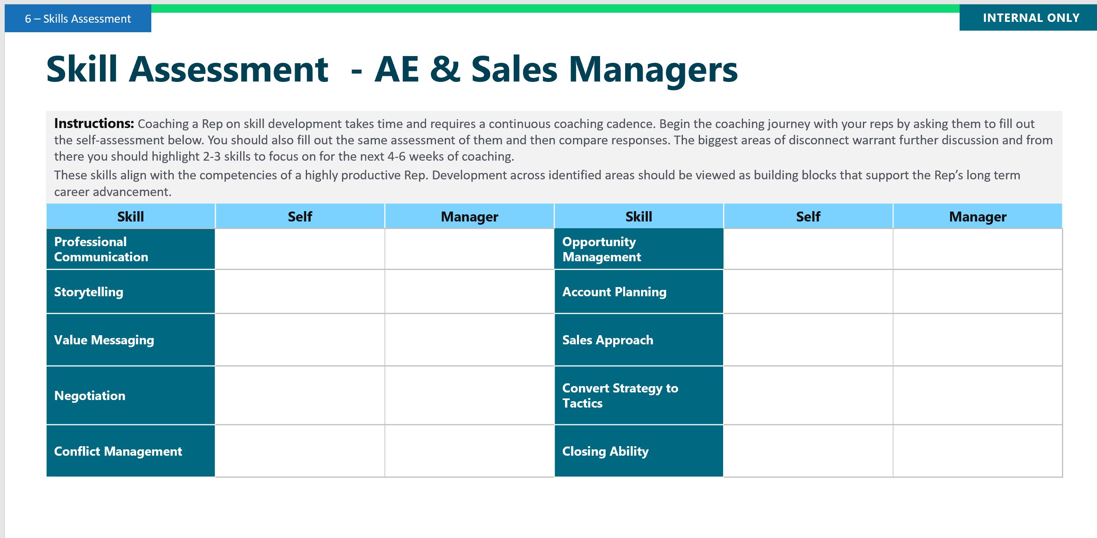
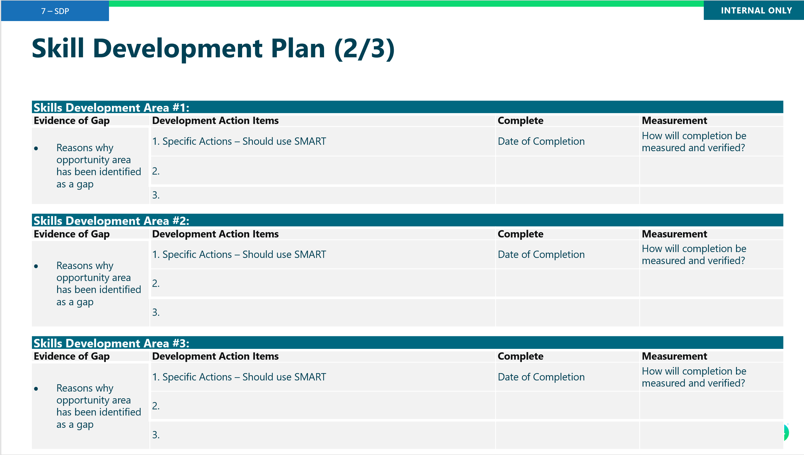
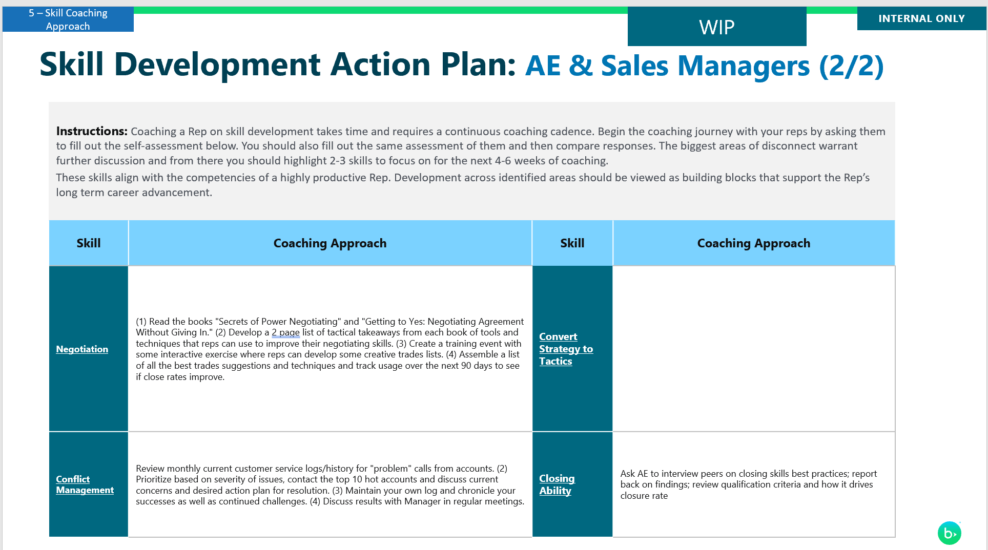
Classifying your reps to apply the appropriate coaching motion and guide on specific skill development
Step | Assess | Classify | Development Plan | Upskill | Measure | Re-Assess
Activity | Performance and Skill Assessment | Determine appropriate level for employee (ie. Developing, Emerging, Excelling) | Create development plan | Coach to appropriate method of upskilling | Document progress and upskilling efforts | Reassess quarterly Repeat process
Resources | Skills Assessment Skills Rubrics Bookings Report Quota Attainment | Evaluation Matrix Coach according to the appropriate level | Skills Development Plan | Skill Coaching Approach Company training programs External training | Evaluation report | Re-evaluate to determine focus

Slide 23
Skills Assessment

Slide 24
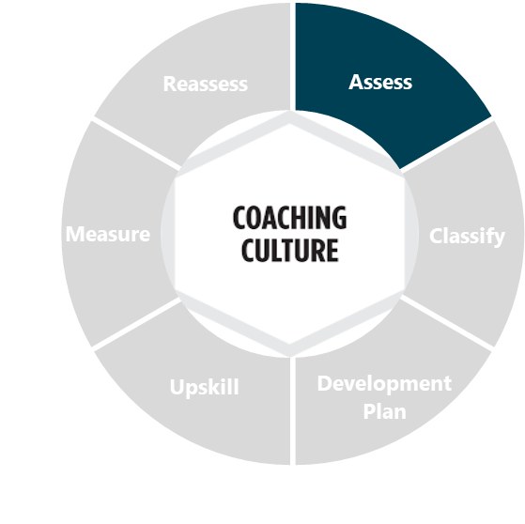
Cadence Event : Skills Assessment
Skills Assessment
Purpose | AE and manager to complete the assessment using the skill rubrics provided to inform the Skills Development Plan.
Frequency | Quarterly / 30 minutes
Participants | Sales Manager and Sales Rep
Tools | Skill assessment template
Preparation | Sales Rep AE to complete the self- assessment using the skill rubrics provided and submit to Coach prior to meeting. Sale Manager Complete the skills assessment for each AE Discuss the self-assessment and coach assessment to identify opportunities for growth for key skills for a seller
Agenda Item | Guidance
Review Prior Skill Development Plan (SDP) | What key factors impacted the previous quarter performance? What are the primary lessons learned from previous quarter performance? How does this impact the upcoming quarter or year? What are you changing?
Activating Performance | What are your personal growth areas? How do they impact quota attainment? What controllable actions drive achievement most significantly? What competencies need to be development to achieve better results? Do the above areas, actions, and competencies align with the sales rep’s SDP? What should be added and/or removed for greater alignment?
Assessing Readiness | How well did you articulate your plan to attain quota in the coming quarter? What can I do to help better support you in achieving your next quarter goals
6

Slide 25
Sample skills used to assess AE’s and Sales Managers
Skills
Select skills for Account Executives and Sales Managers based on specific behaviors that align with the competencies required for a highly productive AE / Sales Manager.
Account executive Skills
Sales Manager Skills
Professional Communication
Storytelling
Value Messaging
Negotiation
Conflict Management
Opportunity Management
Account Planning
Sales Approach
Convert Strategy to Tactics
Closing Ability
Coaching and Talent Development
Managing Processes
Talent Management
Conflict Management
Team Builder
Managing Diversity & Inclusion
Organization/ Planning
Presentation Skills
Strategic Skills
Drive for Results

Slide 26
Skill Assessment - AE & Sales Managers
Skills Assessment
Instructions: Coaching a Rep on skill development takes time and requires a continuous coaching cadence. Begin the coaching journey with your reps by asking them to fill out the self-assessment below. You should also fill out the same assessment of them and then compare responses. The biggest areas of disconnect warrant further discussion and from there you should highlight 2-3 skills to focus on for the next 4-6 weeks of coaching. These skills align with the competencies of a highly productive Rep. Development across identified areas should be viewed as building blocks that support the Rep’s long term career advancement.
Instructions: AE and Manager individually provide a 1-5 rating for each skill where 1 = no evidence of skill and 5 = skill mastery. Top 3 largest gaps should receive special coaching priority.
Skill | Self | Manager | Skill | Self | Manager
Professional Communication |  |  | Opportunity Management
Storytelling |  |  | Account Planning
Value Messaging |  |  | Sales Approach
Negotiation |  |  | Convert Strategy to Tactics
Conflict Management |  |  | Closing Ability
6
*Refer to the Skills rubrics for the description of excelling vs. developing

Slide 27
Skill Assessment - Sales Managers & Directors
Skills Assessment
Instructions: Coaching a Sales Manager on skill development takes time and requires a continuous coaching cadence. Begin the coaching journey with your reps by asking them to fill out the self-assessment below. You should also fill out the same assessment of them and then compare responses. The biggest areas of disconnect warrant further discussion and from there you should highlight 2-3 skills to focus on for the next 4-6 weeks of coaching. These skills align with the competencies of a highly productive Rep. Development across identified areas should be viewed as building blocks that support the Rep’s long term career advancement.
Instructions: Manager and Director individually provide a 1-5 rating for each skill where 1 = no evidence of skill and 5 = skill mastery. Top 3 largest gaps should receive special coaching priority.
Skill | Self | Manager | Skill | Self | Manager
Coaching and Talent Development |  |  | Managing Diversity & Inclusion
Managing Processes |  |  | Organization/ Planning
Talent Management |  |  | Presentation Skills
Conflict Management |  |  | Strategic Skills
Team Builder |  |  | Drive for Results
6
*Refer to the Skills rubrics for the description of excelling vs. developing

Slide 28
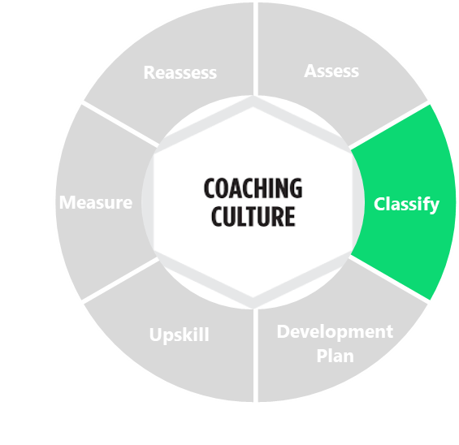
Tailor your coaching approach based on sellers' performance to focus on specific areas for growth
Coaching Guidance
Evaluation MATRIX
Performance:
  High – 90% and above quota attainment
  Low – below 90% quota attainment
Skills:
  High - 3.0 or higher average from skills assessment
  Low – below a 3.0 average on skills assessment
Developing Players: B1
  Low skill proficiency / Low Performance
Emerging Players: B2
  Some to moderate skill proficiency / Moderate or variable Performance
Excelling Players: B3
  High skill proficiency / High Performance
4
Example: An Account Executive classification
Skill Assessment: Scored an average of a 2.7
Performance: At 92% of quota for the past three quarters

Slide 29
Assessment Template
Evaluation MATRIX
Name | [name] |  |  | Date | mm/dd/yy | mm/dd/yy
Performance Assessment (Quota Attainment) |  |  |  | Skills Assessment (Average of scores)
Previous 3 quarters:
1: | _____% | _____% |  | Average: |  | _____ / 5
2: | _____% | _____%
3: | _____% | _____%
Performance Average: (High / Low) | _____________ | _____________ |  | Skills: (High / Low) |  | ___________
 |  |  | Level: (Developing, Emerging, Excelling) | Level (Developing, Emerging, Excelling) |  | ___________
Performance:
  High – 90% and above quota attainment
  Low – below 90% quota attainment
Skills:
  High - 3.0 or higher average from skills assessment
  Low – below a 3.0 average on skills assessment
Developing Players: B1
  Low skill proficiency / Low Performance
Emerging Players: B2
  Some to moderate skill proficiency / Moderate or variable Performance
Excelling Players: B3
  High skill proficiency / High Performance

Slide 30
Coaching Guidance

Slide 31
Coaching for ‘Developing’ Sellers
Coaching Guidance
B1 (low skill proficiency / low performance)
Coaching Approach
Low skill proficiency – Below expectations on some or most competencies
Low performance – Struggles to achieve quota in any given period
This individual requires very specific teaching and guidance on what to do. Help them to improve their pipeline and close deals with specific actions
4
Sample Questions to ask:
“ When did you learn about this deal?
“What have you done to influence the decision makers?”
“What percent of your quota does this deal represent?”
“Do you have a close plan?”
“Is your [internal sales strategy deliverable] complete? “
“Has the buyer/sponsor agreed to the plan to evaluate the solution?”
Pipeline Development and Management | Sales Performance | Opportunity Development
New Opportunities: Give them a target number of new opportunities Stage Duration: Inspect deals with stages exceeding 100 days Pipeline Coverage: Inspect coverage weekly | YTD Sales Performance: Develop monthly goals – review weekly progress towards them in coaching calls Quarterly Quota Performance: Have monthly mock quarterly reviews to discuss progress towards goals | Opportunity Planning: Tie account planning to a metric – any deal that exceeds a stage by 100 days needs to have a completed Sales Strategy Form and Evaluation Plan reviewed with the AE and manager

Slide 32
Additional Conversation Starters for ‘Developing’ Sellers
Identify purpose of meeting | “What I want to talk to you about is…”
Acknowledge sales drive | “I appreciate your commercial initiative…drive to make your number…”
Acknowledge transferrable skills | “Your skills of…will be really helpful on…I’d like to have you use your skills of…to…”
Get B1 “Coaching for ‘Developing’ Sellers” agreement | “Since you haven’t done this before, would it be useful if I provided you with some direction… resources…. information?”
Define targets, quotas, priorities, timelines | “What I’d like you to do is…by… I’d like to talk to you today about a project to…over the next…months…. Here’s where we are now and what we need to achieve… What a good quarter looks like is…”
Clarify how performance will be tracked and monitored: set up follow-up meetings | “For the next few weeks, we should meet… We’ll track your sales performance by…(reviewing CRM reports…talking to others…observe actual performance etc.)”
Take the lead in action planning | “Here are the next steps to make your number…What I need you to do first, second, third, etc. is...”
Define limits and clarify roles | “What you need to do is…Here’s what I’ll do to help you…When you get to this point, you need to check in or we’ll need to get together…”
Provide information / resources | “here’s some information that will be helpful/that you’ll need…Here’s the name of the person you should talk to…Here’s the name of the sales rep you should observe…”
Develop plan to learn new skills | “To learn how to do this, it would be good for you to…I’ve arranged for you to…Together, we should…Why don’t you observe…study…read…I’ll ask this person to coach you.”
Check for understanding | “So, why don’t you recap/tell me what you’ve heard so I can make sure I’ve given you everything you need to be successful…so I can make sure I’ve been clear…”

Slide 33
Coaching for ‘Emerging’ Sellers
Coaching Guidance
B2 (some to moderate skill proficiency / moderate or variable performance
Coaching Approach
Some to moderate skill proficiency – Meets expectations on most competencies; below or above expectations on some competencies
Moderate or variable performance – Meets or exceeds quota some of the time
Using the skills assessment and coaching matrix, determine the best approach. Coaching focus on reinforcing the core sales techniques to advance opportunities through the stages, helping the seller understand the reasons why their pipeline is not converting to closed deals, and helping to address obstacles that might be preventing sellers from achieving their true potential.
4
Sample Questions to ask:
“Where are you having success generating new opportunities?”
“Are you running the full range of early-stage opportunity plays?”
“Which job aids are you finding the most effective and why?”
“What are your under-penetrated market segments?”
“Are you properly qualifying leads into early-stage opportunities?
Do you have a mobilizer for your biggest deals?”
Pipeline Development and Management | Sales Performance | Opportunity Development
New Opportunities: Ensure proper qualification with new opportunities; Diversify opportunities – products, customer segments, personas Stage Duration: Identify stage(s) where the opportunities are stalling or breaking down; ensure deals are not moving “too quickly” Pipeline Coverage: Inspect coverage weekly | YTD Sales Performance: Develop monthly goals – review weekly progress towards them in coaching calls Quarterly Quota Performance: Prioritize top forecasted opportunities and ensure team is running proper plays to close the deal; prioritize time spent on converting latest stage opportunities and getting them “across the line” | Account Planning: Focus account planning efforts on converting early opportunities into middle, then late-stage opportunities; ensure account plans are in place for top 20% of opportunities being worked

Slide 34
Additional Conversation Starters for ‘Emerging’ Sellers
Clarify purpose of meeting | “I wanted to meet today to talk to you about…Remember, your target was to achieve…by…”
Help the person consider alternatives | “What else could you do? What are the alternatives? Here’s some ideas/next steps that we may want to consider… What are the pros and cons to each alternative we’ve discussed?”
Make final decisions about action plans | “Given what we’ve talked about, I think you ought to…So, do you agree that the next steps are to…”
Provide coaching | “Here’s what I might do next…what do you think? Often, it’s helpful to…what do you think? You may want to spend some time doing…I’ll be here to…or I’ll ask this rep to work with you…Here’s how you might want to think about that further… Here are some more sales resources…”
Explain why; link to business results and self-interest | “Remember, this is important because…Let’s think about why you wanted to do this in the first place…As you think back to when you first started working towards this target, why were you excited? If you make this target, it will mean more money for you and for the organisation.”
Provide support, reassurance, praise and encouragement | “I know you can do this…I know this is harder than you thought it was going to be…Hang in there…I’m here to help…”
Listen | “Can you tell me more about…? What did you mean when you said…? Do you have anything else you want to talk to me about? Concerns? Problems?”
Explain ways to make the goal/task more interesting and challenging if motivation is low | “What would it take for you to be excited about this again? How could we restructure this so it’s more fun? More challenging? So that you continue to grow and develop?”
Reflect on past successes | “Just like last time, you…Do you remember when you…? What feedback have you gotten from others about the success you’ve been having? You’ve already used those skills to...”
Get B2 “Coaching for ‘Emerging’ Sellers” agreement | “Here’s an idea…what do you think? How can I help? What’s getting in your way? Is there anything I can do?”

Slide 35
Coaching for ‘Excelling’ Sellers
Coaching Guidance
B3 (high skill proficiency / high performance)
Coaching Approach
High skill proficiency – Meets or exceeds expectations on all core competencies
High performance – Able to consistently close deals and generate revenue above and beyond their quota
This individual can consistently provide results that exceed their individual target without too much guidance. The objective with this individual is to motivate them to become even more targeted on who they are generating opportunities with, ensuring that these are the highest quality and can bring the biggest returns.
4
4
Sample Questions to ask:
“Do you understand the opportunity cost of your prospecting efforts?”
“To whom can you delegate long-tail opportunities?”
“What tactics will double deal size?”
“What negotiation strategy will minimize discount requests?”
“Have you marshalled internal pre-sales resources to differentiate?”
“What percentage of your pipeline is crosssell?”
Pipeline Development and Management | Sales Performance | Opportunity Development
New Opportunities: Focus on quality opportunities over quantity Stage Duration: Identify best practices that are enabling strong conversions Pipeline Coverage: Manage your pipeline to at least a 4x pipeline to quota coverage | YTD Sales Performance: Develop monthly goals – review bi-weekly progress towards them in coaching calls Quarterly Quota Performance: Identify any roadblocks to closing business and have a plan in place to remove those obstacles | Territory Planning: Identify short, medium and long-term opportunities in account plans, begin to “plant seeds” for future opportunities

Slide 36
Additional Conversation Starters for ‘Excelling’ Sellers
Clarify purpose of meeting | “Tell me what you’ve been working on…what you’re most excited about…what you’ve accomplished…what you’re proud of…”
Get B3 “Coaching for ‘Excelling’ Sellers” agreement | “I know you’re taking the lead, but I’m here when you need me…we need to figure out a way for me to stay in touch / informed with what you’re doing…”
Review goals | “Let’s review the targets you’ve set…I agree that your targets are…”
Discuss career progression and possible promotion goals | “In your development plan, you had mentioned… I want to help you get there, so let’s look at where you are. Let’s talk through and agree actions that move you closer to …”
Evaluate/share successes | “So, how do you think you’re doing on…? What success have you had with…? What feedback have you been getting? What is still exciting/new for you? What are you doing to keep your work fresh? What ideas have you had about…?”
Encourage innovation/challenge the person to even higher levels of performance | “What are you dreaming about? What new projects interest you? What would a ‘stretch goal’ look like?”
Provide opportunities to teach/mentor others | “Would you be willing to teach…? Could I ask you to work with…? Could you share what you’ve learned/what you think ‘best practices are with…?”
Acknowledge contributions | “We’ve always benefited from…You’ve exceeded expectations by…You have made a major contribution to…by…How would you like to be acknowledged for the work you’ve done?”
Provide additional resources if necessary | “Is there anything I can do to help? Do you need anything to make your work easier? Do you need anything to be more successful?”
Stay in touch | “How do we stay in touch?”

Slide 37
Skills Development Plan

Slide 38
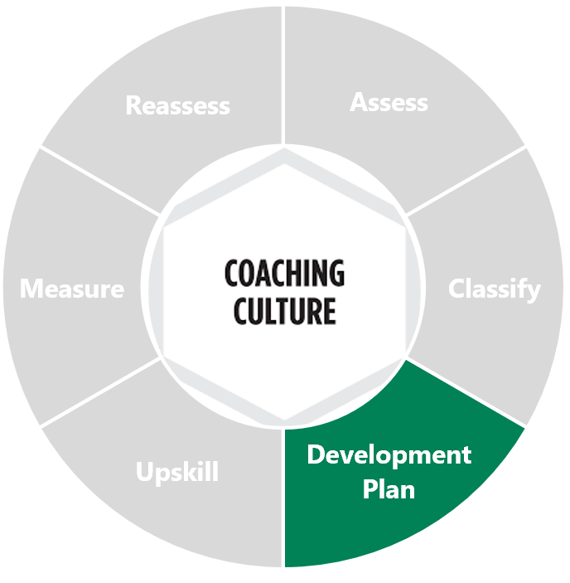
Cadence Meeting : Skill Development Plan (SDP)
SDP
Purpose | Rep to create action plan and evaluate performance vs. goals on a quarterly basis to review achievement and planning on SDP within 7 days of QBR with sales manager 1:1. This meeting should drive completion of the QBR template.
Frequency | Quarterly / 60 minutes
Participants | Sales Manager and Sales Rep
Tools | Skill development plan template
Preparation | Prepare performance metrics for the seller from previous quarter (quota attainment, pipeline metrics, etc.) and YTD Gather feedback from colleagues they have worked with Review SDP and make necessary updates to align future action to areas of highest priority
Agenda Item | Guidance
Review Prior SDP | What key factors impacted the previous quarter performance? What are the primary lessons learned from previous quarters performance? How does this impact the upcoming year? What are you changing?
Activating Performance | What are your personal growth areas? How do they impact quota attainment? What controllable actions drive achievement most significantly? What competencies need to be development to achieve better results? Do the above areas, actions, and competencies align with the sales rep’s SDP? What should be added and/or removed for greater alignment?
Assessing Readiness | How well did you articulate your plan to attain quota in the coming quarter? What can I do to help better support you in achieving your next quarter goals
4
7

Slide 39
Cadence Event : Skill Development Plan (SDP) Thought Starters
SDP
# | Exercise Example
1 | Skill Development – Leverage reps SDP to reinforce the why behind this meeting. Make sure to monitor progress against SDP and Skills goals – Keep the end goals in mind.
2 | Success Metrics - Keep reps focused on demos, new contacts, demo to close percentage, deal sizes, etc. Coaches need to enforce the “how” behind metrics, ensuring skill develop rather than simply coaching to outcomes
3 | The Stretch Goal - Use their personal goals and game-changing money desires to chart a path for them to turning it into reality
4 | The Stark Reality - If someone falls way behind, help them chart a path to recovery that focuses on the controllable levers – activity and closing deals. Don’t let someone get so far off pace that they lose motivation
1 | Skill Development – Leverage reps SDP to reinforce the why behind this meeting. Make sure to monitor progress against SDP and Skills goals – Keep the end goals in mind.
4
7

Slide 40
Skill Development Plan
SDP
This is intended for the coachee to complete – the AE being coached by their Sales Manager or the Manager being coached by their Director.
4
7
Note: To receive the most benefit from the Skill Development Plan (SDP):
Meet with your supervisor and other mentors, coaches, or peers to get their suggestions
Meet 1:1 with your supervisor on a quarterly basis to review progress against goal
The items listed under ‘Key Strengths’ and ‘Key Opportunities’ should be role competencies that align with the relevant performance scorecard.
Include as many developmental items as you wish, but don’t overdo it. It is better to have three items and follow-through on all three, than six items with partial follow-through on all six. This is a quarterly exercise, so although we all have many ways to improve our strengths and lessen our weaker points, we want to prioritize actions.
The way to prioritize required improvements is to tie them back to the impact they have on the responsibilities of a given role. A “high impact” item for a “high priority” responsibility would be a better area of focus than a “high impact” item for a “low priority” responsibility.
Each item chosen for action/implementation should conform to the SMART - Specific, Measurable, Attainable, Realistic, and Timely. Example quarterly action plans could include:
Training, coaching, mentoring​
E-learning, books, audio, other media​
Specific projects and assignments​
Peer-to-peer support/insight
Managers should retain the SDP as an ongoing tool to measure performance – both formally and informally. Progress should be measured and tracked. For those employees who are going on their second or subsequent quarter of evaluation, the SDP should include a section at the beginning that tracks progress against the previous period’s actions.

Slide 41
Skill Development Plan (1/3)
SDP
Key Strengths Top 1-3 Skills (use role profile/competencies ) | Key Opportunities Top 1-3 Skills for Development (use role profile/competencies)
4
7
Quarterly Goals | Ways to Leverage Strengths to Achieve Goals | Complete | Measurement (These metrics should be relevant to each skill and have both leading and lagging indicators of success)
 | 1.
 | 2.
 | 3.

Slide 42
Skill Development Plan (2/3)
SDP
Skills Development Area #1:
Evidence of Gap | Development Action Items | Complete | Measurement
Reasons why opportunity area has been identified as a gap | 1. Specific Actions – Should use SMART | Date of Completion | How will completion be measured and verified?
 | 2.
 | 3.
4
7
Skills Development Area #2:
Evidence of Gap | Development Action Items | Complete | Measurement
Reasons why opportunity area has been identified as a gap | 1. Specific Actions – Should use SMART | Date of Completion | How will completion be measured and verified?
 | 2.
 | 3.
Skills Development Area #3:
Evidence of Gap | Development Action Items | Complete | Measurement
Reasons why opportunity area has been identified as a gap | 1. Specific Actions – Should use SMART | Date of Completion | How will completion be measured and verified?
 | 2.
 | 3.

Slide 43
Skill Development Plan (3/3)
SDP
 | Skills | Development Area | Progress Made | Roadblocks Encountered | Updates to Plan
3-Month Checkpoint | Skills #1 | #1:
 | Skills #2 | #2:
 | Skills #3 | #3:
6-Month Checkpoint | Skills #1 | #1:
 | Skills #2 | #2:
 | Skills #3 | #3:
9-Month Checkpoint | Skills #1 | #1:
 | Skills #2 | #2:
 | Skills #3 | #3:
4
7
Signatures:
________________________ _________________________
Employee Manager

Slide 44
Individual Development Plan Example – June 2022 John Doe
Competency #1: Converting Strategy to Tactics
Evidence of Gap | Development Action Items | Complete | Measurement
Ambiguous / no distinction between strategy and tactics Unstructured approach | Contact and interview 5-10 customers in different branches/markets to understand local nuances of ACME’s GTM model and learn how ACME’s new product lines are being positioned in the market | TBD | Interview execution
 | Identify variances between target vs. actual GTM model, product positioning and synthesize into a document that can be used to educate the ELT + regional leadership on your findings | TBD | Deliverable complete
 | Identify potential changes and form an execution plan with KPIs that can be used to improve sales effectiveness and efficiency across branches | TBD | Deliverable complete
 | Institute governing infrastructure – reports, execution cadences – to drive execution and adherence of these new changes | TBD | Execution completion; adherence to governance cadence
Competency #2: Lead Management
Evidence of Gap | Development Action Items | Complete | Measurement
Lack of understanding of marketing channel mix & ROI | Work with marketing leaders to select a recent sample of sales qualified leads generated across all channels that were not converted to a sale. | TBD | X leads selected
 | Determine the root cause for the failed conversion by following the lead from generation through qualification to sales handoff and through the opportunity management process. | TBD | ~10 page PowerPoint that summarizes root cause analysis
 | Work with marketing leaders to review the spend against lead channels, lead nurturing process, qualification criteria and handoff/feedback process to sales for quick wins that will improve the lead management process. | TBD | List of improvement opportunities + ROI, owner and ETA for each
Competency #3: Talent Management
Evidence of Gap | Development Action Items | Complete | Measurement
No stated framework for assessing or developing talent | Read "Talent Management: Strategies from Six Leading Companies" and summarize the best practices that apply to you, your immediate team and your organization | TBD | Best practices documented
 | Create a presentation of the best practices for you in your role as an executive leader; also identify best practices and/or process improvement changes that may help your team / organization more broadly | TBD | Deliverable complete
 | Share your findings with the ELT and your regional managers with recommendations on how, when to implement the changes | TBD | Meeting conducted

Slide 45
Skills Coaching Guidance

Slide 46
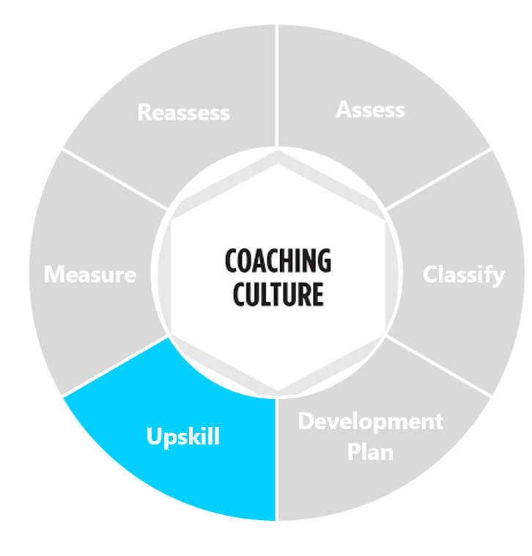
Skill Development Action Plan Example:
AE & Sales Managers (1/2)
Skill Coaching Approach
Instructions: Coaching a Rep on skill development takes time and requires a continuous coaching cadence. These skills align with the competencies of a highly productive Rep. Development across identified areas should be viewed as building blocks that support the Rep’s long term career advancement. The coaching approaches provided below are potential activities to be provided to the AE to act as a guide to coaching to specific skills.
Example Skill | Coaching Approach | Example Skill | Example Coaching Approach
Professional Communication | Review with your manager your most recent customer-facing emails, presentations, and documents. Ask him/her to scour your output to find extraneous words/phrases, poor diction, grammar problems, improper syntax, misplaced voice, inappropriate tone or colloquialisms, and ineffective wording. Based on their feedback, re-write the documents and resubmit them for a second round of review. Document how much improvement was achieved and repeat this process in one month and see of the need for improvement has declined substantially. | Opportunity Management | Inspect all current sales opportunities that are stalled or have not tracked to expected phase advancement timeframes. Identify 10 specific tactics that will jump-start this sales campaign and also which align with your stated Sales strategy. Prioritize this list of tactics in order of applicability, importance and relevancy. Introduce these tactics into your campaigns in order of prioritization. Review the outcome with your manager. Ask for insight and adjust your list of tactics to reflect what is working. Rinse and repeat.
Storytelling | Interview three top reps in your region to uncover how they achieve success specifically by focusing on customer business outcomes. Document any commonalities in their approach. Develop some basic guidance for yourself, and create a flow diagram to help guide your potential future customer interactions with an emphasis on customer outcomes. Share your diagram with your manager and seek input. Choose five situations ahead of time where you are going to deploy these new skills of persuasion and, based on your meeting objectives, determine with your manager if you have improved in this area. | Account Planning | Ask AE to interview peers on closing skills best practices Report back on findings Review qualification criteria and how it drives closure rate
Value Messaging | Ask AE: For your top 3 in-flight opportunities; identify the value prop(s) that the prospect has validated are most important to them | Sales Approach | Compare your pre and post prospecting call notes from the last 5 sales calls to those of your 3 top-performing peers. Develop a Guidance list of 15 key areas where your pre and post-call planning has need of improvement. For the next 10 Major Interactions, follow your Guidance list in doing your pre and post-Call Plans. After the 10th Call Plan is complete, review the results with your manager to determine if the quality of your sales campaigns has improved and the results (e.g. accelerated deals, better discovery, etc..) are better.
5

Slide 47
Skill Development Action Plan Example:
AE & Sales Managers (1/2)
Skill Coaching Approach
Instructions: Coaching a Rep on skill development takes time and requires a continuous coaching cadence. These skills align with the competencies of a highly productive Rep. Development across identified areas should be viewed as building blocks that support the Rep’s long term career advancement. The coaching approaches provided below are potential activities to be provided to the AE to act as a guide to coaching to specific skills.
Example Skill | Coaching Approach | Example Skill | Example Coaching Approach
Negotiation | Read the books "Secrets of Power Negotiating" and "Getting to Yes: Negotiating Agreement Without Giving In." Develop a 2 page list of tactical takeaways from each book of tools and techniques that reps can use to improve their negotiating skills. Create a training event with some interactive exercise where reps can develop some creative trades lists. Assemble a list of all the best trades suggestions and techniques and track usage over the next 90 days to see if close rates improve. | Convert Strategy to Tactics | Inspect all current sales opportunities that are stalled or have not tracked to expected phase advancement timeframes. Identify 10 specific tactics that will jump-start this sales campaign and also which align with your stated Sales strategy. Prioritize this list of tactics in order of applicability, importance and relevancy. Introduce these tactics into your campaigns in order of prioritization. Review the outcome with your manager. Ask for insight and adjust your list of tactics to reflect what is working. Rinse and repeat.
Conflict Management | Complete a role play exercise Provide AE with a quick scenario of a potential problem The AE must be able to quickly address the problem | Closing Ability | Ask AE to interview peers on closing skills best practices Report back on findings Review qualification criteria and how it drives closure rate
5
*Refer to the Skills rubrics for the description of excelling vs. developing

Slide 48
Skill Development Action Plan Example:
Sales Managers & Directors (1/2)
Skill Coaching Approach
Instructions: Coaching a Sales Manager on skill development takes time and requires a continuous coaching cadence. These skills align with the competencies of a highly productive Sales Manager . Development across identified areas should be viewed as building blocks that support the Manager’s long term career advancement. The coaching approaches provided below are potential activities to be provided to the Sales Manager to act as a guide to coaching to specific skills.
Example Skill | Coaching Approach | Example Skill | Example Coaching Approach
Coaching and Talent Development | Create a table, listing direct reports down the left-hand side, and then in the columns to the right, list 3 short and/or long-term career aspirations that each of them has expressed to you. Leave columns blank if you're not currently aware of these aspirations. On your next coaching sessions with each of your direct reports, look to fill in the blanks in the above table by talking more about their career aspirations Once the above table is now complete, insert 2 additional columns - in the 1st column, comment on the skills & attributes each person already possesses that will allow them to reach their career goals and in the 2nd column, comment on the skills & attributes that they lack. Discuss the above tool with your Director and discuss specific actions you can take, in coaching calls and beyond to help your direct reports improve their trajectory | Managing Diversity & Inclusion | At your next team meeting, set aside 1-2 hours for a discussion on inclusivity. In preparation, ask every member of your team to come prepared to discuss ways in which they demonstrate inclusivity in their day-to-day activities At the team meeting or QBR, ask everyone to share the thoughts they had prepared on inclusivity. As you facilitate the discussion, ensure that you're driving clarity on what Inclusivity means at your company. End the session by going around and asking everyone to commit to something they will do going forward to drive more inclusivity. Keep a list of the behaviors that each individual has committed to. At a team meeting 90 days later, ask everyone to speak to how they have upheld the behavior that they committed to 90 days earlier, and have them cite specific examples where they have demonstrated this behavior.
Managing Processes | Consult with top-level reps and managers to identify their methodology for managing transactions from inception to implementation. Use best practices to develop your own checklist that is signed off on by the appropriate parties at each step in the process to ensure world-class account management. Implement this checklist across your entire team as a required document for account implementation. Revisit this after 90 -120 days and determine the impact of your efforts. | Organization/ Planning | Read "The Procrastinator's Guide to Getting Things Done.“ Implement methodology from the book for 1 short and 1 mid-length project. Share results with your peers and provide them with best practices.
Talent Management | Read "Talent Management: Strategies from Six Leading Companies." Summarize the best practices that support your team. Create a presentation of the best practices of your role as a manager, process improvement and set goals for results in improving your talent management skills. Share your finding with your peers with recommendations on how to leverage the findings. | Presentation Skills | Read "The Naked Presenter" by Garr Reynolds. Use Garr's guidelines to create a 10-minute PowerPoint slide presentation. Deliver your presentation to your organization. After the presentation, ask for feedback from your peers.
5

Slide 49
Skill Development Action Plan Example:
Sales Managers & Directors (2/2)
Skill Coaching Approach
Instructions: Coaching a Sales Manager on skill development takes time and requires a continuous coaching cadence. These skills align with the competencies of a highly productive Sales Manager . Development across identified areas should be viewed as building blocks that support the Manager’s long term career advancement. The coaching approaches provided below are potential activities to be provided to the Sales Manager to act as a guide to coaching to specific skills.
Example Skill | Coaching Approach | Example Skill | Example Coaching Approach
Conflict Management | Make a list of the 5 most common sources of conflict that you observe when it comes to your interactions with other internal departments For each source of conflict, be intentional in documenting 3 sound approaches to addressing this conflict as well as 3 poor approaches to addressing the conflict Construct a 1-pager from the above exercise and hang near your desk, refer to this framework when such situations arise - modeling the sound behaviors and avoiding the poor behaviors | Strategic Skills | Do a blog search on Sales Strategy and strategic goaling read one blog each day of the week for one month. Each day, capture one insight gleaned from the daily reading. At the end of the week, coalesce these daily insights into a draft Action plan that you can implement at the end of the month. Present this Action Plan to your boss and then, after approval, to your team. After implementing the Action Plan, look for improvement using leading indicators of performance and adopt a continuous improvement approach.
Team Builder | Read the books "Building a Winning Sales Team: How To Recruit, Train, And Motivate The Best" by Scott and "The First-Time Manager's Guide to Team Building" by Topchik. Based on what you learn identify the top 5 team-building actions you can take in the next 90 days that will improve the productivity of your sales team. Meet with the sales team, review these items with them, solicit their input, and choose at least one to implement. Create the basic plan to implement this team-building initiative and track its impact against a pre-defined performance metric that the team believes will be most impacted. | Drive for Results | Ask your Director which Managers are the best in terms of Driving Results through measurement of short-term, measurable goals. Set up an interview with this Manager. Interview this Manager, with a focus on the following questions: how they break annual or quarterly goals into smaller increments what leading KPIs do they pay most attention to what behavioral/activity KPIs do they emphasize how do they hold their team accountable to these goals Capture the learnings from the above exercise and dedicate yourself to at least 3 new tactics that you will use to drive performance goals down to your team. Share these with your Director and solicit their input Put your new tactics into place and ask your Director to hold you accountable for an update in 90 days
5

Slide 50
Example Skills Rubric: Professional Communication
AE ONLY
Definition | Developing | Emerging | Excelling
Clarity in both written and oral interactions Public speaking skills in front of large internal and external audiences Captures attention and audience engagement when presenting data-rich content Creates audience relevance when presenting hard to understand topics or ideas Establishes thought leadership for others inside and/or outside the company Creates strong first impressions | Often delivers over technical presentations that may not align to the audience Can become flustered under pressure when engaging with large audiences or new individuals Does not always effectively use all presentation time and often reads content directly Creates strong presentations but does not consistently blend visual and written elements effectively Relies on sales managers to create strong first impressions | Presentations may occasionally be overly technical and lose audience interest Successfully presents to new individuals but struggles delivering effective presentations to larger audiences Is generally able to make the subject relevant to audiences, but sometimes stumbles with difficult-to-understand topics Consistently blends visual and written elements but occasionally reads content directly when presenting Nearly all communications internally and externally are productive Consistently has strong first impressions | Eloquently presents material to large internal and external audiences Consistently delivers effective material for the audience Comfortably delivers compelling solutions from slide presentations in a way that initiates a call to action by attendees Adeptly able to handle the pressure and effectively presents to large and small groups with minimal preparation time Excels in the ability to create relevancy to audience when presenting difficult-to-understand topics Effectively blends visual elements into written content to improve the messaging All communications internally and externally are productive

Slide 51
Example Skills Rubric: Storytelling
AE ONLY
Definition | Developing | Emerging | Excelling
Develops pitches using customer success stories that show value of the offering Communicates clearly and responds to both logical and emotional objections in the sales process Captures verbal queues; repeats back input; teases out reluctant talkers; does not interrupt; obtains (and documents) rich insight from verbal interactions with peers, superiors, and subordinates Creating a multiproduct story for the customer to understand their growth with solution/company | Understands value in communicating the customer’s journey with the product/solution Works to develop stories relevant to the buyer persona and their most common business challenges with sales manager Able to communicate thoroughly and tie back to the customer/persona Relies on sales manager to create a multiproduct story | Instills customer confidence by connecting business case to a successful long-term outcome with product Possesses stories specific to the core product offering and most common personas Able to set up and tell a story succinctly yet provides enough detail to provide validity Obtains actionable insight from reluctant talkers Can create a multiproduct story but requires a sales manager review | Able to engage audience and portray persona as a hero to give customer confidence and connect emotionally to solution Has a broad array of stories depending on persona, product, and success metrics that connect to audience Able to set up and tell a story succinctly that directly addresses the needs of the customer’s persona through the lens of the product Conducts productive verbal interactions with peers, superiors, and subordinates Consistently creates multiproduct stories and delivers actionable insight to create growth potential in customers

Slide 52
Example Skills Rubric: Value Messaging
AE ONLY
Definition | Developing | Emerging | Excelling
Exhibiting thorough understanding of the company’s offerings and which customers are most likely to benefit from products​ Absorbing new product information and can easily communicate value to end users​ Consistently presenting and closing deals that include both new and existing product & content offerings​ Understanding major competitors and how their value proposition differs from the company’s products​ Understanding how products can solve customer’s business challenges ​ | ​Has a foundational knowledge of the company’s product and can cite the base-level Knows generally where the company’s products fall in the competitive landscape and can articulate the company’s position Briefly communicates new offerings to accounts Utilizes competitor battlecards to help position products during the sales process | Consistently seeks to build knowledge of the company’s product to incorporate into sales Consistently presents and closes deals on new and existing offerings Incorporates positioning for new offerings into sales process once appropriate Stays current with competitor and product advances Utilizes marketing collateral effectively to aid in the sales process | Is a subject matter expert for the company’s products/services within the market segment and can articulate differences between competitors Leads peer group in presenting and closing deals on new and existing offerings Rapidly incorporates positioning for new offerings into sales process Stays current on competitor product advances and can modify value prop without needing internal help Successful in presenting the value of the company for different business use-cases across different industries

Slide 53
Example Skills Rubric: Negotiation
AE ONLY
Definition | Developing | Emerging | Excelling
Drives consensus among stakeholders to reach a decision and begin implementation Creates win-win outcomes that enhance mutual business value over time Executes proposal writing and prepares valuable sales information for customers Closes late-stage deals Develops reasons for prospects to act Overcomes late-stage deal obstacles Wins confidence and support of late-stage new entrants to the sales campaign | Deals make it to late stage of the sales campaign but relies on a sales manager to win the deal Close rate is below peers Does not ask difficult questions of the economic buyer Unable to anticipate and/or avoid delays caused by the buyer’s legal/finance/stakeholder approval processes Does not consistently create a compelling event to cause buyer action without manager assistance Frequent late-stage delays due to 'unforeseen' developments and many deals simply push 'in perpetuity | Consistent record of late-stage sales campaign performance Close rate is like that of peers Tentative in asking difficult questions of the economic buyer in the late stages of a deal Stumbles when asked to escort a deal through the buyer’s legal/finance/stakeholder approval processes Often creates compelling events that cause buyer action with minimal assistance Occasionally experiences late-stage delays due to 'unforeseen' developments | Consistently excels in advancing sales campaigns and acts as a thought partner throughout the process Has a higher closing percentage than that of peers Creates compelling need for customer to act and then creates compelling events to cause buyer action Consistently anticipates and overcomes late-stage obstacles Accomplished at guiding deals through the buyer’s legal/finance/stakeholder approval processes Deftly integrates late-stage entrants to the sales campaign so that they do not slow down or otherwise disrupt the deal

Slide 54
Example Skills Rubric: Conflict Management
AE ONLY
Definition | Developing | Emerging | Excelling
Cannot resolve internal organizational battles Partner organizations under his/her care conflict with each other and the company Rarely even attempts to act proactively to avoid major internal and external conflicts | Cannot resolve internal organizational battles Partner organizations under his/her care conflict with each other and the company Rarely even attempts to act proactively to avoid major internal and external conflicts | Attempts to resolve internal organizational battles as best as appears possible Manages most partner organizations with minimal strife, but does have a few relationships that are conflicting Occasionally acts proactively to avoid major internal and external conflicts but usually is unable to do so even when operating with some advance warning | Deftly navigates internal organizational battles and establishes reputation for conflict resolution in the process Manages all partner organizations with minimal strife, even those who may compete with each other Proactively avoids major internal and external conflicts by anticipating build-up of pressure and addressing it to the satisfaction of all parties

Slide 55
Example Skills Rubric: Opportunity Management
AE ONLY
Definition | Developing | Emerging | Excelling
Manages pipeline effectively to ensure deals do not stagnate Has efficient and effective prospecting practices Utilizes the company’s’ standardized sales processes Prioritizes pipeline based on potential of account & likelihood to buy Monitors key pipeline metrics Utilizes CRM to manage pipeline and log information Researches prospects to understand business model and general understanding of business | Does not enter detailed notes into CRM Does not consistently monitor pipeline reports unless instructed to do so Occasionally does not close deals in CRM even after opportunity has closed Engages in prospecting consistently but has a disorganized process Does not consistently use KPIs to evaluate pipeline | Enters mostly-detailed notes into CRM to utilize during future prospect meetings Sometimes monitors pipeline reports and identifies way to improve metrics with sales manager Somewhat follows the company’s sales process during prospect calls Has an organized process for prospecting Occasionally prioritizes pipeline based on account potential and likeliness to buy | Enters detailed notes into CRM to utilize during future prospect meetings Consistently monitors pipeline reports and creates plans to improve key metrics individually Closely follows the company’s sales process during prospect calls Closes deals upon opportunity closing Prioritizes pipeline based on account potential and likeliness to buy Proactively researches and understands prospects before initial meeting

Slide 56
Example Skills Rubric: Account Planning
AE ONLY
Definition | Developing | Emerging | Excelling
Understands the importance of account and territory planning and how it can impact quota attainment Reviews and provides guidance on competitive sales and account management plans Anticipates future needs and discusses them in relation to adding value to the customer’s business Proactively plans a roadmap for long term customer growth across multiple products Uses account management tools such as, account plans, QBR templates, etc., to plan and prioritize customer interactions | Addresses expressed business needs of the customer Occasionally presents product offering outside of direct business need of customer Relies on sales manager to outline strategic roadmap for accounts Leverages the company’s account management process for largest accounts Engages customers on an ad-hoc basis and may document critical findings | Identifies and prioritizes opportunities based on expressed customer business need Creates strategic roadmaps with input from sales manager Outlines product offering outside of desired business need and their value proposition Consistently follows the company’s account management process and uses company account/territory planning materials Plans most customer touchpoints and documents any critical information uncovered | Partners with the customer to uncover future needs that require long-term product support Consistently creates a strategic roadmap for accounts to enable optimized planning Follows the company’s account management process and responds with agility to fit the needs of the customer Proactively plans all customer touchpoints and documents findings from all connections Proactively plans for common customer objections and pain-points in the sales process

Slide 57
Example Skills Rubric: Sales Approach
AE ONLY
Definition | Developing | Emerging | Excelling
Handling different sales scenarios Setting agenda Following complex sales process guidance Presenting company value propositions | Laggard in adopting new sales process, techniques, and tools Not a source for sales thought leadership Poor customer relationships Cannot repeat any positive performance Unable to represent the company well to prospects" | Adopts new sales guidance but with reservation Sometimes misreads sales situations Hit or miss instinct on campaign next steps Inconsistent use of required sales performance tools Weak in some areas of sales methodology | Comfortable and effective in multiple different sales situations (new prospects, existing customers, competitive battles, technical buying, RFP campaigns, etc..) Leads peers in sales process adherence and sales tool usage Consistently sets agendas from the customer/prospect perspective Consistently uses call plans with both pre and post call documentation Offers accurate insight on prospect behavior Proactive in adopting sales best practices Performance role model to other sales reps Thought-leads customers to purchase decisions

Slide 58
Example Skills Rubric: Convert Strategy to Tactics
AE ONLY
Definition | Developing | Emerging | Excelling
Developing tactics to implement internal corporate sales strategy Linking customer strategic goals into solutions Developing sales-related tactics; linking corporate strategic goals to customer-facing solution Developing action items from strategic account plans Identifying implementation tasks from management strategic guidance Deploying sales tactics that tie back to customer/prospect corporate goals | Does not develop tactics to implement internal corporate sales strategy inside a sales campaign Does not link the customer's own strategic goals to solutions Does not embed the language of a customer's strategic goals into sales collateral presented at any time in a campaign Is not capable of linking corporate strategic goals to sales campaigns and/or account planning lacks the aptitude to identifying a complete and accurate set of tasks that are needed to properly implement strategic guidance Deploys sales tactics that rarely tie back to customer strategic goals; the velocity and close rate of transactions suffer a severe negatively impact | Develops some tactics to implement internal corporate sales strategy inside a sales campaign Sometimes links the customer's own strategic goals to solutions Sometimes embeds the language of a customer's strategic goals into customized sales collateral presented at a few points in a campaign Requires some assistance in linking corporate strategic goals to sales campaigns and/or account planning Falls short of completeness and accuracy when identifying the set of tasks that are needed to properly implement strategic guidance Deploys sales tactics that do not always tie back to customer strategic goals; the velocity and close rate of transactions are sometimes compromised | Develops specific and successful tactics to implement internal corporate sales strategy inside a sales campaign Links the customer's own strategic goals to compelling solutions that can be delivered Embeds the language of a customer's strategic goals into customized sales collateral presented at multiple points in a campaign Consistently links corporate strategic goals to sales campaigns and/or account planning Fully identifies the specific and complete set of tasks that are needed to properly management strategic guidance Deploys sales tactics that tie back to customer strategic goals and, therefore, improve the velocity and close rate of those transactions

Slide 59
Example Skills Rubric: Closing Ability
AE ONLY
Definition | Developing | Emerging | Excelling
Concluding sales campaigns successfully after they have progressed past needs development Closing late-stage deals Developing reasons for prospects to act | Rarely gets deals to late stage of the sales campaign and relies on sales manager to win the deal Poor close rate for deals that make it to last third of campaign other than those directly run by sales manager Does not ask difficult questions of the economic buyer Unable to anticipate and/or avoid delays caused by the buyer's legal/finance/stakeholder approval processes Cannot create a compelling event to cause buyer action Frequent late-stage delays due to 'unforeseen' developments and many deals simply push 'in perpetuity' | Inconsistent record of late stage sales campaign performance Mediocre close rate for deals that make it to last third of campaign Tentative in asking difficult questions of the economic buyer in the late stages of a deal Stumbles when asked to escort a deal through the buyer's legal/finance/stakeholder approval processes Struggles to create compelling events that cause buyer action Often experiences late stage delays due to 'unforeseen' developments | Shines in the latter half of sales campaign Has very high close rate for deals that make it to last third of campaign Unafraid of asking 'tough' questions of the economic buyer Accomplished at guiding deals through the buyer's legal/finance/stakeholder approval processes Develops compelling events that cause buyer action Experiences few late-stage delays due to 'unforeseen' developments

Slide 60
Example Skills Rubric: Coaching and Talent Development
SALES MANAGER ONLY
Definition | Developing | Emerging | Excelling
Overseeing talent development programs and efforts Taking interest in advancement of subordinates; success of previous subordinates in other areas of the organization Ensuring stable of qualified and available replacement Developing Career Action Plans | Does not prioritize long-term career planning and development; spends on-on-one time on immediate needs vs. Long-range goals. Cannot reliably provide compelling examples of previous subordinates in other areas of the organization who have been successful No evidence of succession planning as a key priority Takes a passive approach to coaching and developing others Abdicates the definition and delivery of training and development programs to internal resources; does not track effectiveness or ROI | Balances short-term development and long-range development during ongoing/regular coaching interactions Struggles to identify multiple examples of previous subordinates in other areas of the organization who have been successful Understands the need for succession planning but provides insufficient evidence/results Lets the individual drive their career action plans; expects the individual to schedule time; does not proactively hold the individual accountable for their progress Partners with internal resources to define necessary training and development programs | Invests substantial professional time in overseeing talent development programs and efforts Takes personal interest in advancement of subordinates, including giving them one-on-one time for the sole purpose of career advancement Can point to previous subordinates in other areas of the organization who have been successful Ensures a stable of qualified and available replacements for his/her role so as to give the organization maximum flexibility Develops complete and applicable career action plans for each employee in their care and uses them to drive improvements in performance

Slide 61
Example Skills Rubric: Managing Processes
SALES MANAGER ONLY
Definition | Developing | Emerging | Excelling
Adopting company policies Utilizing CRM system Adhering to sales process Understanding sales methodologies Defining handoffs; measuring process output Providing specific governance and guidance around process adherence | Allows sales reps to learn of company policies and processes on their own Unconcerned with CRM/SFA system usage or accuracy Does not inspect sales reps adherence to sales process Only partially aware of some of the handoffs occurring within the sales process Rarely measures sales process output or the completeness with which individual steps are accomplished Rarely uses the sales process to govern and guide management of the pipeline Limited ability to follow the published governance and guidance around sales process adherence and takes no steps to improve it over time | Briefs sales reps on company policies and processes Asks sales reps in his/her territory to utilize the applicable CRM/SFA system and can show a moderate degree of content accuracy Ensures most sales reps are following most steps in the sales process most of the time Is aware of all the handoffs occurring within the sales process Sometimes measures sales process output but only occasionally measures completeness with which individual steps are accomplished Sometimes uses the sales process to govern and guide management of the pipeline Follows the published governance and guidance around sales process adherence but does not improve it over time | Ensures adoption of company policies and processes Ensures that sales reps in his/her territory heavily utilize the applicable CRM/SFA system and have a high degree of content accuracy Frequently inspects sales rep adherence to defined sales process Has defined and understands the handoffs occurring within the sales process and reduces the friction of these interactions Frequently measures sales process output and measures the completeness with which individual steps are accomplished Uses the sales process to govern and guide management of the pipeline Provides specific governance and guidance around sales process adherence and puts in place steps for continuous improvement

Slide 62
Example Skills Rubric: Talent Management
SALES MANAGER ONLY
Definition | Developing | Emerging | Excelling
Maintaining a virtual bench; attracting top talent within the organization; assessing talent at all stages in a candidate lifecycle; onboarding oversight | Does not maintain a virtual bench Cannot attract top talent within the organization A poor judge of sales talent Does not get involved with onboarding subordinates Does not uses performance improvement plans effectively Rarely uses career action plans to drive improvements in performance | Maintains a partial virtual bench for some roles under their management Occasionally attracts top sales talent within the organization Sometimes shows good judge of talent at early, middle, or latter stages of the candidate review lifecycle Oversees a basic onboarding plan but without clear metrics and accountability and only limited link to reducing ramp time to full productivity Uses performance improvement plans to move employees out of the business but in a less deliberate and sometimes more disruptive fashion than is preferred by human resources Sometimes creates career action plans tries to use them to drive improvements in performance | Maintains an active and deep virtual bench for all roles under their management Consistently attracts top sales talent within the organization who request for transfer and seek leadership with him/her Astute judge of talent at early stages (resume and phone screen), middle stages (interviews), and latter stages (job tryouts and reference interviews) Ensures new hires have a clear onboarding path to success and are carefully managed and assisted to reduce ramp time to full productivity Uses performance improvement plans (PIP) to move employees out of the business in a deliberate and smooth fashion because the 'paper trail' of their inadequate performance is detailed and compelling Develops complete and applicable career action plans (caps) for each employee in their care and uses them to drive improvements in performance

Slide 63
Example Skills Rubric: Team Builder
SALES MANAGER ONLY
Definition | Developing | Emerging | Excelling
Creates unity and productivity of sales reps under management; his/her reps consistently state they feel part of a high-performing team; is able to improve average performers and motivate above average performers to excellence; develops team-building and team motivating activities | Sales reps do not collaborate Little rep-to-rep assistance Few of his/her reps feel part of a high-performing team Cannot lifts performance of average or above average staff Avoids or resists team-building and team motivating activities Rarely creates a sense of teamwork with the support and other sales-related staff | Struggles to establish a sense of unity amongst the sales reps under management Attempts to impact productivity of the sales team through rep-to-rep assistance but encounters obstacles Some of his/her reps state they feel part of a high-performing team Lifts average performers above mediocrity but has difficulty motivating above average performers to excellence Supports team-building and team motivating activities when asked by management but does not see their value Sometimes creates a sense of teamwork from some of the support and other sales-related staff | Actively engenders a sense of unity amongst the sales reps under management Ensures a high level of productivity of the sales team through clear and consistent rep-to-rep assistance His/her reps consistently state they feel part of a high-performing team and are proud to be part of the organization Lifts average performers above mediocrity and motivates above average performers to excellence Supports team-building and team motivating activities Creates a strong sense of teamwork and camaraderie from among support and other sales-related staff

Slide 64
Example Skills Rubric: Managing Diversity & Inclusion
SALES MANAGER ONLY
Definition | Developing | Emerging | Excelling
Valuing contributions of all team members; soliciting input from all; leveraging different perspectives from team members for advancement of the overall territory; supporting an open environment for exchange of views based on mutual respect and tolerance; degree of exhibiting bias based on gender or ethnicity | Rarely asks for the contribution from people with differing viewpoints or backgrounds Has difficulty in managing those with whom he/she does not share similar ideas and vision Does not promote or give evidence of the benefit of a diverse workforce Avoids addressing issues of gender or ethnic challenges in the work place Lacks confidence in responding to issues of diversity in the workplace that affect productivity Unable to manage and unite team members from different backgrounds | Sometimes asks for input from people with differing viewpoints or backgrounds Occasionally promotes the benefit of managing a diverse workforce but has little practical successes that can be tied to it Struggles to address gender or ethnic conflicts in the workplace Responds to issues related to gender or diversity but resolutions lack clarity and have led to follow-on diversity issues Is sometimes transparent in the way diversity issues are handled but other times can be opaque | Has many productive professional relationships with people from backgrounds and viewpoints different their own Promotes and demonstrates the value that a diverse workplace can offer Holds a track record of handling sensitive personnel issues in a constructive fashion without bias Responds with honesty and clarity about issues related to diversity Has not exhibited bias towards or against anyone of different gender or ethnicity

Slide 65
Example Skills Rubric: Organization/ Planning
SALES MANAGER ONLY
Definition | Developing | Emerging | Excelling
Budgeting time Meeting management Assignment management Handling conflicting commitments Time management (optimize time) | Does not budget the effort to accomplish long-range efforts Misses meetings even when there are not conflicting commitments Cannot manage the pace of assignments for short- or long-term commitments Poor user of professional time | Under-budgets the effort to accomplish long-range efforts Occasionally misses meetings in times when there are many and conflicting commitments Manages most assignments for short and long term commitments without missing deadlines Somewhat efficient user of professional time | Budgets time to accomplish long-range efforts that take significant time Does not miss meetings in times when there are many and conflicting commitments Manages assignments for short and long term commitments without missing deadlines Highly efficient user of professional time

Slide 66
Example Skills Rubric: Presentation Skills
SALES MANAGER ONLY
Definition | Developing | Emerging | Excelling
Performing in multiple oral forums Demonstrating a verbal style Speaking extemporaneously Exhibiting eloquence | Excellent oratorical skills Highly effective and comfortable in multiple oral forums – phone, meetings, formal presentations, webex (virtual events), and in face-to-face encounters Can turn a phrase and speak extemporaneously Eloquent and polished in speech | Average oratorical skills Sometimes effective in multiple oral forums – phone, meetings, formal presentations, webex (virtual events), and in face-to-face encounters Struggles to speak extemporaneously Adequate in explaining issues orally | Inept oratorical skills Rarely effective in any of the oral forums – phone, meetings, formal presentations, webex, and in face-to-face encounters Cannot speak extemporaneously Cannot explain issues orally to the satisfaction of others

Slide 67
Example Skills Rubric: Strategic Skills
SALES MANAGER ONLY
Definition | Developing | Emerging | Excelling
Managing territory Understanding and adopting corporate strategic goal Conducting business conversations with account executives based on their strategic goals Mapping solutions to address them (management of funnel) | Cannot produce a strategic territory plan without step-by-step direction Never adapts territory plan to strategic organizational changes Cannot articulate customers strategic value proposition with any certainty Frequently lets the day to day get in the way of the customer or companies' long term strategic goals; | Requires some direction to produce a strategic territory plan, Sometimes adapts territory plan to strategic organizational changes Can articulate customers strategic value proposition with some certainty Sometimes lets the day to day get in the way of the customer or companies' long term strategic goals | Independently produces a strategic territory plan, Frequently adapts territory plan to strategic organizational changes Can articulate customers strategic value proposition with absolute certainty Never lets the day to day get in the way of the customer or companies' long term strategic goals

Slide 68
Example Skills Rubric: Drive for Results
SALES MANAGER ONLY
Definition | Developing | Emerging | Excelling
Pursuing goals; maintaining focus; seeking out quantitative comparison; demonstrating results in variety of selling environments | Does not actively pursue strategic goals Loses focus consistently from core mission Avoids assessment of past personal performance Rarely delivers positive results irrespective of the selling environment | Pursues some strategic goals some of the time Can lose focus from core mission when distracted Occasionally seeks out quantitative assessment of past personal performance, but somewhat uncomfortable with comparison to internal and external peers Delivers positive results in good selling environments but struggles in more challenging selling environments | Relentless in the pursuit of a key strategic goals Does not lose focus and is not easily distracted from core mission Seeks out quantitative comparison, both of past performance and against peer groups (internal and external benchmarks) Shows a consistent pattern of results delivery in good and negative selling environments

Slide 69
Example Skills Rubric: Leadership & Talent Management
SALES MANAGER ONLY
Definition | Developing | Emerging | Excelling
Overseeing talent development programs and efforts; Exhibits coaching discipline and quality Taking interest in advancement of subordinates Pursuing goals; maintaining focus; seeking out quantitative comparison Demonstrating results in variety of selling environments. Creates unity and productivity of sales reps under management; his/her reps consistently state they feel part of a high-performing team Improving average performers and motivating above average performers to excellence Developing team-building and team-motivating activities Collaborating with HR to be involved with hiring/interview process Possessing an inspiring personality | Thinks outside of individual role and assists team members when asked​ Provides constructive feedback to team member when requested​ Generally, understands career progression opportunities, and can share insight when asked Assists with developing individual career advancement plans when asked based on existing templates Conducts mid-year and year-end coaching calls with a focus on recent performance Occasionally interviews candidates on an as-needed basis | Consistently thinks outside of individual role and proactively assists team members Consistently provides constructive feedback to team member when requested​ Understands career progression opportunities and shares advice with team members proactively​ Coaching calls are regular, focus is on constructive feedback and career goals Reviews sales calls and provides general feedback​ Schedules and conducts team-building activities Actively involved with the company’s hiring process; volunteers to interview candidates Is an assigned mentor to other employees | Consistently thinks of entire team and understands strengths, weaknesses, and goals of all members ​ Regularly partakes in call planning sessions with sellers and understands stages of deals being worked on by team members​ Consistently reviews sales calls and provides feedback to sellers on ways to improve, ensuring sellers understand and internalize feedback​ Coaching calls are focused against competencies​, career goals, and plans for achieving career goals Others admire this leader and consider them a professional role model Serves as an integral member of the hiring team, regularly conducting prospective new hire interviews

Slide 70
Establishing a Sales Management Cadence

Slide 71
Establishing a Sales Management Cadence
Coaching Cadence & Expectations
Why should I use a structured Sales Management cadence?
A sales management cadence is a structured series of events that establish a pace to the business for Sales Leaders and reps. It helps reps to set goals, track results, improve performance and hit their number. This structured approach is foundational for improving performance, managing the pipeline/opportunities and keeping a firm grasp on the health of the business at the individual and team levels. Structure wins every time over an ad-hoc or inconsistent approach.
Preparation for any cadence event is critical but should not be time-consuming if you standardize your approach and leverage your resources. Consider the following when establishing your structured Sales Management cadence:
3
Set Objectives | What do you hope to accomplish? Are you being crystal clear? Who should attend and what is expected of them after the meeting? What does success look like? How will you measure it?
Set an Agenda | How long should the meeting be? What are the primary discussion topics? Add a placeholder for high impact topics. Who should participate and what’s expected during the meeting?
Consider timing | Optimal time of day or week? Competing priorities? Other sales events, campaigns, season, etc. Have you given appropriate lead time and enough time afterwards for coaching / initiative to gain traction?
Consider Communication | How, when, and by what channel (email etc.) should you communicate meeting objectives , timing , & agenda? Who needs to be informed? What data or reports need to be shared with the participants?
Pre-Meeting Excellence | What data do you need? Do you have a hypothesis about successes or gaps in MTD, QTD, or YTD sales performance? What areas of achievement or challenges can you highlight? Craft open ended coaching questions to get the rep talking. What are your expectations and measures of success? What could go wrong? How will you manage if it happens? Do you need another manager in the meeting for special circumstances (positive or negative)?

Slide 72
Establishing clear expectations for Account Executives, Sales Managers, and Directors will drive the conversation
Coaching Cadence & Expectations
Coachee
Coach
Coaching is a choice, not an obligation. The relationship between the coach and employee is one of collaboration and partnership, not obligation. As an Account Executive you are expected to come prepared and to participate in each of the cadence events. This will allow you to make the most of each meeting and will ensure it is the best use of both yours and your Coach’s time.
Be present: video on for remote attendees, meet face-to-face in office setting
Come prepared: clear agenda and expectations set prior to call 24 hours in advance
Be open and receptive: your coach will guide you and provide feedback that will equip you to reach your full potential
Own your development: put forth the time to think through your goals and to execute them. This is your development; own it!
The coach should be focused on the employee and only their needs during coaching sessions. It is not about the coach or helping the coach achieve their goals, it is about one thing: development of the employee. A coach’s responsibilities can be summed up as follows:
Help people uncover their true passions and orient their lives around them
Assist in discovering and leveraging people’s natural strengths, skills and gifts to bring out their best
Work with people to create what they really want out of life, personally and professionally
Guide people to consider new possibilities that did not exist before, as well as an action plan to help people achieve their goals
Provide guidance, support, insight, structure, accountability and encouragement people can use today
Challenge thinking, attitudes and assumptions to increase awareness of the truth, enrich the quality of their lives and boost their effectiveness
Create a comfortable and open environment for the Coachee to feel that you are trustworthy, reliable, and that they can openly ask questions
3

Slide 73
Example Coaching & Sales Management Cadence Meetings
Coaching Cadence & Expectations
 |  | Key Meetings | Frequency / Duration | Description
1:1 Meetings | 1 | 1:1 Coaching Sessions | Weekly 30 min / 15 min prep | Meet with each Sales Rep to review goals and coach with a focus on professional development and Skills.
 | 2 | Deal Deep Dive | Weekly / Ad-Hoc 30 min | Analyze, develop and execute plans to win larger deals; enhance skills of the Sales Rep (usually occurs 1-3 times per month depending on Sales Rep proficiency).
 | 3 | Side-by-Side Coaching Sessions | Ad-Hoc 30 – 60 min | Observe a Sales Rep during sales calls, ensuring that each customer interaction has optimal impact to advance a sales opportunity.
Team Meetings | 4 | Pipeline Review | Bi-Weekly 90 min / 30 min prep | Meet with Sales Reps to review pipeline health and discuss proactive approaches to strengthen the pipeline. Session should be focused on deals that are occurring within the out quarter or later (NOT in current forecast period).
 | 5 | Forecasting Reviews | Bi-Weekly 90 min / 30 min prep | Meet with Sales Reps to review notable opportunities, manage gaps against targets, and plan corrective actions to drive wins and give an accurate forecast for the current quarter.
Team Meetings | 6 | Daily Stand-Up | Daily 15 min / 5 min prep | Meet with the full team daily to review key activities in previous and upcoming 24 hours, status updates on goals, & resolve “stucks” that inhibit goal achievement. Define what a great week looks like (activities & outcomes) at beginning of week. Discuss retrospective on what we set out to do at end of week.
 | 7 | Team Skill-Building Sessions | Bi-weekly 60 min / 30 min prep | Share best practices across the team, participate in exercises rooted in improving seller competencies.
3

Slide 74
Scheduling a Sales Management Cadence Example:
Illustrative
Coaching Cadence & Expectations
Leverage the example cadence below to build a routine with your direct reports that gives them appropriate time to action on their goals, while still providing the structure they need to succeed role.
Assumptions:
Estimated weekly meeting time
10 AEs on team
40 working hours per week
Pipeline Reviews and Forecast Reviews alternate weeks
1:1 Coaching is weekly, but may move to bi-weekly at manager’s discretion, particularly for Excelling AEs
 | Hours | % of Week
Coaching Time | 10 | 25%
Managing Time | 6 | 15%
Combined Time | 16 | 40%
3
 | Key Meetings | Frequency / Duration | Total Meeting Time
1:1 Meetings | 1:1 Coaching Sessions | Weekly 30 min | 5 hours
 | Deal Deep Dive | Weekly / Ad-Hoc 30 min | 3 hours
 | Side-by-Side Coaching Sessions | Ad-Hoc 30 – 60 min | 4 hours
Team Meetings | Pipeline Review | Bi-Weekly 90 min | 1.5 hours
 | Forecasting Reviews | Bi-Weekly 90 min | 1.5 hours
Team Meetings | Daily Stand-Up | Daily 15 min | 1.5 hours
 | Team Skill-Building Sessions | Bi-weekly 60 min | 1 hour
 | Monday | Tuesday | Wednesday | Thursday | Friday
8:00 AM
 |  |  | 1:1 Coaching Session
9:00 AM | 1:1 Coaching Session |  |  | 1:1 Coaching Session
 |  | 1:1 Coaching Session |  | 1:1 Coaching Session
10:00 AM | Team Daily Stand-up | Team Daily Stand-up | Team Daily Stand-up | Team Daily Stand-up | Team Daily Stand-up
 | 1:1 Coaching Session | 1:1 Deal Deep-Dive |  | 1:1 Deal Deep-Dive
11:00 AM |  | 1:1 Deal Deep-Dive | 1:1 Coaching Session | 1:1 Deal Deep-Dive
 |  |  |  |  | 1:1 Coaching Session
12:00 PM | Lunch | Lunch | Lunch | Lunch | Lunch
1:00 PM |  | 1:1 Coaching Session |  |  | 1:1 Coaching Session
2:00 PM | Team Skill Building *bi-weekly* |  | 1:1 Deal Deep-Dive | Team Forecast Review *alternating weeks* | Team Pipeline Review *alternating weeks*
 |  |  | 1:1 Deal Deep-Dive
3:00 PM
4:00 PM | 1:1 Side-by-Side Coaching | 1:1 Side-by-Side Coaching | 1:1 Side-by-Side Coaching | 1:1 Side-by-Side Coaching
 |  | 1:1 Side-by-Side Coaching |  | 1:1 Side-by-Side Coaching
5:00 PM

Slide 75
What’s in this section?
This section will provide the sales coach with the recommended preparation necessary for each coaching session. In addition, we use a standard coaching template and regular metrics to track sales process during every session. This document provides the overall framework to be followed for effective coaching.
II
Sales Coaching Excellence
How do I use this section?
Sales leaders should use this section to understand the agenda, format and structure of each type of 1:1 cadence meeting, how to prepare, and what questions to ask to successfully address the goals of each meeting type. Leaders should document coaching advice using coaching tools in appendix and be involved in regular coaching discussions that will improve sales performance.
Key Content
  1:1 Coaching Session
  Deal Deep Dive
  Side-by-side Coaching Session

Slide 76
Cadence Meeting : 1:1 Coaching Session Example
Coaching Guidance
Purpose | Guide Sales Reps to generate the right volume of activity and maintain a sustainable business while mastering the required skills for the role
Frequency | Weekly / 30 min, 15 min prep
Participants | Sales Manager and Sales Rep
Tools | Ex: CRM, sales systems, internal training platforms, third-party training
Preparation | Sales Rep Send agenda for specific topics they’d like to cover in advance of the meeting >24 hours in advance (if Rep does not clearly define agenda, cancel the meeting and reschedule) Be prepared with questions or needs you have for your Sales Manager. Career related, process related, territory related, etc. Items the AE owes themselves and their Sales Manager from the previous 1:1 or other interactions. Example: coaching curriculum assignments that are required to improve key areas of AE development. Ensure CRM entries are up-to-date Manager Review pipeline, MTD performance in advance. Check whether the Sales Rep is on or off track to meet goals Determine questions to ask that will open the dialogue and spark a productive coaching discussion (think through what “game film” you can bring) Encourage the sales rep to prepare in advance and think through what they want to get from the coaching interaction Ensure that the conversation is focused on skill development Align on what list/opportunities the rep will be calling (have enough to call) Notes from previous coaching events Skills assessment scores Notes from assessing recorded calls
Agenda Item | Guidance
Connection Conversation | How are you doing personally? How is your week going in the job? Did you learn anything new this week or is there anything you’re stuck on?
Update vs. Quarterly Goals | How are you progressing vs. your quarterly goals? What key skills do you feel confident in / need to develop? Why? What specifically do you need to make your number this quarter?
Skill Building Activities | How are you leveraging internal and external training opportunities to expand your skills? Can I recommend content? Skill building activities [See next slide for details]
Next Steps: Focus on Coming Weeks | Are you confident in your strategy for the next two weeks? Do you have the tools and resources to get the most of the next two weeks? What support or resources do you need from me to help you succeed in the next two weeks?
4
1

Slide 77
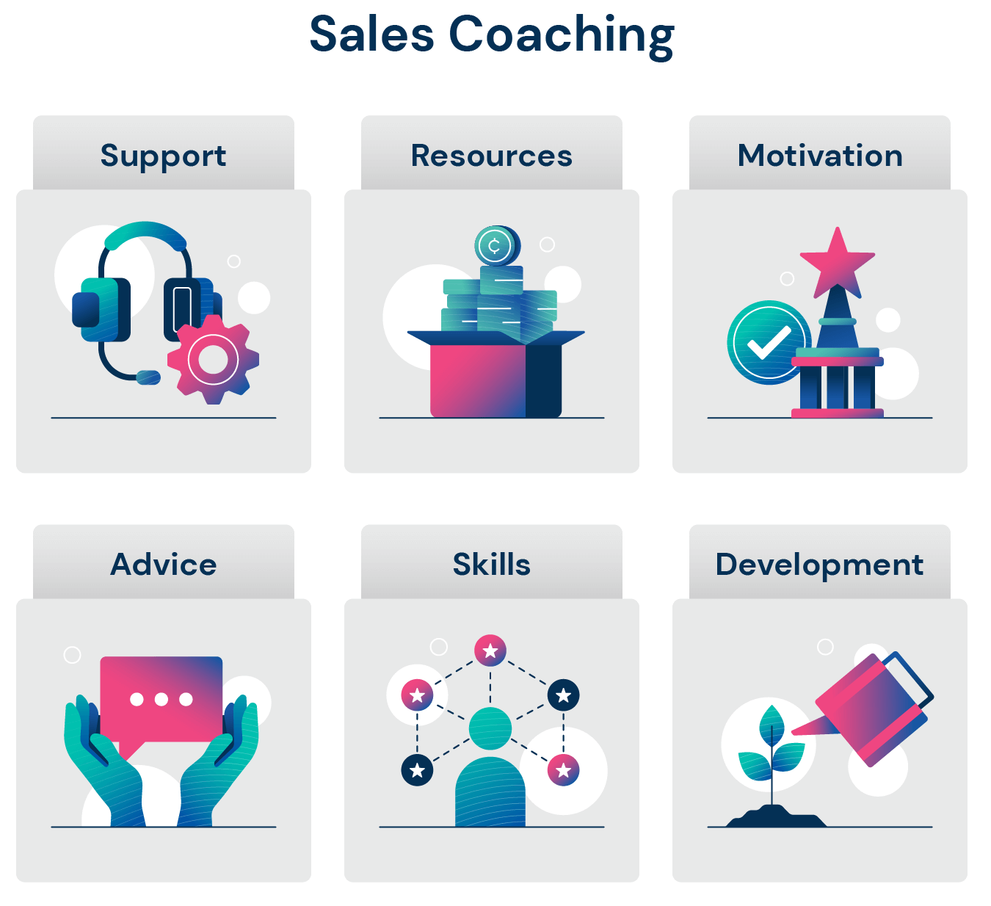
Examples: 1:1 Coaching Skill Building Activities
Coaching Guidance
Best Practices | Best Practices
 | Live Fire Session - Create 1:1 client role play scenarios based on a development area such as qualifying, pitching, managing objections, closing, etc. (1x/QTR)
 | Discovery Call Review – Review a pitch or discovery call with the rep to call out areas of strength and areas of improvement. (1x/Month)
 | Playbook Knowledge Check – Test ability to speak to sales process, personas, products / value proposition, sales plays, competitive positioning, etc. (ongoing)
 | Post-Mortem Win/Loss Analysis – Why did we win? Why did we lose? (2x/Month)
 | Follow-Up Peer Coaching – Assign tenured reps to help build the skills of others (1x/QTR)
 | Pipeline Expansion Conversation – Review the math from first interaction to close and investigate progress (2x/Month)
 | Role Play Sales Calls - Focus on specific development areas such as qualifying, identifying and implicating pain points, identifying and positioning competition, managing objections, closing, etc. (2x/Month)
 | Fluency Practice – Test ability to speak to a variety of industries, products, use cases, success stories, etc. (2x/Month)
 | LMS – Leverage internal and external training platforms to build skills
4
1

Slide 78
Cadence Meeting : Deal Deep Dive Example
Coaching Guidance
Purpose | Review opportunity details to pressure test the rep’s understanding of the sales process, evaluation criteria, & critical success factors; discuss strategies to advance the opportunity, aligning week of the month to sales stage (Week 1 = Early Stage, Week 2 = Mid Stage, Week 3 = Mid to Late Stage., Week 4/5 = Late Stage); enhance sales rep skills
Frequency | Weekly / 30 min , 15 min prep
Participants | Sales Rep, Sales Manager
Tools | CRM
Preparation | Sales Rep Select 1-2 deals to be reviewed and gather necessary deal information in advance of the conversation Communicate / provide opportunity information to the call participants including identified win-themes and any asks of supporting functions Sale Manager Review opportunity information and the rep-gathered deal information Win / loss review of similar deals Prepare deal inspection questions and coaching areas Always address: How do we win? How could we lose? What are the value drivers for the customer?
Agenda Item | Guidance
Assessing the Deal | What is the nature of the deal (specific qualifying details that quantify the opportunity)? What is the status of the deal and the summary of how we meet the requirements? Is there a compelling event driving the timeline (e.g., new decision makers, unhappy with current platform, new requirements, mandated change)? What is the cost of inaction (quantified impact of not buying the product)? What is our business impact? Are we engaged with the right decision makers? Do we know the full details of the decision process?
Assessing the Situation / Context | Where is the customer in the buying process? How do we know this? Who is the competition and what is their positioning? How can we differentiate? Who is your Mobilizer/Champion? How can you tell?
Winning the Deal | Have we collaborated internally to isolate success stories, competitive positioning and a reference (if needed)? What do we feel we do not know about the deal? What are the risks? How will you close the information gaps and mitigate risks? Who has the authority to buy?
4
1

Slide 79
Cadence Meeting : Deal Deep Dive Thought Starters
Coaching Guidance
# | Best Practices
1 | Focus on the Front of the Sales Process – Engage reps on how they qualify deals and get to the middle of the sales process – late-stage problems happen in the past
2 | Pressure Test – Analyze and challenge the sales rep’s buyer map
3 | Competitive Focus – Use team knowledge to collaborate on how to differentiate and inspire action to advance deals more quickly
4 | Large Deal Tear Down – Dissect a larger deal (during or after) as an exercise to understand why we won and what things we did to advance the sales process
4
1

Slide 80
Cadence Meeting : Side-by-Side Coaching Example
Coaching Guidance
Purpose | Observe a sales rep during sales calls, ensuring that each customer interaction has optimal impact to advance a sales opportunity
Frequency | As needed
Participants | Sales Manager and Sales Rep
Tools
Preparation | What items/skills do you want to work on while we are together? Are there specific products what you want help with? Align on what list/opportunities/demos the rep will be calling Notes from previous coaching events Skills assessment scores Notes from assessing recorded calls
Agenda Item | Guidance
Debrief | How do you feel the call went? Did you achieve the desired outcome? What value did you bring to the customer? What could you have done differently? What went well that should be repeated?
Demo | How did you set the context for the demo? How did you align to what the customer wanted to learn? What questions came up? How did you handle with the questions? What key features/capabilities matter to the customer? How did you appeal to those needs? What outcomes came from the demo? What are the next steps?
Discovery | How much conversation vs. one-way dialogue happened? How effective were you at question asking, listening, and qualifying? What could we have done better? How clear is the size of the opportunity? How did you uncover the decision makers?

Slide 81
Cadence Meeting : Side-by-Side Coaching Thought Starters
Coaching Guidance
# | Best Practices
1 | The Practice Field – Use observations and recorded calls to role play while focusing on strengthening core skills
2 | The Obstacle Course – Prior to planned calls, ask questions about what could take the meeting off track and how they will handle obstacles
3 | Watch/Listen to the Experts – Have the rep listen to peers who have mastered skills they are working
4 | Watch Me – Take the lead on some calls during side-by-side; let the rep hear the differences in how you handle specific situations and discuss
4
1

Slide 82
What’s in this section?
This section will provide the sales coach with the recommended preparation necessary for team meeting. In addition, this document provides the overall framework to be followed for effective team meetings.
III
How do I use this section?
Sales Team Cadence Meetings
Sales managers should use this section to understand the format, structure, and agenda of team meetings, how to prepare, and what topics and questions will best address the goals of each meeting type.
Key Content
  Daily Stand-Up Meeting
  Team Pipeline Review
  Team Forecast Review
  Team Skill Building Session

Slide 83
Cadence Meeting : Daily Team Stand-Up Meeting Example
Coaching Guidance
Purpose | Set the daily pace for Sales Reps by running a consistent meeting that is productive, engaging, informative, and helps identify areas where Sales Rep are stuck
Frequency / Duration | Daily / 15 min, 5 min prep
Participants | Sales Manager, Sales Reps, other internal participants as required (e.g., supporting BDRs, Channel Managers)
Preparation | Sales Reps Ready answers to cadence format questions Prepare to discuss “stucks” Monday Only: Prepare to discuss great week milestones / outcomes Manager Have your own answers to the cadence format ready to go Prepare an element of learning / education that can be delivered in under five minutes Manager should lead the call with one or two observations from prior days/week Monday Only: Each rep aligns on outcomes / milestones for the week When applicable, a manager should share an element of learning / education that can be delivered in under five minutes
Agenda Item | Guidance
Format | All Sales Reps should prepare the following: Good News – personal or professional to start off on a positive note Last 24 Hours – one thing you accomplished yesterday Next 24 Hours – one thing you must accomplish in the next 24 hours Data – your performance numbers from the previous day (ex. meetings booked, closed/won opportunities and their value) Stuck – an item or activity you are stuck on Alternatively, for Monday meetings, consider the following Good News Professional – share something you closed last week or something positive for the week ahead Good News Personal
Tips for the Sales Manager | Do not let people talk for too long – keep them on task Address “stuck” items in the meeting and encourage other team members to offer help as well – take detailed solutioning offline Do not dig into each person’s performance numbers in the meeting – just get the numbers and dig deeper 1:1 if needed Encourage the team to take notes – they will hear some good ideas from their peers Encourage them to come with questions prepared
4
1

Slide 84
Cadence Meeting : Team Pipeline Review Example
Coaching Guidance
Purpose | Each sales rep should spend 5-10 minutes walking through their early to mid-stage pipeline. The goal is to talk through how to progress key deals through Deal Stages over the next 60 – 90 days.
Frequency / Duration | Bi-weekly / 90 min, 30 min prep
Participants | Sales Manager and Team
Tools | CRM
Preparation | Sales Rep Identify specific deals / topics they’d like to cover in advance of the meeting Ensure that CRM entries are updated Sale Manager Review process adherence (e.g., CRM hygiene, opportunity completeness, advancing opportunities per exit criteria, RACI adherence, utilization of Sales job aids, etc.) Snapshot of current pipeline from CRM (deals, value, stages) Focus on building and maintaining pipeline health for the next quarter
Agenda Item | Guidance
Review Pipeline Health | How would you assess your pipeline health? (Coverage ratio, stage conversion rates, pipeline mix, and pipeline source mix) How did you perform vs. target activity metrics? Are you struggling with any of these and why? (prospecting calls, meetings set, targeted account outreach)
Highlights and Opportunities | What are the brightest opportunities in your pipeline? What does the detail in your pipeline look like? (number of deals, stage progression, opportunity types, deal sizes) If (insert deal) big deal doesn’t close – how will you make your number? What deals in the pipeline are at-risk within the next quarter? What can you proactively do to prevent these from losing? Which metrics have the most opportunity to improve effectiveness?
Performance Planning | How has your performance affected next quarter’s pipeline? What trends have you noticed about deals you win and lose? What can you do differently or repeat because it works? What personas (decision makers) do you feel you have mastered? Which ones do you feel you need to improve upon? What outreach sources are working well? Which ones can be improved? What are some of the other tactics you’re utilizing to grow your pipeline?
4
1

Slide 85
Cadence Meeting : Team Pipeline Review Thought Starters
Coaching Guidance
# | Best Practices
1 | Fill the Funnel – Focus on the funnel composition (product mix, opportunity size, customer mix, pipeline sources) to encourage diversification and achieving the multiple
2 | Knowledge Check – Assure that reps can understand the characteristics of a healthy pipeline. Reps should be able to explain the positive and negative aspects of their pipeline then compare those against company best practices.
3 | Moving the Needle – Have the rep describe a sub-optimal aspect of their pipeline (opp. distribution by sales stage, avg. sales velocity) and develop ideas on what actions to take
4 | Focus on the Math – Have the rep isolate metrics determined within the sales process (prospects to demo, demo to qualified/quantified live opportunity, closing percentage, average deal value)
1

Slide 86
Cadence Meeting : Team Forecast Review Example
Coaching Guidance
Purpose | To review forecasted opportunities that are scheduled to close within the next 30-days and discuss plans and action items to ensure all forecasted deals close as scheduled.
Frequency / Duration | Bi-weekly / 90 min, 30 min prep
Participants | Sales Manager and Sales Rep
Tools
Preparation | Sales Rep Ensure that CRM entries are updated Record recent activity; be prepared to discuss Bring updated deal specifics (i.e., close dates, amount, bundles, etc.) for deal that are forecasted to close within next 30-days Be prepared to talk through your commit and stretch numbers by month Manager Review sales rep forecast deal by deal Manager and Rep to review target that has been committed/forecasted to ensure alignment on hypothesized forecast between Rep and Manager
Agenda Item | Guidance
Tops-Down Forecast Review | Does the quantitative view of forecast coincide with the bottoms-up view of the rep? How does your forecast align to your quarterly sales target, and what needs to happen for you to close the gap? Have you targeted the right deals to move the needle in the current quarter?
Pressure Testing Key Deals | Are you actively managing the opportunity? What is driving urgency for your accounts to buy now? What are potential deal killers? How will you manage them?
Closing the Top Deals | For every forecasted opportunity, can you confidently answer 1) Why will the customer change? 2) Why now? & 3) Why us? Is there a mutual action plan, including a timeline & sequence of events leading up to procurement? What are the next steps in each forecasted opportunity? What are potential obstacles to closing? Have you engaged the full buying decision team?
4
1

Slide 87
Cadence Meeting : Team Forecast Review Thought Starters
Coaching Guidance
# | Best Practices
1 | Key Deals – In some cases, you may not have time to deep-dive into every single deal with every single rep, that’s okay – prepare by identifying key deals
2 | 3 Why’s Drill – Help the sales rep reaffirm which forecast category their top deals are in by having the rep answer the following questions for each account: Why buy anything?, Why buy from us?, Why buy now?
3 | Moving Deals Out – Comb through the sales rep’s forecast to pick out deals that become unrealistic candidates to be won by the end of the forecast period
4 | Slipped Deals – Even the best teams have deals that are not won by the end of the forecast period and slip to the next forecast – it is important to minimize “slippage” longer than necessary
4
1

Slide 88
Cadence Meeting : Team Skill Building Session Example
Coaching Guidance
Purpose | Reps can share their best practices in an open and honest environment and promote learning & skills development using interactive and fun methods.
Frequency / Duration | Bi- weekly / 60-minute meeting, 30 minutes preparation
Participants | Sales Manager, Sales Reps
Tools
Preparation | Sales Reps Come prepared to learn Manager Determine the critical Skills gap that will drive the focus of the conversation Align on who is leading the session: Manager-led, Peer-led, an outside resource (channel, marketing, etc.) Prepare interactive team exercises that promote communication, negotiation, prospecting, industry & market knowledge, etc. Leverage Sales Coaching to help on creating content and guidance on delivery
Agenda Item | Guidance
Tips for the facilitator | Welcome in relevant stakeholders as guests to communicate firm initiatives, product/marketing updates, recent success stories Embrace the opportunity for sales reps to engage with and learn from each other Use follow-ups for topics that are not beneficial for the broader group Encourage the team to take notes – they will hear some good ideas from their peers Session is NOT meant to discuss team performance metrics
Example Activities | Listening to and dissecting a recent discovery and demo calls​ Have a sales rep present a recent big win (or loss) and talking through critical success factors, tactics, sales plays they ran, and lessons learned​ Role playing specific customer interactions between manager and team​ Have an A Player sales rep talk through territory or account planning best practices​ Have an A Player sales rep talk through prospecting best practices​ Have a sales rep and their CS counterpart present best practices for account planning and tactics they use to drive account expansion​ Have a support role come in and train on specific topics (FENXT, new product training, SE demo training)​
4
1

Slide 89
Cadence Meeting : Team Skill Building Session Thought Starters
Coaching Guidance
# | Exercise Example
1 | Features & Benefits - One person is assigned to give a brief description of a product they want to buy. The first rep lists one feature of the product they're selling and passes it to the next to create a benefit from that feature. This pattern is followed until your team runs out of features or benefits.
2 | Ugali Orange - The goal of the game is to help reps learn how to negotiate to get what they want, and hopefully find a solution that makes everyone happy.
3 | Cold Call Bingo - Build cold calling skills by having junior reps listen to more experienced reps while they cold call. Each junior rep will have a bingo card and must listen closely for the common sales methods and conversation milestones listed there.
4 | Sales Jeopardy! - You can use Jeopardy! to reinforce product/market knowledge or strategies for the entire team.
5 | Latest & Greatest News - Your team needs to stay up-to-date on industry knowledge and trends. Set up a Teams channel for your team where they can reference the latest industry news, market trends, etc. The rep whose news item gets the most Teams reactions during the month wins a prize.
4
1

Slide 90
What’s in this section?
This section will provide the sales coach with the recommended preparation necessary for team meeting. In addition, this document provides the overall framework to be followed for effective team meetings.
IV
How do I use this section?
Sales Director Cadence Meetings
Sales managers should use this section to understand the format, structure, and agenda of team meetings, how to prepare, and what topics and questions will best address the goals of each meeting type.
Key Content
  1:1 Sales Manager Coaching Session
  Team Pipeline Review
  Team Forecast Review
  Team Meeting

Slide 91
Cadence Meeting : 1:1 Sales Manager Coaching Session Example
Coaching Guidance
Purpose | Guide Sales Managers to drive the right volume of activity across their teams to maintain a sustainable business while mastering the required skills for the role
Frequency / Duration | Weekly / 30 min, 15 minutes prep
Participants | Sales Manager, Sales Director
Tools | CRM
Preparation | Sales Managers Prepare recap of key considerations from 1:1s with directs Chief Sales Officer Review the Sales Manager’s team’s MTD, QTD performance in advance, assess whether the manager’s team is on track Determine questions to ask that will open the dialogue and spark a productive coaching discussion (think through what “game film” you can bring)
Agenda Item | Guidance
Debrief | How are you doing personally? How is your week going in the job? Are you stuck on anything that I can help with? Did you learn anything new this week?
Demo | How is your team progressing against their quarterly goals? Anyone struggling or excelling? Where can I provide strategic guidance to the field, or unstuck a barrier with an internal or external partner? What specifically do you need to make your number this quarter?
Discovery | Are you confident in your team’s strategy for the next two weeks? Do you and your team have the tools and resources to maximize sales productivity over the next two weeks? What immediate support do you need from me to help you succeed?
4
1

Slide 92
Cadence Meeting : Team Pipeline Review Example
Coaching Guidance
Purpose | Ground leadership team in overall pipeline health & identify timely strategies to build pipeline for the out quarter to mitigate risk to bookings targets
Frequency / Duration | Monthly / 60 min, 30 minutes prep
Participants | Sales Director and all direct reports
Tools | CRM
Preparation | Sales Operations Prepare sales performance data to support the meeting Maintain SMART (Specific, Measurable, Achievable, Relevant, and Time-Bound) actions; distribute following each meeting Sales Managers Ensure that Salesforce opportunities are updated Sales Director Review current pipeline coverage ratio and change in performance MoM, YoY in the same period; hypothesize on increases and decreases in performance
Agenda Item | Guidance
Change in Pipeline | Review core metrics: Change in pipeline coverage from the previous call (# of opportunities created, total $ value) Change in pipeline coverage from same period YoY (e.g., Feb 2022 change from Feb 2021 pipeline) Review SMART Actions from previous call
Pipeline Hygiene | Ensure that key daily, weekly, monthly activities are inspected (ie. auditing qualified opportunities and confirming the Sales Strategy Form is completed) Review pipeline by stage, $ amount in each sales stage & forecast category; is the mix healthy? Are we depending on 1-2 big deals? Evaluate how many opportunities were created and who generated them Compare historical win rate to pipeline generated for the out quarter – will we hit the number?
Marketing / Lead to Opportunity Efforts | Review Lead-to-Opportunity performance – how many leads converted to opportunities, any significant wins, any risks in the process? Identify opportunities to collaborate with marketing to drive increased pipeline coverage
SMART Actions | Identify SMART activities to address gaps in out quarter pipeline coverage
4
1

Slide 93
Cadence Meeting : Team Forecast Review Example
Coaching Guidance
Purpose | Ground leadership team in progress to monthly targets, accurately project committed deals for the current month and identify timely strategies for closing those deals
Frequency / Duration | Weekly / 60 min, 30 minutes prep
Participants | Sales Director and all direct reports
Tools | CRM
Preparation | Sales Operations Prepare sales performance data to support the meeting Maintain SMART (Specific, Measurable, Achievable, Relevant, and Time-Bound) actions; distribute following each meeting Sales Managers Ensure that Salesforce opportunities are updated Be prepared to discuss critical opportunities in current month’s forecast Sales Director Review week-over-week performance Identify critical deals for review
Agenda Item | Guidance
Sales Performance | Review core metrics: Progress against MRR bookings targets (MTD) Pipeline coverage ratio for current month, quarter Pipeline generated (# of opportunities created, total $ value) Review SMART Actions from previous week
Deal Review | Inspect the most critical deals to validate $ amount, forecast category and close date Discuss specifics of each deal to make sure they are forecasted accurately and give advice to increase likelihood of deal closure
Risk / Remediation | Evaluate opportunities that look inaccurate. (i.e., Opportunities with past due close dates, opportunities with no activity) Identify at risk opportunities or elements within a deal that pose significant risks to deal size, close date; discuss risk mitigation strategies Highlight unseen areas where important deals may slip
SMART Actions | Identify activities that could reduce likelihood of deal slippage & when they should be executed; capture the action owners & assigned dates Look for ways that senior leaders can remove deal obstacles
4
1

Slide 94
Cadence Meeting : Team Meeting Example
Coaching Guidance
Purpose | Ground leadership team in progress to quarterly/yearly targets, provide company updates, and pull in functional leaders to discuss rotating topics
Frequency / Duration | Monthly / 60 min, 30 minutes prep
Participants | Sales Director and all direct reports
Tools | CRM
Preparation | Sales Operations Prepare sales performance data to support the meeting Sales Managers Identify bright spots, recent wins to share with the broader team; share with CSO prior to call Come prepared to learn Sales Director Set agenda; gather recent wins, bright spots, & recognition to share with the team Facilitate support internal support from guest speakers
Agenda Item | Guidance
Sales Performance | Review core metrics: Progress against MRR bookings targets (QTD & YTD) Pipeline coverage (current quarter, out quarter) Pipeline generated (trailing 4 weeks, QTD)
Deal Review | Corporate updates – company-wide initiatives HR updates – sales talent pipeline, internal promotions and employee turnover outside of the sales team Product / solution updates – new features, products & upcoming training
Risk / Remediation | Highlight recent wins / success stories Recognition - awards & sales team internal promotions Updates on sales team initiatives, team meetings & events (ex. SKO) Important announcements, communications to the sales team
SMART Actions | Guest speakers from Marketing, HR, Product Management, Sales Enablement Skill building exercise for sales coaches Ask a top performing sales coach to share a best practice with the team
4
1

Slide 95
For more resources like this, contact your advisor or visit SBI Pro.
Schedule a session with your advisor
SBI Advisors help clients with practical advice, whether strategic or surgically tactical, to drive revenue and growth.
Contact your advisor to schedule a work session and tune this guidance to your situation.
Login to SBI Pro:
https://pro.sbigrowth.com/

