Slide 1
How to Build and Mature a Sales Enablement Capability
Current as of March 30, 2024

Slide 2
Eight Core Capabilities for Sales Enablement
Sales Enablement Charter
Playbook Development
Sales Training
Technology Roadmap
Certification
Coaching
Measurement
Sales Content Guidance
Markers of Successful Sales Enablement:
❑ Content and sales tools are designed for each stage of a buyer-aligned sales process
❑ Sellers can easily find, access, and share content and sales tools
❑ Adoption of sales enablement such as buyer personas and playbooks translates to:
  Increases in sales revenue per employee
  Improved quota attainment
  Increased wallet share
  Improved penetration rates
Core Sales Enablement Capabilities

Slide 3
Overview: Leading a Sales Enablement Transformation
STEP 1:
Assess Current Talent
STEP 2:
Assess Enablement
STEP 3:
Develop Charter/KPIs
STEP 4:
Construct & Launch
STEP 5:
Ongoing Refinement
Goal
Understand current skills and competency across the sales force
Goal
Determine enablement strengths and weaknesses; analyze current state to understand contributing factors to rep performance
Goal
Define a charter that makes sense for the sales environment, org, and culture
Goal
Deliver actionable resources to reps in the field using technology
Goal
Continually refine approach to develop A-player talent and
upskilling
Key Activities
❑ Align with revenue leadership on the most essential competencies for success in selling roles
❑ Assess all sellers against those competencies
❑ Pinpoint enablement needs on three fronts:
organization-wide, role-specific, and individually focused
Key Activities
❑ Review existing coaching, training, and enablement material and how often it is leveraged in the GTM organization
❑ Interview sellers by cohort (inside sales, field sales, etc) to understand adoption of enablement and identify gaps
Key Activities
❑ Define the mission, objectives, and desired outcome of sales enablement program
❑ Align internal resources to prepare for training cadence, notifying trainers/coaches, and housing enablement content & resources
Key Activities
❑ Leverage assessment findings and rep interviews to prioritize content and tool creation in the areas that will improve rep performance and efficiency
❑ Communicate cadence to GTM leadership and field sales managers
❑ Rollout enablement content and certification program
❑ Evaluate current and potential enablement tools to support program objectives
Key Activities
❑ Collect feedback on usage and adoption of enablement materials
❑ Set annual goals for enablement, reviewing and prioritizing quarterly

Slide 4
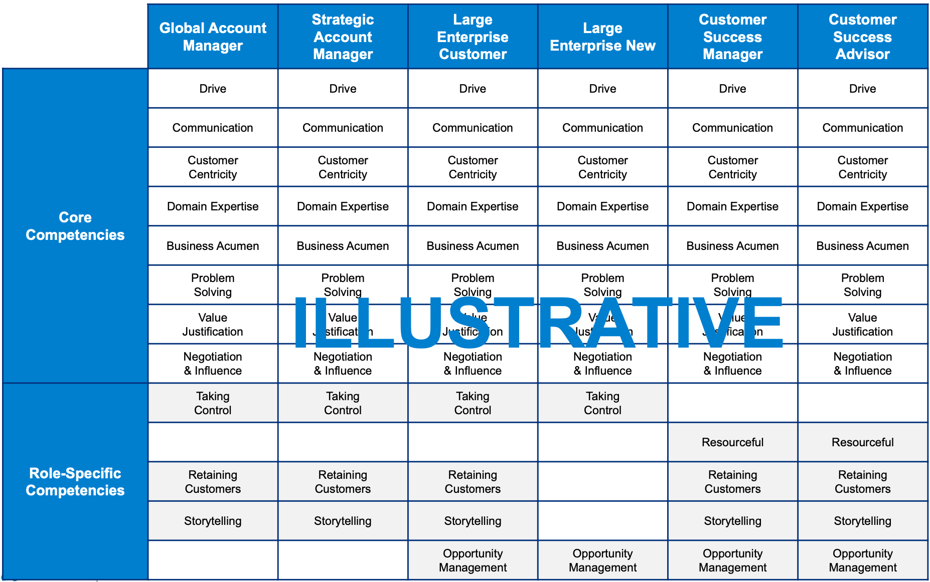
1. Assess Current Talent
Define Core and Role-Specific Competencies Exemplified by High-Pers
Approach
Review rep performance data, job descriptions, coverage model and sales motions
Conduct expert panels with sales leadership and high-performing sales reps to contextualize the competencies of your organization
Analyze high-performer traits as well as compare potential competencies to best practice for the industry
Iterate on competencies with sales leadership (plus HR as applicable)
Craft A/B/C-Player definitions for use in assessments
Review and finalize with team

Slide 5
1. Assess Current Talent
Deploy 3-Part for Comprehensive Views of Competency Gaps
Evals
Approach
Individuals complete the competency assessment
Individual Assessment
Company Assessment
Manager Assessment
Work with SBI expert advisors to develop a top-grading approach for the following roles:
  a) Account Executives
  b) Solution Engineers
  c) Customer Success Managers
  d) Industry Consultants
  e) Consulting Sellers
Consider the following series of assessments for a 360-degree view of talent:
  a) Everyone completes self-assessment
  b) Managers assess their team members
  c) SBI assesses front-line managers
Enablement to assess responses to scenario-based questions aligned to each competency
Managers assess each rep for how well they exhibit each competency
360 assessment provides a comprehensive view of competency gaps

Slide 6
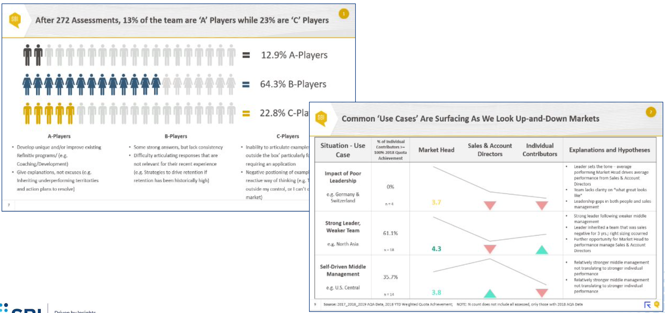
1. Assess Current Talent
Sample Outputs

Slide 7
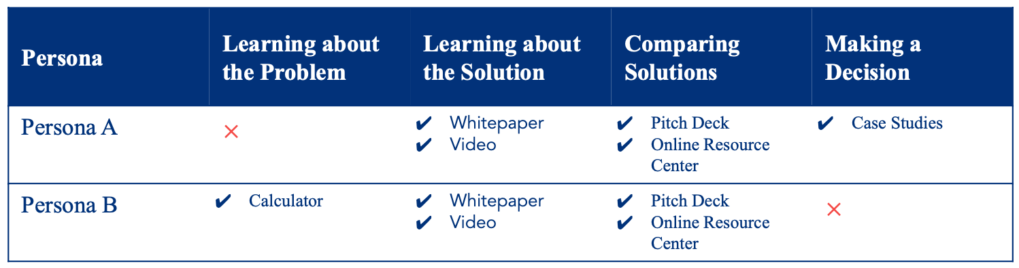
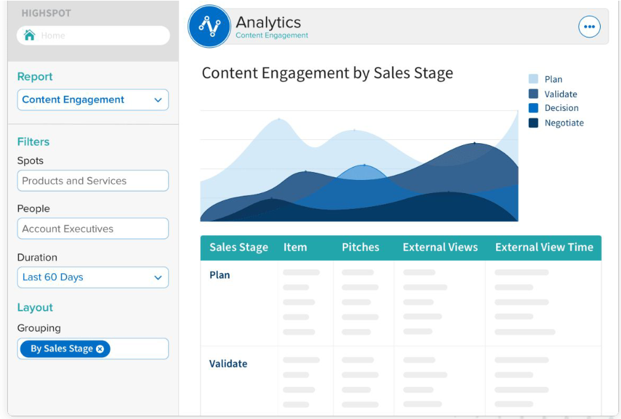
2. Assess Enablement
Use Data to Evaluate Gaps and Opportunities with Marketing
Sample Content Audit
Objective
Serve as the voice of sales, so marketing can develop the sales content needed to increase wallet share, penetration rates, and/or land new accounts. Manage the content management system and ensure that Marketing is helping to make sales more effective in ways other than lead generation. Ensure that there is continuing clarity on Marketing’s role in enabling the sales force and this role is clearly codified in the Sales Enablement charter.
Outcomes & Typical Deliverables
Content Assessment
Creation/Curation Process
Ensure relevance with Personas and Buyer Process
Maps
Content Lifecycle Management
Content Usage Tracking
Content Usage Tracking
www.highspot.com

Slide 8
3. Develop Charter and KPIs
Sales Enablement
Key Functions Supported: | Marketing, Product, Sales, Success
Exec Sponsor / Charter Owner:
Capability Objectives
Support commercial teams’ rapid attainment of productivity standards through scalable training and ongoing coaching Define and develop critical competencies
Financial Impact TBD One Time Investment TBD
Objective
Define the sales enablement approach that will get the right sales content into the hands of the right sellers at the right time to move a sales opportunity forward. The charter should guide the efforts of the enablement function overall while also creating clarity around who is responsible for what.
Outcomes & Typical
Deliverables
Sales Enablement Mission, Vision and Values
Sales Enablement Goals (Activities/Results)
Sales Enablement Scope (Process Descriptions)
Playbook Development (New Product Introductions and SKU expansion)
KPIs, meeting cadences & structure, etc.
Sales Enablement Roles and
Responsibilities
Sales Enablement RACI (Responsible,
Accountable, Consulted, Informed)
Initiative Objectives | Issues/Risks/Dependencies | Mitigation/Assumptions
Business objective: Reach 15% growth by end of FY1 to impact FY2 revenue while integrating 2 companies Project objectives: Identify buyer personas and map their journeys Develop sales playbook Buyer personas Sales plays Competitive positioning | Risks: • Timely customer and rep access • Access to data and content • Product challenges | • Schedule interviews with cross functional stakeholders • Prioritization of customer segments • Align on most significant product challenges
Project Actions | RACI Team / Stakeholders | Metrics and KPIs
See timeline | A: Bob Smith R: Jane Doe C: Brian/Marc/Jenny | • FY2 new logo bookings • Organic growth rate • Productivity per rep • Win rate • Average deal size

Slide 9
4. Construct & Launch
Key Enablers for Sales Reps, Coaches and Managers
1. Enablement Playbooks
2. Onboarding and Training
3. Certification
Single source of information aligned to the sales process that guides the day-to-day efforts of sellers and makes them more effective
Training and onboarding designed to efficiently and effectively onboard new talent and impact key competency areas across the employee lifecycle
Multi-level assessments to identify how well sellers have absorbed key concepts and apply them as part of their day-to-day work
4. Coaching
5. Tools and Technology
Guidance, structure, and training to support managers’ efforts to institute an ongoing culture of coaching
Tools and roadmap to enable automation of core business processes, increased productivity of the sales organization, and reduced administrative burden

Slide 10
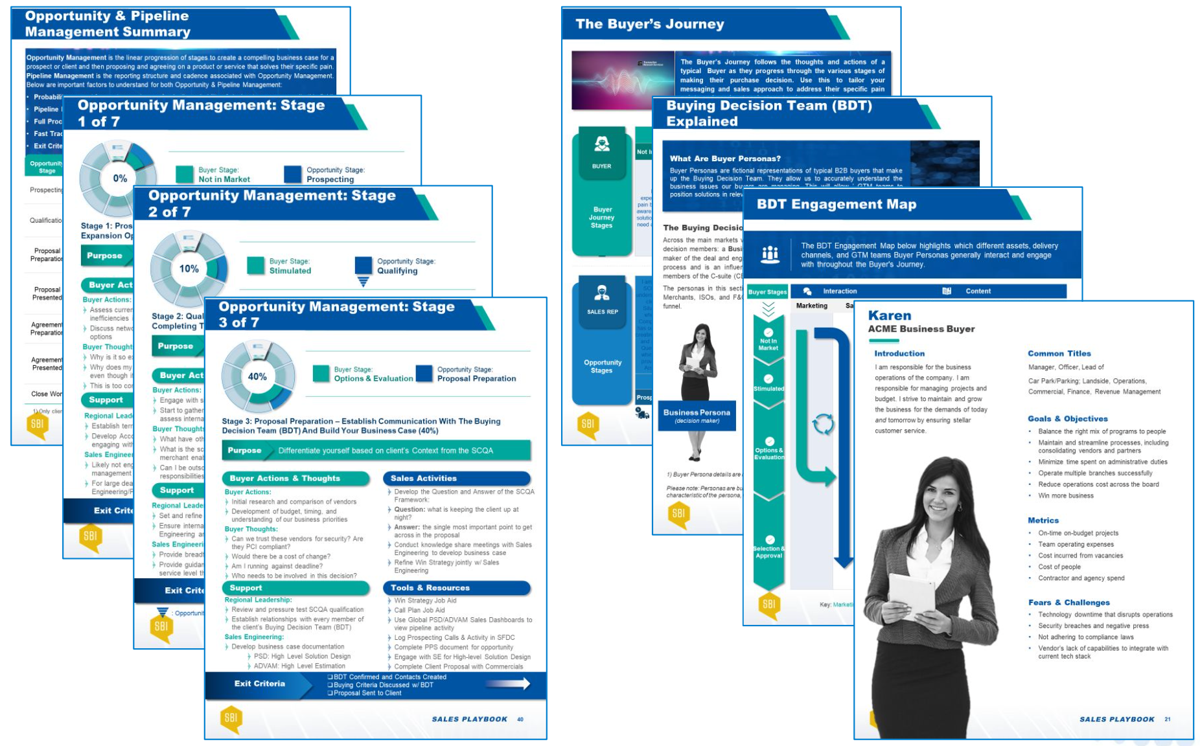
4. Enablement Playbooks
Should Align Comprehensively to a Buyer-Driven Sales Process
Objective
Design, implement, and package playbooks that represent a single source of information to guide the day-to-day efforts of sellers and make them more effective. Playbooks should be built around a consistent sales process and should include ‘plays’ that sales reps should run at different points within the process. Playbooks should drive greater understanding of buyer persona, buyers’ motivations, their decision-making process, and how to present value to different types of buyers.
Outcomes & Typical Deliverables
Playbook that encompass:
  − Detailed guidance around a standardized sales
  process
  − Sales Plays / Call/Visit Choreography
  − Misc. Sales Aids (i.e. Objection Handling,
  Opportunity Assessments, etc.)
  − Buyer Personas
  − Buyer Process Maps
  − Competitive Landscape & Battle Cards
Product Launch Planning/Product Use Scenarios/Product Demos
Pricing/discounting guidelines
Marketing Campaign Schedule

Slide 11
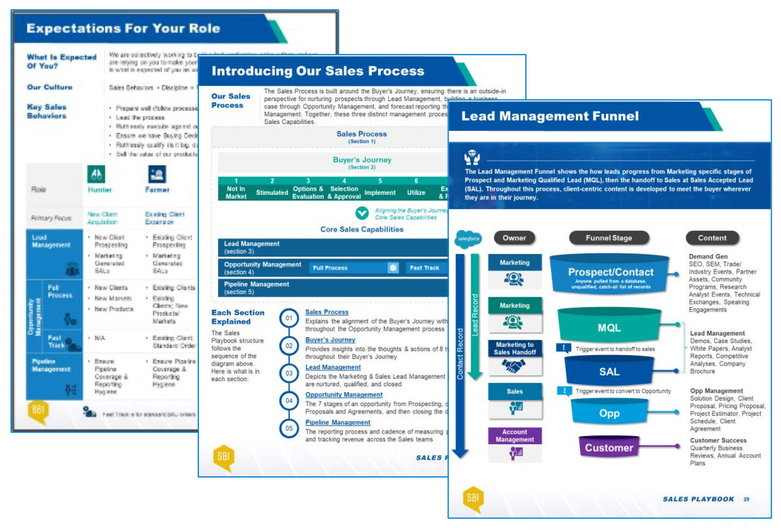
4. Strong Onboarding & Training Programs Accelerate New Hire Ramp Times and Drives Productivity Gains Throughout the Employee Lifecycle
Objective
Train the sales team on the sales skills and product knowledge needed to meet buyer needs. Create consistency in the way that training is delivered to both new and tenured reps. Drive training through different modalities – in-person, online, etc. Maximize the training value of events like Sales Kickoff (SKO).
Outcomes & Typical Deliverables
Courseware Development
Onboarding Planning, Design and Execution
Ongoing Training Planning, Design and Execution
Reinforcement Plan
Reinforcement Execution
Sales Skills Training
Translate Product training into applicable sales training
SKO and other internal events

Slide 12
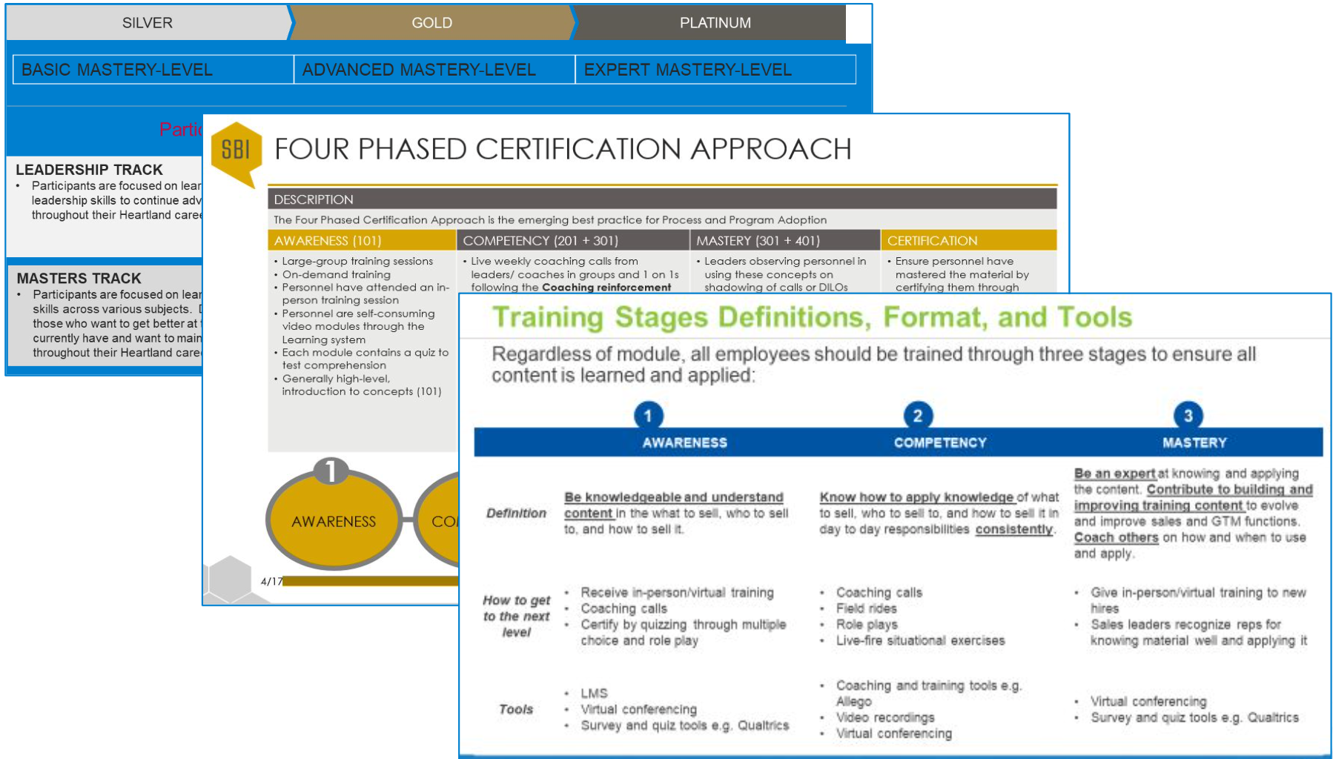
4. Certification Programs Drive Accountability for Sellers to Advance from Awareness to Competency to Mastery of Key Concepts
Objective
Certify that sales training has been absorbed by the sales team. Ensure that sales enablement assets have been adopted by the sales team. Create a competitive environment where learning is encouraged and rewarded. Leverage gamification for learning, reinforcement, and motivation.
Outcomes & Typical Deliverables
Maintain Certification Process
Facilitate Certification Process
Recognition programs, contests, president’s club
Spiffs
Game Design (rules, points, prizes)
Real Time Leaderboard Design & Execution
Gamification Communication Plan
Gamification Administration

Slide 13
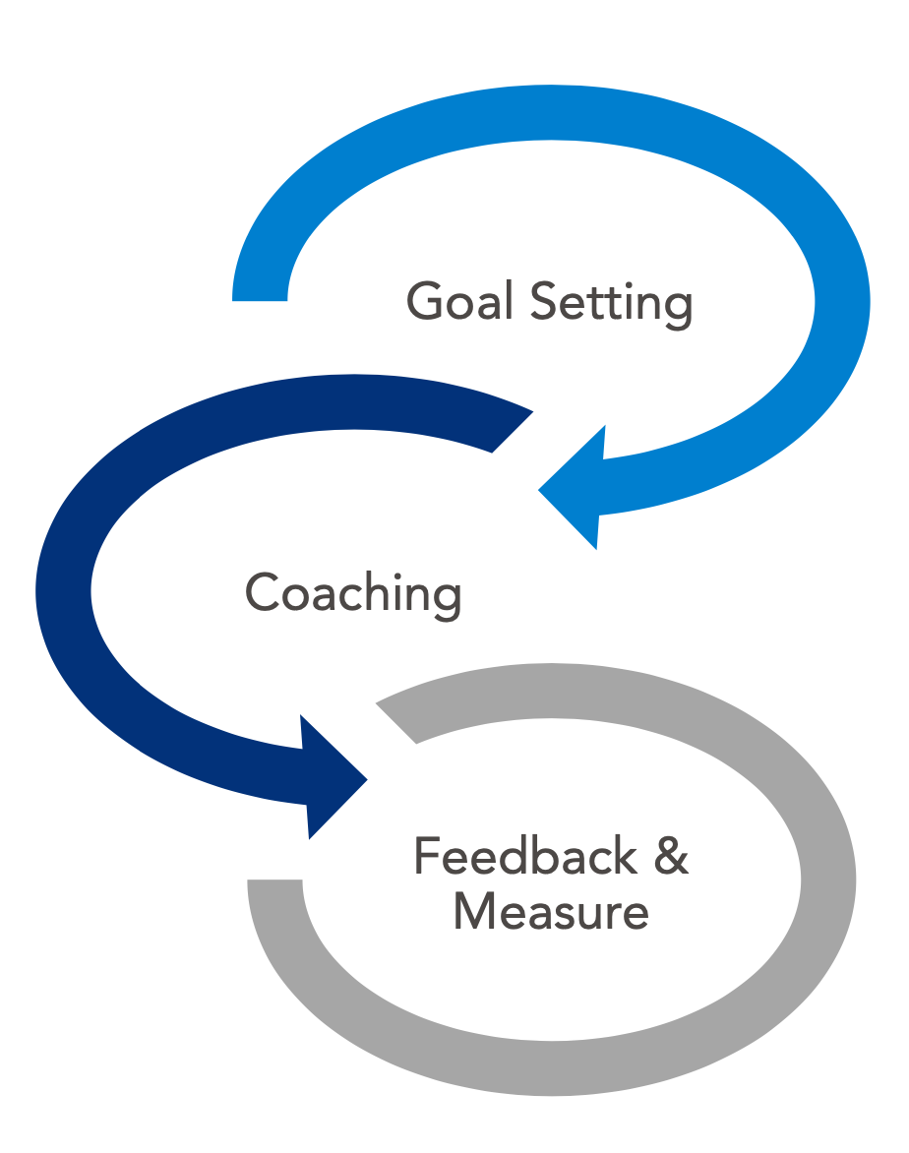
4. Sales Coaching is Essential to Reinforcing Learnings Gleaned from the Sales Enablement Program
Objective
Create a culture of sales coaching where Managers execute against defined expectations around coaching. Provide guidance and structure that enables Managers to be better coaches. Provide continuous training on how to maximize the value of coaching.
Outcomes & Typical Deliverables
Coaching charter
Sales team communication planning and execution
Coaching cadence
Coaching process & job aids
Coaching playbook
Individual Development Plans
Train-the-Trainer Session(s)
Coaching Certification
• Define Coaching Charter and Goals
• Identify Coaching Relationships
• Schedule Interaction Cadence
• Inform Team of Program Structure
• Initiate Introductory Meetings
• Prioritize Behaviors to Focus On
• Clarify by Asking Questions
• Discuss What People Need/Want
• Encourage with Information/Instruction
• Agree on Action to Take
• Consolidate Findings From Coaching
• Measure Behavior Change
• Performance Feedback
• Solicit Feedback to Accelerate Adoption

Slide 14
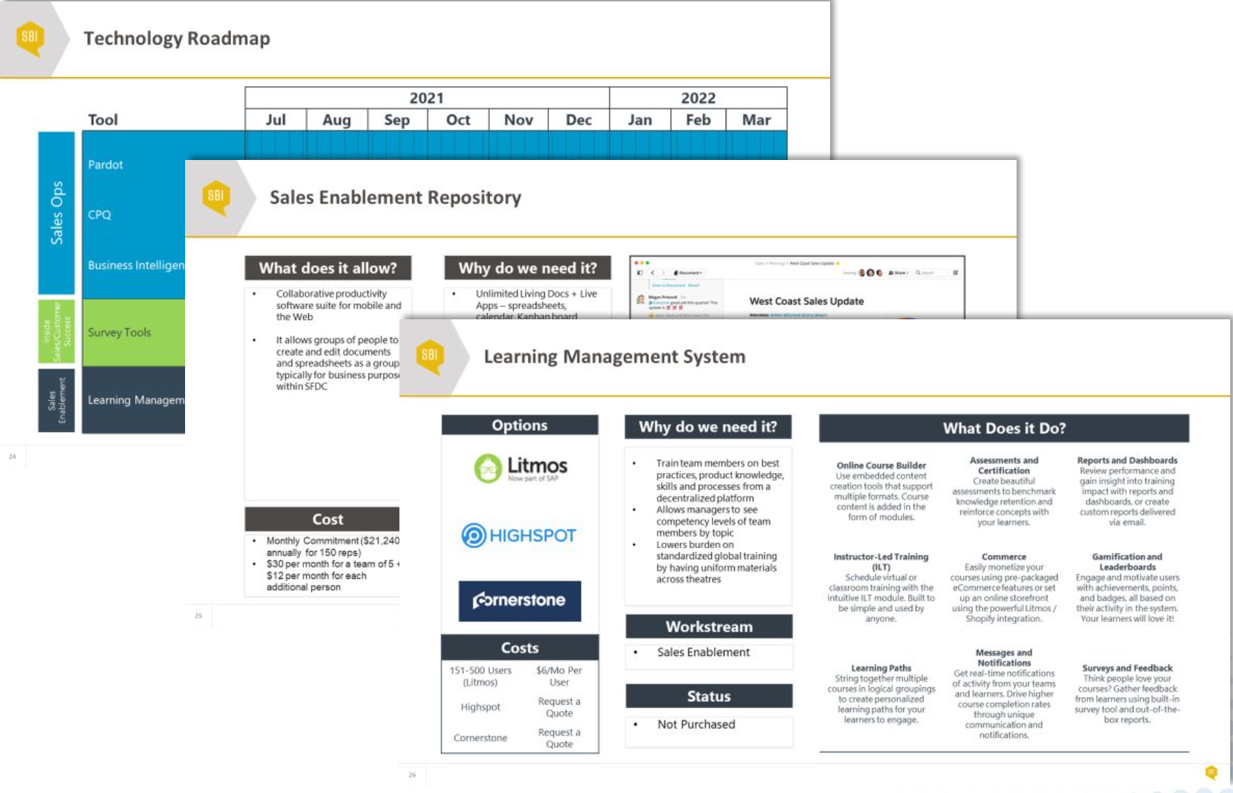
4. Sales Enablement Tools and Technology
Objective
Automate the core business processes to increase the productivity of the sales organization while reducing any administrative burden. Document business/functional requirements that will lead to greater sales productivity. Identify and implement technologies that will play a role in the future training & enablement of the sales force.
Outcomes & Typical Deliverables
Technology roadmap
CRM (Identify & Implement)
Content Management System
Learning Management System (LMS)
Knowledge Management System
Mobile functionality (including Automated Playbooks)
Gamification tools
Quality Assurance System (eg. call monitoring w/recording capabilities for inside sales)

Slide 15
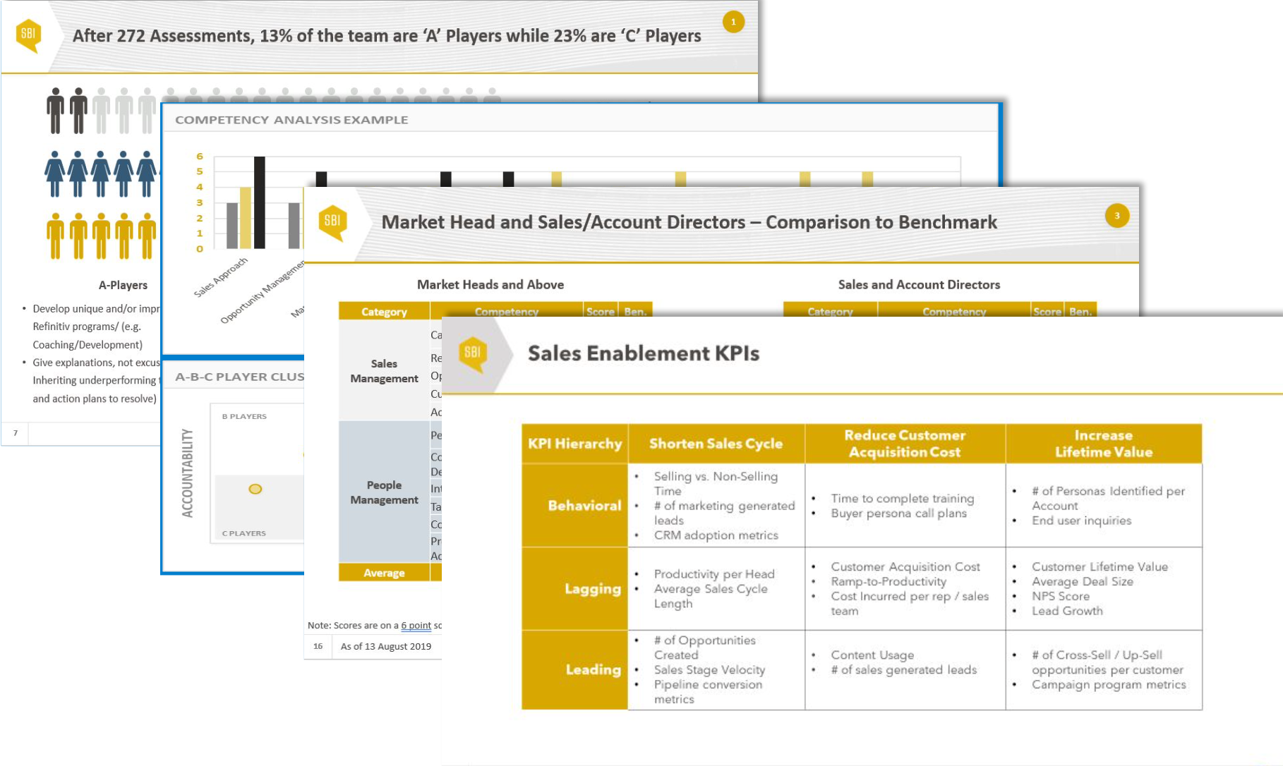
5. Ongoing Refinement
Objective
Measure the impact of the investment in sales enablement. Identify the KPIs that define the effectiveness of sales enablement and create dashboards that will effectively track these KPIs.
Outcomes & Typical Deliverables
Defined measurable goals of Sales Enablement program
Partner with Sales Operations on appropriate metrics to track: Behavioral, Leading, Lagging
Partner with Sales Ops to develop dashboards to track progress – individual and aggregated

