Slide 1
Sales Compensation Design Methodology

Slide 2
SBI follows a four-step process in assessing, designing, communicating, and implementing sales incentive plans
Current-State Plan Assessment
Direction Setting & Plan Design
Quota-Setting & Allocation
Communication & Implementation Planning
01
02
03
04
Project Planning
Leadership Interviews (7-10)
Current Plan Assessment
Pay Level Benchmarking
Pay & Performance Analysis
Pay Differentiation
Quota Achievement
Tenure & Turnover Analysis
Sales Rep Survey
Rep Focus Groups (3-5)
Design Team Meetings
Compensation Philosophy
Incentive Plan “Straw Models”
Financial Modeling
Plan Finalization
Global Governance Framework
Legal Review
Executive Approval
Account & Territory Potential
Rep Production Capacity Models
Quota Setting Principles & Process
Quota Assignment Methodology
Quota Stress Testing
Sensitivity Models (as needed)
Implementation planning
Roll-out strategy and transition roadmap
Communication Material Development
Train-the-Trainer Materials
Plan Documents
Compensation Calculators
FAQ Sheets
Terms & Conditions
Activities
Weeks 1 – 3
Weeks 4 – 6
Weeks 7– 9
Weeks 10 – 11
Assessment of design principles against business objectives and sales strategy
Evaluation of current-state sales incentive plans
Current state plan comparison to market and industry best practice
Leverage assessment findings to set future-state plan direction
Develop plan designs that align to business and sales strategy and incorporate best practices to drive desired behavior and performance
Understand cost and rep-level impact of new plan design
Review of current-state quota-setting methodology and processes
Develop and assign quotas that reflect market potential, not just historical spend patterns
Alignment of rep and management quotas to financial targets
Clearly articulated implementation plan outlining priority, effort, timing, and dependencies for plan roll-out
Develop tools and resources that will enable sales reps to “win” early
Outcomes
Overall objective is to develop sales compensation plans that align to the business objectives and sales strategy, are competitive with industry
and best-practice, are simple and easy to understand and administer, and deliver financial results

Slide 3
Current-State Plan Assessment

Slide 4
In Steps 1 & 2, SBI assesses and designs compensation plans across 10 different design elements to ensure an organization’s ability to attract and retain top talent
1
Sales Compensation Strategy
Competitive
Alignment to Market
Plan Effectiveness
2
Eligibility
5
Measures & Weights
8
Quotas & Crediting
3
Target Pay Levels
4
Pay Mix
6
Upside Opportunity
7
Plan Mechanics
9
Timing
10
Administration
2. Eligibility | Who should be eligible for sales compensation (versus other forms of variable pay)
3. Target Pay Levels | How do base salary and target variable incentive (e.g. on- target earnings) earned at target performance compare to market
4. Pay Mix | Is the allocation of on-target earnings between fixed salary (e.g. base salary) and variable pay aligned with the selling role?
5. Measures & Weights | Have the right performance measures been selected to align with the overall corporate strategy? Are they controllable by reps?
6. Upside Opportunity | Are top performers adequately rewarded compared to average and bottom performers?
7. Plan Mechanics | Do the payout tables (e.g. thresholds & excellence), links, and incentive caps create a plan that drives a pay for performance culture?
8. Quotas & Crediting | Are the rules determining which sales individuals receive quota credit for certain sales and allocation of those goals aligned?
9. Payout Timing & Performance Period | Does the payout timing provide adequate cash flow? Does it align with the pay levels, pay mix, and performance measures?
10. Administration | Are the plans simple and easy to understand? Is plan execution (e.g. processes, systems, measurement, etc.) effective and efficient?
Notes:
SBI assesses and designs compensation plans across 10 design principles to ensure an organization’s ability to attract and retain top sales talent
This is your story board
Following this framework will inform the data you need and the analysis to conduct to determine alignment to market
A common mistake that organizations & consultants make is not following this framework; we jump into selecting performance measures without understanding the strategic imperatives
You can have the best compensation plan in the world, but if it is not aligned to the sales strategy and corporate objectives it will not work
Call on Alex & Julie

Slide 5
SBI’s approach to assessing market alignment across the ten design elements includes qualitative, quantitative and benchmarking
Quantitative
Quantitative
Revenue Growth
Rep Productivity
Pay Levels
Pipeline & Funnel
Assessed historical data to understand target & actual pay levels
Pay & performance culture, upside opportunity for top performers, and attainment curve
Qualitative
Conduct interviews with project stakeholders, sales leaders, and sales reps to understand strategic objectives, talent strategy, and compensation philosophy
Conduct interviews with industry and subject-matter experts to understand latest trends in the industry and validate rep survey findings
Qualitative
Leadership Interviews
Industry Expert Discussions
Rep Surveys
Focus Group Discussions
Benchmarking
YoY Revenue Growth
Rep Productivity
Total Pay & Pay Mix
Cost of Sales
Benchmarking
Benchmark pay levels base salary, on-target earnings, and actual total cash to market 25th, 50th, and 75th percentiles to understand ability to attract and retain top talent
Compare key metrics (e.g. turnover, percent of reps at 100%, etc.) to market practice to ensure competitive and market-aligned plans
Best-in-class incentive plans drive greater strategic alignment between corporate and sales objectives, enable organizations to attract and retain top sales talent, and reward the field for delivering results
Notes:
SBI assesses and designs compensation plans across 10 design principles to ensure an organization’s ability to attract and retain top sales talent
This is your story board
Following this framework will inform the data you need and the analysis to conduct to determine alignment to market
A common mistake that organizations & consultants make is not following this framework; we jump into selecting performance measures without understanding the strategic imperatives
You can have the best compensation plan in the world, but if it is not aligned to the sales strategy and corporate objectives it will not work
Call on Alex & Julie

Slide 6
SBI leverages outputs from quantitative and qualitative analyses to assess alignment to market across each design principle based on industry and market best practice
Gap/Gulf Analysis
Sample Analysis
Design Principle | Description | Grade
1. Strategic Alignment | Do the incentive plans align with the strategic objectives of the organization? Is the client aligned in cost of sales to best practice and adherence to cost objectives? | ●
2. Incentive Eligibility | Are the right sales roles eligible for sales incentive compensation? Do all roles in-scope pass the incentive eligibility criteria? | ●
3. Pay Levels | Are target pay levels (e.g. base salary + target variable) competitive with market? Are actual pay levels(e.g. base salary + actual variable) competitive with market? | ●
4. Pay Mix | Is the mix of base salary to target variable incentive competitive with market? Does the mix drive the desired behaviors? | ●
5. Measures & Weighting | Do the performance measures support the strategic imperatives of the sales org? Are there fewer than 3 measures, with each representing 20% of incentive opportunity? | ●
6. Upside Opportunity | Does the upside opportunity for top performers align with best practice? Is the upside opportunity realistic or more theoretical in nature? | ●
7. Plan Mechanics | Are thresholds and excellence appropriate for the measure? How many inflection points in payout table above & below target attainment? | ●
8. Quotas & Crediting¹ | Are quotas set such that 50 – 60% of the sales reps can be at or above 100%? Do thresholds and excellence reflect historic attainment distribution? | ●
9. Timing | Is payout timing and performance period appropriate for role and given pay mix? Is performance period appropriate for the measure, seasonality and complexity? | ●
10. Administrative | Are the plans simple and easy to understand? Is the organization able to track, measure and payout on a rep’s performance? | ●
Leadership Interviews
Turnover Analysis
Compensation Cost of Sales (Total, By Rep)
Pay Level Benchmarking
Base Salary
On-Target Earnings / Actual Total Cash
Rep Productivity
Pay for Performance ($ or %)
Pay Differentiation
Incentive Attainment Distribution
Quota Distribution
Quota Achievement Distribution
Year over Year Attainment

Slide 7

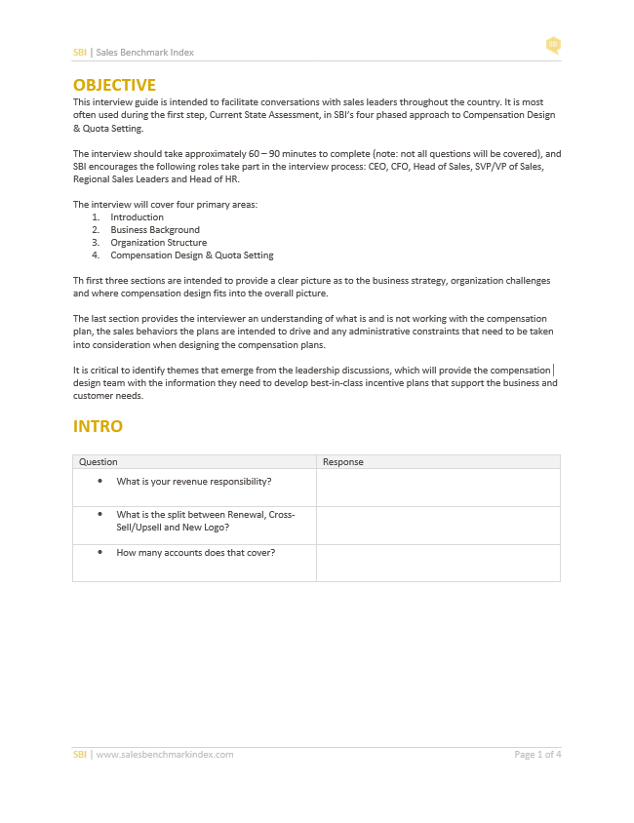
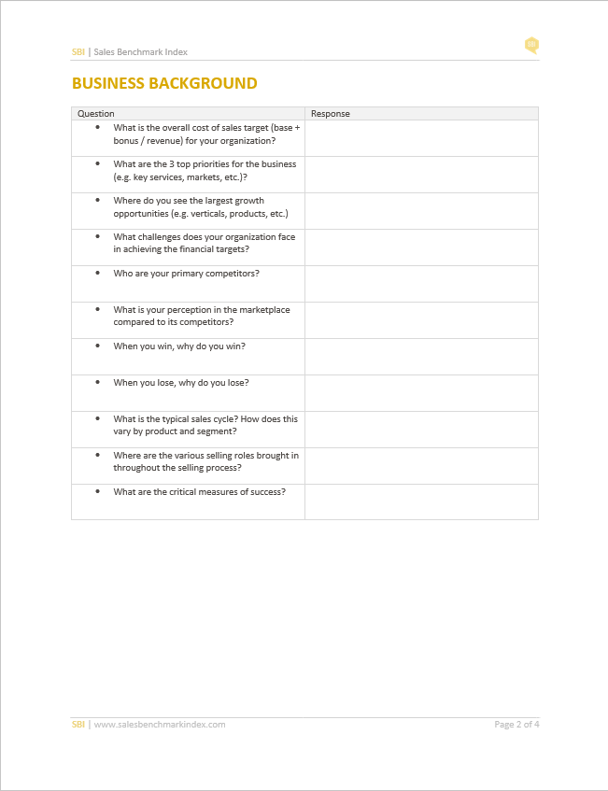
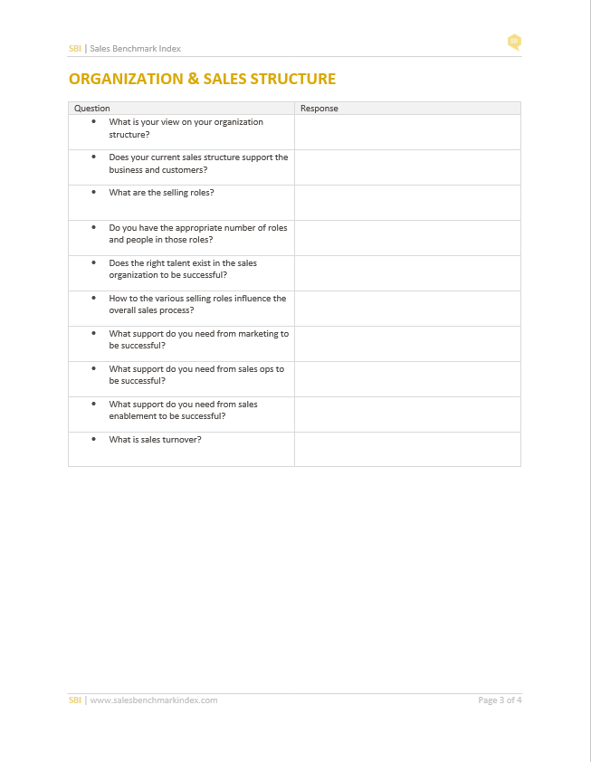
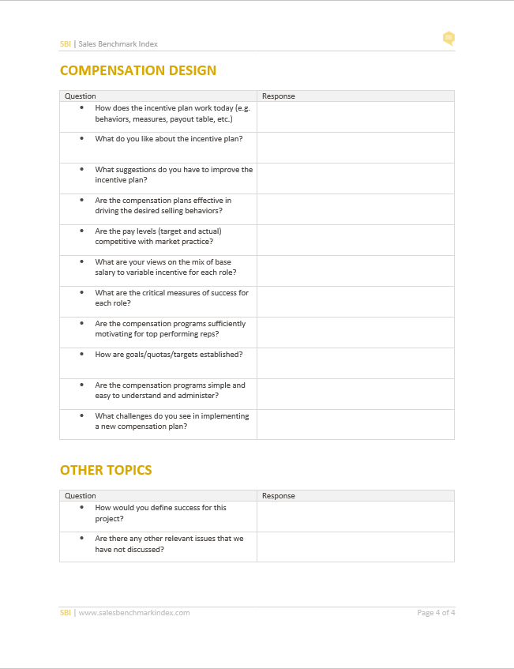
Conduct leadership interviews and focus group discussions to understand strategic imperatives and what is and is not working with the current compensation design
Potential Red Flags During Current State Assessment
Strategic Misalignment Between Corporate & Sales Objectives
01
Cost of Sales Above or Below Market Practice
02
Above-Market Voluntary Rep Attrition (e.g. > 20%)
03
Poor Sales Talent(e.g. High % of B & C Players)
04
Bi-Modal Attainment Distribution and/or Boom/Bust Culture
05
Sub-Optimal Quota Attainment Distribution (e.g. < 50% Achieving)
06

Slide 8
Direction Setting & Plan Design

Slide 9
Compensation design will reflect a company’s stage within the business lifecycle maturity model (from startup to decline)
Sales Compensation Design Across Business Lifecycle
There are two common sales compensation approaches –cost of sales (commissions) and cost of labor (quota) .
 | Start-Up | Rapid-Growth | Maturity | Decline
Sales
Issues | Minimal market presence Undefined channel strategy Complex territories | Minimal new product success Changing channel strategies Reward top performers Account & buyer segmentation | Profitability (i.e. Margin) Sales rep productivity Ability to attract/retain talent Lack of defined roles | Manage channel conflict Profitability (i.e. Margin) Sales rep productivity Ability to attract/retain talent
Details | High risk Simple territories Solo credit | Moderate risk Split territories Split credit | Moderate risk Territories Multiple credit | Moderate risk Territories Team credit
Roles | Territory Sales Rep | Strategic Account Managers Account Managers Business Development Reps Inside Sales Reps | Customer/Vertical Specialists Product Specialists Inside Sales Reps | By business unit / segment Customer/Vertical Specialists Product Specialists Inside Sales Reps
Metrics | Revenue | Existing Revenue New Business Revenue | Existing/New Revenue Product Initiatives Margins/Profitability | Existing/New Revenue Product Initiatives Margins/Profitability
Mechanics | Commissions | Commissions (or Hybrid) | Quota/Bonus (or Hybrid) | Quota/Bonus
Cost of sales models incentivize sales reps by providing a commission percentage against the sales volume generated.
Cost of labor models typically use quota-based mechanics and attempt to deliver market commensurate pay based on the perceived value of the role in the market.
Recommended Practice
Align compensation plans to industry and market practice and tailor to meet your business needs
Create a counsel of top-performing reps to introduce design concepts to ensure buy-in and retention of top talent
Develop a multi-year compensation strategy to evolve compensation design as company matures

Slide 10
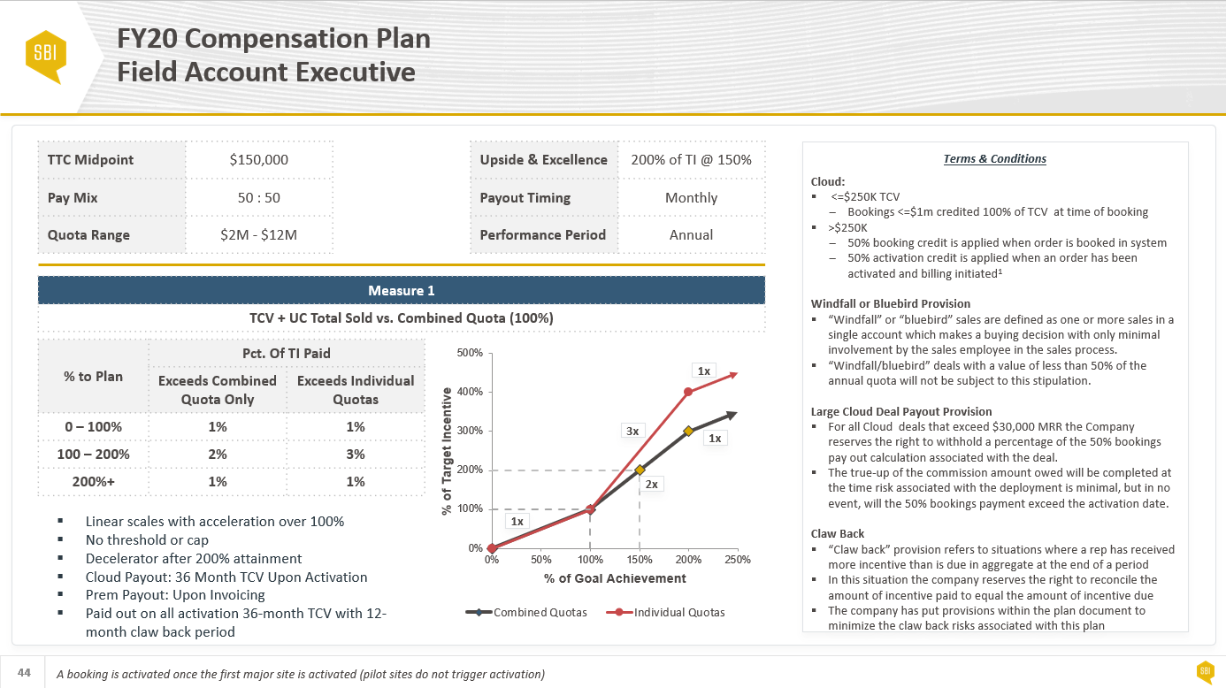
An organization’s business and talent strategy, culture, and compensation philosophy will inform the future-state plan design
Sales Compensation Philosophy
Influencers
Plan Design
Internal / External Equity
Cost of Labor vs. Cost of Sale
Market
01
Standardized vs. Customized
Sales Compensation Philosophy
Non-Sales Alignment
Business Strategy & Talent Strategy
02
Eligibility Inclusiveness
Approach to Governance
Overall Culture & Sales Culture
03
Risk/Reward Trade-Off
Team/Individual Differentiation
Notes:
The objective of compensation design is to develop compensation plans that drive greater strategic alignment between corporate and sales objectives, enable organizations to attract and retain top sales talent and reward the field for delivering results
So what does an end deliverable look like?
For each role in scope, we are delivering a one-page overview called a “Plan Abstract”
Plan Abstracts define the 10 design principles, such as On-Target Earnings, Pay Mix, Target Performance, etc.

Slide 11
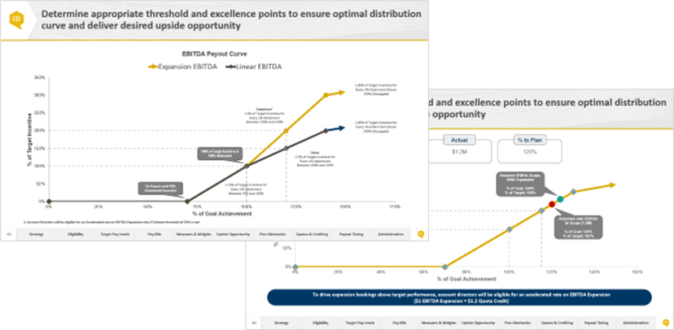
Develop straw models to gauge leadership thinking and determine which plan construct is most appropriate given business needs and administrative complexity
Introduction to Straw Models
Straw models present specific concepts that tie back to the company’s evolving strategy, business model, and themes from stakeholder interviews
Concepts or aspects from different straw models may ultimately be mixed and matched to determine a preferred design concept for each field sales role
The objective of the straw models is to give leadership an opportunity to provide guidance as to which straw models are best aligned to company’s strategy and sales culture
01
02
03
For Consideration
Examples
Performance Measures: One measure (e.g. total sales) or two measure plans (e.g. Retention & new business)
Plan Mechanics: Commission, quota, or hybrid
Thresholds Below 100% Attainment: No threshold, soft threshold, or hard threshold
Incentive Cap or Decelerators Above 100% Attainment: No cap, decelerators, or cap

Slide 12
Quota-Setting & Allocation

Slide 13
Agree on plan design and develop rep-level financial model to understand cost under various performance scenarios and individuals positively & negatively impacted
Introduction to Straw Models
Financial modeling estimates payouts using different attainment distributions to simulate variations in sales force performance | Financial modeling also estimates the impact of payouts based on overall corporate performance
Narrow Distribution
Underachievement -15%
Overachievement +15%
Normal Distribution
Wide Distribution
Outputs from the Financial Model
High Level Financial Estimates – Provides direction to management, sales and finance around sales force costs relative to budget and cost of sales
Individual Estimated Payouts – Identifies individuals positively and negatively impacted by the new plan design allowing company to take corrective action as needed
Alignment to Best Practice – pay differentiation and upside opportunity, % of sales force above target attainment, below threshold, and above excellence
01
02
03

Slide 14
Use the financial model to understand the cost of sales structure under different performance distribution curves and overall attainment levels
Modeling Distribution | Overall Attainment | Headcount | Net Sales | Base Salary | Target Total Cash | Actual Incentive | Actual Total Cash | VCOS
Random (Narrow) | 70% | 47 | $10,045,410 | $985,023 | $1,790,736 | $468,355 | $1,453,378 | 4.66%
 | 80% | 47 | $11,480,469 | $985,023 | $1,790,736 | $575,778 | $1,560,801 | 5.02%
 | 85% | 47 | $12,197,998 | $985,023 | $1,790,736 | $632,483 | $1,617,506 | 5.19%
 | 90% | 47 | $12,915,527 | $985,023 | $1,790,736 | $693,411 | $1,678,434 | 5.37%
 | 100% | 47 | $14,350,586 | $985,023 | $1,790,736 | $835,514 | $1,820,537 | 5.82%
Random (Normal) | 70% | 47 | $10,045,410 | $985,023 | $1,790,736 | $485,638 | $1,470,661 | 4.83%
 | 80% | 47 | $11,480,469 | $985,023 | $1,790,736 | $593,838 | $1,578,861 | 5.17%
 | 85% | 47 | $12,197,998 | $985,023 | $1,790,736 | $656,541 | $1,641,564 | 5.38%
 | 90% | 47 | $12,915,527 | $985,023 | $1,790,736 | $724,191 | $1,709,214 | 5.61%
 | 100% | 47 | $14,350,586 | $985,023 | $1,790,736 | $886,148 | $1,871,171 | 6.17%
Random (Wide) | 70% | 47 | $10,045,410 | $985,023 | $1,790,736 | $521,896 | $1,506,919 | 5.20%
 | 80% | 47 | $11,480,469 | $985,023 | $1,790,736 | $640,195 | $1,625,218 | 5.58%
 | 85% | 47 | $12,197,998 | $985,023 | $1,790,736 | $704,264 | $1,689,287 | 5.77%
 | 90% | 47 | $12,915,527 | $985,023 | $1,790,736 | $776,467 | $1,761,490 | 6.01%
 | 100% | 47 | $14,350,586 | $985,023 | $1,790,736 | $935,444 | $1,920,467 | 6.52%
Building a Rep Level Model
Financial model should include all individuals that are part of the go-forward sales model
The financial model is backwards—based on historical attainment—and forwards—based on random simulation--looking
Backwards Modeling: For each rep, estimate the incentive payout under the new plan using historical attainment percentage to understand those individuals positively and negatively impacted; make necessary adjustments to protect against unwanted turnover in top performers
Forwards Modeling: Determine overall cost structure using random simulations (e.g. Monte Carlo) to understand sales expense under various performance distributions and overall attainment
Adjust the commission rate and/or payout table as needed to ensure compensation plan adheres to the overall cost objectives
Review this information with the Steering Committee to determine if incentive payout and cost of sales is appropriate under the various performance scenarios and adjust plans as needed
14

Slide 15
Communication & Implementation Planning

Slide 16
Document the final plan design and prepare for rollout
For each role, define the following:
Incentive Eligibility
On-Target Earnings (e.g. Base + Target Variable)
Pay Mix (Base : Variable)
Performance Measures & Weights
Upside Opportunity
Target Quota
Payout Timing
Performance Period
Terms & Conditions
Administrative Guidelines
Compensation plans should be simple, motivational—both in terms of upside opportunity for top performers and achievability of sales quota—and fiscally responsible (e.g. adhere to overall cost targets)
Notes:
The objective of compensation design is to develop compensation plans that drive greater strategic alignment between corporate and sales objectives, enable organizations to attract and retain top sales talent and reward the field for delivering results
So what does an end deliverable look like?
For each role in scope, we are delivering a one-page overview called a “Plan Abstract”
Plan Abstracts define the 10 design principles, such as On-Target Earnings, Pay Mix, Target Performance, etc.

Slide 17
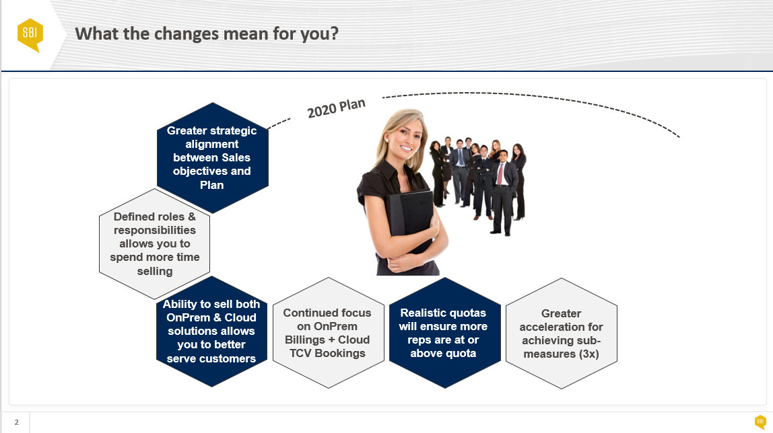
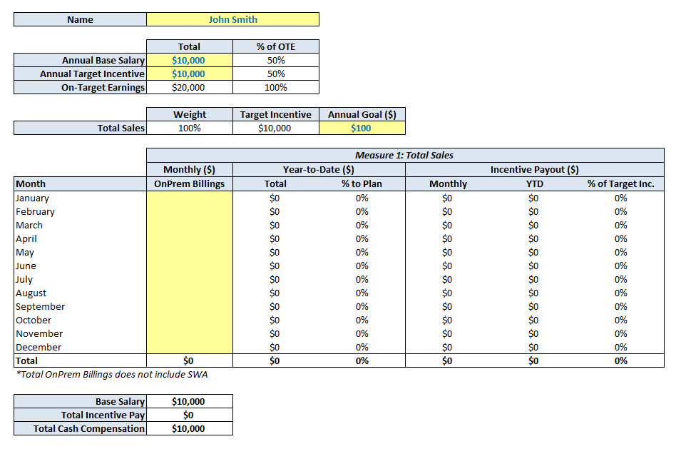
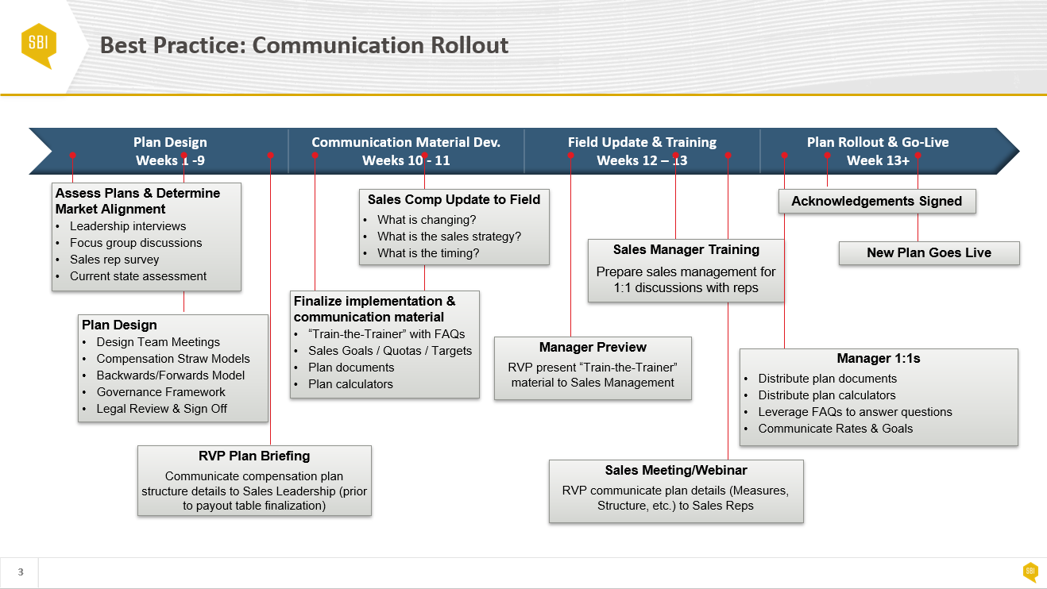
Develop communication material to support the compensation plan rollout
Communication Material
Communication Material
Train-the-Trainer
Incentive Calculators
Implementation Plan
Description
Document to prepare Sales Leadership and Management to rollout incentive plans
Why are compensation plans changing?
What specifically is changing?
How do the compensation plans work?
Description
A motivational sales tool that enables reps to understand their incentive payout under the new compensation plan at various performance levels
Description
A timeline of events that need to occur prior to plan rollout/go live to ensure seamless transition and rep-buy in
Notes:
The objective of compensation design is to develop compensation plans that drive greater strategic alignment between corporate and sales objectives, enable organizations to attract and retain top sales talent and reward the field for delivering results
So what does an end deliverable look like?
For each role in scope, we are delivering a one-page overview called a “Plan Abstract”
Plan Abstracts define the 10 design principles, such as On-Target Earnings, Pay Mix, Target Performance, etc.

