Slide 1
Unlock the Secrets to Amplifying Seller Productivity: Building Environments for Success
2024

Slide 2
Seller productivity remains a challenge
Recent Trends in Deal Size
Recent Trends in Deal Velocity
Increasing
Accelerating
Flat or shrinking
Flat or slowing
N = 113 CEOs and go-to-market leaders
Source: SBI Q3 2023 CEO Survey

Slide 3
Question 1: What separates the most productive sellers from everyone else?
REPLAY LINK: Seller Approaches to Increase Sales Velocity
Question 2: What can leaders do to amplify seller productivity?

Slide 4
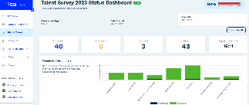
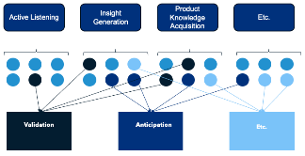
SBI conducted an advanced analysis to understand winning behaviors
SBI’s Research Methodology
1
2
3
Built inventory of 90+ seller skills and behaviors observed through decades of client talent assessments
Surveyed 300+ SEs, SDRs, and Sales Managers across industries and company sizes on those skills and behaviors
Conducted factor analysis to develop seller profiles, and tested them against outcomes with regression analysis

Slide 5
Factor analysis revealed four commercial approaches sellers fall into
Factor analysis
Narrowing
Anticipating
Narrowing
Provoking
Translating
Anticipating
34% of Sellers
19% of Sellers
25% of Sellers
22% of Sellers
Prescribes buying steps and criteria
Prevents the introduction of additional noise
Establishes a smooth close
Applies an insight-led posture
Tailors insight to the buyer
Tightly aligns with marketing
Denominates in buyer data
Positions with meaningful context
Simplifies complex messages
De-risks decisions
Proactively manages the buying decision team
Collaborates internally to anticipate missteps
N = 325
Source: SBI 2023 Seller Skills Survey

Slide 6
Not all approaches are equal
Narrowing
Provoking
Translating
Anticipating
Average Change in Deal Size When Prioritized
7% Larger
9% Larger
16% Larger
11% Larger
20% Longer
22% Longer
1% Shorter
12% Shorter
Average Change in Sales Cycle Time When Prioritized
53% of sellers take a lower-productivity approach where deal size improvements are undercut by extended sales cycles.
47% of sellers take a higher-productivity approach where deal size improvements are amplified by extended sales cycles.
N = 325
Source: SBI 2023 Seller Skills Survey

Slide 7
Question 1: What separates the most productive sellers from everyone else?
REPLAY LINK: Seller Approaches to Increase Sales Velocity
Question 2: What can leaders do to amplify seller productivity?

Slide 8
Levers leadership teams can pull for more productive sales teams
Sales Process Blueprint
Personal Connection to Product/Customer
We looked at the most common levers leadership
teams often pull to drive seller productivity.
Scalable Tools and Technology
Customer Data and Intelligence
Incentives and Rewards for Success
Consistent Expectations and Targets
Leadership Guidance and Support
Manager Coaching

Slide 9
Leadership levers can be applied at different altitudes
“Micro”-Level Application
“Macro"-Level Application
Provide individual and deal-level support
Boost productivity across the entire sales team
Front-Line Sales Managers
Chief Revenue Officer & Senior Leadership
Primary Responsibility
Skills Coaching
Deal Coaching
Personal Connection to Product a Customer
Leadership Guidance & Support
Examples
CS

Slide 10
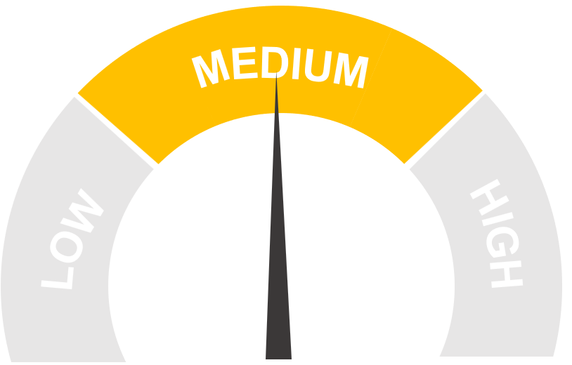
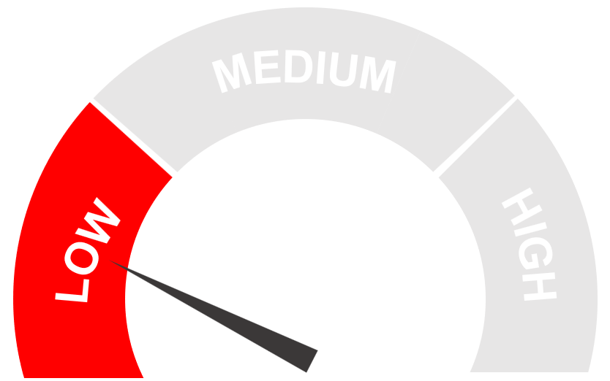
The ”Micro” level, Coaching and Support, is not moving the needle much
Change in Likelihood of Showing Strong Sales Approach Performance
Coaching & Support (“Micro”)
Translating
Higher-Productivity Approaches
Anticipating
Narrowing
Lower-Productivity Approaches
Provoking
N = 325
Source: SBI 2023 Seller Skills Survey

Slide 11
Managers overwhelmingly coach to the less productive approaches
Portion of Managers Prioritizing Each Approach
Higher-Productivity Approaches
Translating
Lower-Productivity Approaches
Narrowing
Anticipating
Provoking
N = 325
Source: SBI 2023 Seller Skills Survey

Slide 12
Our analysis revealed two “Macro”, leadership-driven sales environments
Structured Environments
Discretionary Environments
A blueprint for success. Leaders translate goals into specific seller actions, telling them what they should and shouldn’t do.
Scalable tools to help focus. Leaders supply support and tools to help sellers prioritize and execute prescribed activities.
Rewards for sellers who succeed. Leaders regularly update compensation plans to reward sellers who succeed following the blueprint.

Slide 13
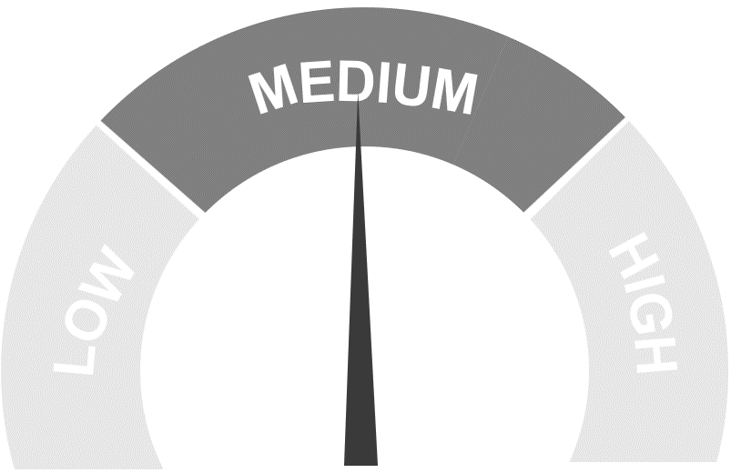
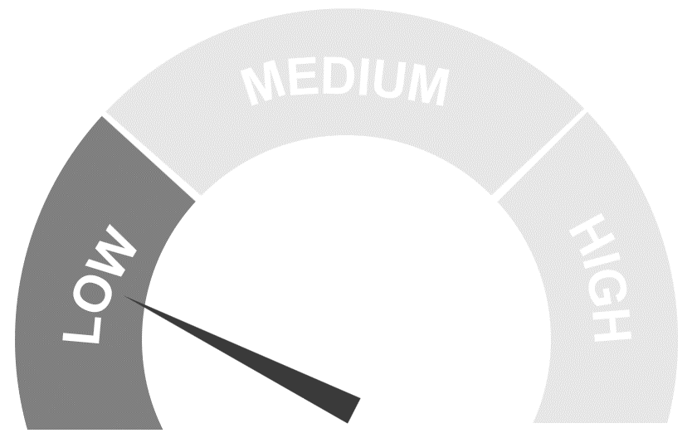
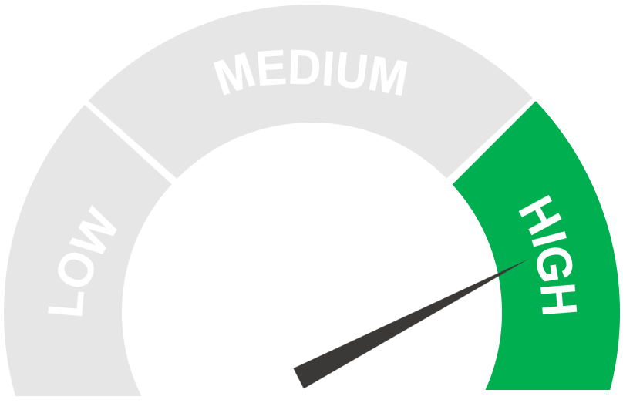
Structured environments boost narrowing and provoking approaches
Change in Likelihood of Showing Strong Sales Approach Performance
Coaching & Support (“Micro”)
Structured Environment (“Macro”)
Translating
Higher-Productivity Approaches
Anticipating
Narrowing
Lower-Productivity Approaches
Provoking
N = 325
Source: SBI 2023 Seller Skills Survey

Slide 14
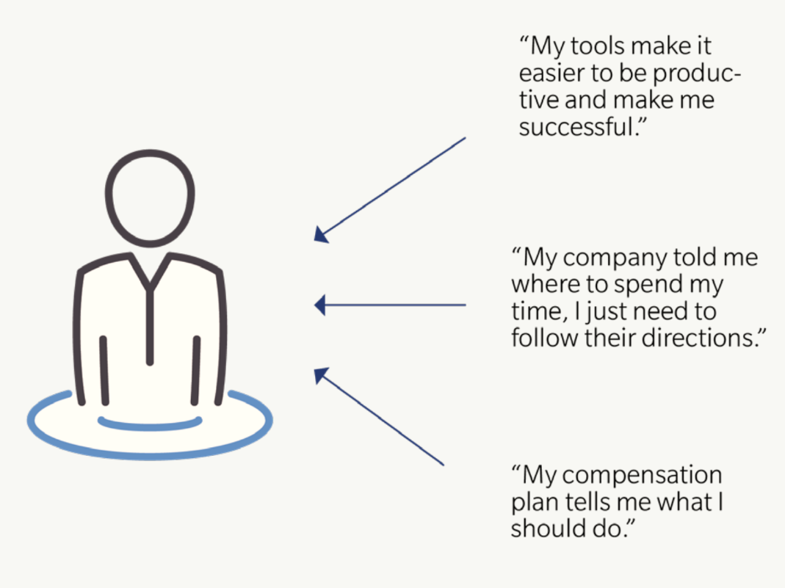
The environment we create shapes how our sellers think
Structured Environments
Sellers feel their success comes from the direction they’re given
“My tools make it easier to be productive and make me successful.”
“My company told me where to spend my time, I just needed to follow their directions.”
“My plan tells me what I should do.”

Slide 15
Our analysis revealed two “Macro”, leadership-driven sales environments
Structured Environments
Discretionary Environments
A blueprint for success. Leaders translate goals into specific seller actions, telling them what they should and shouldn’t do.
Scalable tools to help focus. Leaders supply support and tools to help sellers prioritize and execute prescribed activities.
Rewards for sellers who succeed. Leaders regularly update compensation plans to reward sellers who succeed following the blueprint.
A personal connection. Leaders help sellers feel connected to their company, colleagues, and customers.
Consistent and reasonable expectations. Leaders make expectations clear to sellers. Sellers feel trusted to use their judgment, and they believe their goals are achievable.
Holistic support. Leaders provide a support structure that considers sellers’ well-being, nurturing both their professional and personal growth.

Slide 16
Discretionary environments boost higher productivity approaches
Change in Likelihood of Showing Strong Sales Approach Performance
Coaching & Support (“Micro”)
Structured Environment (“Macro”)
Discretionary Environment
(“Macro”)
Translating
Higher-Productivity Approaches
Anticipating
Narrowing
Lower-Productivity Approaches
Provoking
N = 325
Source: SBI 2023 Seller Skills Survey

Slide 17
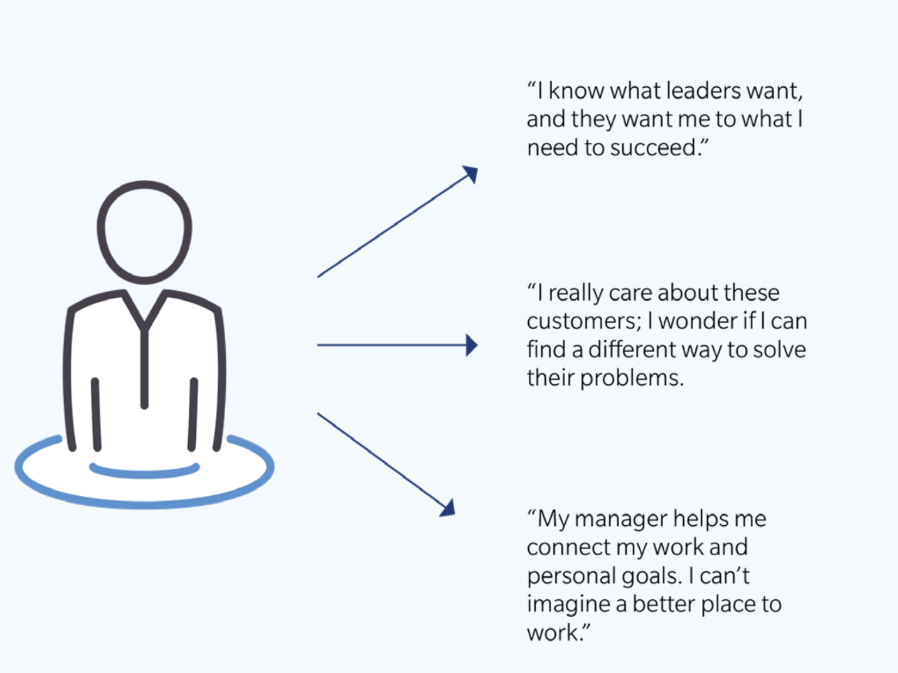
The environment we create shapes how our sellers think
Structured Environments
Discretionary Environments
Sellers feel their success comes from the direction they’re given
Sellers feel their success comes from using their own judgment
“My tools make it easier to be productive and make me successful.”
“I know what leaders want, and they trust me to use my judgment to succeed.”
“I really care about these customers; I wonder if I can find a different way to solve their problems.”
“My company told me where to spend my time, I just needed to follow their directions.”
“My manager helps me connect my work and personal goals. I can’t imagine a better place to work.”
“My plan tells me what I should do.”

Slide 18

A discretionary environment checklist
1
2
3
Showcase Real-World Impact
Build a Foundation of Mutual Trust
Develop People Holistically
Foster a personal connection by celebrating how sellers drive impact.
Demonstrate consistent, reasonable expectations and encourage seller judgment.
Integrate holistic support into regular coaching conversations at all levels.
Company: Go beyond revenue and show how sellers help advance the company’s strategic goals and values.
Customers: Display how sellers’ efforts impact customers by integrating testimonials into internal sales communications.
Colleagues: Create collaborative learning hubs where sellers can swap ideas with peers and share ways to succeed.
The Why: Include the 'why' behind sellers' goals and explain how the number was reached.
The What: Document your customers’ buying journey and where breakdowns typically occur.
The How: Teach sellers how to be proactive and flexible in helping customers avoid roadblocks and evaluate opportunities successfully.
Develop: Show frontline managers how to grow beyond deal coaching and truly develop individuals and foster a healthy team.
Lead: Help sellers understand the intersection of their personal & professional goals.

Slide 19


Rick Karlton
Senior Vice President, Advisory Services
Email: rick.karlton@sbigrowth.com
Bryan Kurey
Head of Research
Email: bryan.kurey@sbigrowth.com

