Slide 1


Annual Planning Inventory Bets

Slide 2
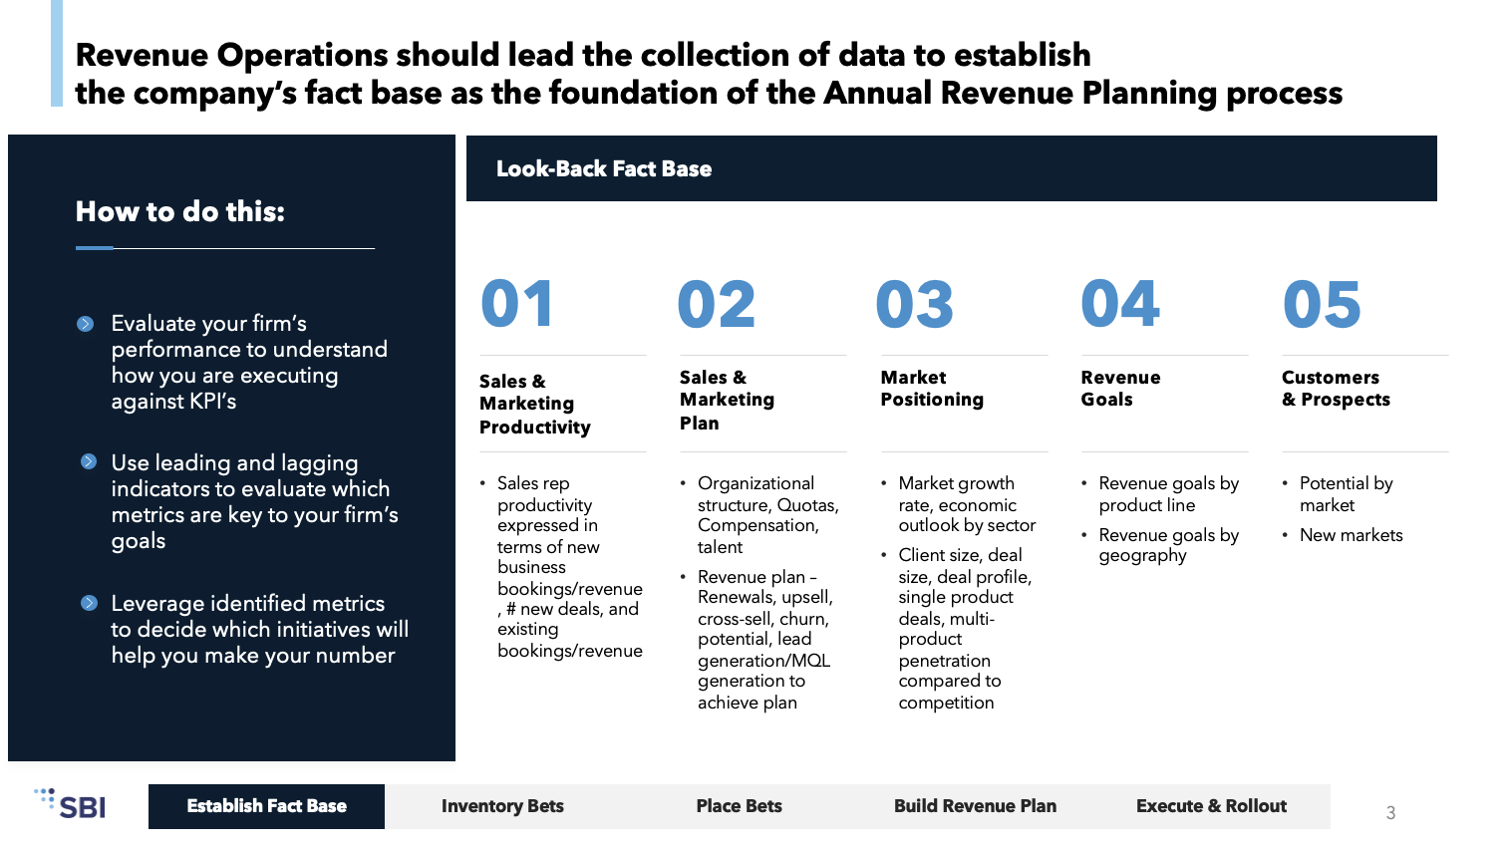
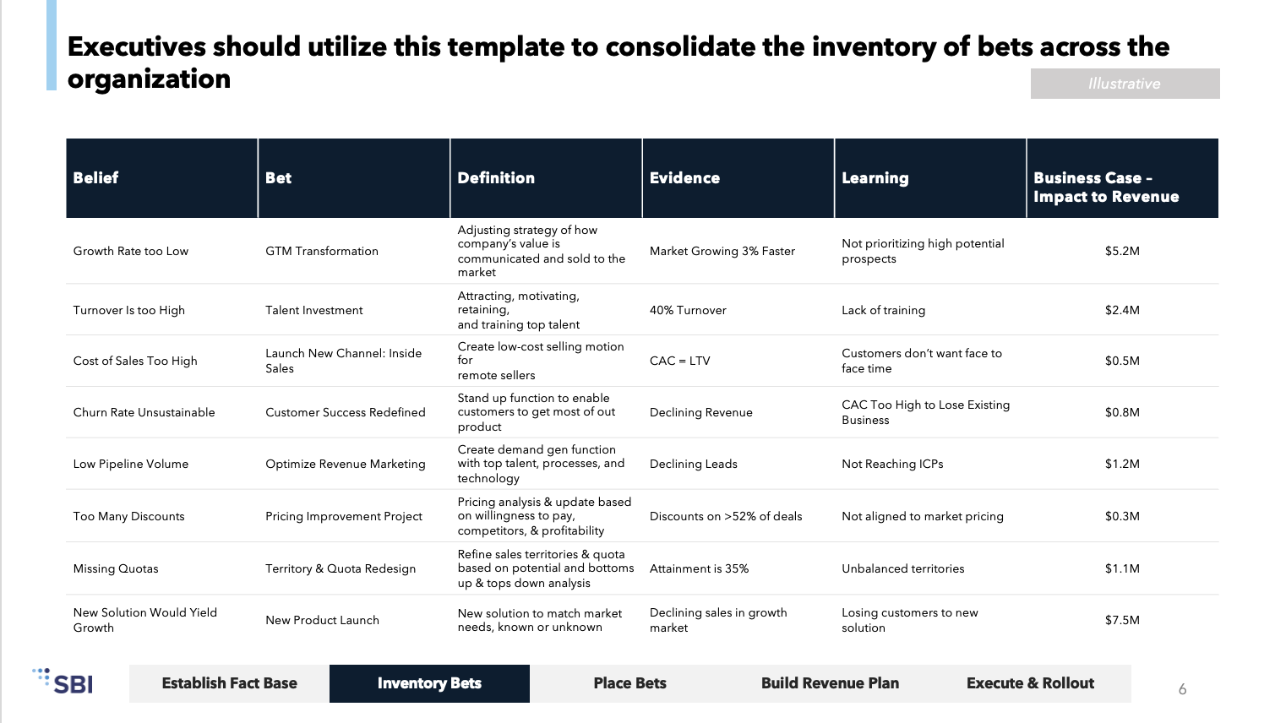
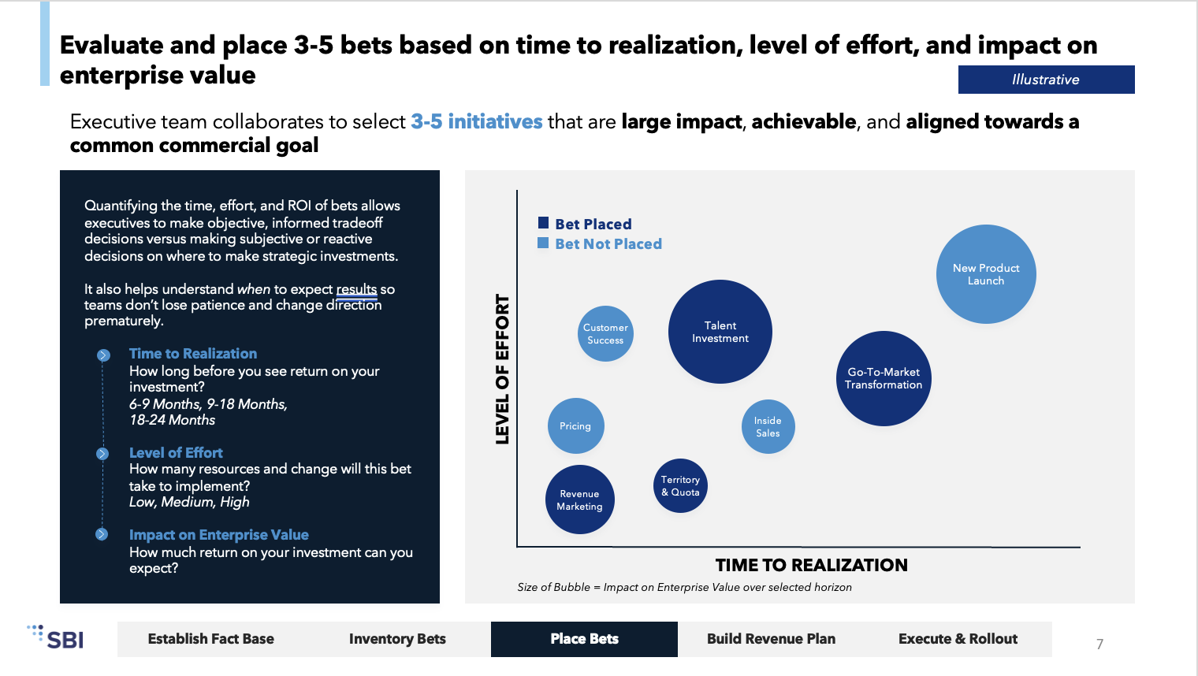
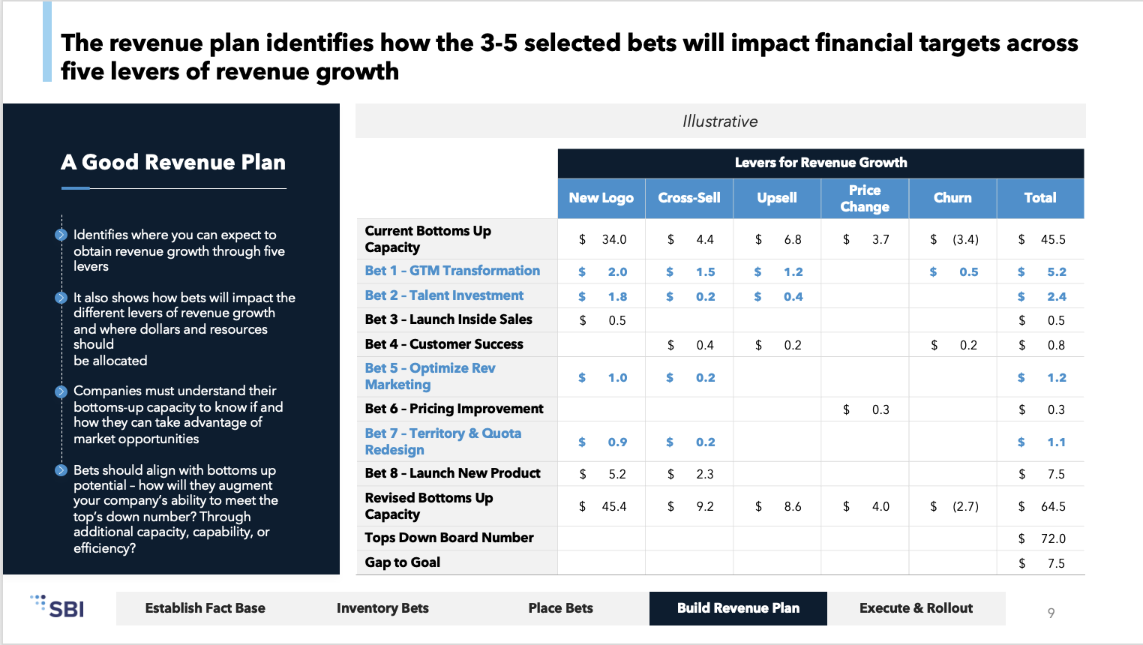
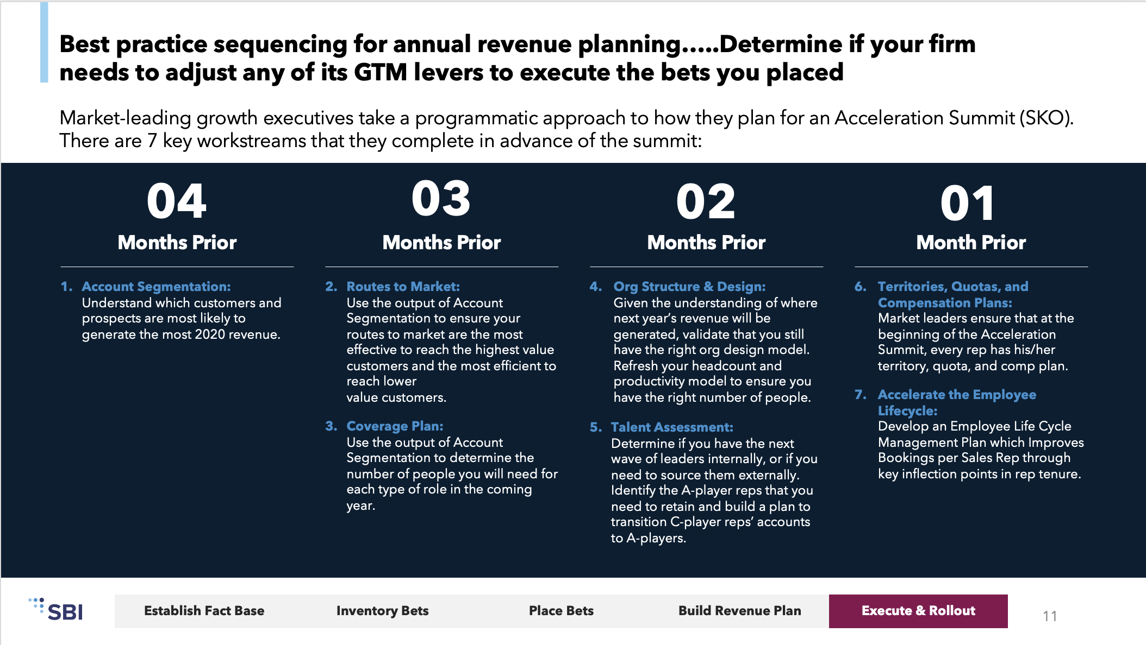
SBI Annual Revenue Planning program follows a five-step process to align go to market functions with strategic growth priorities
Annual Revenue Planning Process
STEP 1: Establish Fact Base
STEP 2: Inventory Bets
STEP 3: Place Bets
STEP 4: Build Revenue Plan
STEP 5: Execute & Rollout
Where are you now?
What are ways you can achieve growth?
What are your goals and how can you achieve them?
How do you narrow your options and select the best ones?
How do you execute on the bets you placed?
Understand how far along your company is on the Revenue Growth Maturity Model to make stage-appropriate bets
Evaluate your firm’s performance with leading & lagging indicators to understand how you are executing against KPI’s
Executive leaders work with their teams to evaluate how and where they can contribute to growth
Executives gather to discuss and evaluate the possible levers to exact strategic priorities
Led by the CEO and CFO
Evaluate based on time to realization, level of effort, and impact to revenue
CEO and CFO narrow down the list of bets to the top 3-5 strategic priorities for focus
Define growth targets
Use bottoms up analysis to determine what can be achieved
Define the gap to growth targets
Create a revenue plan of how GTM teams will strategically align to execute the bets and achieve targets
Use a detailed execution cadence to align the GTM teams to drive desired results
The executive team sets the annual priorities, commercial leaders will then break initiatives into quarterly and weekly priorities
Establish Fact Base | Inventory Bets | Place Bets | Build Revenue Plan | Execute & Rollout

Slide 3

Revenue Operations should lead the collection of data to establish the company’s fact base as the foundation of the Annual Revenue Planning process
Look-Back Fact Base
How to do this:
01
02
03
04
05
Evaluate your firm’s performance to understand how you are executing against KPI’s
Sales & Marketing Productivity
Sales & Marketing
Plan
Market
Positioning
Revenue
Goals
Customers & Prospects
Use leading and lagging indicators to evaluate which metrics are key to your firm’s goals
Sales rep productivity expressed in terms of new business bookings/revenue, # new deals, and existing bookings/revenue
Organizational structure, Quotas, Compensation, talent
Revenue plan – Renewals, upsell, cross-sell, churn, potential, lead generation/MQL generation to achieve plan
Market growth rate, economic outlook by sector
Client size, deal size, deal profile, single product deals, multi-product penetration compared to competition
Revenue goals by product line
Revenue goals by geography
Potential by market
New markets
Leverage identified metrics to decide which initiatives will help you make your number
Establish Fact Base | Inventory Bets | Place Bets | Build Revenue Plan | Execute & Rollout

Slide 4
Instructions
Using the following template, partner with your Revenue Operations team to determine the various potential “bets” the organization can act on to achieve next year’s revenue target.

Slide 5
EXAMPLE: Annual Planning Strategic Growth Bets
Belief | Bet | Definition | Evidence | Learning | Impact to Revenue | Time to Realization | Level of Effort
Growth Rate too Low | GTM Transformation | Adjusting strategy of how company’s value is communicated and sold to the market | Market Growing 3% Faster | Not prioritizing high potential prospects | $5.2 M | 6 Months | Very High
Turnover Is too High | Talent Investment | Attracting, motivating, retaining, and training top talent | 40% Turnover | Lack of training | $2.4 M | 3 Months | Very Low
Cost of Sales Too High | Launch New Channel: Inside Sales | Create low-cost selling motion for remote sellers | CAC = LTV | Customers don’t want face to face time | $0.5 M | 1 Months | Low
Churn Rate Unsustainable | Customer Success Redefined | Stand up function to enable customers to get most of out product | Declining Revenue | CAC Too High to Lose Existing Business | $0.8 M | 2 Months | High
Low Pipeline Volume | Optimize Revenue Marketing | Create demand gen function with top talent, processes, and technology | Declining Leads | Not Reaching ICPs | $1.2 M | 5 Months | Medium
Too Many Discounts | Pricing Project | Pricing analysis & update based on willingness to pay, competitors, & profitability | Discounts on >52% of deals | Not aligned to market pricing | $0.3 M | 1 Months | High
Missing Quotas | Territory & Quota Redesign | Refine sales territories & quota based on potential and bottoms up & tops down analysis | Attainment is 35% | Unbalanced territories | $1.1 M | 2 Months | Medium
New Solution Would Yield Growth | Product Launch | New solution to match market needs, known or unknown | Declining sales in growth market | Losing customers to new solution | $7.5 M | 7 Months | High

Slide 6
Annual Planning Strategic Growth Bets
Belief | Bet | Definition | Evidence | Learning | Impact to Revenue | Time to Realization | Level of Effort

