Slide 1
Account Segmentation Primer
Supplement to Growth Project Guide to Account Segmentation

Slide 2
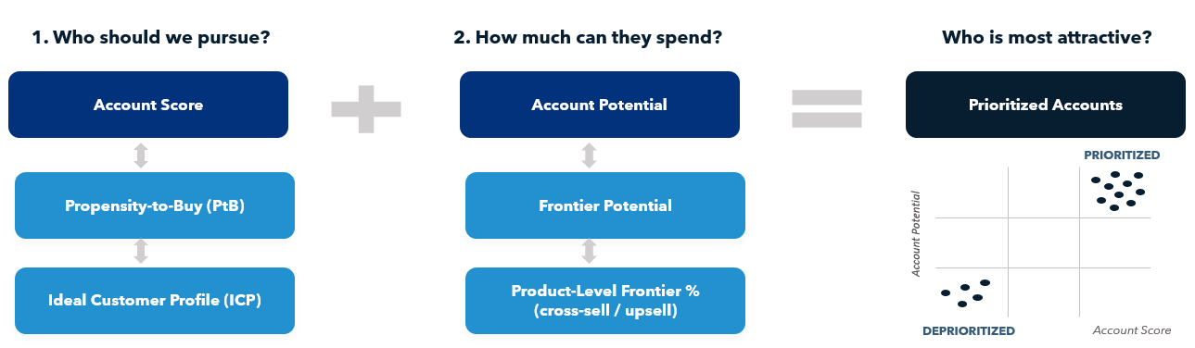
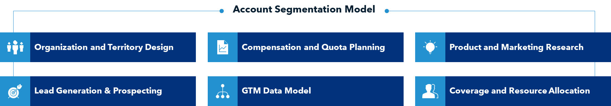
Account Segmentation underpins the entire GTM strategy.
Account Segmentation
Account Score & Account Potential combine to create prioritized account segments.
Benefits:
Prioritize accounts based on propensity to buy and size of available opportunity within the account
Analyze, rank and select the customers that are likely to spend the most in the shortest period
The output of Account Segmentation creates more clarity for strategic decisions in Coverage, Resourcing, Territory Design, Compensation/Quota Setting, and Hiring

Slide 3
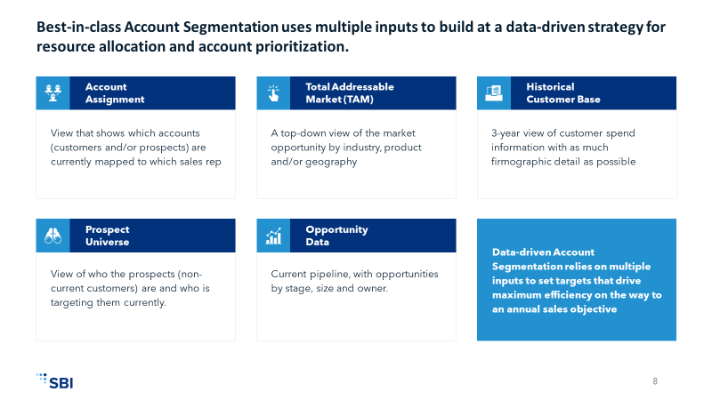
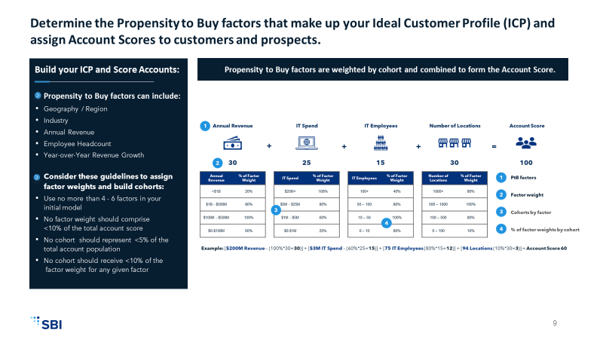
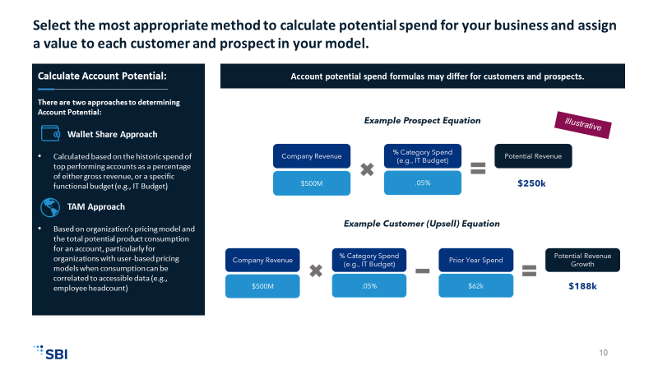
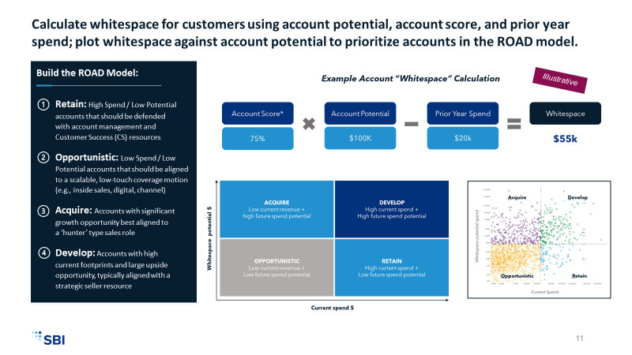
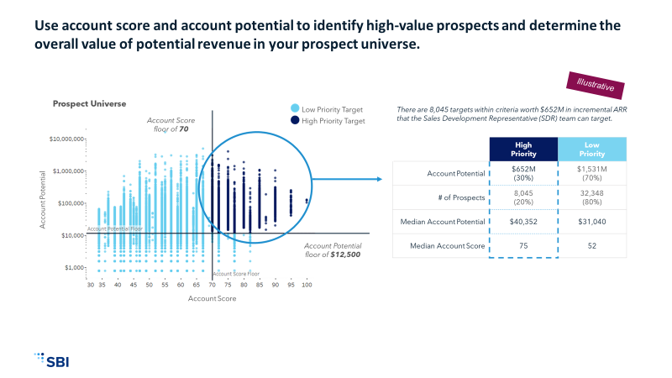
Account Segmentation follows a five-step process to prioritize high-potential customer accounts and prospects across geographies, segments and routes to market.
STEP 1: Gather & Enrich Data
STEP 2:
Build ICP & Score Accounts
STEP 3: Calculate Account Potential
STEP 4: Prioritize Customers (ROAD)
STEP 5: Target High-Value Prospects
How have our customers historically performed?
Which customers are most likely to buy?
How much can customers spend?
Which customer accounts should we prioritize?
Which prospect accounts should we pursue?
Identify, gather, and prepare the customer and transactional data necessary for modeling
Discuss dependencies and implications with functional and business leaders
Gain buy-in to support future projects related to your segmentation strategy
Determine the ICP factors that most closely correlate with propensity to buy
Use your ICP as a formula to assign scores for customer and prospects
Select the most appropriate method to calculate potential spend for your business
Assign a potential value to each customer and prospect in your model
Calculate adjusted account potential for customers using account score
Use the ROAD Model (Retain, Opportunistic, Acquire, and Develop) to prioritize customer accounts based on potential and whitespace
Use account score and account potential to identify high-value prospects
Determine the number of prospects you will pursue and the overall value of the potential revenue

Slide 4



Best-in-class Account Segmentation uses multiple inputs to build a data-driven strategy for resource allocation and account prioritization.
Account Assignment
Total Addressable Market (TAM)
Historical Customer Base
View that shows which accounts (customers and/or prospects) are currently mapped to which sales rep
A top-down view of the market opportunity by industry, product and/or geography
3-year view of customer spend information with as much firmographic detail as possible
Prospect Universe
Opportunity Data
Data-driven Account Segmentation relies on multiple inputs to set targets that drive maximum efficiency on the way to an annual sales objective.
View of who the prospects (non- current customers) are and who is targeting them currently
Current pipeline, with opportunities by stage, size and owner

Slide 5
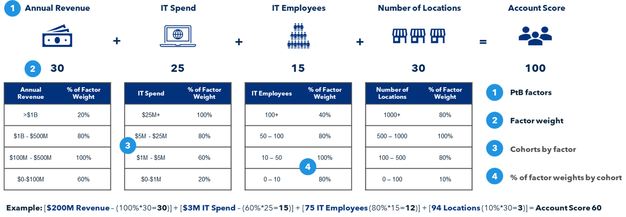
Determine the Propensity to Buy factors that make up your Ideal Customer Profile (ICP) and assign Account Scores to customers and prospects.
Build your ICP and Score Accounts:
Propensity to Buy factors are weighted by cohort and combined to form the Account Score.
Propensity to Buy factors can include:
Geography / Region
Industry
Annual Revenue
Employee Headcount
Year-over-Year Revenue Growth
Consider these guidelines to assign factor weights and build cohorts:
Use no more than 4 - 6 factors in your initial model
No factor weight should comprise <10% of the total account score
No cohort should represent <5% of the total account population
No cohort should receive <10% of the factor weight for any given factor
Illustrative

Slide 6
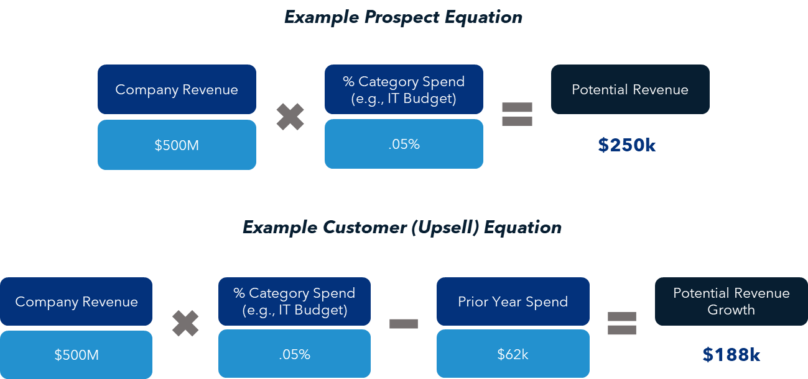


Select the most appropriate method to calculate potential spend for your business and assign a value to each customer and prospect in your model.
Calculate Account Potential:
Account potential spend formulas may differ for customers and prospects.
There are two approaches to determining Account Potential:
Wallet Share Approach
Calculated based on the historic spend of top performing accounts as a percentage of either gross revenue, or a specific functional budget (e.g., IT Budget)
TAM Approach
Based on organization’s pricing model and the total potential product consumption for an account, particularly good for organizations with user-based pricing models when consumption can be correlated to accessible data (e.g., employee headcount)
Illustrative

Slide 7
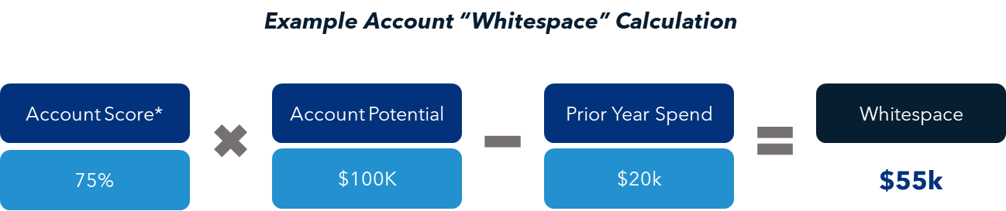


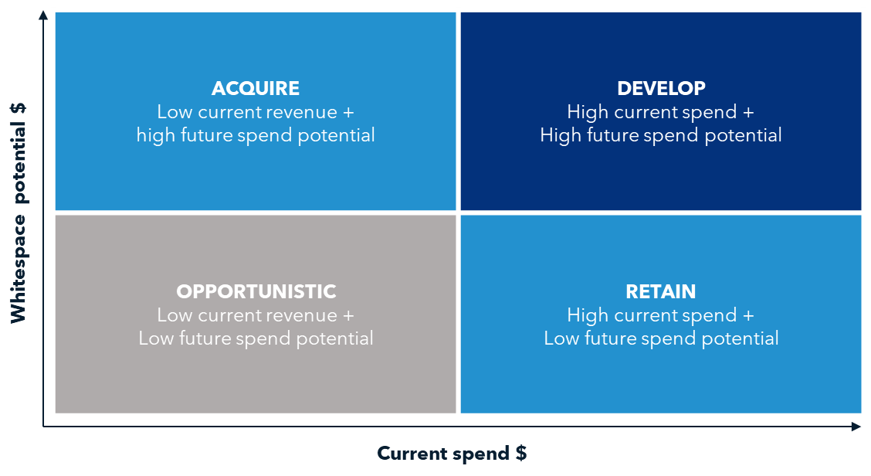
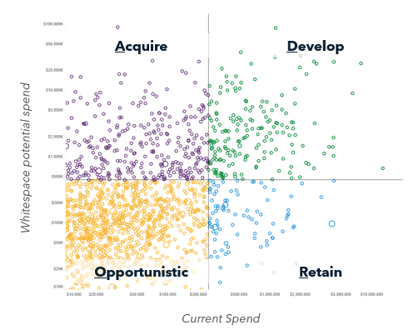


Calculate whitespace for customers using account potential, account score, and prior year spend; plot whitespace against account potential to prioritize accounts in the ROAD model.
Build the ROAD Model:
Title
Illustrative
Retain: High Spend / Low Potential accounts that should be defended with account management and Customer Success (CS) resources
Opportunistic: Low Spend / Low Potential accounts that should be aligned to a scalable, low-touch coverage motion (e.g., inside sales, digital, channel)
Acquire: Accounts with significant growth opportunity best aligned to a ‘hunter’ type sales role
Develop: Accounts with high current footprints and large upside opportunity, typically aligned with a strategic seller resource

Slide 8
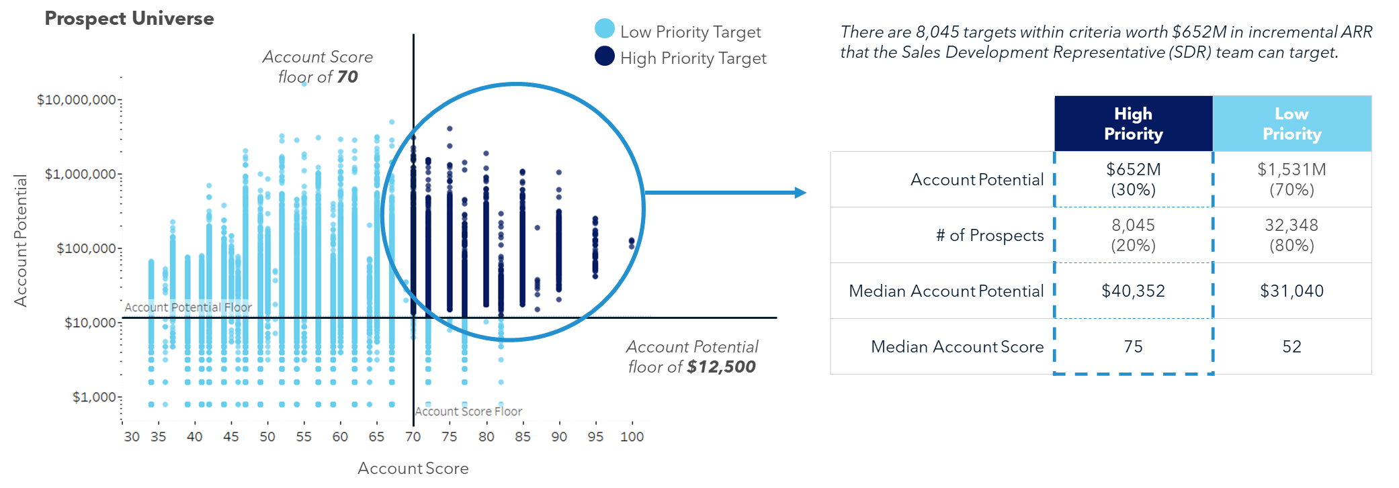
Use account score and account potential to identify high-value prospects and determine the overall value of potential revenue in your prospect universe.
Illustrative

