Slide 1
Example Account Segmentation Output
Supplement to Growth Project Guide to Account Segmentation

Slide 2
CONTENTS
How to use this document | 3
Section 1: Example Account Potential Output | 4
Section 2: Example ICP & Account Score Output | 8
Section 3: Example ROAD & Prospect Model Output | 12
Section 4: Example Summary Findings & Recommendations | 17

Slide 3
How to use this document
This document includes example output for several pivotal stages in the Account Segmentation process, gleaned from SBI clients who have applied these techniques in real-word scenarios.
The example output is divided into four sections aligned to Step 3 – 7 in the Growth Project Guide to Account Segmentation. Sections 1 – 3 provide examples of output related to Account Potential, ICP and Account Score, and segmentation modeling, respectively. Section 4 illustrates examples of summary findings or recommendations you might make as a result of your segmentation work.
As you execute your segmentation project, refer to these examples for guidance on how to present and communicate critical insights at each step in the process.

Slide 4
Account Potential
01
Account Potential

Slide 5
Group A Strategic customers have on average $10.3M upsell potential per customer
Market Segment | Group A | Group B | Group C | Group D
Strategic Acme Identified | $10.3M | N/A | $6.6M | $3.7M
Large Enterprise $1B+ | $471K | $212K | $335K | $244K
Enterprise $300M-$1B | $234K | $209K | $153K | $108K
Mid – Market $10M-$300M | $90K | $116K | $70K | $62K
SMB <$10M | $72K | $32K | $67K | $56K
Market Vertical Listed by Annual Contract Value ($) | Finance Manufacturing Information Services Healthcare | Public Sector Education | Wholesale Utilities Transportation Retail Administrative | Retail Extraction Hospitality Construction Entertainment Harvesting Other Logistics

Slide 6

Americas leads all geos with ~$5.2B in total potential and $574 average potential per account
$5,200M
Insights & Observations:
$4,800M
Potential is used to assign targets and coverage by territory.
Average Potential by account for Strategic, Large Enterprise, and Enterprise accounts are:
  AMS – $574K
  EMEA – $446K
  APJ – $409K
The number of Accounts for Strategic, Large Enterprise, and Enterprise accounts are:
  AMS – 3,100
  EMEA – 2,700
  APJ – 2,700
New Business Potential
$4,200M
$4,200M
$2,600M
$2,200M
FY Bookings
$1,000M
$600M
$400M
Americas
EMEA
APJ

Slide 7
Strategic and Large Enterprise customers each have approximately $1.2B—for a total of $2.4B—in total potential
$2,400M
$1,000M of weighted potential in Public Sector & Education
Insights & Observations:
Strategic Accounts have an average potential of $8.7M per account.
High cross-sell and upsell opportunities lead to the potential per account being higher.
Potential in Large Enterprise is average $393K per account.
Enterprise potential is $212K per account
The potential per account is being used to assign coverage and to potentially re-tier the accounts.
$1,200M
$1,200M
New Business Potential
$900M
$900M
$700M
$600M
FY Bookings
$300M
$300M
$100M
Strategic
Large Enterprise
Enterprise

Slide 8
Account Scoring
02
ICP & Account Score

Slide 9





The Ideal Customer Profile is made up of five factors determined by quantitative and qualitative input
Market
Vertical
Territory
Data Readiness
# of Product
Families
New Business ($)
FY A + B
Renewals ($)
FY A + B
Customer
Score
35
+
20
+
20
+
15
+
10
=
100
Market Vertical – Customers with high on-prem data needs, large workloads, and complex environments are ideal for Acme. Verticals are segmented according to 12 factors to determine like groupings which are used to determine account potential $.
Territory Data Readiness – Customers within territories with more mature data environments provide Acme opportunity to backup ever changing environments with high data usage. 10 readiness factors are used to score the territory
Number of Product Families – Customers that have Acme throughout their environment become “stickier” over time with higher retention rates as the number of product families per customer grows. It is more difficult to be displaced by competitors.
New Business Revenue – Customers with more new business revenues and high # of product families have the highest retention. New business leads to renewals which benefits Acme’s renewal recapture efforts and cross-sell upsell opportunities.
Renewal Revenue – Customers with high renewal bookings are an indicator of opportunity to recapture revenue as Renewal bookings are brought direct. This also provides opportunity for cross-sell and upsell through Customer Success motions.
– SHOULD BE UPDATED SEMI-ANNUALLY–
Factors and weightings may change over time as the model is used, feedback is provided, and other data becomes available

Slide 10
Factor sub-weightings have been determined for each factor. These provide a custom score to each customer
Market
Vertical
Territory
Data Readiness
# of Product
Families
New Business ($)
FY A + B
Renewals ($)
FY A + B
Customer
Score
35
+
20
+
20
+
15
+
10
=
100
Frontier potential assigned by segmentation group
Focus on the areas that have mature data environments
Higher penetration implies “stickiness” with Acme
Customers with more purchases are growing with Acme
Position customers with renewals for recapture efforts
Group | Pts |  | Maturity Score | Pts |  | # of Product Families | Pts |  | New Business (FY A + B) | Pts |  | Renewals (FY A + B) | Pts
Group A | 35 |  | 5.6+ | 20 |  | >11 | 20 |  | $1.5M+ | 15 |  | $4M+ | 10
Group B | 22 |  | 4.1-5.5 | 14 |  | 9-10 | 16 |  | $500K-$1.5M | 10 |  | $500K-$4M | 6
Group C | 15 |  | 3.6-4.0 | 10 |  | 6-8 | 12 |  | $100K-$500K | 6 |  | $100K-$500K | 4
Group D | 10 |  | 2.6-3.5 | 6 |  | 4-5 | 8 |  | $50K-$100K | 2 |  | $50K-$100K | 2
 |  |  | <2.5 | 2 |  | 2-3 | 4 |  | Less Than $50K | 0 |  | Less Than $50K | 0
 |  |  |  |  |  | 1 | 0

Slide 11
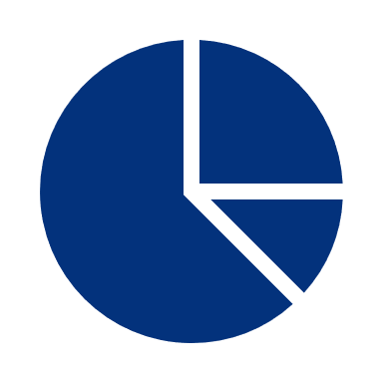





A top prospect, Target Corporation scored a 91/100 which is in the 98th Percentile of Prospects
Retail
Market Segment
Number of Employees
Territory
Data Readiness
Territory
Data Maturity
Customer
Score
30
+
25
+
15
+
15
+
15
=
100
Retail
Strategic
$69B in Revenue
323K
Employees
5.9 Territory
Data Readiness Score
6.9 Territory
Data Maturity
Prospect
Score
20
+
25
+
15
+
15
+
15
=
90

Slide 12
Account Scoring
03
ROAD & Prospect Segmentation Models

Slide 13
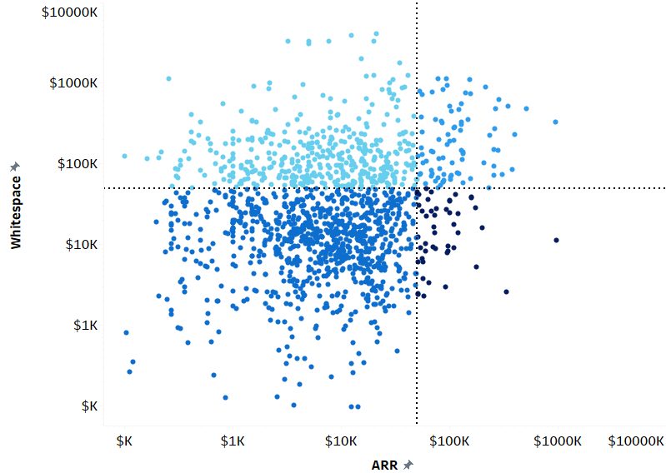
The ROAD model will provide coverage recommendations for each customer
Acquire
Develop
SBI Perspective
ROAD model helps us understand different coverage motions against the four cohorts
Retain- High FY22 spend, Low Remaining Potential
Opportunistic- Low FY22 spend, Low Remaining Potential
Acquire- Low FY22 spend, High Remaining Potential
Develop- High FY22 spend, High Remaining Potential
Opportunistic
Retain

Slide 14
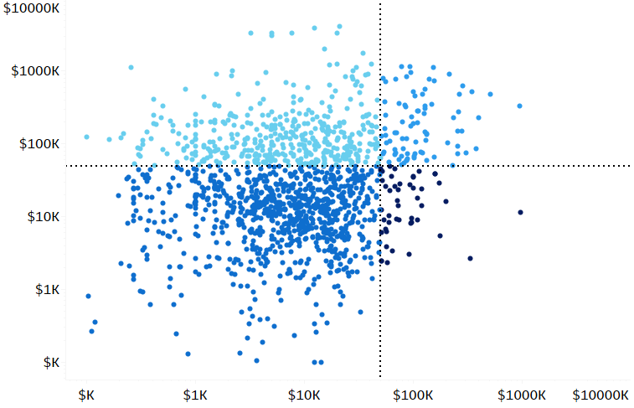
Segmentation Use Case Example
ROAD model can help ACME identify which high-value, high-penetration customers to spend additional effort on during renewals
Customer ROAD Model (Retain)
CS team should prioritize covering these 417 customers that fall into the retain bucket (i.e., high spend, high penetration)
Current ARR floor of $50,000
 | # Customers | Current ARR | Whitespace
Retain | 417 | $79M | $1M
Opportunistic | 1,257 | $18M | $13M
Acquire | 420 | $5M | $100M
Develop | 83 | $12M | $24M
Grand Total | 2,177 | $113M | $138M
Whitespace
Remaining Whitespace floor of $50,000
Current ARR
Retain
Acquire
Opportunistic
Develop

Slide 15
Segmentation Use Case Example
For the account management team, ROAD model highlights which accounts to prioritize from a coverage standpoint
Customer ROAD Model (Develop)
There are 503 customers that should be covered by the Account Management team for additional growth, of which 83 should be prioritized as strategic
Current ARR floor of $50,000
 | # Customers | Current ARR | Whitespace
Retain | 417 | $79M | $1M
Opportunistic | 1,257 | $18M | $13M
Acquire | 420 | $5M | $100M
Develop | 83 | $12M | $24M
Grand Total | 2,177 | $113M | $138M
Whitespace
Remaining Whitespace floor of $50,000
Current ARR
Retain
Opportunistic
Acquire
Develop

Slide 16
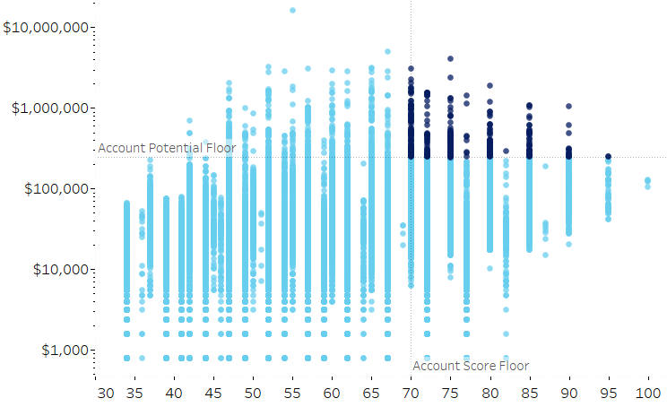
Segmentation Use Case Example
Marketing can leverage the segmentation to inform Account-Based Marketing and future campaign initiatives
Prospect/Suspect Universe
Within the prospect universe, Marketing can target 12% of the adjusted potential by focusing on 1% of accounts
Firmographic score floor of 70
 | High Priority | Low Priority
Account Potential | $208M (10%) | $1,975M (90%)
# of Prospects/Suspects | 400 (1%) | 39,993 (99%)
# of Prospects | 163 (2%) | 9,688 (98%)
# of Suspects | 237 (1%) | 30,305 (99%)
Median Account Potential | $356,864 | $32,282
Median Score | 75 | 57
Account Potential (FAVR)
Potential floor of $250,000
Firmographic Score
Low Priority Target
High Priority Target

Slide 17
Summary Findings and Recommendations
04
Summary Findings and Recommendations

Slide 18
Finance, Manufacturing, Information, Services and Healthcare (Group A) account for 52% ($6.5B) of total current potential
$6,500M
Insights & Observations:
Previous FY Bookings
Vertical groupings reflect areas with the highest potential and customer profiles that are favorable for Acme (Slide 8)
Currently there are not vertically focused reps, however the heatmap shows that there may be opportunity for some type of vertically focused sales motion.
The total potential in Group A verticals is 3x higher than Group D. Group A Strategic Accounts have $10.7B in weighted potential
Groupings are formed to highlight verticals that are valuable to Acme and align to Acme’s strengths
$5,300M
$2,400M
$2,000M
$1,700M
$1,500M
$1,500M
$2,300M
$1,200M
$500M
$200M
$100M
Group A
Group B
Group C
Group D
Avg. Potential Per Account
$156K | $181K | $111K | $76K
Group A | Group B | Group C | Group D
Finance Manufacturing Information Services Healthcare | Public Sector Education | Wholesale Utilities Transportation Retail Administrative | Retail Real Estate Extraction Hospitality Construction Entertainment Harvesting Other

Slide 19
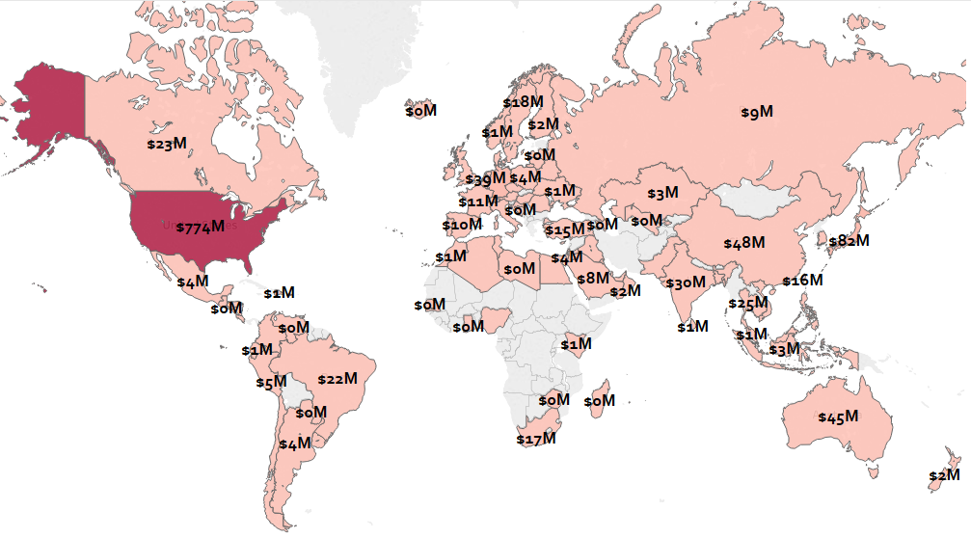
There is $1.482B in potential for Large Enterprise & Enterprise prospects
Further Detail:
Prospect potential can be added to current customer potential to determine how to assign sales coverage
The US led prospect potential for Large Enterprise and Enterprise customers
  AMS - $850M
  EMEA - $325M
  APJ - $307M
Top Prospects Include:
  Target Corporation
  Whirlpool Corporation
  Fifth-Third Bancorp
Mid-Market Prospect Universe is over $5.6B in potential due to high volume of prospects

Slide 20
Aligning resources to accounts with the greatest potential – part of
“shift and lift”
Rep Territory Guidelines
Further Detail:
Number of reps: 50
Account Ratio: 2:1
Quotas:$4.0M
SE coverage ratio: 1:1
Total Potential Account Average: $11.3M
Average footprint per account: $1.2M
Average products per account: 5
Conceptually:
Increase the number of Strategic Accounts
Creation of Large Enterprise Group
Creation of strategic group that executes at the top of the pyramid
Product and technology specialist overlay field SE team
Focused channel that sells up and down the pyramid, sells all the way down to mid-market
Further Detail:
43 overlay SEs
250 channel partners
80 channel managers
Strategic
Number of reps: 200
Account Ratio: 10:1
Quotas: $2.5M
SE coverage ratio: 2:1
Total Potential Account Average: $1.5M
Average footprint per account: $373k
Average products per account: 5
Large Enterprise
Number of reps: 130
Account Ratio: +30:1
Quotas: $2.5M
SE coverage ratio: 2:1
Total Potential Account Average: $290k
Average footprint per account: $26k
Average products per account: 2
Enterprise
Inside Sales
Number of reps: 100 ISRs
Quotas: $900k
CSMs (Iris)
Number of CSMs: 60
Quotas: $500k
Mid-Market

