Slide 1
Sales Coverage & Organization Design Primer
Supplement to the Growth Project Guide to Sales Coverage & Organization Design

Slide 2
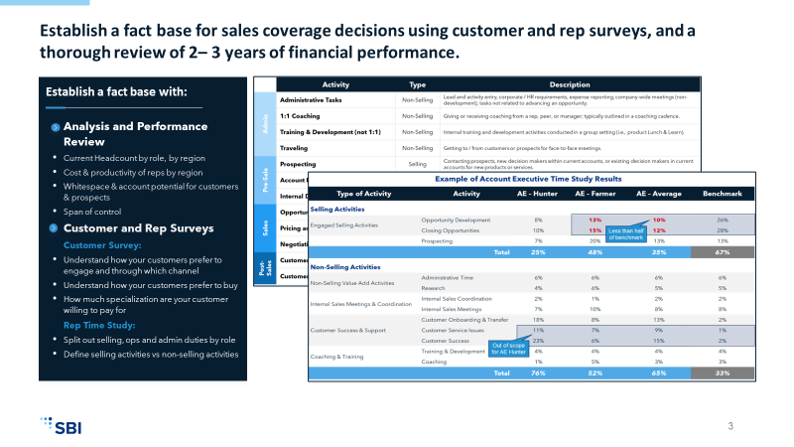
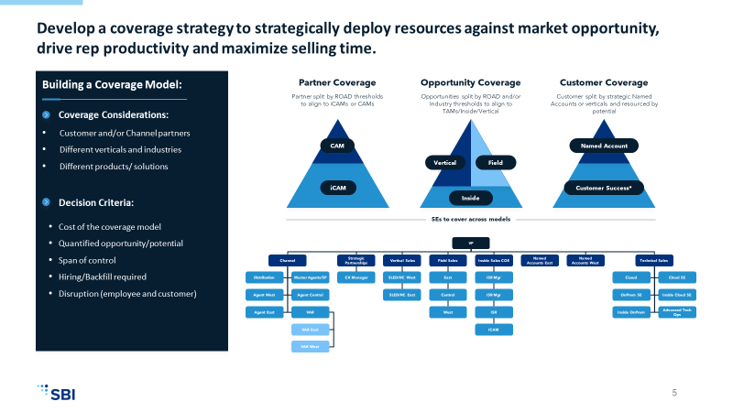
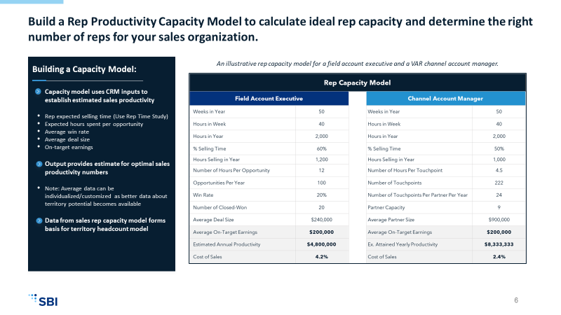
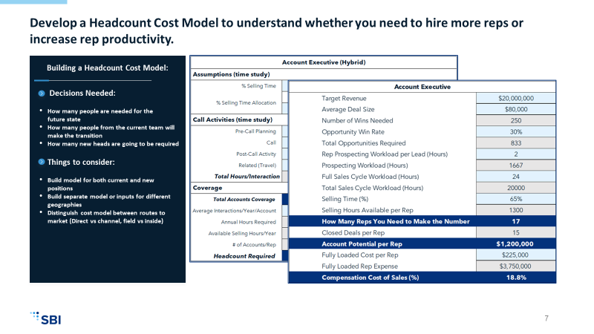
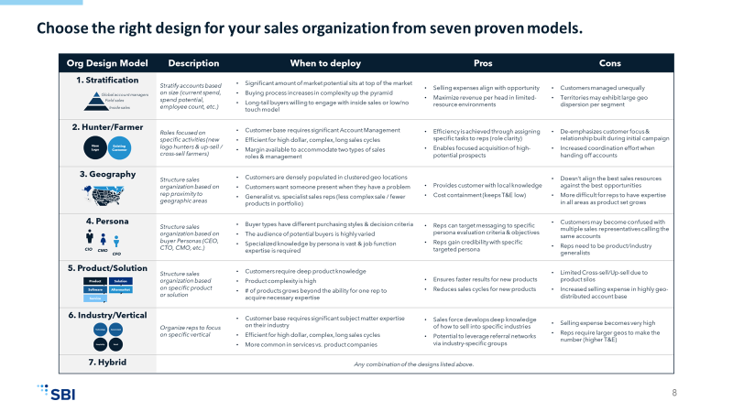
Sales Coverage & Organization Design projects follow a five-step process to develop an integrated coverage strategy & build an effective sales organization. Step 6 is implementation.
STEP 1:
Establish a Fact Base
STEP 1:
Establish a Fact Base
STEP 2:
Develop a Coverage Strategy
STEP 2:
Develop a Coverage Strategy
STEP 3:
Determine Rep Capacity
STEP 3:
Determine Rep Capacity
STEP 4:
Evaluate Sales Headcount
STEP 4:
Evaluate Sales Headcount
STEP 5:
Design the Sales Org
How have our customers historically performed?
How do we profitably
serve customers in their
preferred channel?
How many accounts
or opportunities can
our reps cover?
How many reps do we need to make the number?
How have our customers historically performed?
How do we profitably
serve customers in their
preferred channel?
How many accounts
or opportunities can
our reps cover?
How many reps do we need to make the number?
How do we structure our sales team for growth?
Gather & analyze past performance data to assess the effectiveness of your current-state sales organization & identify gaps in your coverage strategy.
Form hypotheses to increase revenue growth & reduce coverage leakage.
Survey customers to understand buying preferences.
Review your current state plan & identify opportunities to optimize your coverage strategy.
Evaluate options for coverage changes & design a future state plan that balances CAC with LTV.
Conduct a seller time study to inform rep capacity planning.
Correlate your time study results with sales performance to understand how top-performing reps allocate selling time & validate your observations in the time study data.
Use time study & past performance data to build a sales rep capacity model.
Model the sales headcount necessary for client development & retention.
Evaluate bottom-up &
top-down models to calculate the team capacity needed to achieve revenue growth targets.
Select the optimal org design model for each direct customer segment in your coverage plan.
Size the sales organization with the appropriate ratios of sellers to sales managers & design ideal roles to support coverage motions.
Design Rules of Engagement for direct & channel sellers to avoid or remediate conflict.

Slide 3
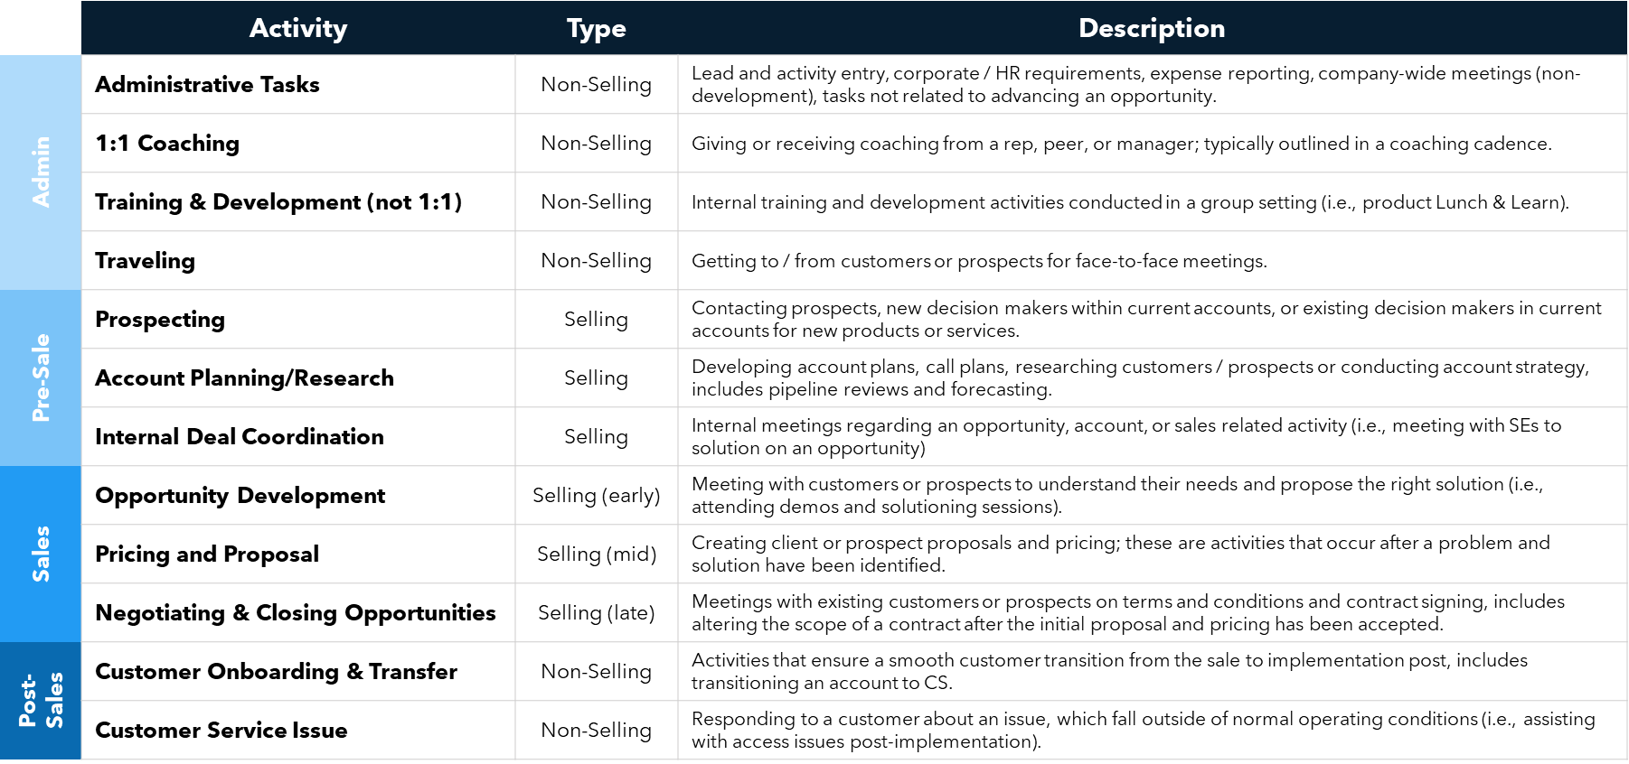
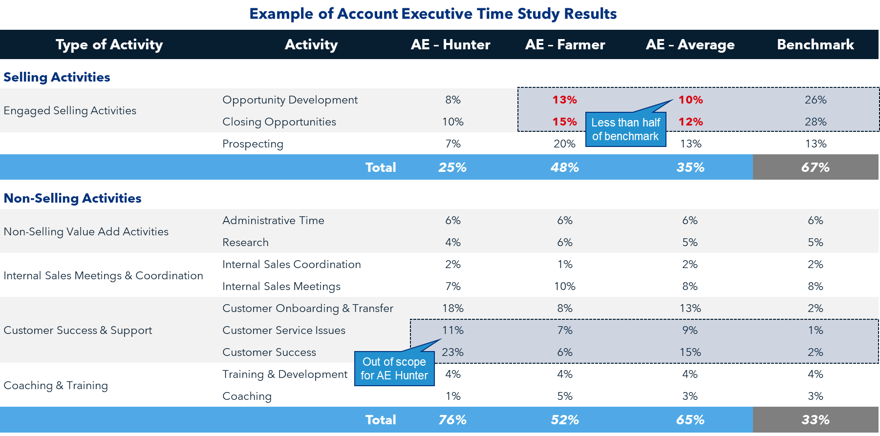
Establish a fact base for sales coverage decisions using customer and rep surveys, and a thorough review of 2– 3 years of financial performance.
Establish a fact base with:
Analysis and Performance Review
Current Headcount by role, by region
Cost & productivity of reps by region
Whitespace & account potential for customers & prospects
Span of control
Customer and Rep Surveys
Customer Survey:
Understand how your customers prefer to engage and through which channel
Understand how your customers prefer to buy
How much specialization are your customer
willing to pay for
Rep Time Study:
Split out selling, ops and admin duties by role
Define selling activities vs non-selling activities

Slide 4
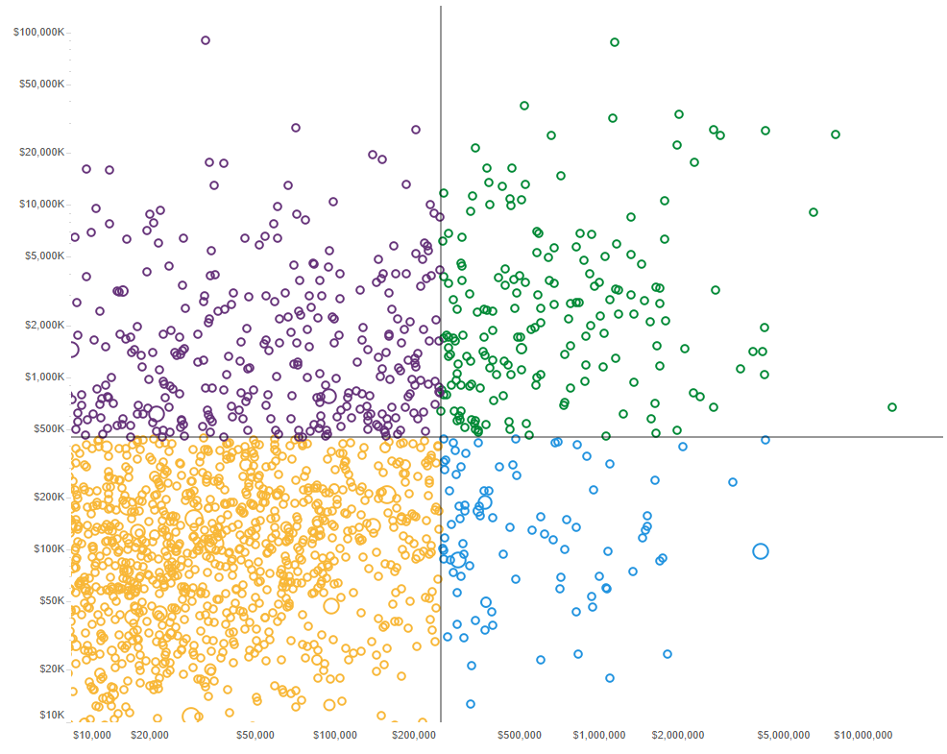
Use the output from Account Segmentation as a foundation to determine optimal routes to market for each customer segment.
Accounts by Current and Potential Spend
Example Sales Coverage based on ROAD model
Field
Sales
Acquire
Develop
Inside
Sales
Key
Accounts
Whitespace potential spend
Whitespace potential spend
Customer
Success
Channel
Opportunistic
Retain
Current Spend
Current Spend
Example ROAD model visualization showing break points denoting current spend (x-axis) and account potential (y-axis).
Example ROAD model visualization showing how break points can be used to design coverage models for existing customers.

Slide 5
Develop a coverage strategy to strategically deploy resources against market opportunity, drive rep productivity and maximize selling time.
Building a Coverage Model:
Partner Coverage
Partner split by ROAD thresholds
to align to iCAMs or CAMs
Opportunity Coverage
Opportunities split by ROAD and/or Industry thresholds to align to TAMs/Inside/Vertical
Customer Coverage
Customer split by strategic Named Accounts or verticals and resourced by potential
Coverage Considerations:
Customer and/or Channel partners
Different verticals and industries
Different products/ solutions
Decision Criteria:
Cost of the coverage model
Quantified opportunity/potential
Span of control
Hiring/Backfill required
Disruption (employee and customer)
CAM
Named Account
Vertical
Field
iCAM
Customer Success*
Inside
SEs to cover across models
VP
Channel
Strategic
Partnerships
Vertical Sales
Field Sales
Inside Sales COE
Named
Accounts East
Named
Accounts West
Technical Sales
Distribution
Master Agents/SP
CX Manager
SLED/HC West
East
ISR Mgr
CLoud
Cloud SE
Agent West
Agent Central
SLED/HC East
Central
ISR Mgr
OnPrem SE
Inside Cloud SE
Agent East
VAR
West
ISR
Inside OnPrem
Advanced Tech
Ops
VAR East
ICAM
VAR West

Slide 6
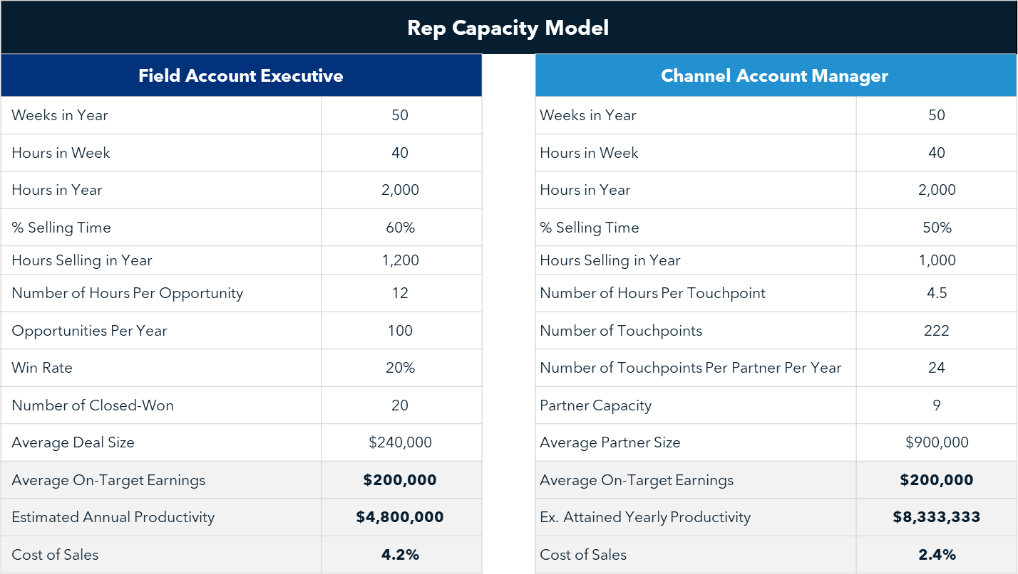
Build a Rep Productivity Capacity Model to calculate ideal rep capacity and determine the right number of reps for your sales organization.
Building a Capacity Model:
An illustrative rep capacity model for a field account executive and a VAR channel account manager.
Capacity model uses CRM inputs to establish estimated sales productivity
Rep expected selling time (Use Rep Time Study)
Expected hours spent per opportunity
Average win rate
Average deal size
On-target earnings
Output provides estimate for optimal sales productivity numbers
Note: Average data can be individualized/customized as better data about territory potential becomes available
Data from sales rep capacity model forms basis for territory headcount model

Slide 7
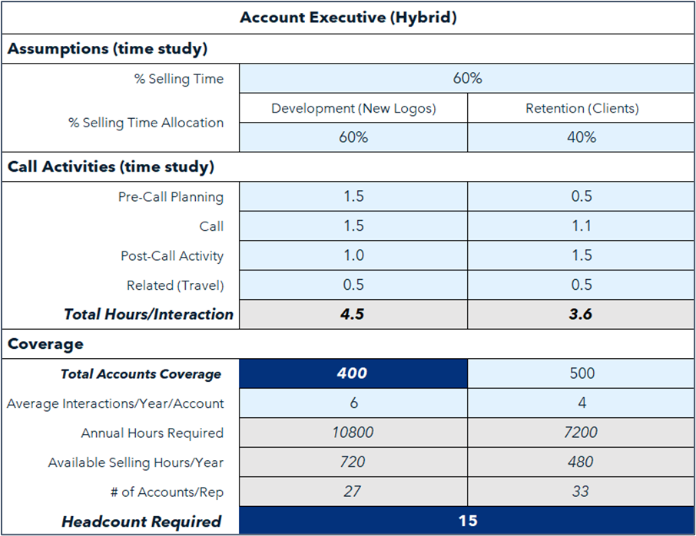
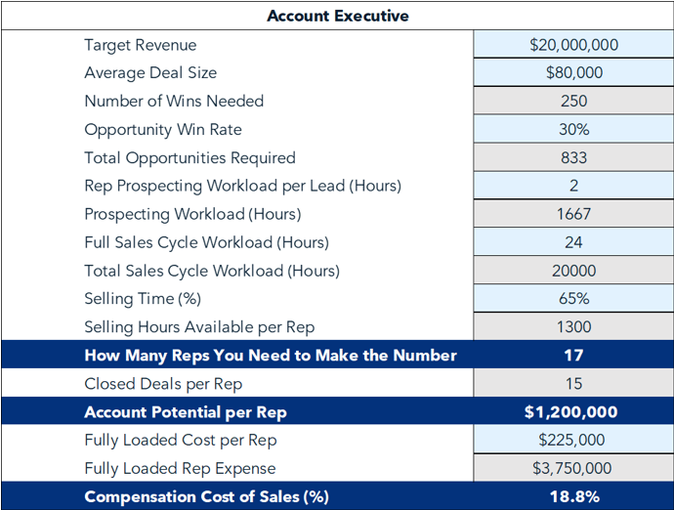
Develop a Headcount Cost Model to understand whether you need to hire more reps or increase rep productivity.
Building a Headcount Cost Model:
Title
Decisions Needed:
How many people are needed for the
future state
How many people from the current team will make the transition
How many new heads are going to be required
Things to consider:
Build model for both current and new positions
Build separate model or inputs for different geographies
Distinguish cost model between routes to market (Direct vs channel, field vs inside)

Slide 8
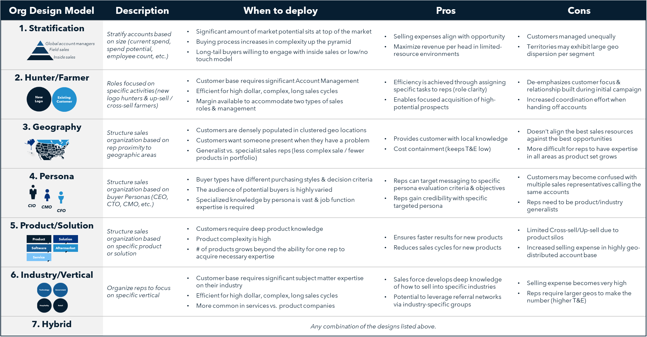
Choose the right design for your sales organization from seven proven models.

Slide 9
For more resources like this, contact your advisor or visit SBI Pro.
Schedule a session with your advisor
SBI Advisors help clients with practical advice, whether strategic or surgically tactical, to drive revenue and growth.
Contact your advisor to schedule a work session and tune this guidance to your situation.
Login to SBI Pro:
https://pro.sbigrowth.com/

