Slide 1
How to Build a Sales Playbook

Slide 2
How to build a Sales playbook
Map Sales Process to Buying Process
- Document both the buying and sales process by stage
- Identify the exit criteria (buyer action) for each
Conduct a Content Audit
- Create an Expert Panel of Sales and Marketing peers
Create Sales Tools
- Identify gaps in collateral and tools that need to be created
- Work with your marketing peers to develop a content creation strategy
- Sales tools and job aides should be internal facing, while collateral is external facing
Create Playbook
- Marry the content with tactical execution & process
- Ensure all of the content is mapped to the appropriate stage and buyer action
- The goal of the playbook is to progress the deal from one stage to the next
Iterate
- Content and process will continue to change
- Be agile in your approach to the process
- Identify gaps and close them in the playbook
- Identify tactical actions to progress the buyer into the next phase of the buying process
- Perform an audit of all sales collateral and sales tools
- Associate content to the appropriate stages/product/buyer action

Slide 3
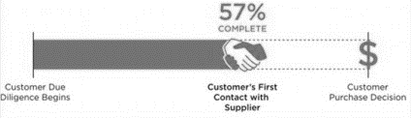
Sales Playbooks – Step 1
Step 1 – Map Buyer Process to Sales Process
Objective: Ensure you have an understanding of the buying behavior of your key buyer personas. Marry the sales process to the buyer process.
Process:
Document both the buying and sales process by stage
Identify the exit criteria (buyer action) for each
Identify tactical actions to progress the buyer into the next phase of the buying process

Slide 4
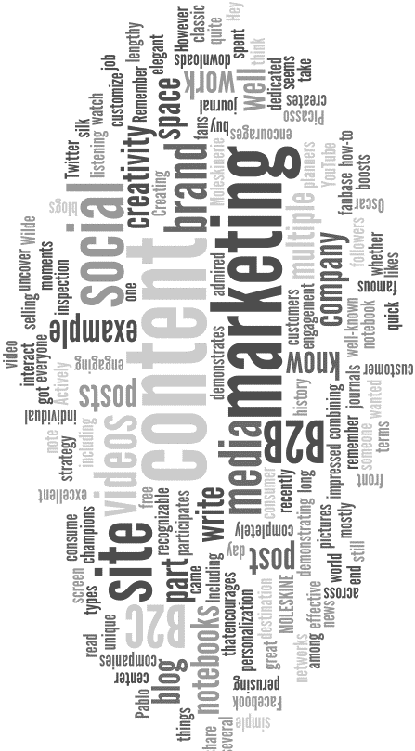
Sales Playbooks – Step 2
Step 2 – Conduct Content Audit
Objective: Evaluate current content and assess how it will help progress a sales cycle. In addition, start to map the content to the sales and buying stages.
Process:
Create an Expert Panel of Sales and Marketing peers
Perform an audit of all sales collateral and sales tools
Associate content to the appropriate stages/product/buyer action

Slide 5

Sales Playbooks – Step 3
Step 3 – Create Sales Tools
Objective: To create tools for both internal consumption (sales tools) and external consumption (collateral) that are mapped to the sales process to progress deals.
Process:
Identify gaps in collateral and tools that need to be created
Work with your marketing peers to develop a content creation strategy
Sales tools and job aides should be internal facing, while collateral is external facing

Slide 6
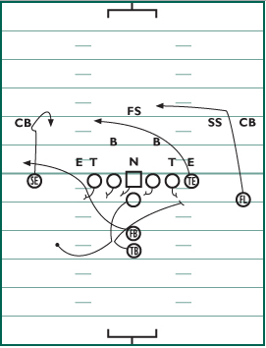
Sales Playbooks – Step 4
Step 4 – Create Playbook
Objective: Design the tactical plan on how to execute the sales process, aided by the tools and collateral.
Process:
Marry the content with tactical execution & process
Ensure all of the content is mapped to the appropriate stage and buyer action
The goal of the playbook is to progress the deal from one stage to the next

Slide 7
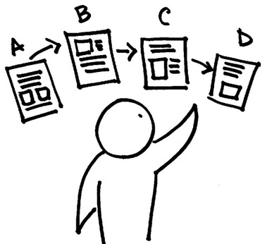
Sales Playbooks – Step 5
Step 5 – Iterate
Objective: To have a fluid and agile approach to design, feedback and creation. The playbook will evolve over time.
Process:
Recognize that content and process will continue to change
Be agile in your approach to the process
Identify gaps and close them in the playbook
Seek regular interaction and feedback from the user community via surveys, expert panels, reviews, etc.

