Slide 1
Pricing KPIs Tool
Common pricing metrics and calculations

Slide 2


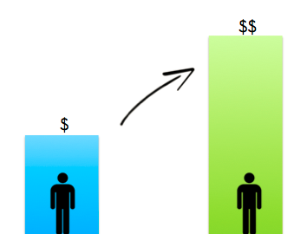
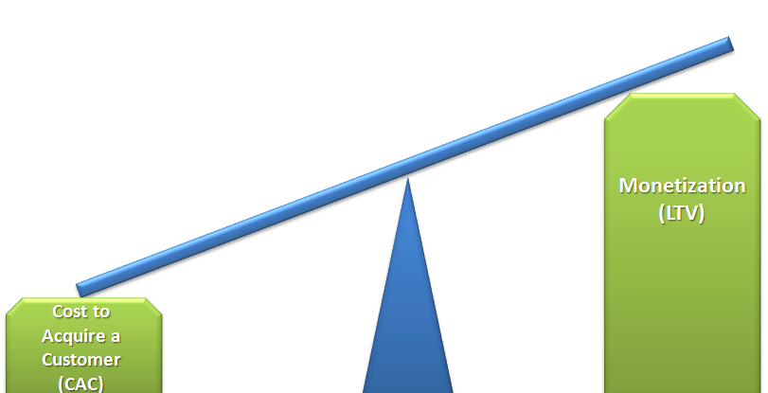
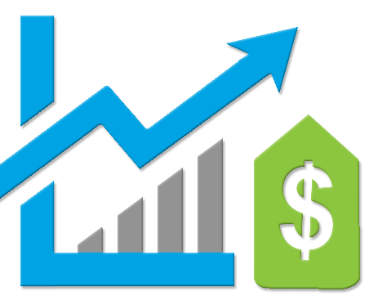





Common Pricing Metrics
CMRR
CAC
CLTV
CLTV:CAC
Discount:Margin
Committed Monthly Recurring Revenue: CMRR looks at current MRR, (New Business + Expansion – Contraction – Churn), then adds in signed contracts going into production and subtracts out revenue that’s likely to churn within that period.
Customer Acquisition Costs. This is comprised of all Go-to-Market costs, including Product, Marketing and Sales that are focused on new customer acquisition. This can be rendered at the customer and unit/user level.
Customer Lifetime Value. The value of gross margin the customer will bring over the lifetime of the subscriber. This can be rendered at the customer and unit/user level.
This is the Lifetime Value of the Customer or User / Customer or User Acquisition Costs..
The number of discount points per margin percentage
Bookings/Head
Magic Number
Customer Churn
Pipeline Velocity
Time to Productivity
A magic number of 1 means that last quarter's sales & marketing spend will be "earned" back over the next 4 quarters in incremental revenue, and is seen as the desired metric for SaaS businesses
Pipeline velocity metric gives predictability in sales results in present and future quarters.
Example Formula:
Qualified Ops = 10
Close Rate 25%
Avg. Deal Size = $100k
Length of Sales Cycle = 60 Days
(10 x 25% x $100k) / 60 = 4.166
This metric measures the length of time from when a rep is hired to when the rep starts to contribute bookings to MRR against his/her goal. This will inform the company the speed it needs to hire to achieve the company’s objectives.
The bookings the company/division/channel is achieving against the weighted average headcount. This will provide visibility to rep productivity & effectiveness over time.
Churn is the percentage rate at which SaaS customers cancel their recurring revenue subscriptions and renewals.

Slide 3
Committed Monthly Recurring Revenue (CMRR)
Defined
Calculation
Why Do I Care?
CMRR looks at current monthly recurring revenue (MRR), then adds in signed contracts going into production and subtracts revenue that’s likely to churn within that period.
CMRR =
Existing MRR + New Signed Bookings
– Downgraded Bookings
– Churn
CMRR measures the net inflow and outflow of subscriptions
Recurring revenue is vital for renewals, subscriptions, and discount governance, you need to know if CMRR is trending positively
Simply reporting new bookings can be misleading if churn is hurting subscription revenue

Slide 4
Customer Acquisition Cost (CAC)
Defined
Calculation
Why Do I Care?
This is comprised of all Go-to-Market costs, including Product, Marketing and Sales that are focused on new customer acquisition. This can be rendered at the customer and unit/user level.
CAC =
Total Sales and Marketing Expenses
New Customers Acquired
Understanding CAC is a crucial for SaaS organizations, because revenue models are dependent on the customer lifetime value
To realize ROI, you need to know how many months of revenue from a customer are needed to recover the CAC and begin profiting

Slide 5
Customer Lifetime Value (CLTV)
Defined
Calculation
Why Do I Care?
CLTV is the value of gross margin the customer will bring over the lifetime of the subscriber. This can be rendered at the customer and unit/user level.
CLTV =
(1 + i)
(1 + i – RR)
M: Annual Profit
i: Discount rate
RR: Retention rate
AC: One-time acquisition/retention costs
CLTV is critical to understanding optimal spend on customer acquisition. It can determine value of the organization based on increasing the customer base
CLTV also shows the cost of churn, and justifies additional spend to decrease churn by showing the impact on customer value
M X
– AC

Slide 6
CLTV:CAC Ratio
Defined
Calculation
Why Do I Care?
This is the Lifetime Value of the Customer or User / Customer or User Acquisition Costs. In a SaaS business, this ratio should be a minimum of 3:1
CLTV:CAC =
Customer Lifetime Value
Customer Acquisition Cost
The best software/hardware business have a ratio that is 2 or higher
Higher ratios imply faster growth potential – and less capital to do so
Lower ratios imply less efficiency in acquiring high-value customers – and will likely need more capital to fuel growth

Slide 7
Discount:Margin
Defined
Calculation
Why Do I Care?
The number of discount points given per margin percentage point per product.
Discount:Margin =
The Discount:Margin matrix will control the product lifecycle to ensure price level optimization
Discount
Margin

Slide 8
Bookings per Head
Defined
Calculation
Why Do I Care?
The bookings the company/division/channel is achieving against the weighted average headcount.
Bookings per Head =
Total bookings
Avg Headcount
This will provide visibility to rep productivity & effectiveness over time

Slide 9
Magic Number
Defined
Calculation
Why Do I Care?
A magic number of 1 means that last quarter's sales & marketing spend will be "earned" back over the next 4 quarters in incremental revenue, and is seen as the desired metric for SaaS businesses.
Magic Number =
The magic number measures sales efficiency
This metric answers the question – For every dollar spent in S&M, how much Annual Recurring Revenue am I generating?
(Current Q Revenue – Prev. Q Revenue) X 4
Prev. Q Sales & Marketing Expense

Slide 10
Customer Churn
Defined
Calculation
Why Do I Care?
SaaS churn is the percentage rate at which SaaS customers cancel their recurring revenue subscriptions.
Customer Churn =
Customer Subscriptions Cancelled
# of Customers X Elapsed time
Customer churn reflects the percentage of customers who end their relationship with a company over a defined time period
Churn is a critical input to:
CLTV calculations
Revenue, bookings, cash flow projections

Slide 11
Pipeline Velocity
Defined
Calculation
Why Do I Care?
Pipeline velocity metric gives predictability in sales results in present and future quarters.
Pipeline Velocity =
MQLs X Win Rate X Deal Size
Length of Sales Cycle
This number allows you to track the rate of change of your velocity (pipeline acceleration) and its high and low points
Pipeline velocity is an effective measure to track because it combines its inputs – MQLs, win rate, deal size, and sales into one number. This allows you to see if you’re increasing or decreasing your sales speed

Slide 12
Rep Time to Productivity
Defined
Calculation
Why Do I Care?
This metric measures the length of time from when a rep is hired to when the rep starts to contribute bookings to MRR against his/her goal. This will inform the company the speed it needs to hire to achieve the company’s objectives.
Time to Productivity =
Length of time to reach 100% bookings to MRR against goal.
By routinely tracking and paying attention to time-to-productivity, you will be able to more accurately predict monthly, quarterly, and annual sales

Slide 13
For more resources like this, contact your advisor or visit SBI Pro.
Schedule a session with your advisor
SBI Advisors help clients with practical advice, whether strategic or surgically tactical, to drive revenue and growth.
Contact your advisor to schedule a work session and tune this guidance to your situation.
Login to SBI Pro:
https://pro.sbigrowth.com/

