Slide 1
Prospecting Call Plan
Template and Best Practices

Slide 2
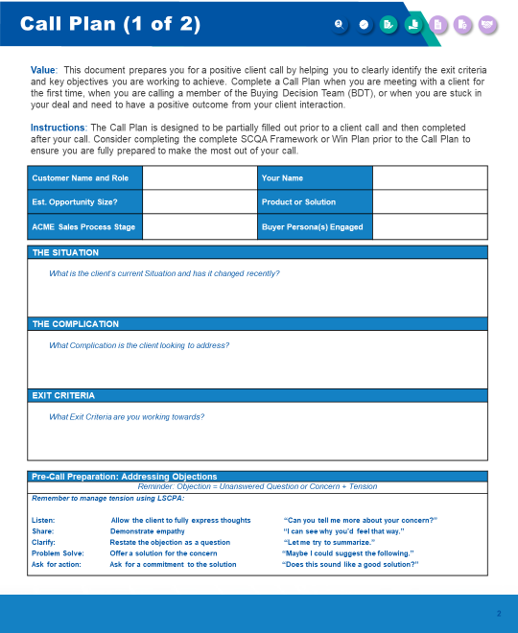
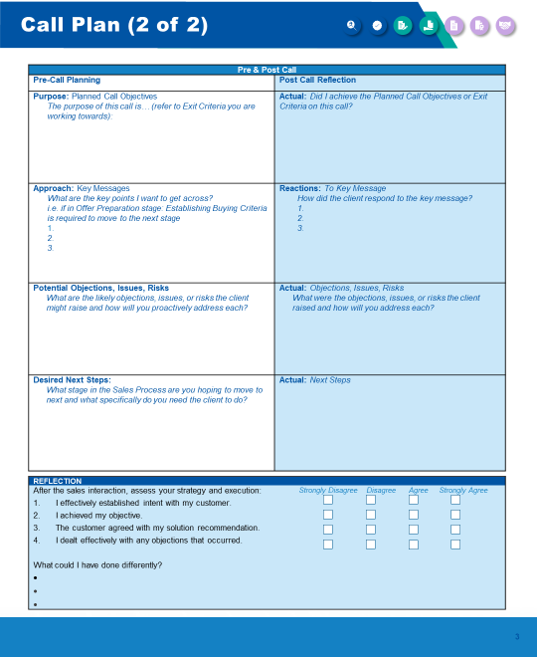
Call Plan Template and Best Practices
A call plan will assist you in preparing for any interaction you have with a prospect or customer. Call plan templates help ensure you get everything you need from a discovery call but should never be used as a script that you read word for word from.
Guiding Principles
Everyone recognizes that preparation takes time. Over time, this process will speed up. Great sales reps always show up prepared and have expected key outcomes and goals for each call.
Follow these guidelines for when to use the call plan template:
USE as the base prep tool – this is the way we need to think
USE during any discovery call
USE during any call if you have your manager, a SE, or some other resource joining the call
USE to outline the goals of the call to the prospect
USE not only for discovery, but for any call to help you better prepare for your interaction
DO NOT USE as a script that you read from verbatim
Tip: Plan out the first 2-3 questions you want to ask to get the conversation started.

Slide 3
Call plan (1of 2)
Customer Name and Role |  | Your Name
Est. Opportunity Size? |  | Product or Solution
ACME Sales Process Stage |  | Buyer Persona(s) Engaged
Value:
This document prepares you for a positive client call by helping you to clearly identify the exit criteria and key objectives you are working to achieve. Complete a Call Plan when you are meeting with a client for the first time, when you are calling a member of the Buying Decision Team (BDT), or when you are stuck in your deal and need to have a positive outcome from your client interaction.
Instructions:
The Call Plan is designed to be partially filled out prior to a client call and then completed after your call. Consider completing the complete SCQA Framework or Win Plan prior to the Call Plan to ensure you are fully prepared to make the most out of your call.
THE SITUATION
What is the client’s current Situation and has it changed recently?
THE COMPLICATION
What Complication is the client looking to address?
EXIT CRITERIA
What Exit Criteria are you working towards?
Pre-Call Preparation: Addressing Objections
Reminder: Objection = Unanswered Question or Concern + Tension
Remember to manage tension using LSCPA:
Listen: | Allow the client to full express thoughts | “Can you tell me more about your concern?”
Share: | Demonstrate empathy | “I can see why you’d feel that way.”
Clarify: | Restate the objection as a question | “Let me try to summarize, is that accurate?”
Problem solve: | Offer a solution for the concern | “Maybe I could suggest the following.”
Ask for action: | Ask for a commitment to the solution | “Does this sound like a good solution?”

Slide 4
Call Plan (2 of 2)
Pre & Post Call
Pre-Call Planning | Post Call Reflection
Purpose: Planned Call Objectives The purpose of this call is… (refer to Exit Criteria you are working towards): | Actual: Did I achieve the Planned Call Objectives or Exit Criteria on this call?
Approach: Key Messages What are the key points I want to get across? i.e. if in Offer Preparation stage: Establishing Buying Criteria is required to move to the next stage 1. 2. 3. | Reactions: To Key Message How did the client respond to the key message? 1. 2. 3.
Potential Objections, Issues, Risks What are the likely objections, issues, or risks the client might raise and how will you proactively address each? | Actual: Objections, Issues, Risks What were the objections, issues, or risks the client raised and how will you address each?
Desired Next Steps: What stage in the Sales Process are you hoping to move to next and what specifically do you need the client to do? | Actual: Next Steps
REFLECTION
After the sales interaction, assess your strategy and execution: I effectively established intent with my customer. I achieved my objective. The customer agreed with my solution recommendation. I dealt effectively with any objections that occurred. What could I have done differently? | Strongly Disagree Dis-agree Agree Strongly Agree

Slide 5
For more resources like this, contact your advisor or visit SBI Pro.
Schedule a session with your advisor
SBI Advisors help clients with practical advice, whether strategic or surgically tactical, to drive revenue and growth.
Contact your advisor to schedule a work session and tune this guidance to your situation.
Login to SBI Pro:
https://pro.sbigrowth.com/

