Slide 1
Seven Sales Organization Design Models

Slide 2

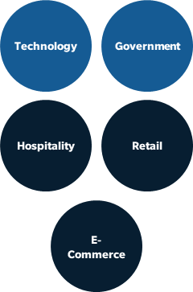
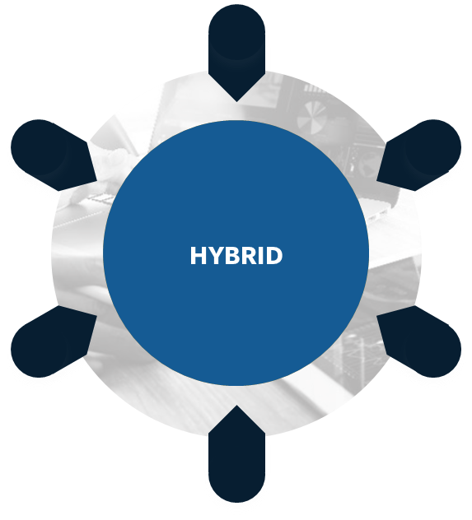
SBI’s seven sales organization design models When you should deploy each model and the pros and cons to consider
Stratification
Stratify your accounts based on size, e.g., current spend, spend potential, employee count, etc. This type of design can be seen in organizations with a clear hierarchy, where different layers represent different levels of decision-making.
Global account managers
Field sales
Inside sales
Hunter/Farmer
The hunter-farmer model recognizes that different sales situations require different strategies. Hunters are crucial for expanding the customer base and bringing in new business, while farmers are vital for building customer loyalty, repeat business, and overall CLTV. Many organizations adopt a combination of both approaches to create a balanced and effective sales strategy.
New logos
Existing customers
Geography
The geography model involves structuring a sales organization based on rep proximity to geographic areas. This involves understanding how regional differences, distribution patterns, market opportunities, and resource allocation affect consumer preferences and behaviors.
NV
NE
IN
WV
KS
MO
KY
NC
AZ
NM
OK
AR
TN
SC
ORG DESIGN MODEL
TX
LA
MS
AL
GA
FL
Persona
The persona model involves structuring a sales organization based on the needs, preferences, and behaviors of different buyer personas. These are typically aligned to different members of the C-Suite, e.g., CEO, CTO, CMO, etc.
CIO
CMO
CFO
Product/Solution
The product/solution model involves structuring a sales organization based on how a specific product or solution addresses the specific needs, problems, and goals of customers.
MS
D&F
Software
Aftermarket
Service
Industry/Vertical
An industry/vertical sales model is a strategy used by companies to organize their sales efforts and tailor their products or services to specific industries or verticals. Instead of taking a one-size-fits-all approach, companies adopting this model focus on understanding the unique needs, challenges, and trends of particular industries and then developing specialized sales strategies to cater to those industries.
Hybrid
This sales model is any combination of the designs listed above. Combing more than two options for a hybrid approach adds too much complexity and will be difficult to implement and scale.

Slide 3

Stratification model
Deploy this model when the following applies:
Description
Stratify your accounts based on size, e.g., current spend, spend potential, employee count, etc. This type of design can be seen in organizations with a clear hierarchy, where different layers represent different levels of decision-making.
Significant amount of market potential sits at top of the market.
Buying process increases in complexity up the pyramid.
Long-tail buyers are willing to engage with inside sales or low/no touch model.
Global account managers
Field sales
Inside sales
Pros
Cons
Selling expenses are aligned with opportunities.
Maximize revenue per head in limited resource environments.
Prospects/customers not equally managed.
Territories may exhibit large geographic dispersion.

Slide 4
Hunter/farmer model
Deploy this model when the following applies:
Description
The hunter-farmer model recognizes that different sales situations require different strategies. Hunters are crucial for expanding the customer base and bringing in new business, while farmers are vital for building customer loyalty, repeat business, and overall CLTV. Many organizations adopt a combination of both approaches to create a balanced and effective sales strategy.
Customer base requires significant account management.
Efficient for high-dollar, complex, and long sales cycles.
Margin available to accommodate two types of sales roles and management.
New logos
Existing customers
Pros
Cons
Efficiency is achieved through assigning specific tasks to reps, i.e., efficiency is reached by instilling role clarity.
This model enables the focused acquisition of top prospects.
De-emphasizes initial campaign’s customer focus and relationship-building.
Requires increased coordination when handing off accounts.

Slide 5
Geography model
Deploy this model when the following applies:
Description
The geography model involves structuring a sales organization based on rep proximity to geographic areas. This involves understanding how regional differences, distribution patterns, market opportunities, and resource allocation affect consumer preferences and behaviors.
Customers are densely populated in clustered geographic locations.
Customers want someone present when they have a problem.
Sales reps are either generalist or specialists, i.e., the sale is less complex or there are fewer products in portfolio.
NV
NE
KS
MO
IN
KY
WV
AZ
NM
OK
AR
TN
SC
NC
TX
LA
MS
AL
GA
FL
Pros
Cons
Provides customers with local and state knowledge.
This model enables cost containment, e.g., keeping travel and entertainment expenses low.
Doesn’t align the best sales resources with the best opportunities.
As product sets grow, it becomes more difficult for reps to have expertise in all areas.

Slide 6
Persona model
Deploy this model when the following applies:
Description
The persona model involves structuring a sales organization based on the needs, preferences, and behaviors of different buyer personas. These are typically aligned to different members of the C-Suite, e.g., CEO, CTO, CMO, etc.
Buyer types have different purchasing styles and decision criteria.
The audience of potential buyers is highly varied.
Specialized knowledge by persona is vast and job function expertise is required.
CIO
CMO
CFO
Pros
Cons
Reps can target messaging to the evaluation criteria and objectives of specific personas.
Reps become skilled at selling to and thus gaining credibility or experience with specific personas.
Customers may become confused with multiple sales representatives calling the same accounts.
Reps need to be product/industry generalists.

Slide 7
Product/solution model
Deploy this model when the following applies:
Description
The product/solution model involves structuring a sales organization based on how a specific product or solution addresses the specific needs, problems, and goals of customers.
Customers require deep product knowledge.
Product complexity is high.
The number of products grows beyond the ability for one rep to acquire necessary expertise.
MS
D&F
Software
Aftermarket
Service
Pros
Cons
This model ensures faster results and a reduced sales cycle for new products.
Cross- and up-sell opportunities are limited due to siloes.
Rising costs of sales operations due to a customer base that is widely spread across different geographical locations.

Slide 8
Industry/vertical model
Deploy this model when the following applies:
Description
An industry/vertical sales model is a strategy used by companies to organize their sales efforts and tailor their products or services to specific industries or verticals. Instead of taking a one-size-fits-all approach, companies adopting this model focus on understanding the unique needs, challenges, and trends of particular industries and then developing specialized sales strategies to cater to those industries.
Customer base requires significant subject matter expertise on their industry.
Sales cycles are high dollar, complex, and long.
When the company in question is focused on services, as opposed to products.
Technology
Government
Hospitality
Retail
E-Commerce
Pros
Cons
Sales force develops deep knowledge of how to sell into specific industries.
There’s a potential to leverage referral networks via industry-specific groups.
Selling expenses become quite high.
Reps require larger geographies to make their number, i.e., there’re higher travel and entertainment expenses.

Slide 9
Hybrid model
HYBRID
HYBRID
The hybrid model includes any combination of the previously listed designs.
Combining more than two options to form your sales strategy will add too much complexity and be difficult to implement and scale.

Slide 10
For more resources like this, contact your advisor or visit SBI Pro.
Schedule a session with your advisor
SBI Advisors help clients with practical advice, whether strategic or surgically tactical, to drive revenue and growth.
Contact your advisor to schedule a work session and tune this guidance to your situation.
Login to SBI Pro:
https://pro.sbigrowth.com/

